Slide 1
TO LOCATE THE BEST LOCATION FOR A BUSINESS IN MADRID
Victor Ortuño Crespo

Slide 2
DATA ORIGIN
The official foreign population statistics offered by Madrid’s City Hall website: You will find the excel document in my GitHub ‘CAPSTONE’ folder. This information is critical, not only because we got the names of all the ‘neighborhood’ we are investigating, but because before we open our restaurant, we must familiarize ourselves with the foreign population in that region. Even though its obvious, we cannot invest in a project destined for Latin people, including typical foods, music and culture-based inside jokes, if they are found halfway across the Autonomous Region.
Google Maps: Considering I was unable to find a document containing all the coordinated I needed, I had to pull them from Google maps. Every coordinate is an exact replica of the information in their database.
Foursquare: This tool has been made available for all students (not exclusively). From this database, I pulled all the pertinent metadata of each venue in a 500m radius and filtered it to fit my needs. For example, venue location (Lat, Lng), type of venue, name, etc…

Slide 3



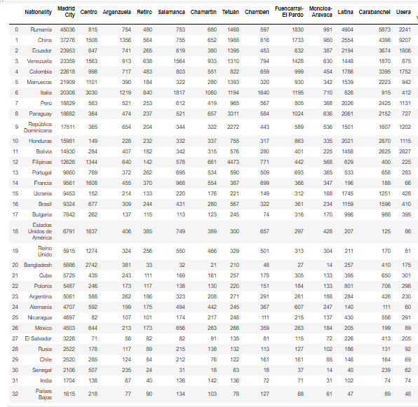
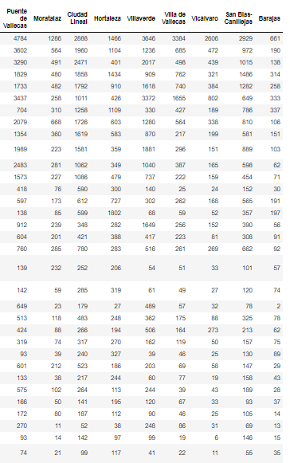
FOREIGN POPULATION DATA

Slide 4
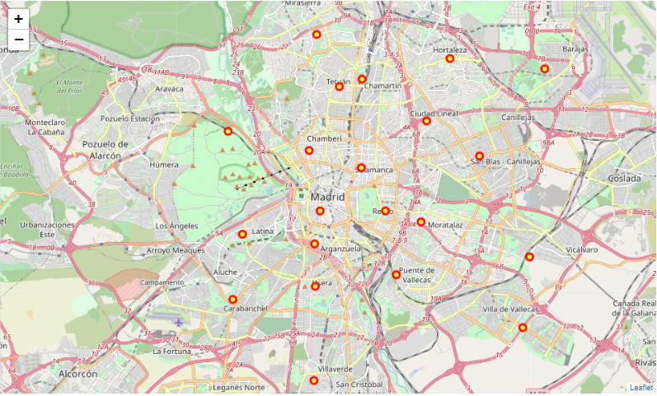
NEIGHBORHOOD MAP

Slide 5
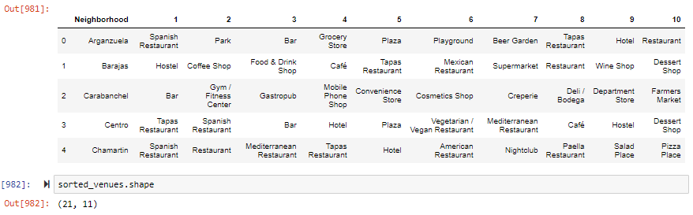
TOP 10 VENUES PER NEIGHBORHOOD
This will show us the path to the most popular venues.
The next step is to marge the data and plot a map containing the assigned K cluster per region.

Slide 6
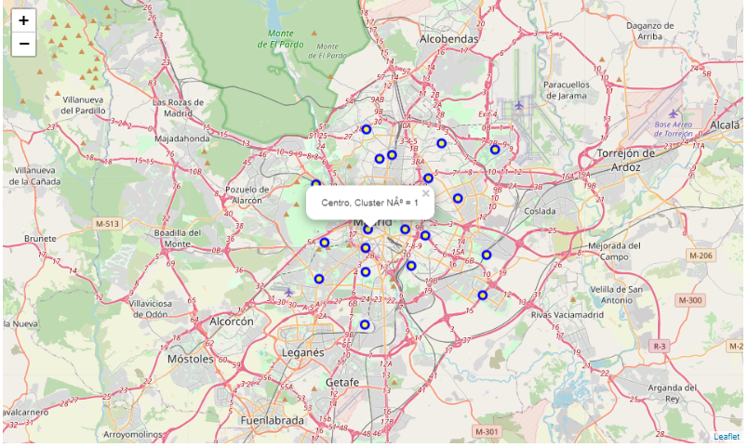
MAP WITH K CLUSTER REGIONS

Slide 7
CLUSTERS THAT ANSWERED MY QUESTION
CLUSTER 1:
There’s a larger variation of countries and regions in this cluster. We can mainly find Latin American countries, occupying 5/12 rows in this cluster. The top 3 most popular venues in each region are related to the food industry, such as: ‘Spanish Restaurants’, ‘Tapas Restaurants’, and ‘Grocery Stores’.
CLUSTER 2:
The country density decreases again, however, it’s not all bad new, Honduras is the only participant in this cluster, making this a very useful data set. Moreover, several of the top 10 venues in this region are related to food.
CLUSTER 3:
I found cluster 3 to be just as lucky, as Ecuador is the sole participant of this cluster. There’s a lower density of food-related venues in this region, however, wcan find a couple of Bars and Pubs in the data.

Slide 8
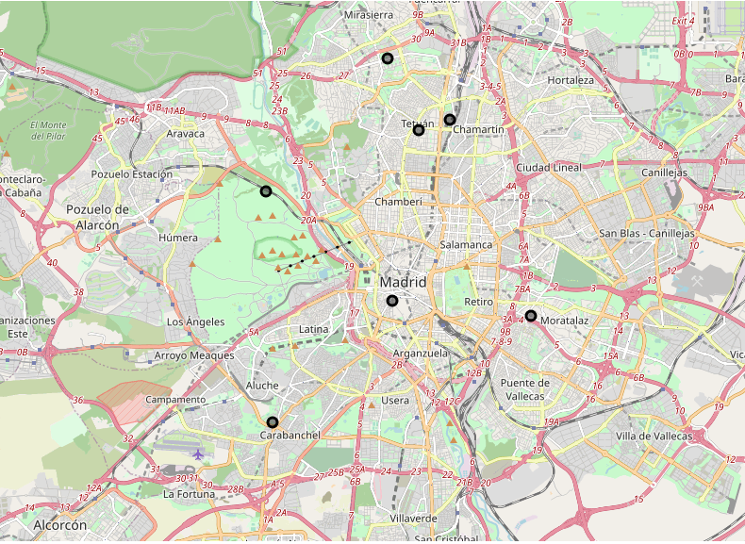
CONCLUSION (Pt.1)
By clustering clusters 1, 2, and 3, we get the ultimate trio. Most of these clusters have food-related venues as their top 5. In cluster 1, we find a high density of Latin countries, occupying 5/12 rows in the data frame. To make the conclusion easier to visualize, I made a map containing the Latin counties in Clusters 1, 2, and 3:

Slide 9
CONCLUSION (Pt. 2)
In the code, the map is interactive, and we can see how in the northern region we find foreigners from Peru, Colombia, and Brazil. Madrid’s subway system offers fast and easy connectivity between Madrid Centro and Chamartín. Considering all of these factors simultaneously, I conclude that the best location of our restaurant is in the region of Chamartín. It’s far enough from the Center, so it won’t be shadowed by other venues with higher reputation, but it’s close enough to the Center, allowing the subway system to do its magic. Moreover, because our main theme is based around Colombia, and Chamartín’s main foreign population are Colombians, this creates an added value.

