Slide 1
Sales Prediction Model
Task – 03 | Python Machine Learning Project

Slide 2
1. Project Objective
Build a sales prediction model using historical sales-related data.
Preprocess missing and categorical data using Pandas, NumPy and Scikit-learn.
Train regression models and compare their performance.
Provide a small dashboard for live sales prediction.

Slide 3
2. Dataset
1,000 synthetic historical sales records.
Numerical features: Month, Quantity, Unit Price, Advertising Spend, Discount, Customers.
Categorical features: Region, Product Category, Sales Channel.
Target variable: Sales.

Slide 4
3. Data Preprocessing
Loaded the CSV dataset using Pandas.
Checked and handled missing numerical values using median imputation.
Handled missing categorical values using the most frequent category.
Encoded categorical variables using One-Hot Encoding.
Split the data into 80% training and 20% testing sets.

Slide 5
4. Machine Learning Models
Linear Regression — baseline regression model.
Decision Tree Regressor — learns non-linear decision rules.
Random Forest Regressor — combines multiple decision trees.
All models were trained using the same preprocessing pipeline.

Slide 6
5. Model Evaluation
Model | R² Score | MAE | RMSE
Linear Regression | 0.7617 | ₹40,618.44 | ₹55,385.90
Decision Tree | 0.5267 | ₹57,750.09 | ₹78,054.15
Random Forest | 0.7283 | ₹41,430.56 | ₹59,143.79

Slide 7
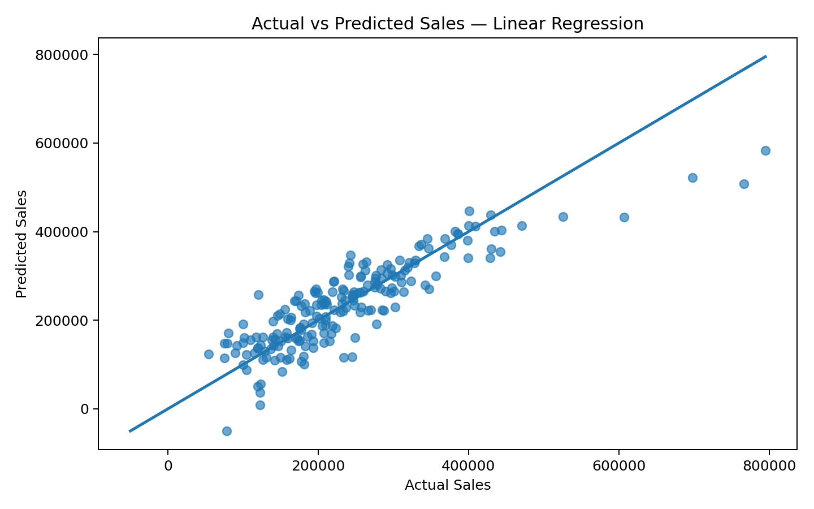
6. Actual vs Predicted Sales

Slide 8
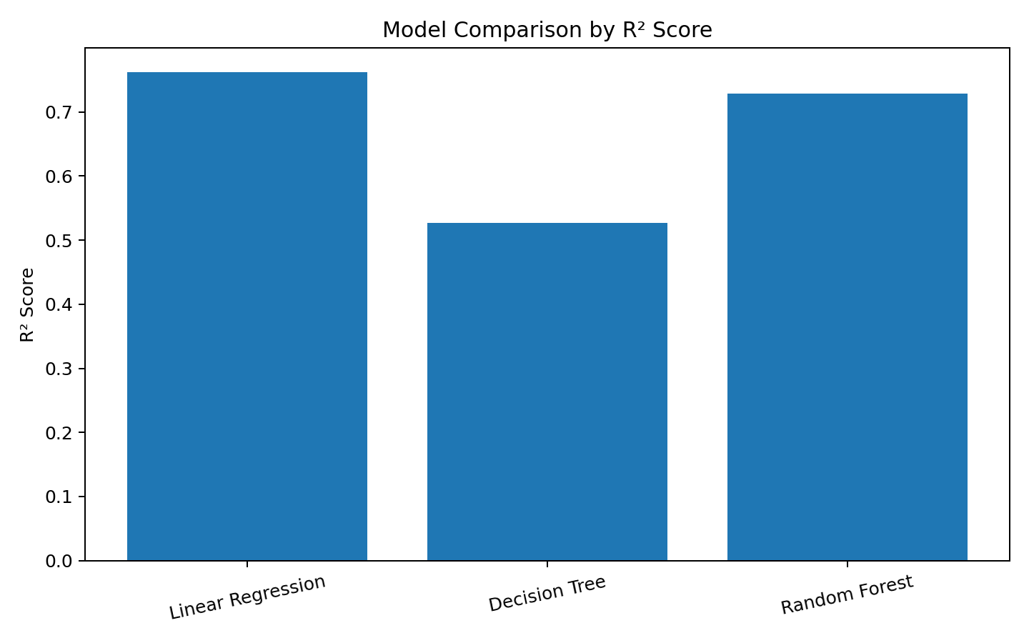
7. Model Comparison

Slide 9
8. Streamlit Dashboard
The dashboard accepts month, region, product, channel, quantity, price, advertising spend, discount and customer inputs.
A trained Random Forest model processes the inputs.
The dashboard displays an estimated sales value instantly.
This provides a simple interface for demonstrating the prediction model.

Slide 10
9. Conclusion
The project demonstrates an end-to-end machine-learning workflow for sales forecasting.
Data preprocessing makes numerical and categorical features suitable for modelling.
Multiple regression algorithms can be compared using R², MAE and RMSE.
The Streamlit dashboard turns the trained model into a simple interactive application.

Slide 11
10. Tools & Technologies
Python
Pandas and NumPy
Scikit-learn
Matplotlib
Streamlit
PowerPoint for project presentation

