Slide 1


Endterm project:
"Word trainer"
Biloshchytskyi Yevhenii SE-2329

Slide 2
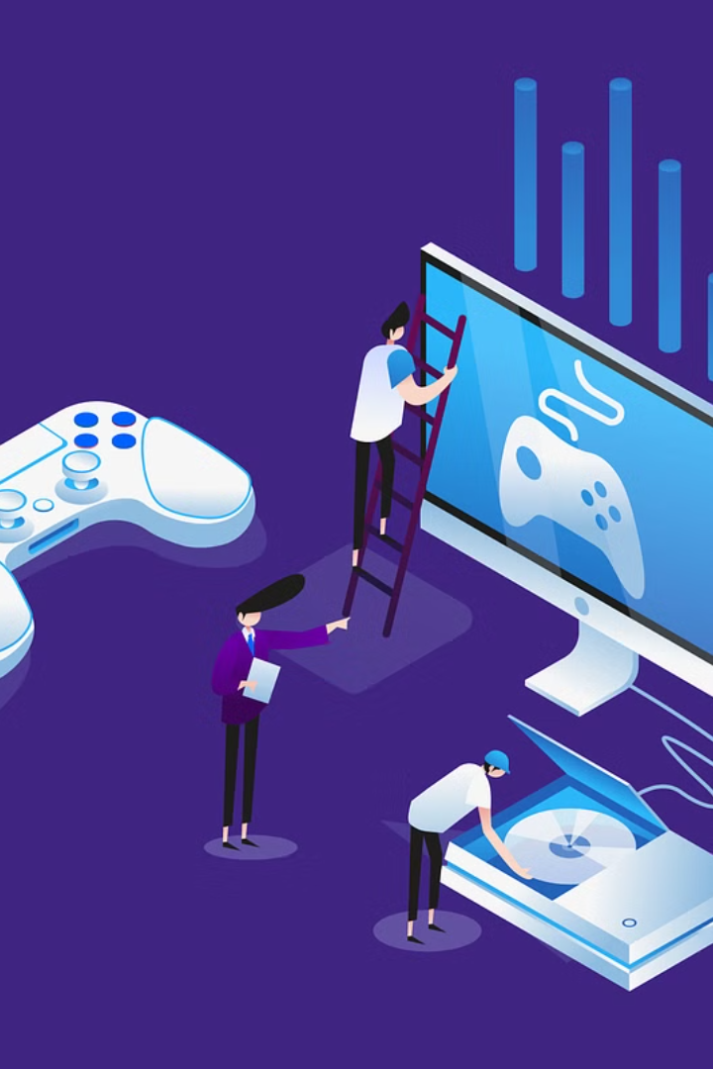
Why You Did This app/game
The Word Train Game is driven by the goal of making language learning enjoyable and educational. It combines interactive quizzes, gaming elements, and captivating animations to offer a unique and engaging platform for users to enhance their language skills. The motivation is to provide a fun and accessible tool that sparks enthusiasm for language learning.

Slide 3
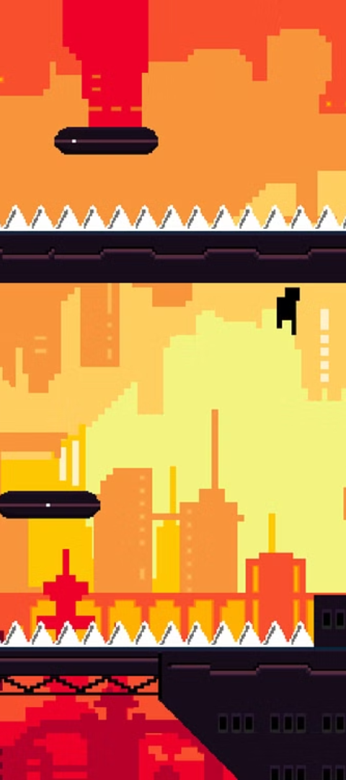
Tasks/objectives
Game Development Setup:
User Interface and Interaction:
Set up a new Python project with the pygame library for game development.
Design an interactive main menu with difficulty selection buttons.
Implement both mouse and keyboard interactions for a seamless user experience.
Quiz Logic and Animation:
Transitions and Audio Integration:
Create language translation data for various difficulty levels.
Design animations for smooth transitions between questions.
Develop smooth card flipping animations and an auto-flip feature for added challenge.
Integrate background music and sound effects to enhance the gaming experience.

Slide 4

Explain what your project is all about
The "Word Train Game" is a Python-based quiz app for language learning. Players translate words between languages in an engaging quiz format with multiple difficulty levels. The game features dynamic animations, smooth transitions, and auto-flip challenges using the pygame library. The goal is to provide an enjoyable language learning experience that combines entertainment and education.

Slide 5
Target audience
The target audience for the Quiz App project includes students, educators, and individuals seeking an interactive and enjoyable learning experience. It caters to language learners of different proficiency levels, making it accessible for beginners and providing a challenge for those at more advanced stages. The app's adaptability and diverse content make it suitable for a broad audience interested in enhancing their knowledge while enjoying a fun and engaging quiz environment.

Slide 6
Which libraries i used to write this project?
Pygame
Sys
Random
This library is used for creating video games and multimedia applications. In your project, pygame facilitates the creation of the graphical user interface, handling events, and managing the game loop.
This library provides access to some variables used or maintained by the Python interpreter and functions that interact with the interpreter. In your project, it's used to handle system-level functionalities, such as exiting the game.
This library is used for generating pseudo-random numbers. In your project, it's employed for randomly selecting questions and answers from the quiz data.

Slide 7

How Word Train Game works
Engage in language learning with the Word Train Game. Offering Easy, Medium, and Hard difficulty levels, this interactive quiz challenges players to translate words. With an intuitive menu, captivating music, and animated transitions, the game provides a fun and educational experience. Navigate flashcards using arrow keys, reveal answers with the space bar, and enhance your language skills in a playful way. Embark on the Word Train for an enjoyable journey to proficiency.

Slide 8
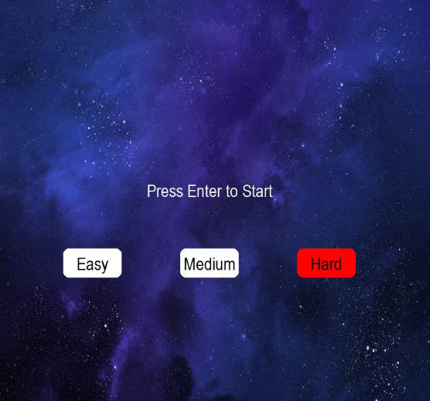
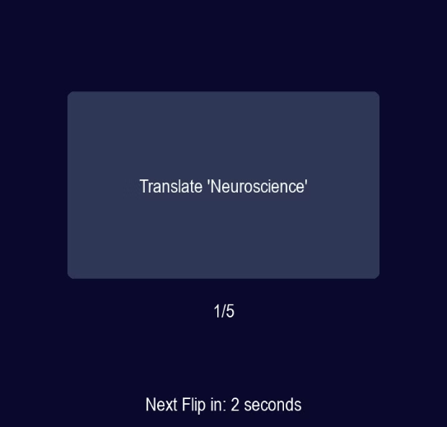
How Word Train Game works
Game menu with different difficulties
Game process

Slide 9
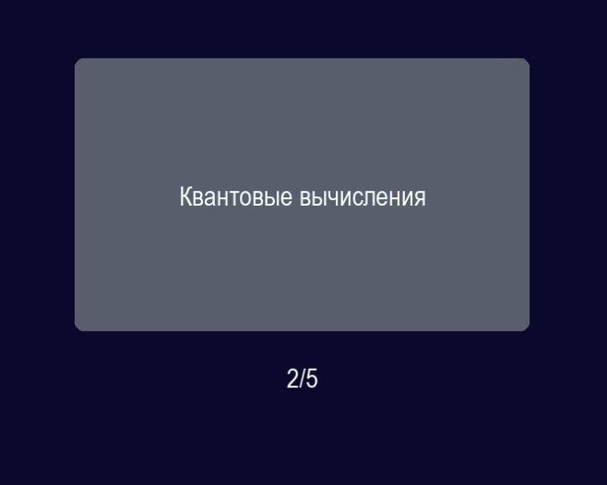
How Word Train Game works
Game process

Slide 10
Сonclusion
Word Train Game demonstrates the potential of gamified learning. By incorporating technology like Python, Pygame, and Pandas, the project successfully delivers an enjoyable language-learning experience. Its user-friendly design and adaptability make it a valuable tool for both individual study and classroom environments.

Slide 11
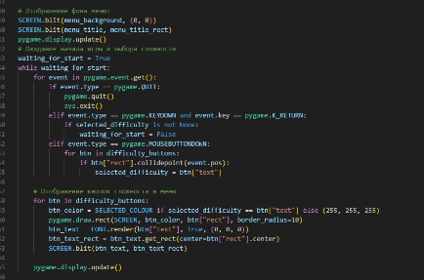
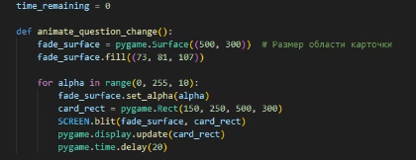
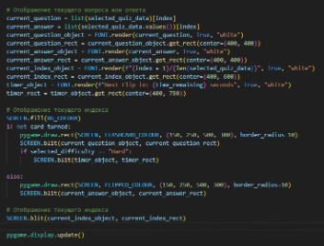
Solution/code
Menu
Card animation func
Visualization

Slide 12

Thank You for your attention!

