Slide 1

From Code to Health Insights
NAME | PRN
Raghav Bhadada | 1262251534
Tanush Pandey | 1262253348
Ayushman Gautam | 1262251925
Virat Pratap Singh | 1262253321
Abhishaurya Gautam | 1262253414

Slide 2

Why C for a Fitness Tracker?
C is a powerful and efficient language, making it an excellent choice for applications requiring direct system interaction and optimal performance. For a fitness tracker, this means:
Performance: Fast execution for real-time data processing.
Resource Efficiency: Minimal memory footprint, ideal for embedded systems or simpler devices.
Fundamental Learning: A solid foundation for understanding how software interacts with hardware.

Slide 3
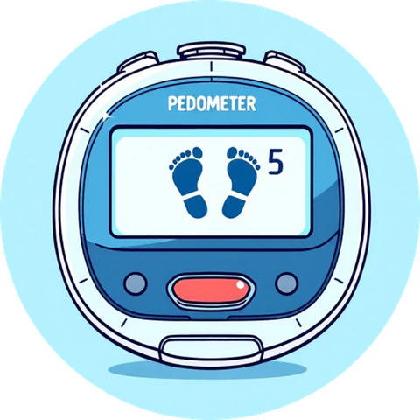

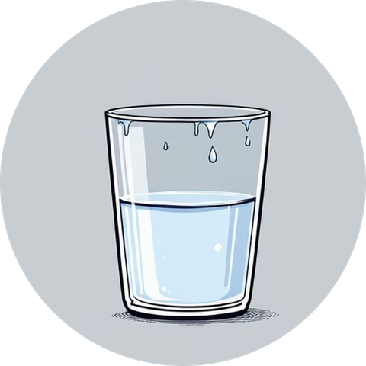

Core Features: What We're Tracking
Daily Steps
Calories Burned
Water Intake
BMI Calculation
Input and track the number of steps walked each day towards a predefined goal.
Record the estimated calories expended daily to monitor energy balance.
Log daily water consumption in liters to ensure adequate hydration.
Calculate Body Mass Index (BMI) based on height and weight for a health assessment.

Slide 4
Setting Up Your Tracker: Initial Input
Input Requirements
int days;
printf("Enter the number of days to track: ");
scanf("%d", &days);
int stepgoal;
printf("Enter your daily step goal: ");
scanf("%d", &stepgoal);
Before tracking begins, the program needs a few essential pieces of information from the user:
Tracking Duration: How many days will you be tracking your fitness?
Daily Step Goal: What's your target number of steps for each day?
This initial setup customizes the tracking period and personalizes the step challenge.

Slide 5
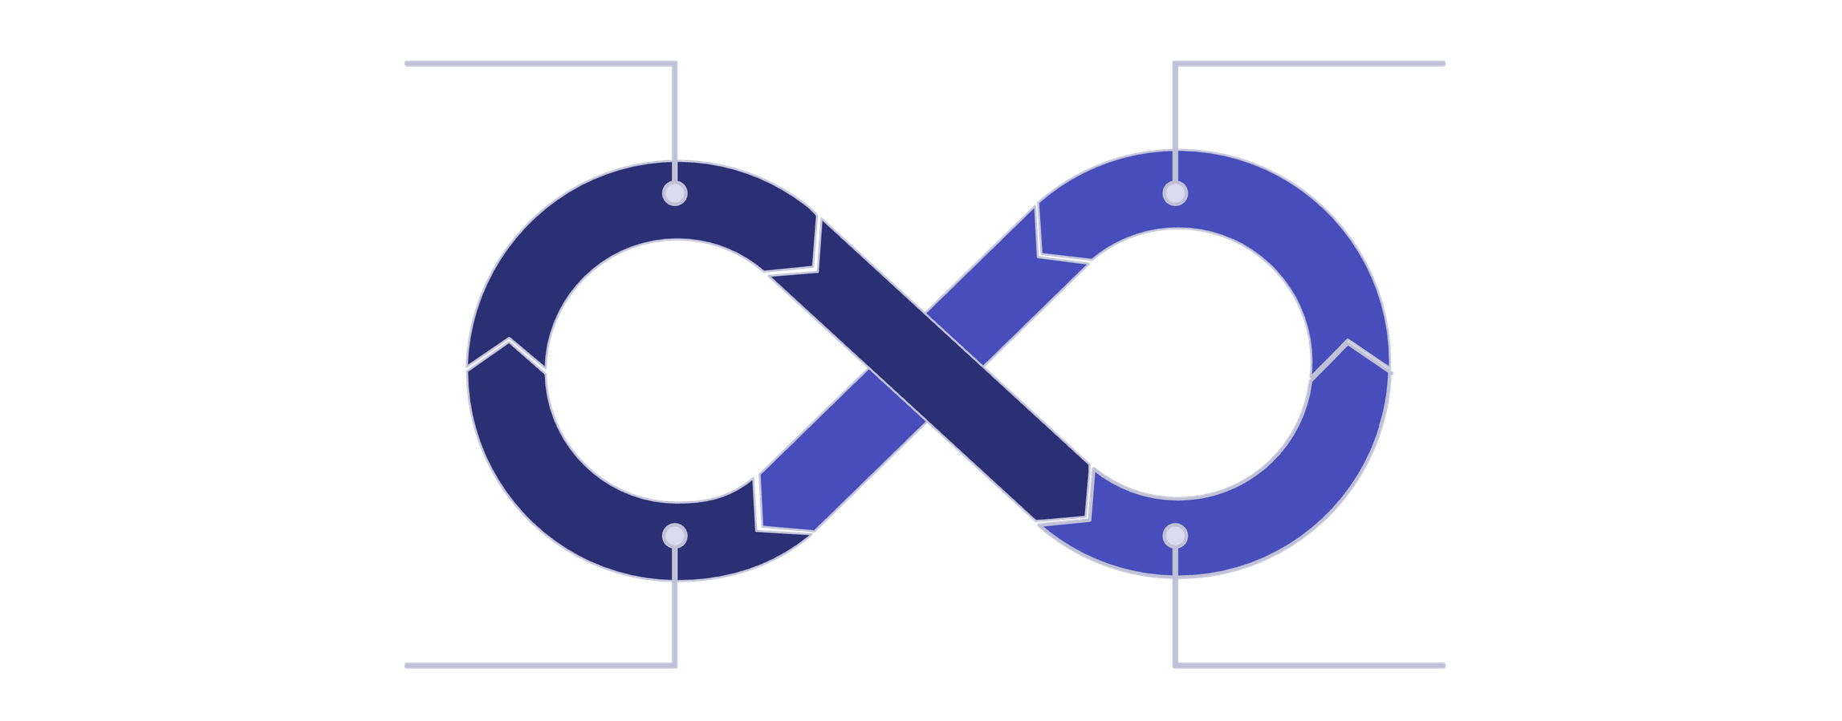
Daily Data Entry Loop
Enter Steps
Enter Calories
Next Day Repeat
Enter Water Intake
For each day of the tracking period, the program systematically prompts the user to input their fitness metrics. This loop ensures all relevant data is captured consistently.

Slide 6
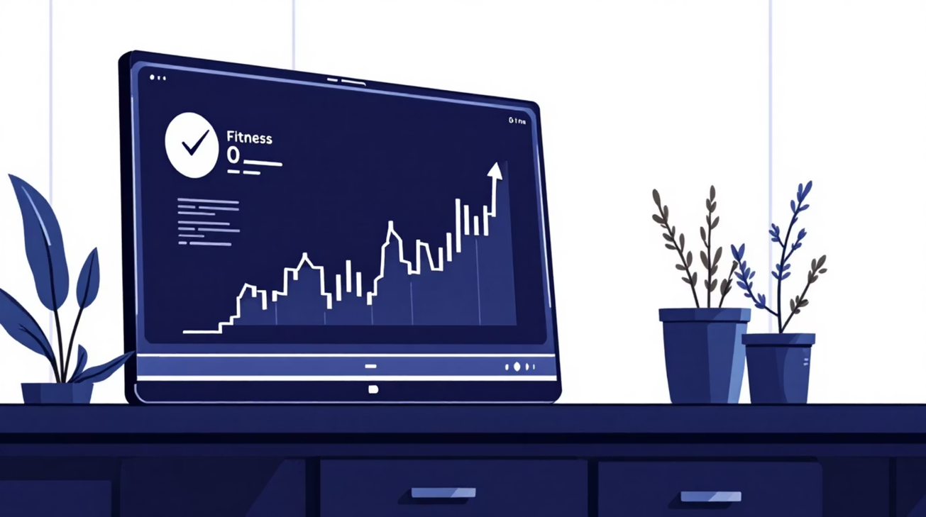
Tracking Progress: Variables & Logic
Several key variables are used to store and process the daily fitness data, enabling comprehensive summary statistics:
Total Steps: Accumulates steps over all days.
Total Calories: Sums up calories burned for the entire period.
Maximum Steps & Best Day: Identifies the day with the highest step count.
Goal Met Count: Tracks how many days the step goal was achieved.

Slide 7
Fitness Summary: At a Glance
Once all daily data is entered, the program generates a comprehensive fitness summary. This output provides valuable insights into overall activity and performance.
1
2
Overall Activity
Daily Averages
Total steps walked and total calories burned across the tracking period.
Average calories burned per day, offering a quick performance benchmark.
3
4
Peak Performance
Goal Achievement
Identification of the "best day" with the maximum steps, highlighting achievements.
A breakdown of days where the step goal was met vs. not met, and the total count.

Slide 8
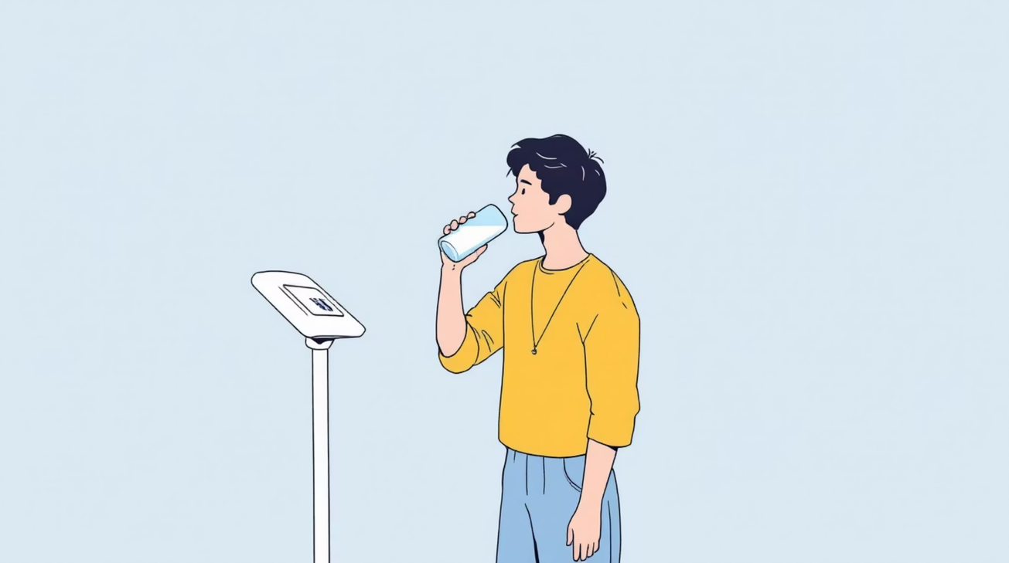
Hydration Check & BMI Calculator
Low Water Intake Alert
The tracker also monitors hydration, flagging days where water consumption falls below the recommended 2-liter threshold. This helps users maintain optimal fluid balance.
if (water[i] < 2) {
printf("Day %d", i);
}

Slide 9
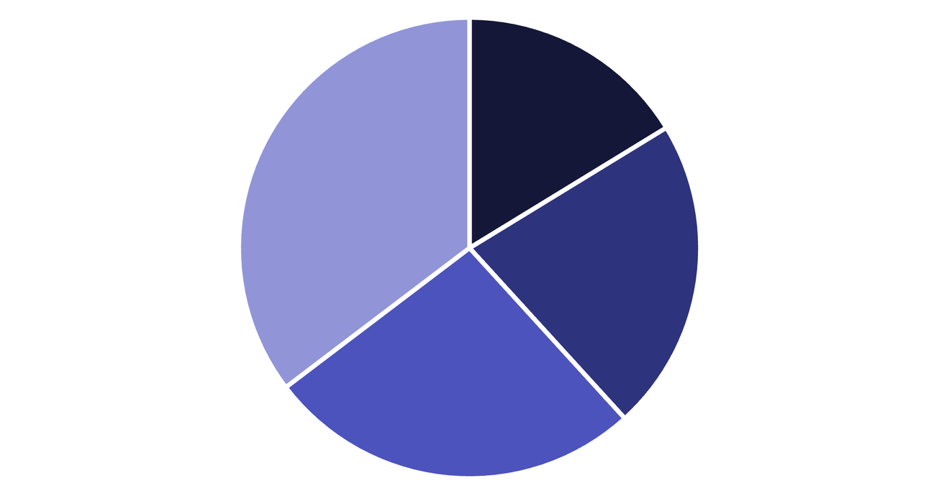
BMI Categories: Understanding Your Health
After calculating your BMI, the program classifies your result into standard health categories, providing immediate context:
Underweight: BMI less than 18.5
Normal weight: BMI between 18.5 and 24.9
Overweight: BMI between 25 and 29.9
Obese: BMI 30 or greater
Underweight
Normal
Overweight
Obese

Slide 10
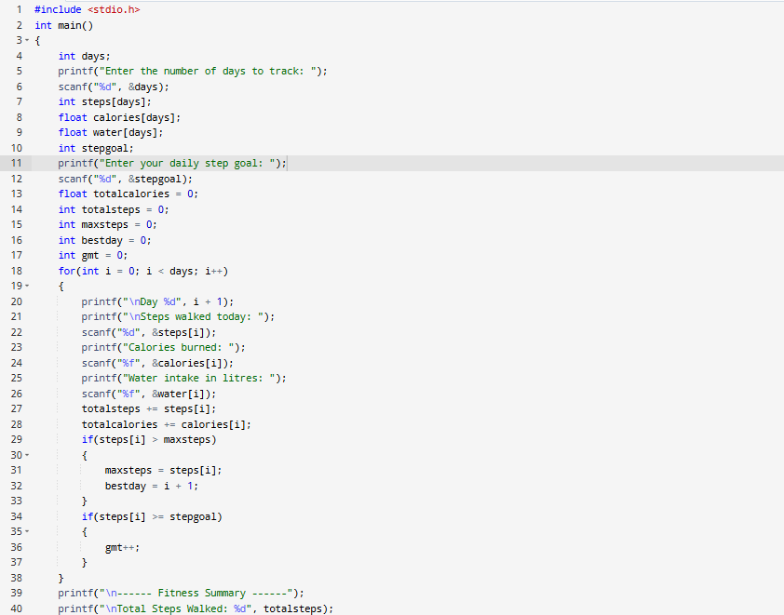
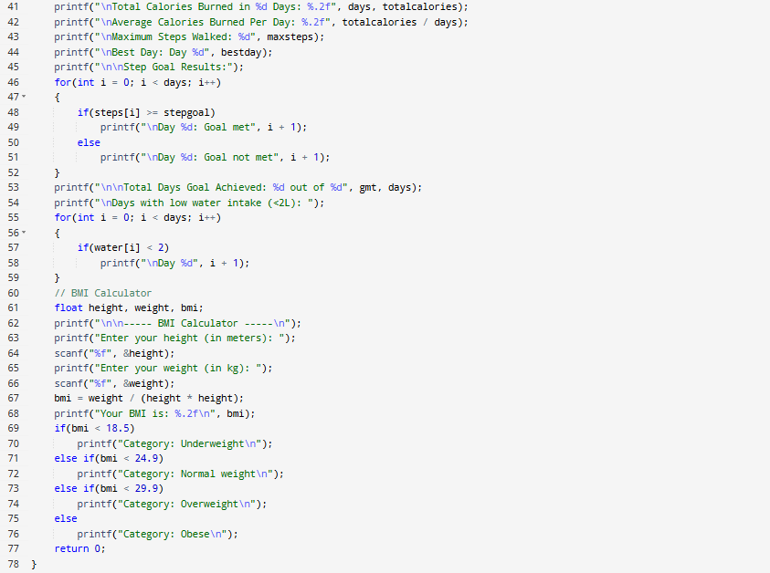

Slide 11
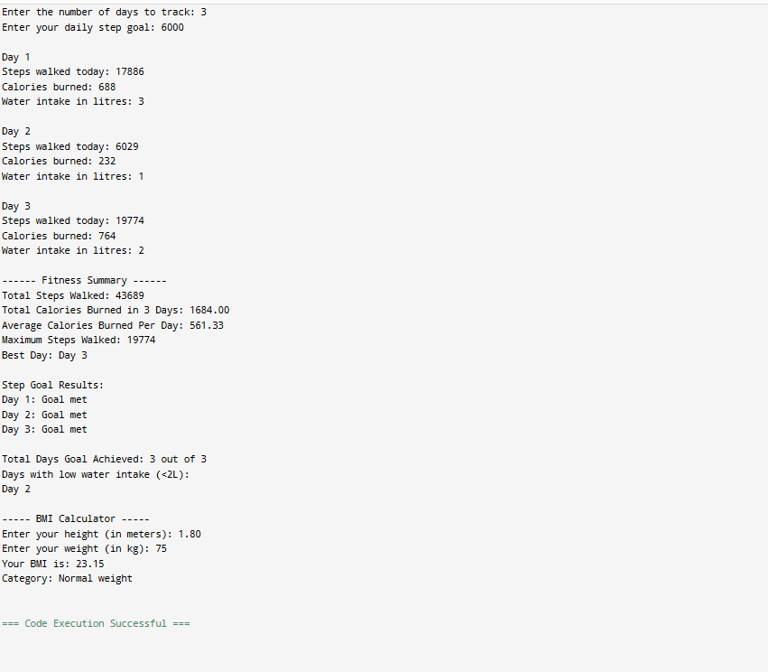
Full C Code Output
This complete C code integrates all features: daily tracking, fitness summary, hydration alerts, and BMI calculation, offering a robust foundation for a personal fitness tracker.

