Slide 1
TECHPRINTS 10.0 | MAY 2026
FinSentinal
Financial Distress Early Warning System
A Comparative Study of Machine Learning and Neural Network Models
SriVishnu Pejathaya
Department of Computer Applications
St Joseph Engineering College, Mangaluru

Slide 2
The Problem
!
Corporate financial distress causes cascading economic damage to investors, creditors, and employees
~
Traditional models (Altman Z-Score, 1968) use only 5 linear ratios — fail on complex non-linear patterns
×
Existing ML systems compare only one or two models with no neural network baseline
?
Most systems lack explainability — black-box predictions are not trusted by financial decision-makers
×
No real-time, interactive early warning dashboard exists for practitioners
"Early detection can prevent bankruptcy cascades — but requires smarter, explainable models."
FinSentinal | SJEC Mangaluru | Techprints 10.0 | May 2026

Slide 3
Literature Review & Research Gap
Approach | Multi-Model | Neural Net | SHAP XAI | Real-Time
Altman Z-Score (1968) | ✗ | ✗ | ✗ | ✗
SVM — Min & Lee (2005) | ✗ | ✗ | ✗ | ✗
Random Forest — Barboza et al. (2017) | ✗ | ✗ | ✗ | ✗
Deep Learning — Shi et al. (2022) | ✗ | ✓ | ✗ | ✗
FinSentinal ★ (This Work) | ✓ | ✓ | ✓ | ✓
Research Gap: No existing study combines 4-model comparison + neural network + SHAP explainability + real-time deployment
FinSentinal | SJEC Mangaluru | Techprints 10.0 | May 2026

Slide 4
FinSentinal System Architecture
DATA LAYER
APPLICATION LAYER
PRESENTATION LAYER
SQLite Database
Flask / Python Backend
React.js Dashboard
95 Financial Ratios
→
ML Models (4 types)
→
FDI & Risk Display
Live Stock Feed
SHAP Explainer
Feature Explanations
(AAPL / GOOG / MSFT)
REST API Endpoints
PDF / CSV Export
FDI = P(Distress | x) = fθ(x)
0.0–0.4 HEALTHY
0.4–0.7 MODERATE
0.7–1.0 DISTRESSED
FinSentinal | SJEC Mangaluru | Techprints 10.0 | May 2026

Slide 5
Dataset: Taiwan Bankruptcy (TEJ)
6,819
95
220
6,599
Total
Companies
Financial
Ratios / Features
Bankrupt
(3.23%)
Non-Bankrupt
(96.77%)
Preprocessing Pipeline
Feature Categories
1. Remove features with >50% missing values
2. Median imputation for remaining NaN
3. StandardScaler for LogReg and MLP
4. Stratified 80/20 train-test split
5. Class imbalance: balanced weights / scale_pos_weight=29.99
• ROA Variants (A, B, C) — Profitability
• Gross & Operating Margins — Efficiency
• Current & Quick Ratio — Liquidity
• Debt Ratios & Borrowing Dependency — Leverage
• EPS & Earnings Growth — Market Performance
• Interest Rates & Cash Flow — Solvency
FinSentinal | SJEC Mangaluru | Techprints 10.0 | May 2026

Slide 6
Methodology — Four Models Compared
Logistic
Regression
Random
Forest
XGBoost
MLP Neural
Network
LR
RF
XG
NN
class_weight = balanced
200 decision trees
200 trees, lr = 0.05
Layers: (128, 64, 32)
C = 0.1, LBFGS solver
max_depth = 10
max_depth = 6
ReLU + Adam optimizer
max_iter = 1000
class_weight = balanced
scale_pos_weight = 29.99
Early stopping
Linear baseline
Non-linear ensemble
Gradient boosting ★ Best
Deep learning baseline
Metrics: Accuracy | Precision | Recall | F1-Score | ROC-AUC | 5-Fold Cross-Validation
FinSentinal | SJEC Mangaluru | Techprints 10.0 | May 2026

Slide 7
Results — Model Performance Comparison
Model | Accuracy | Precision | Recall | F1-Score | ROC-AUC
Logistic Regression | 88.27% | 96.64% | 88.27% | 91.56% | 92.30%
Random Forest | 96.04% | 96.79% | 96.04% | 96.36% | 94.29%
XGBoost ★ BEST | 96.92% | 97.20% | 96.92% | 97.04% | 95.32%
MLP Neural Net | 96.55% | 95.54% | 96.55% | 95.89% | 85.73%
Key Finding: XGBoost leads all models — Accuracy 96.92% | F1 97.04% | ROC-AUC 95.32%
FinSentinal | SJEC Mangaluru | Techprints 10.0 | May 2026

Slide 8
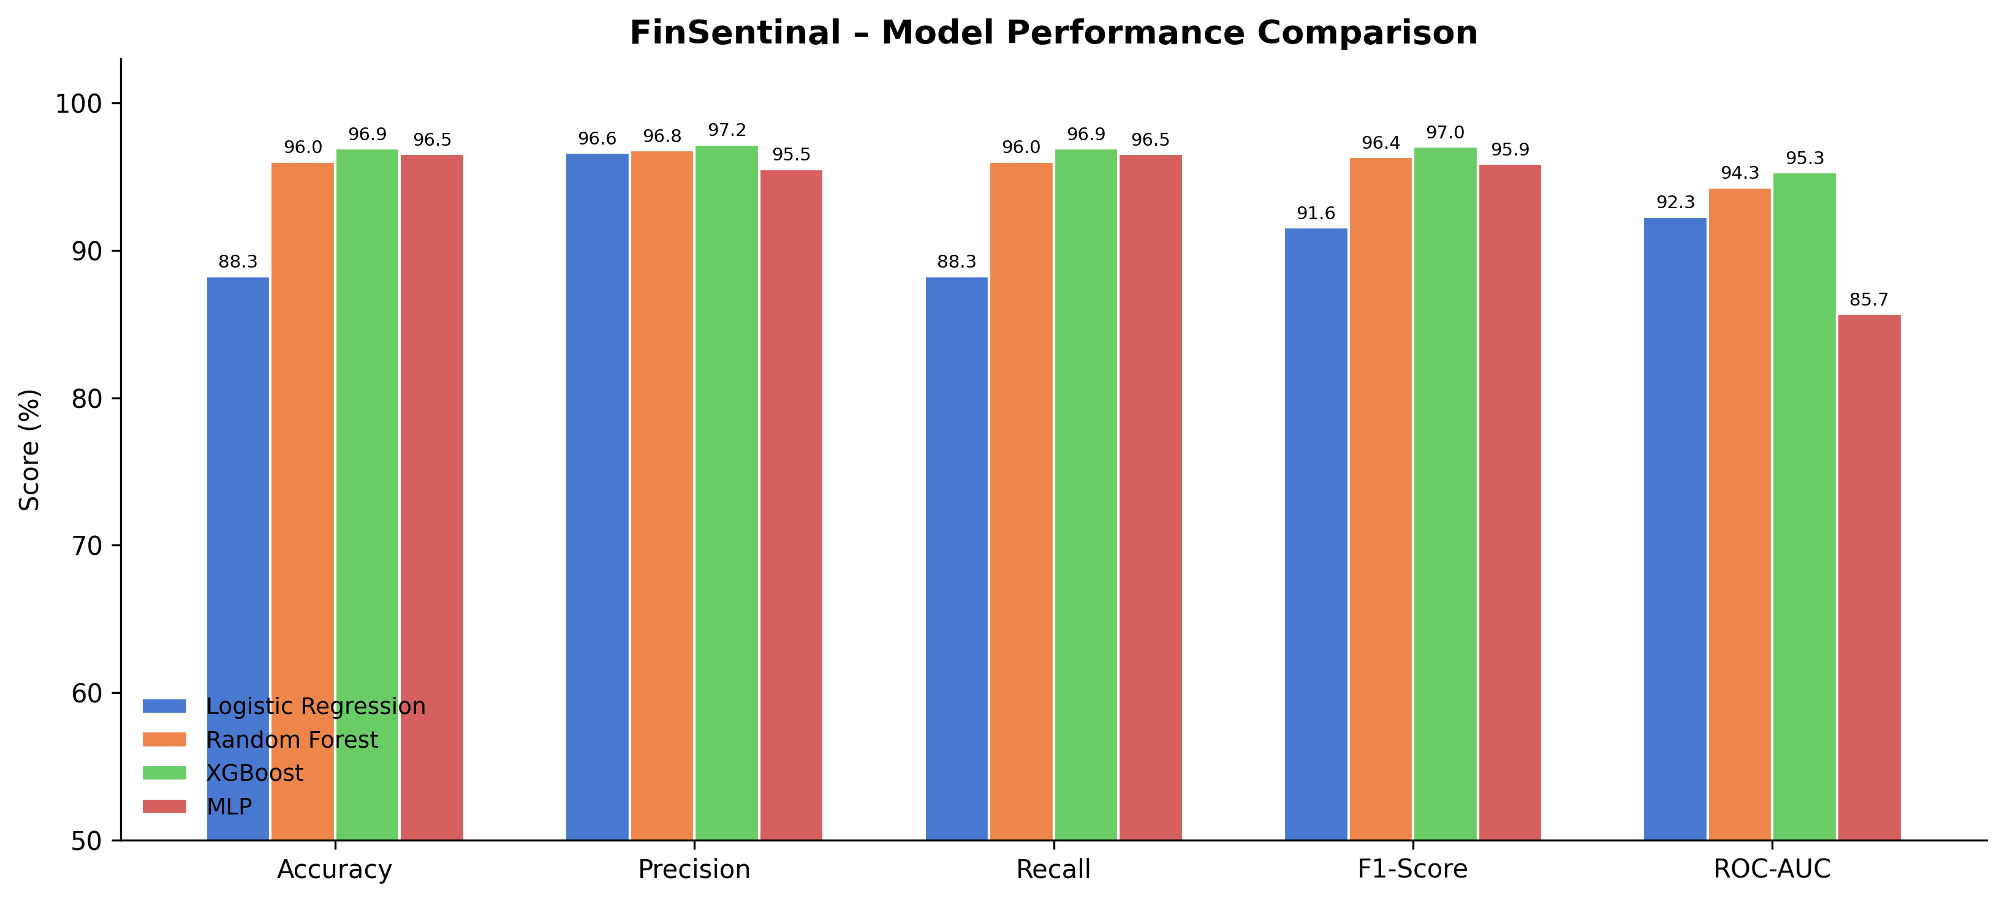
Visual Comparison — All Metrics
XGBoost consistently outperforms. MLP matches accuracy but trails ROC-AUC (85.73% vs 95.32%) — revealing weaker discrimination for the rare bankrupt class.
FinSentinal | SJEC Mangaluru | Techprints 10.0 | May 2026

Slide 9
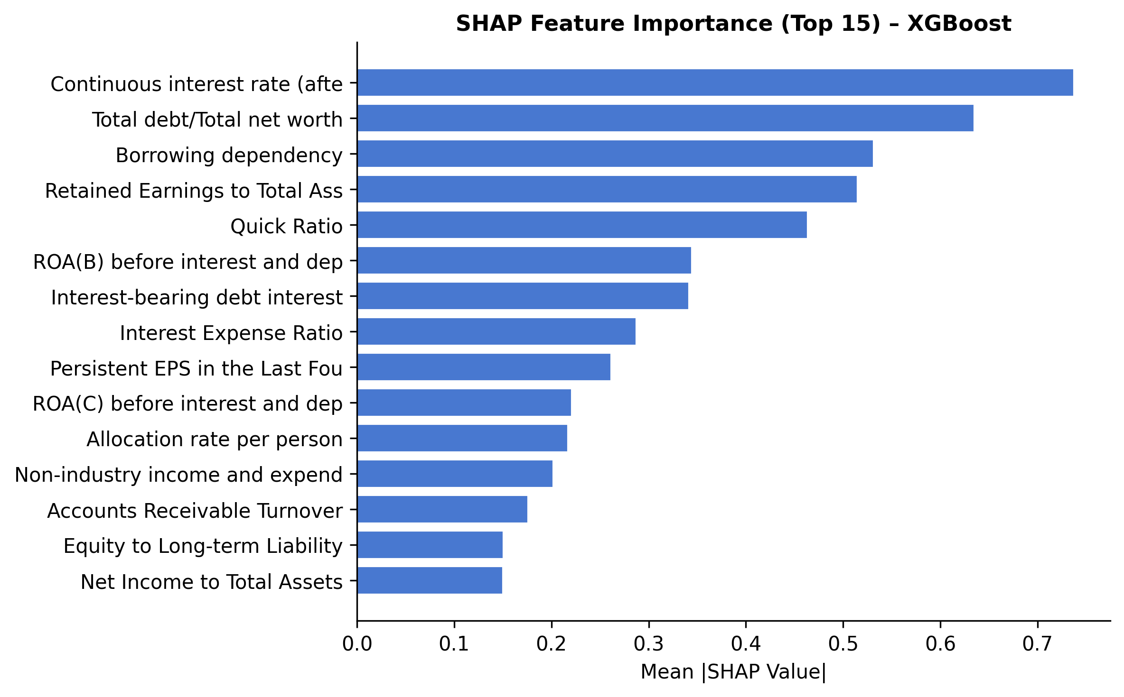
SHAP Explainability — Why Did the Model Predict Distress?
Top Predictors of Financial Distress
0.7378
Continuous Interest Rate High interest = debt pressure
0.6352
Total Debt / Net Worth High leverage = over-indebted
0.5318
Borrowing Dependency Heavy reliance on external debt
0.5152
Retained Earnings / Assets Low retention = reduced buffer
0.4636
Quick Ratio Low liquidity = can't pay bills
SHAP findings align with financial theory
FinSentinal | SJEC Mangaluru | Techprints 10.0 | May 2026

Slide 10
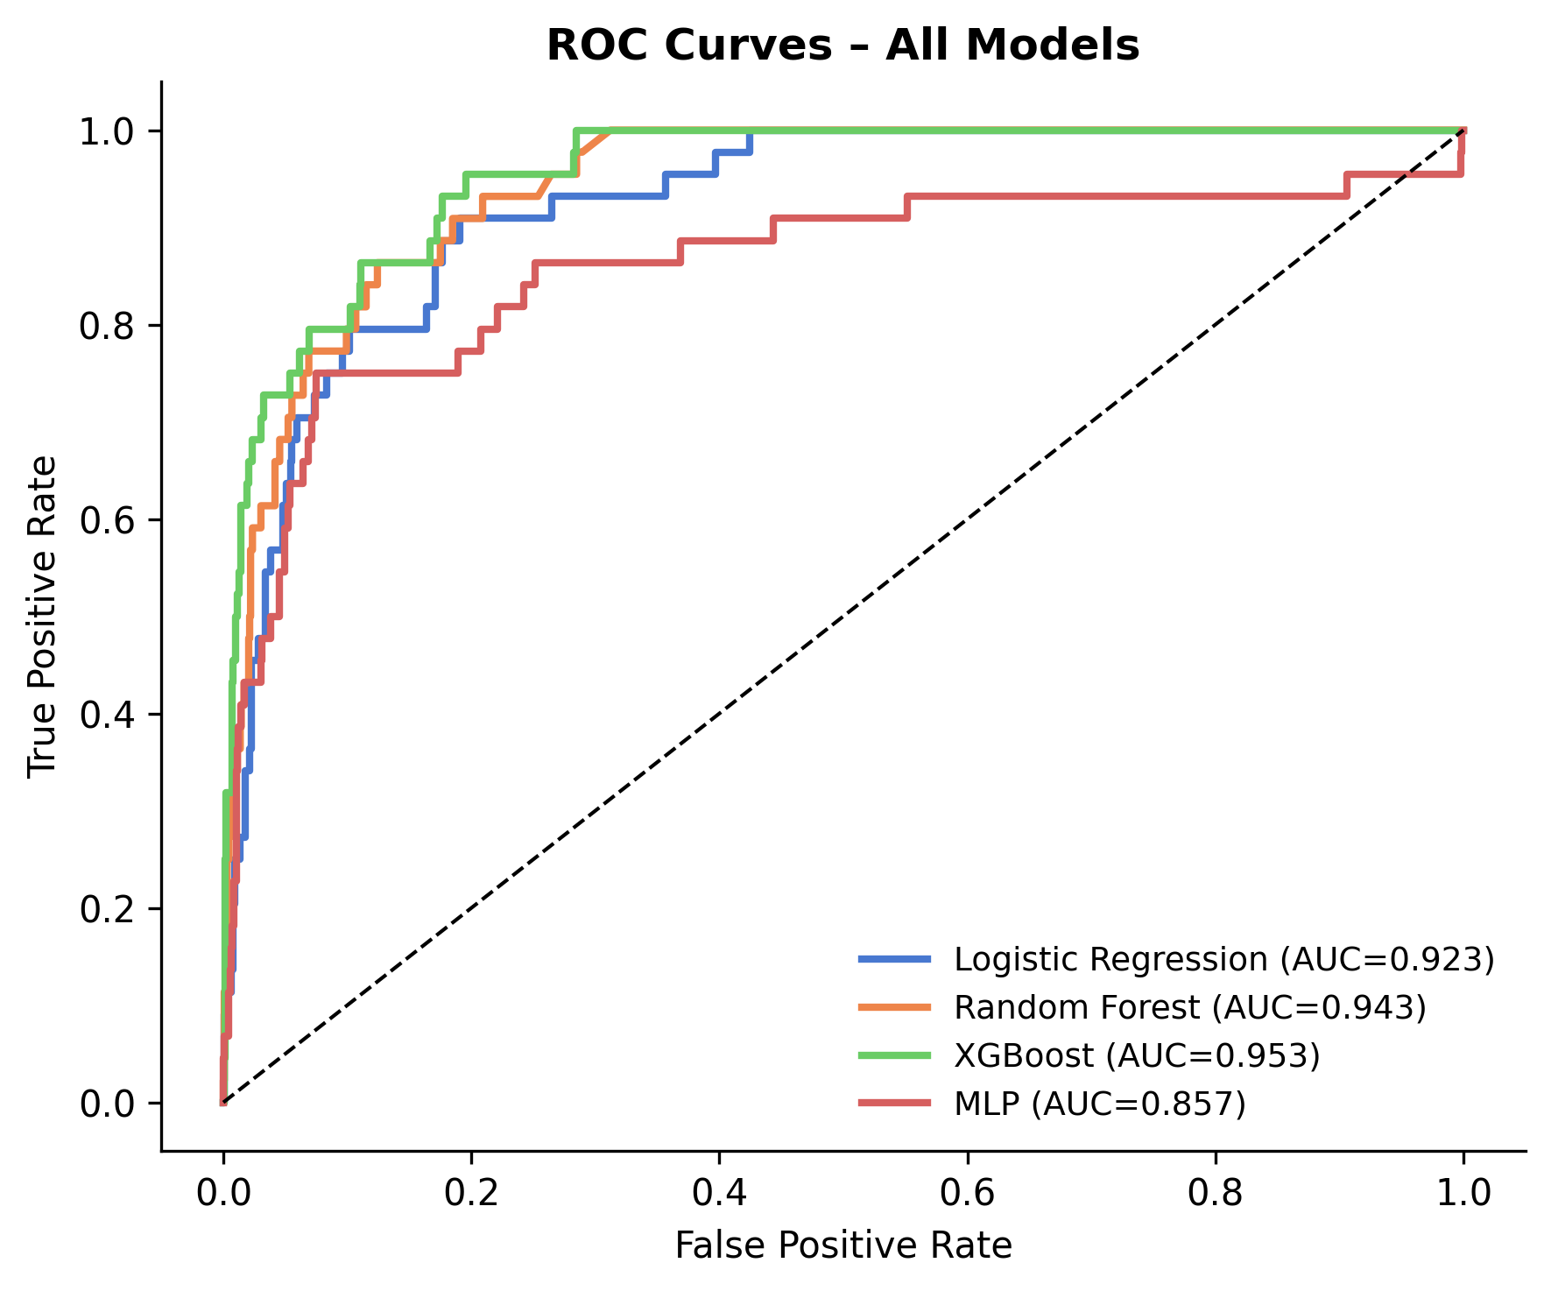
ROC Curve Analysis
0.953
XGBoost Best — highest discrimination between classes
0.943
Random Forest Close second — stable and robust
0.923
Logistic Regression Strong for a linear model
0.857
MLP Neural Net Lower AUC despite high accuracy
In financial risk, high AUC matters more than accuracy
— missing a bankruptcy is far costlier than a false alarm.
FinSentinal | SJEC Mangaluru | Techprints 10.0 | May 2026

Slide 11
FinSentinal vs Existing Approaches
Feature | Altman Z-Score | SVM (2005) | Random Forest | Deep Learning | FinSentinal ★
Accuracy | ~72% | 88.4% | 93.1% | 95.6% | 96.92%
Multi-Model Comparison | ✗ | ✗ | ✗ | ✗ | ✓
Neural Network | ✗ | ✗ | ✗ | ✓ | ✓
SHAP Explainability | ✗ | ✗ | ✗ | ✗ | ✓
Real-Time Dashboard | ✗ | ✗ | ✗ | ✗ | ✓
FinSentinal is the only system combining all five capabilities.
FinSentinal | SJEC Mangaluru | Techprints 10.0 | May 2026

Slide 12
Conclusion & Future Work
KEY FINDINGS
FUTURE WORK
✓
XGBoost: Acc 96.92% | F1 97.04% | AUC 95.32%
→
Integrate macroeconomic indicators (GDP, rate cycles)
✓
Ensemble methods outperform linear models
→
Add sentiment analysis from financial news
✓
MLP matches accuracy but trails on rare-class detection
→
Replace MLP with LSTM for temporal modeling
✓
SHAP: Interest rate, leverage, and liquidity are top predictors
→
Cloud deployment for real-time scalability
✓
FinSentinal: real-time, explainable, multi-model FDEWS
→
Target Scopus-indexed journal publication
FinSentinal advances financial distress prediction through rigorous benchmarking, neural network integration, and explainable AI.
Department of Computer Applications | SJEC Mangaluru | Techprints 10.0 | May 2026

