Slide 1

Predictive Model for Customer Reviews
Training a random forest classifier to predict customer behaviour using data. Demonstrated data preparation, model training, and evaluation with accuracy and AUC scores to assess the model’s efficiency in predicting outcomes.

Slide 2
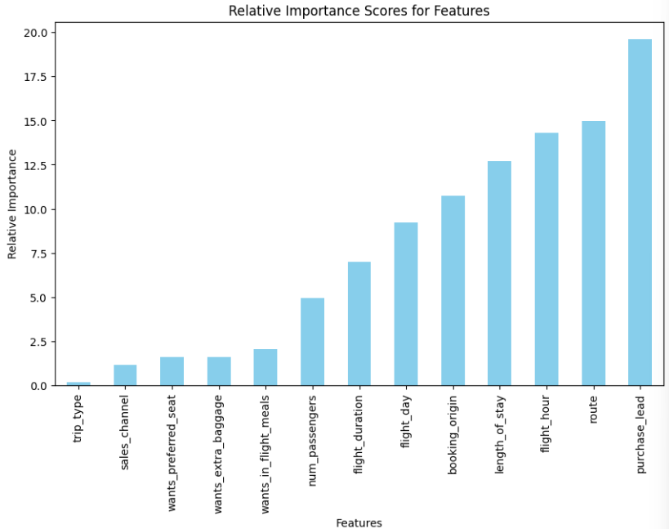
Predictive Model to understand and evaluate Customer’s Behaviour
We have trained the data set with Random Forest Classifier Model and received
RF ACCURACY : 85.41%
AUC Score : 0.56
1. purchase_leads
2. routes
3. flight_hour
4. length_of_stay
5. booking_origin
The top 5 features which highly
influence the customer’s behavior.
AUC Score can be increased further more.

