Slide 1
Qualitative Neural Network
Verification with StarV
FNN safety, CNN robustness, semantic segmentation verification
Sung Woo Choi · University of Florida
Hoang Dung · University of Florida
Bardh Hoxha · Toyota Research Institute of North America
SAFE / UNSAFE / UNKNOWN
Star-based reachability
Perception networks

Slide 2
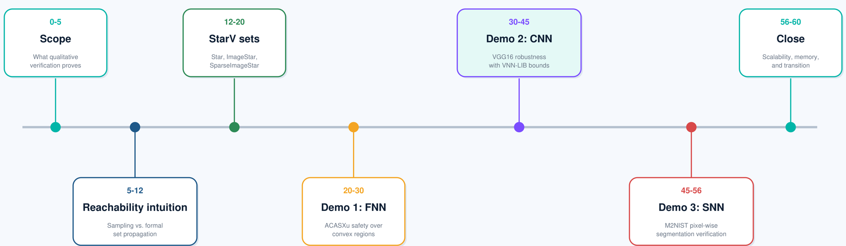
AGENDA
StarV qualitative verification tutorial
StarV qualitative verification tutorial

Slide 3
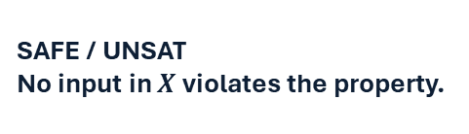
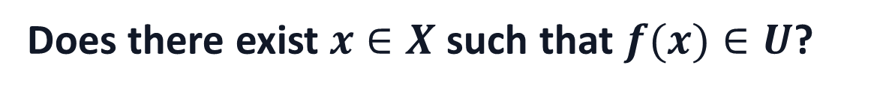
PROBLEM STATEMENT
What qualitative verification proves
Given a neural network $f$, an input set $X$, and an unsafe output set $U$:
Does there exist $x∈X$such that $f(x)∈U$?
SAFE / UNSAT
No input in $X$ violates the property.
UNSAFE / SAT
A counterexample exists.
UNKNOWN
The verifier cannot conclude within the chosen method/time.
For safety verification, X is a physical operating region.
$X_{safe} = \left\{ x :A_{in}x≤b_{in}\right\}$ we verify $f\left(X_{rob}\right)∩U=∅$
For robustness verification, X is usually a perturbation set around one nominal input $x_{0}$.
$X_{rob} = \left\{ x : \left\|x−x_{0}\right\|≤ ε \right\}$ we verify $∀x∈X_{safe}, f_{c}\left(x\right)≥max_{i≠c} f_{i}(x)$
StarV qualitative verification tutorial

Slide 4
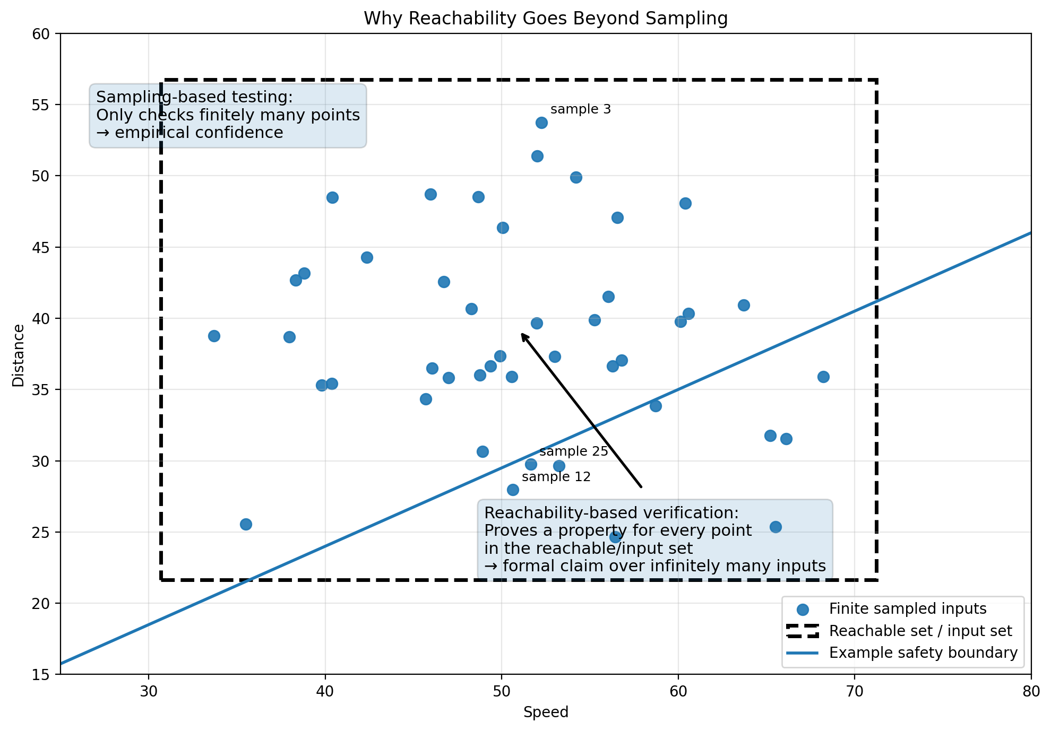
KEY DISTINCTION
Why verification via reachability analysis is important
Verification replaces empirical confidence with a formal claim over infinitely many inputs.
StarV qualitative verification tutorial
Notes:
For FNNs, X may be a low-dimensional box. For CNNs, X is a high-dimensional image set.
sampling = empirical confidence, reachability = formal guarantee over all points in the set.

Slide 5
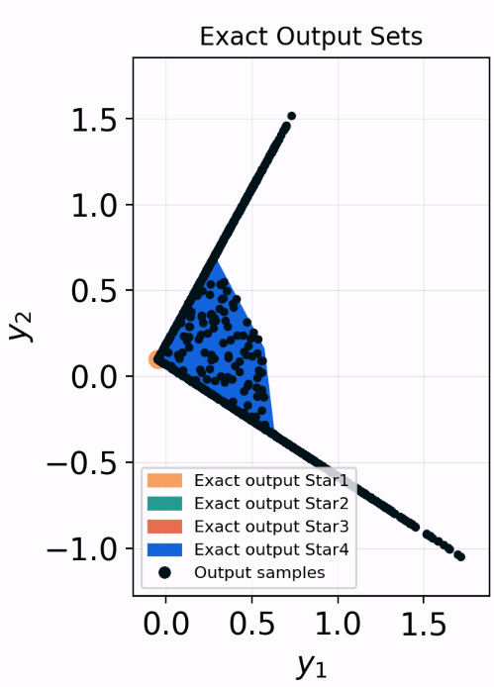
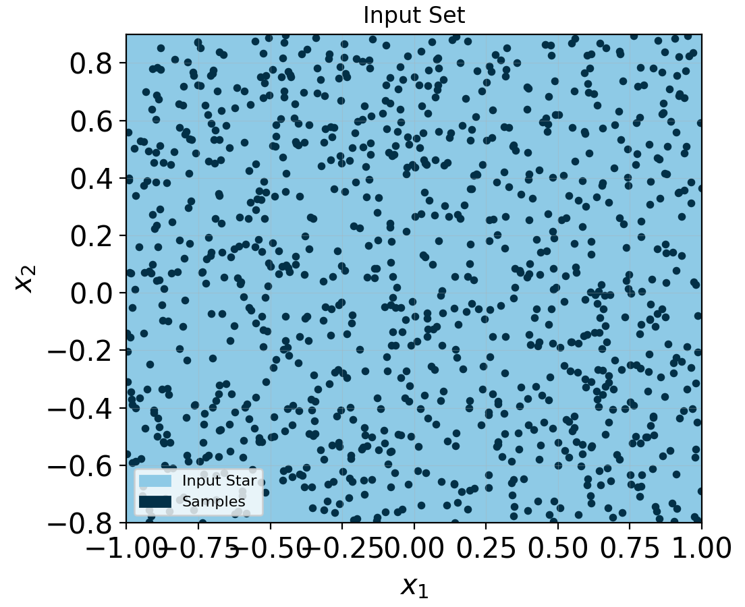
KEY DISTINCTION
Why verification via reachability analysis is important
f
StarV qualitative verification tutorial
Notes:
For FNNs, X may be a low-dimensional box. For CNNs, X is a high-dimensional image set.
sampling = empirical confidence, reachability = formal guarantee over all points in the set.

Slide 6
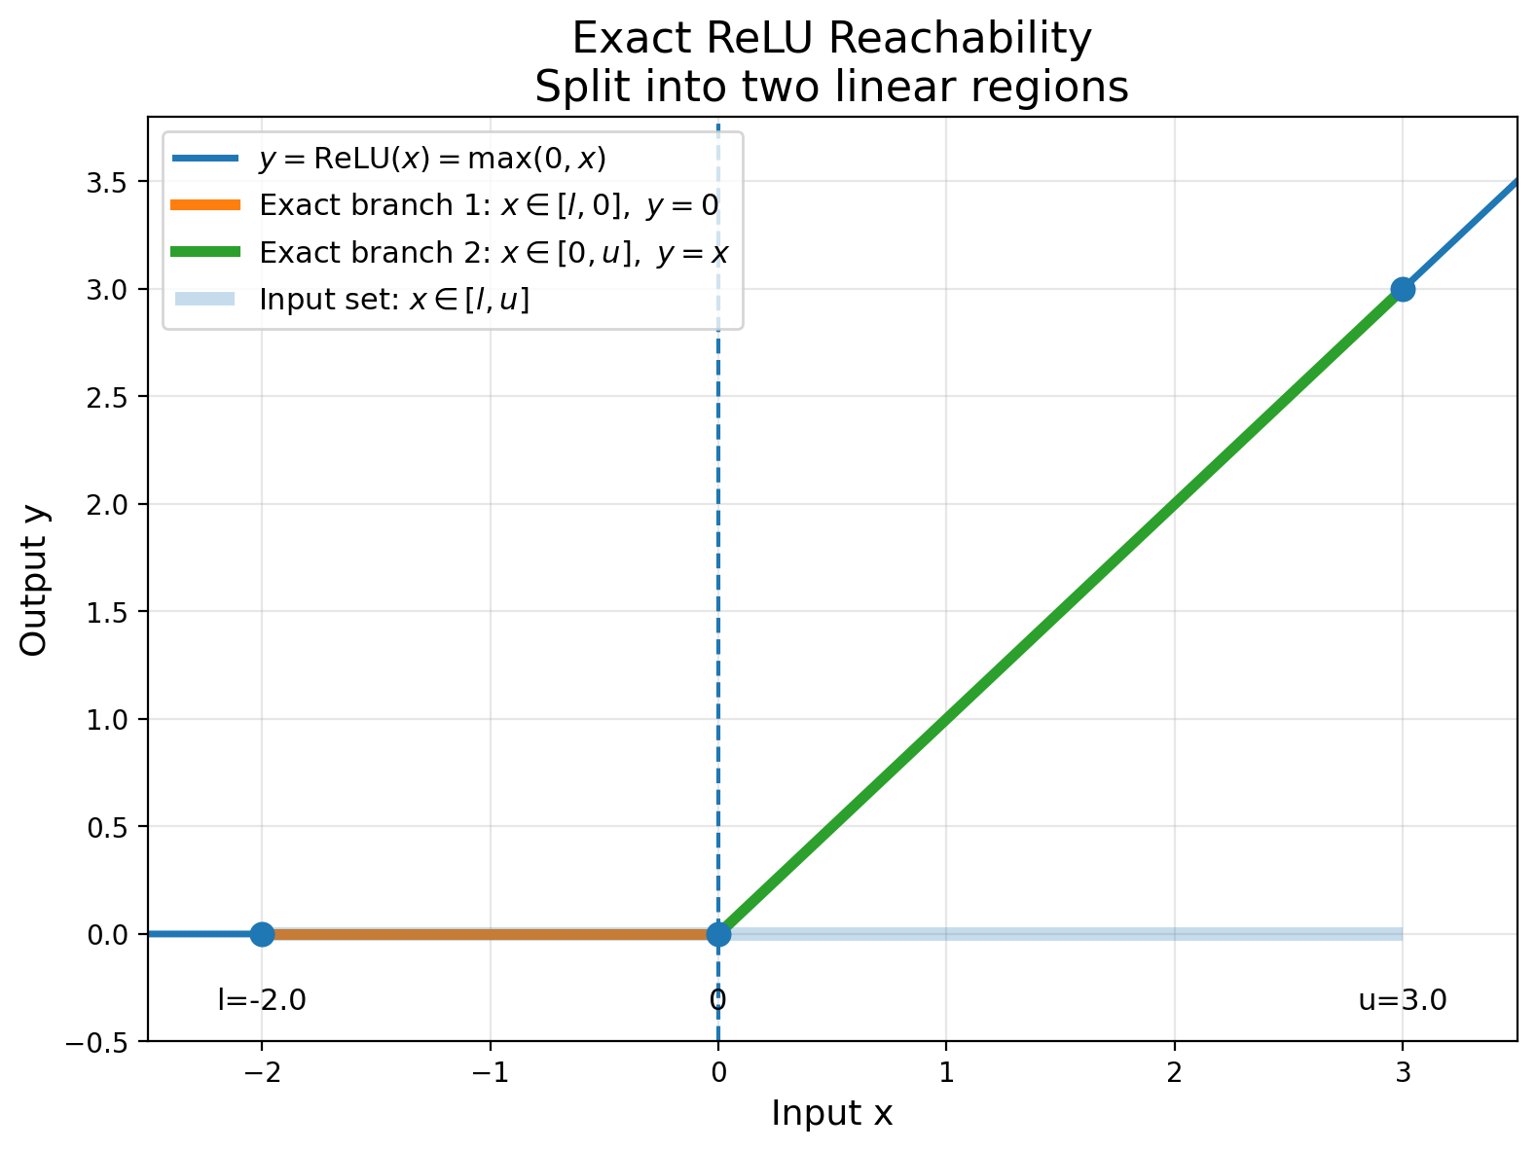
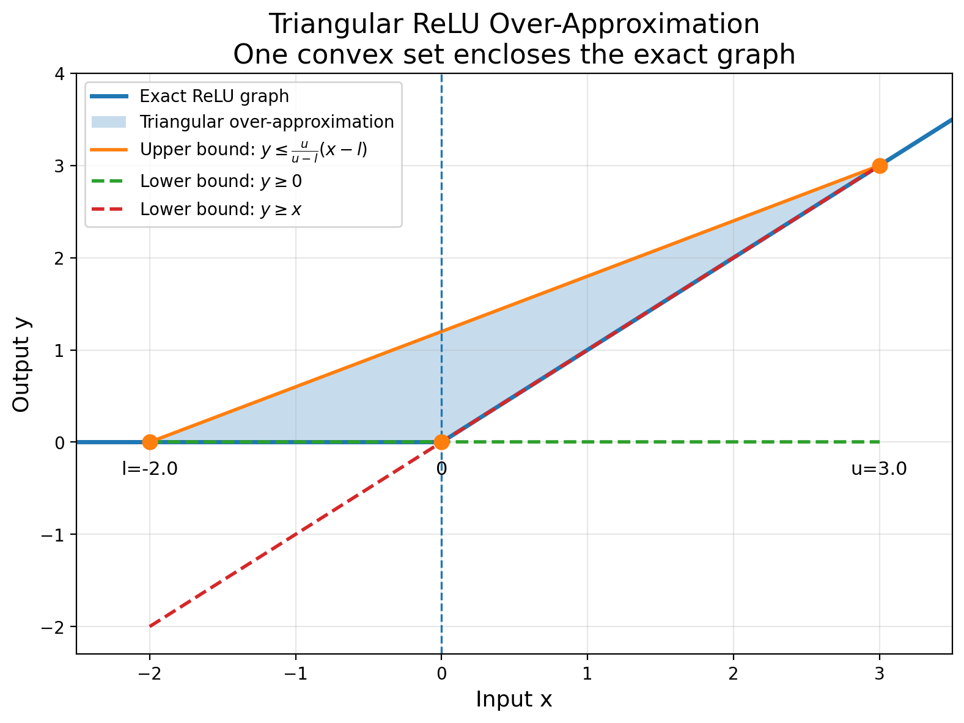
REACHABILITY METHODS
Two Types of Reachability Methods: Exact and Over-approximate
Reachability Methods:
Exact Reachability
Over-approximate Reachability
StarV qualitative verification tutorial

Slide 7
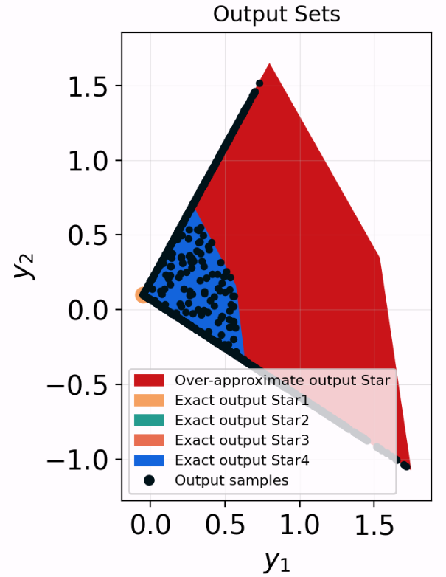
REACHABILITY METHODS
Two Types of Reachability Methods: Exact and Over-approximate
f
StarV qualitative verification tutorial

Slide 8
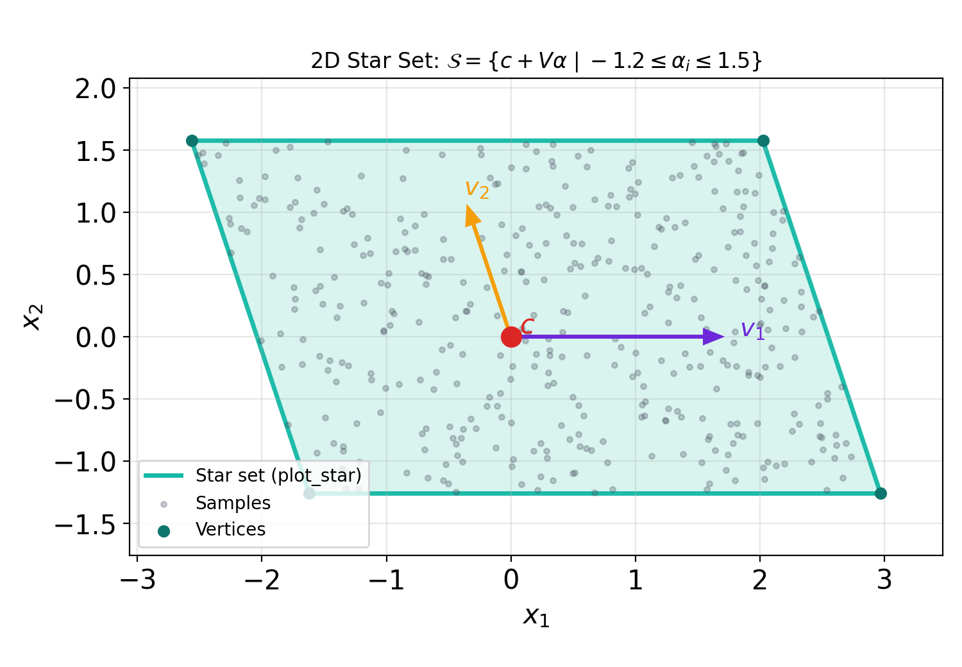
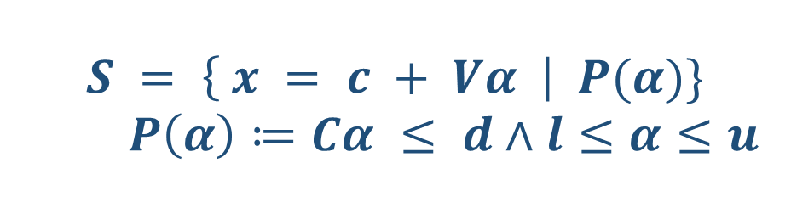
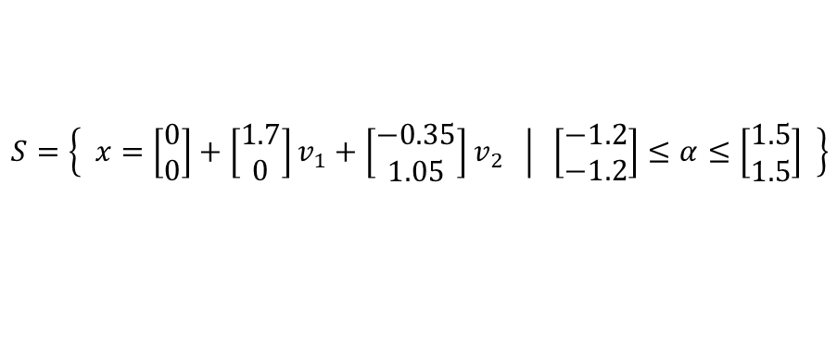
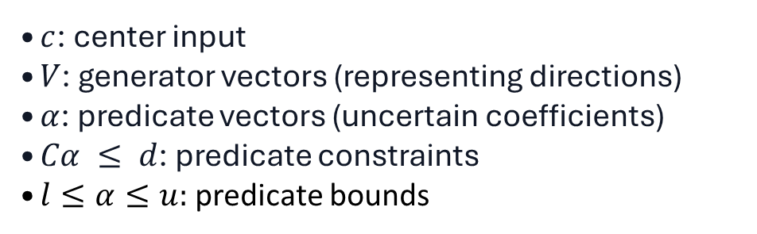
CORE ABSTRACTION
Star set: compact representation of infinitely many inputs
$$S = \left\{ x = c + Vα \right| P(α)\}$$
$P\left(α\right)≔Cα ≤ d∧l≤α≤u$
$c$: center input
$V$: generator vectors (representing directions)
$α$: predicate vectors (uncertain coefficients)
$Cα ≤ d$: predicate constraints
$l≤α≤u:$ predicate bounds
$$S=\left\{ \left.x=\left[\begin{matrix}0 \\ 0\end{matrix}\right]+\left[\begin{matrix}1.7 \\ 0\end{matrix}\right]v_{1}+\left[\begin{matrix}−0.35 \\ 1.05\end{matrix}\right]v_{2} \right| \left[\begin{matrix}−1.2 \\ −1.2\end{matrix}\right]≤α≤\left[\begin{matrix}1.5 \\ 1.5\end{matrix}\right] \right\}$$
Geometric meaning: one symbolic object represents a full polytope of possible inputs.
StarV qualitative verification tutorial

Slide 9
SCALING PERCEPTION NETWORKS
From Star to ImageStar to SparseImageStar
Star
ImageStar
SparseImageStar
Vector networks
FNN / ACASXu
Image-shaped sets
CNN robustness
Sparse generator dataset
large CNN / segmentation
Why sparse?
CNN feature maps create huge intermediate symbolic states.
Dense generators can cause memory exhaustion for high-dimensional inputs and large neural networks.
SparseImageStar keeps reachability feasible for larger perception models.
StarV qualitative verification tutorial

Slide 10
WORKFLOW
StarV verification pipeline
1. Load model
ONNX / MATLAB / Pytorch network
2. Create input set
Star, ImageStar, SparseImageStar
3. Define property
safety or robustness inequalities
6. Visualize bounds, counterexamples, robust regions
5. Check result
SAFE/ROBUST, UNSAFE/UNROBUST, UNKNOWN
4. Reachability
propagate sets through layers
StarV qualitative verification tutorial

Slide 11
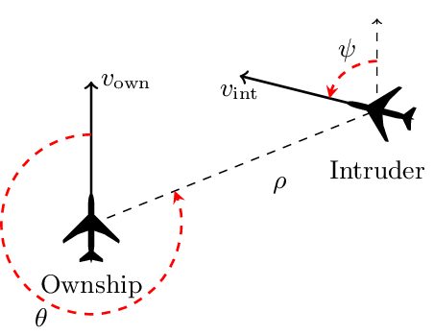
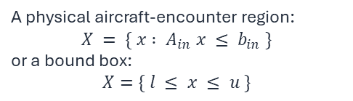
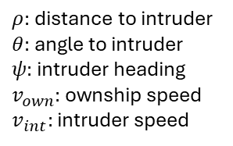
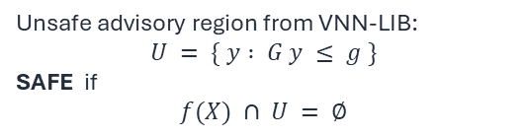
FNN DEMO
Demo 1: FNN control network — ACASXu
Safety verification over a convex operating region, not image-style perturbation.
Network
Input set
Output property
ACASXU_FFNN_1_1 5 inputs → 5 advisory scores 13 StarV layers: FC/ReLU alternation
A physical aircraft-encounter region: $$X = \{ x : A_{in} x ≤ b_{in} \}$$ or a bound box:
$$X=\{ l ≤ x ≤ u \}$$
Unsafe advisory region from VNN-LIB: $$U = \{ y : G y ≤ g \}$$ SAFE if
$$f(X) ∩ U = ∅$$
net_id = (1, 1) spec_id = 1
net, lb, ub, unsafe_mat, unsafe_vec = load_ACASXU(*net_id, spec_id)
X = Star(lb, ub)
State variables
$ρ:$distance to intruder $θ:$angle to intruder $ψ:$intruder heading $v_{own}:$ownship speed $v_{int}:$intruder speed
StarV qualitative verification tutorial
15

Slide 12
FNN DEMO
Approximate BFS vs. Exact BFS
Both methods propagate the Star input set through the same FNN, then test intersection with the unsafe output set.
Approximate BFS
Exact BFS
One over-approximated output Star. Fast, but unsafe overlap can produce UNKNOWN.
Splits ReLU ambiguity exactly. More precise, but can generate many Star sets.
output_set, unsafe_output_set, result = qualiVerifyApproxBFS( net, X, unsafe_mat, unsafe_vec, lp_solver='gurobi' )
output_set, unsafe_output_set, cex_sets, result = qualiVerifyExactBFS( net, [X], unsafe_mat, unsafe_vec, lp_solver='gurobi' )
Interpretation rule
Approximate UNKNOWN means the over-approximation intersects the unsafe region.
Exact UNSAT for every generated output Star proves safety for the given input set.
Do not interpret UNKNOWN as unsafe or safe.
StarV qualitative verification tutorial
16

Slide 13
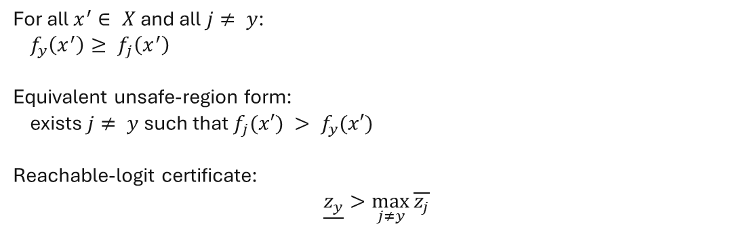
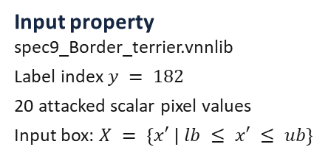

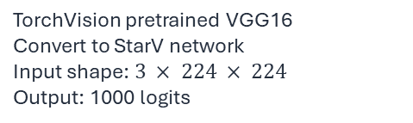
CNN DEMO
Demo 2: VGG16 robustness verification — fill the output property
ImageNet classifier, VNN-LIB perturbation property, ImageStar/SparseImageStar input sets.
Model
TorchVision pretrained VGG16 → StarV network
Input shape: 224 × 224 × 3
Output: 1000 ImageNet logits
Output property: classification robustness
For all $x^{′}∈ X$and all $j≠ y$:
$f_{y}\left(x^{′}\right)≥ f_{j}\left(x^{′}\right)$
Equivalent unsafe-region form:
exists $j≠ y$such that $f_{j}(x′) > f_{y}(x′)$
Reachable-logit certificate:
$$\underline{z_{y}}>\max_{j≠y}{\overline{z_{j}}}$$
TorchVision pretrained VGG16 Convert to StarV network Input shape: $3 × 224 × 224$ Output: 1000 logits
spec9_Border_terrier.vnnlib ImageNet label index: 182 20 attacked scalar pixel values
The robust input set is
$$X_{rob}=\{ x: {\left\|x−x_{0}\right\|}_{∞}≤ε \}$$
Input property
spec9_Border_terrier.vnnlib
Label index $y = 182$
20 attacked scalar pixel values
Input box: $X = \{x′ | lb ≤ x′ ≤ ub\}$
Demo certificate: 29.77 > 17.44, margin = 12.34 → ROBUST
Interpretation: every admissible image in the VNN-LIB input box remains classified as Border terrier.
result = certifyRobustness(
net=net, inputs=input_set, labels=182,
reachability_method='approx', lp_solver='gurobi')
StarV qualitative verification tutorial
17
Notes:
an admissible image is any image that satisfies all those pixel-wise constraints.

Slide 14
CNN DEMO
Input-set representations and robustness call
The same VNN-LIB input box is represented as ImageStar, SparseImageStar COO, and SparseImageStar CSR.
What changes across runs?
input_sets = { 'ImageStar': ImageStar(lb, ub), 'SparseImageStar2DCSR': SparseImageStar2DCSR(lb, ub), 'SparseImageStar2DCOO': SparseImageStar2DCOO(lb, ub), } for set_name, input_set in input_sets.items(): result, reach_time, total_time, output_set = certifyRobustness( net=net, inputs=input_set, labels=label, reachability_method='approx', lp_solver='gurobi' )
Only the set representation changes. The network, property, label, and solver remain fixed.
Why show all three?
It makes the memory/scalability story concrete: ImageStar is simple; sparse variants target large inputs and deep network with large number of perturbations.
StarV qualitative verification tutorial
19

Slide 15
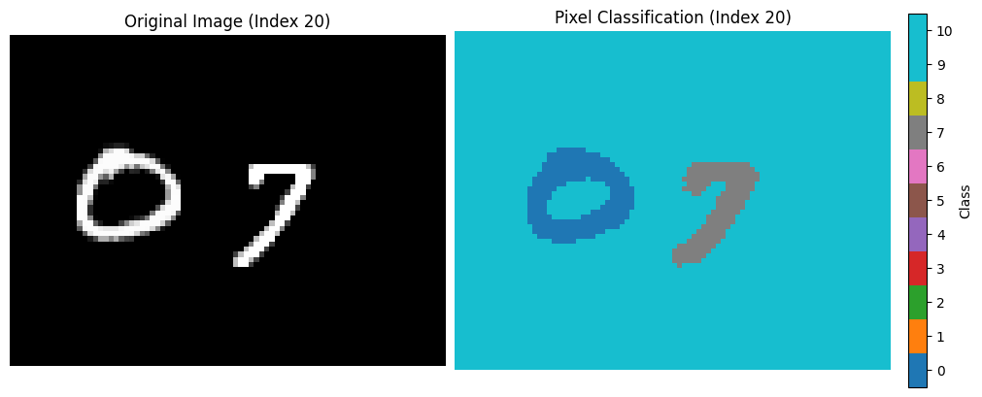

SNN DEMO
Demo 3: M2NIST semantic segmentation robustness verification
A pixel-wise segmentation network under a bounded darkening attack.
Model and data
Network: m2nist_75iou_transposedcnn_avgpool
Image size: 64 × 84 × 1
Classes: 0–9 digits, 10 background
Output: one class logit vector per pixel
Pixel-wise robustness property
For each pixel $p=(i,j),$nominal class $y_{p}$:
For all $x^{′}∈ X$and all $c≠y_{p}$:
$f{\left(x^{′}\right)}_{p,y_{p}}≥ f{\left(x^{′}\right)}_{p, c}$
This produces a map of robust / unknown / non-robust pixels, not one scalar answer for the whole image.
results = certifyRobustness_pixel(net, input_set, in_datas,
num_classes, veriMethod, reachMethod, lp_solver)
Input set
Attack: UBAA darkening
image_index = 20
num_max_pixels_attack = 25
threshold d = 150, delta = 0.0
Set types: ImageStar, SparseImageStar CSR/COO
StarV qualitative verification tutorial
21

Slide 16
CHALLENGES
Why qualitative verification is hard
High dimension
Images and feature maps create millions of symbolic variables.
ReLU ambiguity
Uncertain neurons require splitting for exactness or relaxation for scalability.
Accumulated over-approximation
Layer-by-layer abstraction errors grow with network depth.
Memory explosion
Dense generators become infeasible for large inputs and deep CNNs.
Complex layer semantics
very layer must be propagated soundly; unsupported operations require conservative abstractions or cannot be verified.
ReLU case split intuition
$z = max⁡(0, x):$if x can be negative or positive, the verifier must split or over-approximate.
StarV qualitative verification tutorial

Slide 17
CLOSE
Summary and transition
Three takeaways
1
Verification reasons about sets,
not sampled points.
2
FNN, CNN, and segmentation verification use the same pipeline: input set → network → property → reachable set → decision.
3
Scalability requires tradeoffs:
exact vs approximate reachability,
dense vs sparse set representations.
Transition to quantitative verification
Qualitative verification asks whether a violation exists. Quantitative verification asks how likely violations are under uncertainty.
StarV qualitative verification tutorial
Notes:
Summary and transition
Three takeaways
1 Verification reasons about sets, not samples. A result is a formal statement over infinitely many inputs in the specified input set.
2 The same verification pipeline applies across FNNs, CNNs, and segmentation networks. What changes is the input representation, output property, and visualization.
3 Scalability requires controlled approximation and memory-efficient set representations. Exact methods are precise but expensive; sparse representations make large perception models more feasible.
Transition to quantitative verification
Qualitative verification asks: Can any violation occur?
Quantitative verification asks: How likely is a violation under uncertainty?

