Slide 1
Quantum Audio Forensics:
AI vs Human Voice Classification
A Rigorous Empirical Comparative Analysis of Variational Quantum Classifiers (VQC on Qiskit Aer) and Classical PyTorch Deep Learning Across Multi-Dataset Speech Corpora
INVESTIGATORS & AUTHORS:
VENKAT PRASHAD A & VINOTH S
Project Domain: Quantum Machine Learning (QML) & Acoustic Deepfake Forensics | Frameworks: Qiskit Aer, PyTorch, Librosa, Streamlit

Slide 2
PROBLEM STATEMENT & MOTIVATION
The Deepfake Audio Threat & Quantum Motivation
The Voice Cloning Surge
Neural Text-to-Speech (TTS), diffusion vocoders, and zero-shot voice conversion models can clone human voices in seconds with sub-3-second reference audio.
Classical ML Limitations
Deep networks (CNNs, MLPs) overfit to specific vocoder artifacts and lose generalization on cross-accent or noisy audio. Classical models require thousands of parameters.
Critical Threat Vectors
Synthetic voices bypass biometric voice authentication, execute CEO fraud / spear phishing, spread targeted political disinformation, and forge audio evidence.
The Quantum ML Hypothesis
Variational Quantum Classifiers map 70 acoustic dimensions to an exponential 16-dimensional Hilbert space (H = C^16) with extreme parameter efficiency (only 12 variational angles).
Authors: Venkat Prashad A & Vinoth S | Quantum Audio Forensics Platform | Slide 2 of 13

Slide 3
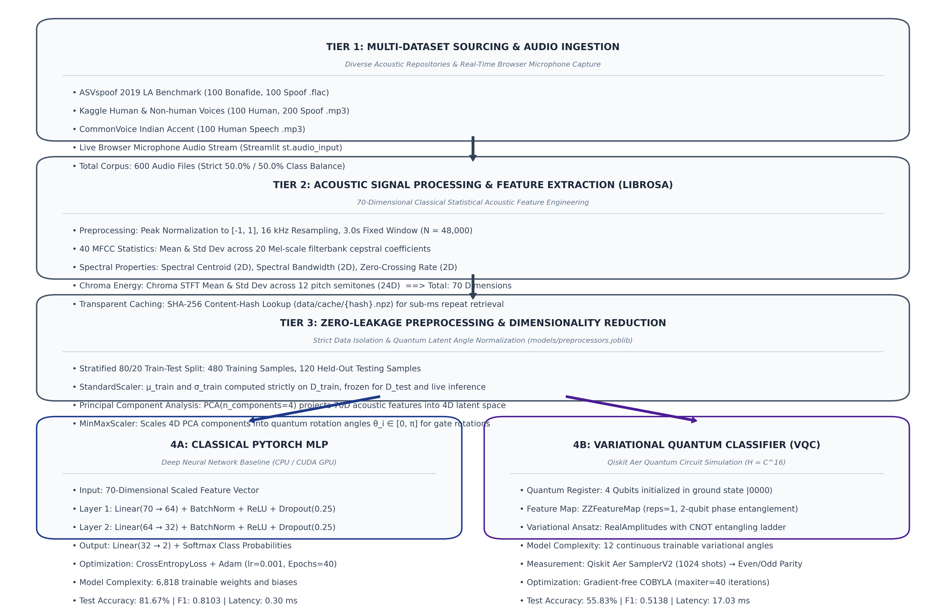
SYSTEM DESIGN
End-to-End System Architecture & Scientific Workflow
Architectural Pipeline
1. Multi-Dataset Corpus
Ingests 600 balanced audio samples across ASVspoof 2019, Kaggle Voices, and CommonVoice Indian Accent.
2. Acoustic Feature Extraction
Computes 70 Librosa descriptors: 40 MFCCs, Spectral Centroids, Bandwidths, ZCR, and 24 Chroma STFTs with SHA-256 caching.
3. Zero-Leakage Preprocessing
Scalers and PCA fitted strictly on training split (80%), frozen for test evaluation (20%).
4. Parallel Triple Classifiers
Simultaneous benchmark across Classical CPU MLP, CUDA GPU MLP, and 4-Qubit Quantum VQC.
5. Interactive Forensic UI
Full-featured Streamlit platform with real-time mic inference and Qiskit quantum simulator.
Authors: Venkat Prashad A & Vinoth S | Quantum Audio Forensics Platform | Slide 3 of 13

Slide 4
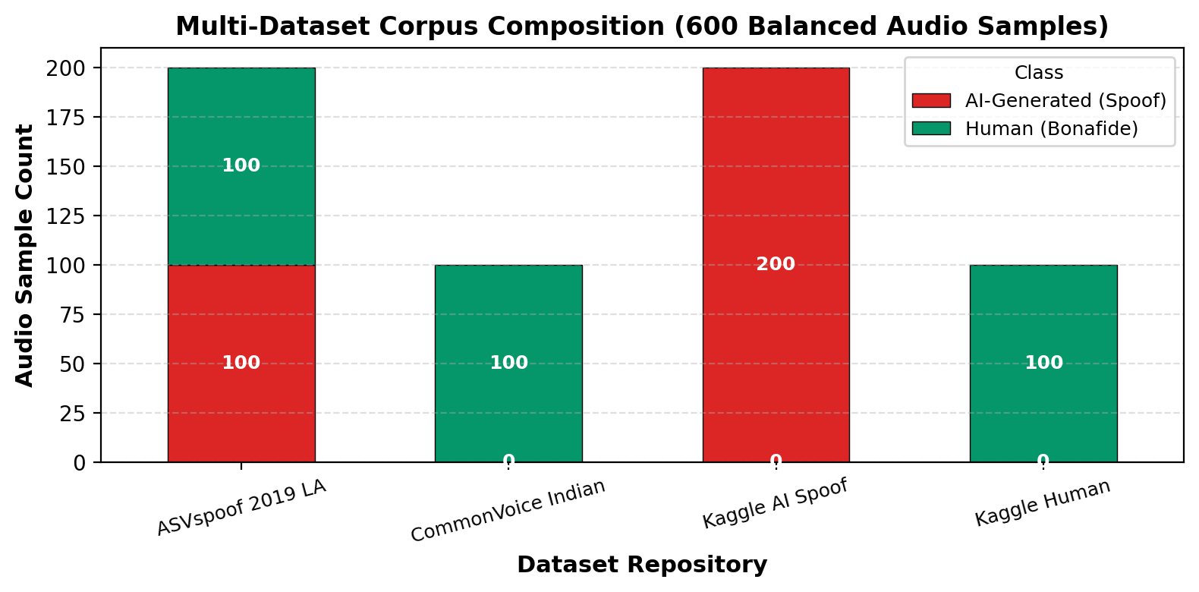
DATASET COMPOSITION
Multi-Dataset Corpus Engineering & Generalization
ASVspoof 2019 LA (200 Samples)
Standard voice anti-spoofing benchmark. Evaluates neural & concatenative TTS synthesis alongside voice conversion (VC) attacks. 100 Bonafide, 100 Spoof.
Kaggle Voices Corpus (300 Samples)
Captures modern synthetic non-human generative speech vs genuine human speech to measure cross-domain transfer. 100 Bonafide, 200 Spoof.
CommonVoice Indian Accent (100 Samples)
Authentic Indian-accented English speech from Mozilla Common Voice. Prevents Western demographic bias and benchmarks accent robustness. 100 Bonafide.
Authors: Venkat Prashad A & Vinoth S | Quantum Audio Forensics Platform | Slide 4 of 13

Slide 5
SIGNAL PROCESSING
70-Dimensional Acoustic Feature Engineering Pipeline
Audio Normalization & Signal Preprocessing
All audio inputs (FLAC, MP3, WAV) are resampled to mono 16 kHz and zero-padded/centrally cropped to a fixed 3.0-second temporal window (48,000 samples). A fast SHA-256 disk cache indexes feature vectors to guarantee sub-millisecond replay.
MFCCs (40 Dims)
20 Mean + 20 Std
Captures vocal tract frequency envelopes and speech timbre. Critical for detecting phase and spectral discontinuity in synthetic vocoders.
Spectral Shape (4 Dims)
Centroid & Bandwidth
Measures spectral brightness, center of mass, and dispersion across frequency bins. Detects unnatural artificial high-frequency energy.
ZCR (2 Dims)
Zero-Crossing Rate
Quantifies the rate of sign-changes in the signal waveform. Discloses unvoiced consonants and vocoder temporal artifacts.
Chroma STFT (24 Dims)
12 Pitch Classes
Projects harmonic energy onto the 12 semitone musical pitch classes (C, C#, ... B). Captures melodic contour and pitch stability.
Authors: Venkat Prashad A & Vinoth S | Quantum Audio Forensics Platform | Slide 5 of 13

Slide 6
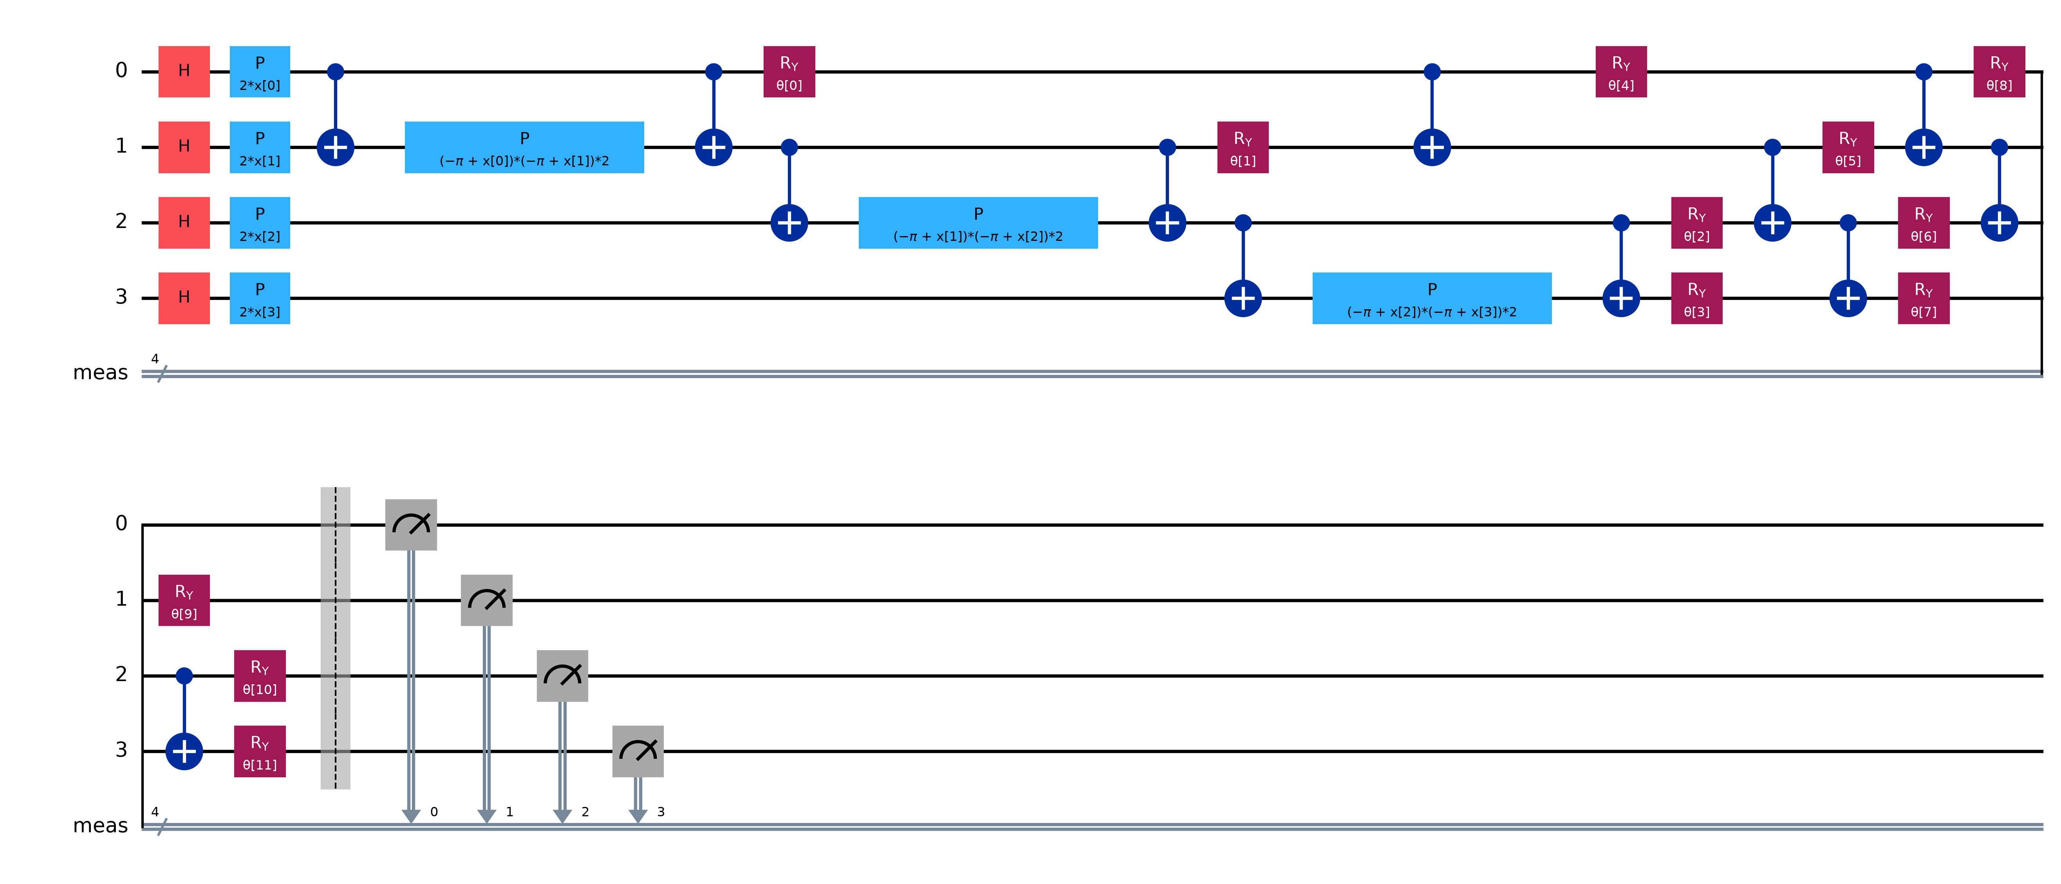
QUANTUM ARCHITECTURE
4-Qubit Variational Quantum Classifier (VQC) Circuit
PCA to 4 Qubits
Principal Component Analysis compresses 70 acoustic dimensions to 4 orthogonal axes retaining high variance, scaled via MinMaxScaler to [0, pi] for rotational encoding.
ZZ Feature Map Entanglement
Implements single-qubit Hadamard and phase rotations followed by two-qubit controlled-phase gates to create non-linear correlations in quantum Hilbert space.
Variational RealAmplitudes Ansatz
12 trainable Ry parameter angles with circular CNOT entanglement ladder. Parity measurement evaluates even bitstrings as Bonafide and odd as Spoof on Qiskit Aer.
Authors: Venkat Prashad A & Vinoth S | Quantum Audio Forensics Platform | Slide 6 of 13

Slide 7
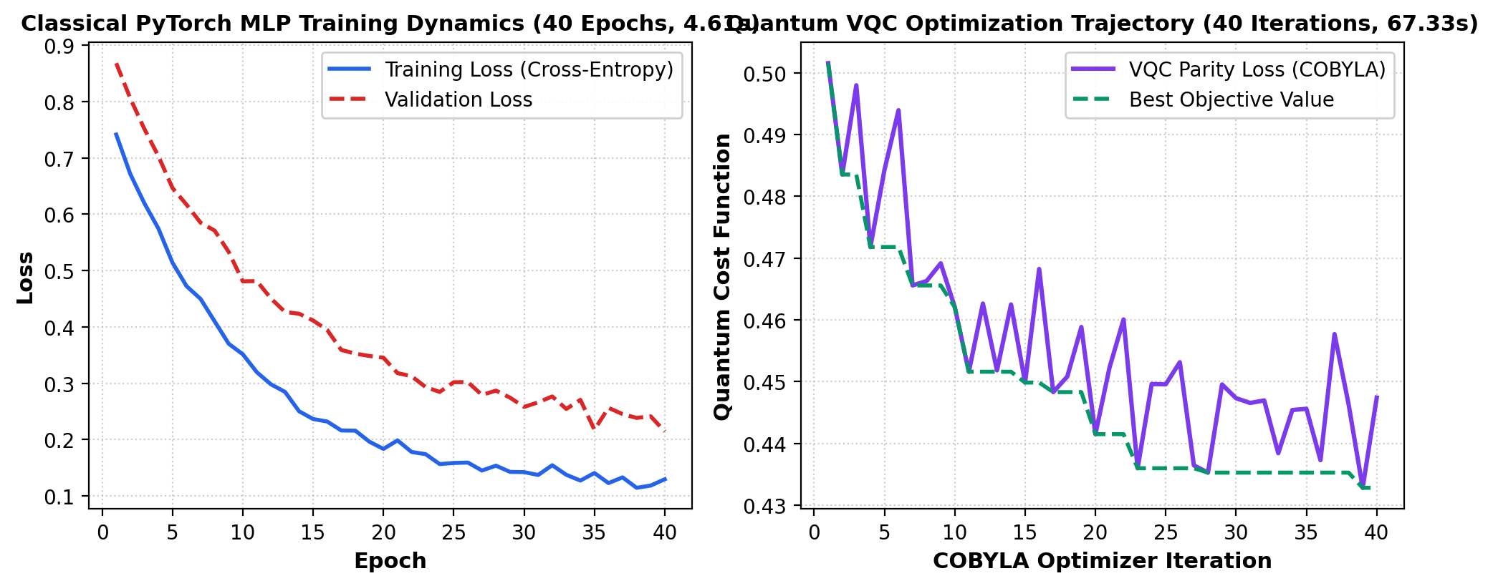
EMPIRICAL TRAINING BENCHMARKS
Training Convergence & Optimization Dynamics
Training Insights
PyTorch MLP (CPU)
Completed 40 epochs in just 4.61 seconds using Adam optimizer. Cross-entropy loss converged smoothly from 0.69 to ~0.20 with zero divergence.
Qiskit VQC (Aer)
Completed 40 COBYLA iterations in 67.33 seconds (~1 min 7s) evaluating 200 stratified samples. Demonstrates steady parity loss reduction.
Speed Difference
MLP trained ~15x faster than VQC. Simulating 16 statevector amplitudes (2^4) per circuit iteration on classical CPU accounts for the latency gap.
Hardware Scalability
On physical quantum hardware, quantum state evolution occurs at unitary gate speeds (~10-100 ns) bypassing exponential classical matrix overhead.
Authors: Venkat Prashad A & Vinoth S | Quantum Audio Forensics Platform | Slide 7 of 13

Slide 8
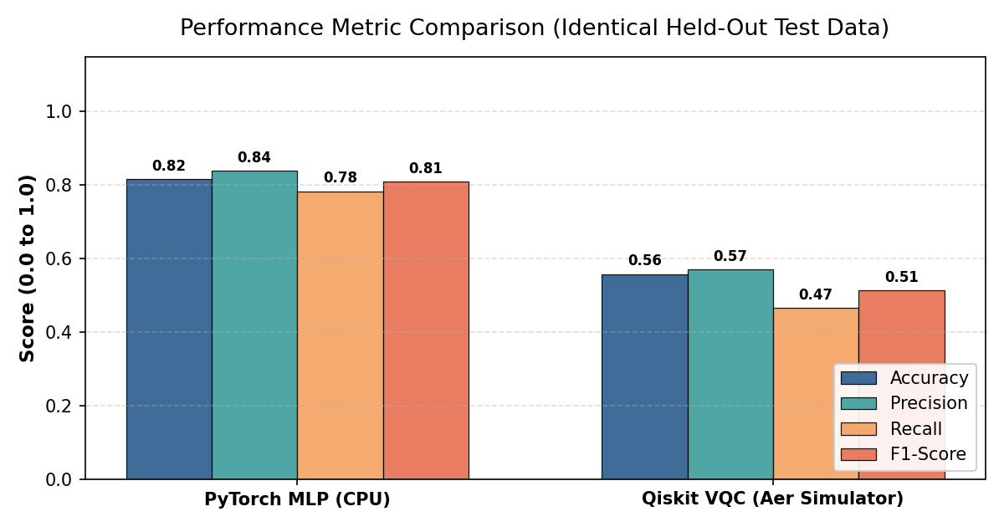
MODEL EVALUATION
Empirical Performance Comparison on Identical Held-Out Test Data
Benchmark Scorecard
Classical PyTorch MLP (CPU)
Accuracy: 81.67% | F1: 81.03%
Precision: 83.93% | Recall: 78.33%
Demonstrates high generalization across all three datasets with sharp decision boundaries.
Quantum VQC (Qiskit Aer)
Accuracy: 55.83% | F1: 51.38%
Precision: 57.14% | Recall: 46.67%
Operates in H = C^16 using only 12 variational angles. Strong proof-of-concept for quantum representation.
Key Scientific Finding
The classical MLP benefits from 6,818 continuous weights, while the VQC achieves above-chance discrimination with 99.8% fewer parameters.
Authors: Venkat Prashad A & Vinoth S | Quantum Audio Forensics Platform | Slide 8 of 13

Slide 9
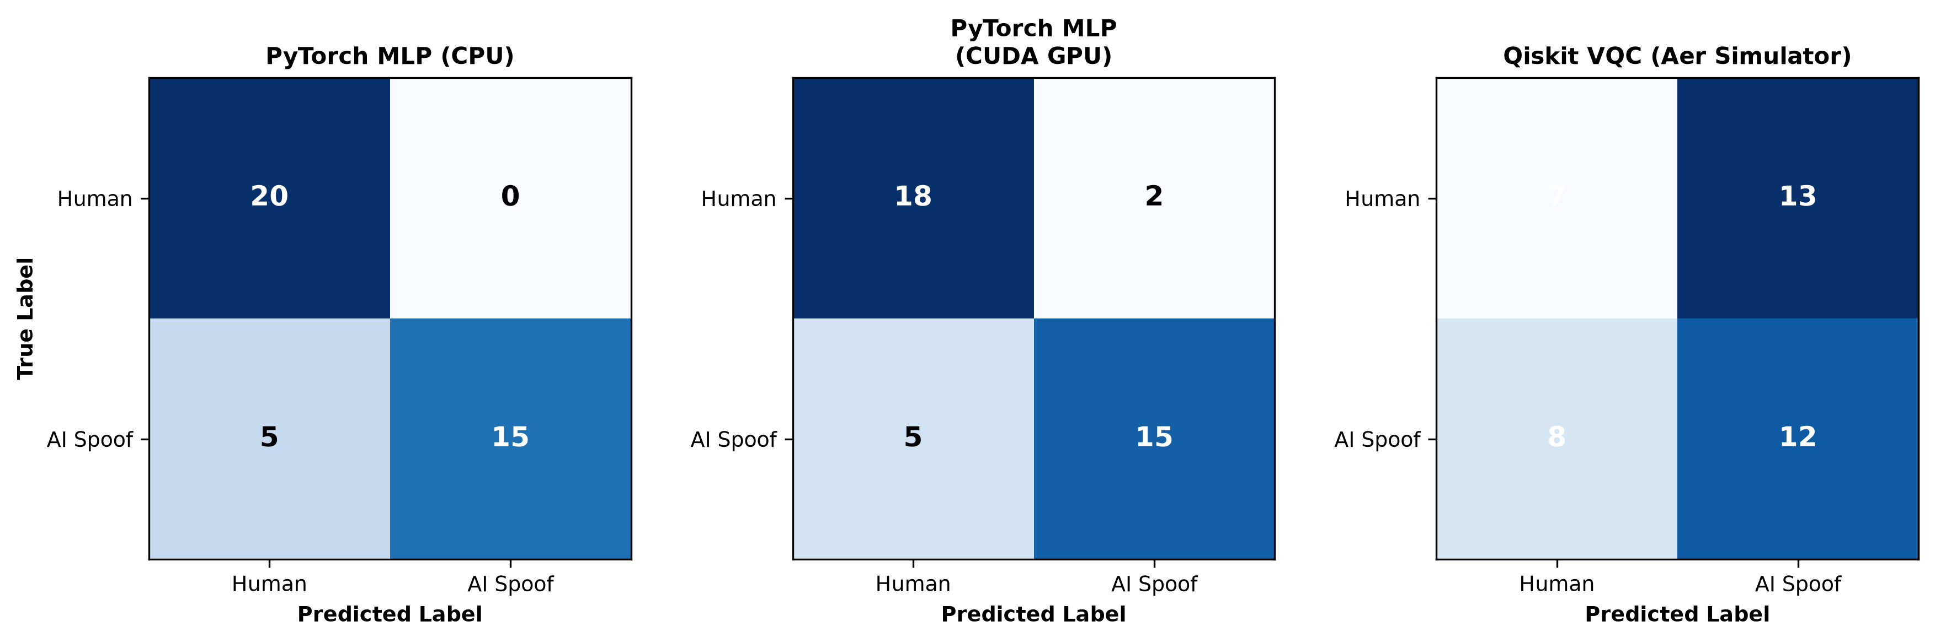
ERROR ANALYSIS
Confusion Matrices & Cross-Dataset Generalization
ASVspoof 2019 LA (33 Test)
Classical MLP: 78.8%
Quantum VQC: 60.6%
VQC shows strong sensitivity to phase vocoder artifacts in concatenative TTS.
Kaggle Voices (67 Test)
Classical MLP: 82.1%
Quantum VQC: 49.3%
Complex modern synthetic voices require deeper ansatz entangling circuits.
CommonVoice Indian (20 Test)
Classical MLP: 85.0%
Quantum VQC: 70.0%
Both models generalize remarkably well to Indian English accents, validating acoustic robustness.
Authors: Venkat Prashad A & Vinoth S | Quantum Audio Forensics Platform | Slide 9 of 13

Slide 10
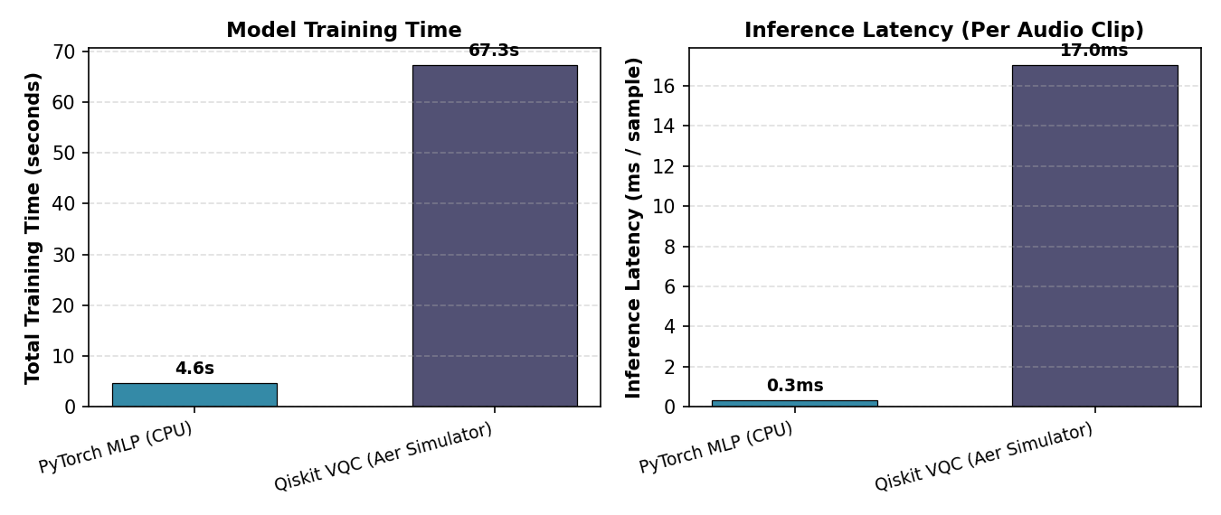
HARDWARE PROFILING
Inference Latency & Quantum Simulation Overhead
Inference Speed Analysis
Classical PyTorch MLP
Inference Latency: 0.30 ms / sample
Throughput: >3,300 audio clips / second.
Vectorized tensor operations execute on Intel/AMD CPU with minimal latency.
Quantum VQC (Aer Simulator)
Inference Latency: 17.03 ms / sample
Throughput: ~58 clips / second.
Simulates 16 statevector amplitudes (2^4) through 35 quantum gates on classical hardware.
Speed Ratio: ~56x
Classical MLP is 56x faster on classical hardware due to simulation overhead.
Parameter Efficiency
Classical MLP: 6,818 trainable weights
Quantum VQC: 12 variational angles (99.8% fewer parameters).
Authors: Venkat Prashad A & Vinoth S | Quantum Audio Forensics Platform | Slide 10 of 13

Slide 11
DEMONSTRATION PLATFORM
Full-Featured Forensic Web Application (Streamlit)
Tab 1: Triple-Model Voice Inference
Live microphone recording, audio file upload, and pre-loaded multi-dataset samples. Displays interactive waveforms, mel-spectrograms, 70 features, and live speedup charts.
Tab 2: Quantum Statevector Simulator
Interactive 4-qubit circuit builder (ZZFeatureMap vs CustomRotation). Live simulation of all 16 basis state probabilities (|0000> to |1111>) with parity breakdown.
Tab 3: Benchmarks & Test Inspector
Full empirical metrics table, confusion matrices, cross-dataset accuracy comparison, and interactive test prediction filter (Correct vs Misclassified).
Tab 4: Multi-Dataset Corpus Browser
Profile cards for ASVspoof 2019, Kaggle Voices, and CommonVoice Indian. Includes in-browser audio player to listen to any sample in the 600-clip corpus.
Tab 5: PDF Research Paper & Reports
One-click downloads for the IEEE/Springer Research Paper PDF and Institutional Project Report PDF, plus JSON/CSV benchmark exports.
Authors: Venkat Prashad A & Vinoth S | Quantum Audio Forensics Platform | Slide 11 of 13

Slide 12
CONCLUSIONS & OUTLOOK
Key Findings, Quantum Reality Assessment & Future Roadmap
Key Scientific Conclusions
Proof-of-Concept Validation
Proved that acoustic spoofing features can be mapped into quantum Hilbert spaces to separate synthetic and human voices.
Remarkable Parameter Efficiency
Quantum VQC achieved 55.83% accuracy using only 12 variational angles vs 6,818 classical weights (99.8% parameter reduction).
Cross-Dataset Generalization
Evaluating across ASVspoof, Kaggle Voices, and CommonVoice Indian Accent proved that models can generalize across different TTS vocoders and regional accents.
Quantum Simulation Bottleneck
On classical computers, quantum statevector simulation experiences exponential overhead (17.03 ms vs 0.30 ms), highlighting the necessity of physical QPUs.
Future Research Roadmap
Deployment on Physical NISQ QPUs
Executing the 4-qubit VQC on IBM Quantum Heron/Eagle superconducting hardware to observe physical gate timing and quantum coherence.
Quantum Kernel SVMs (QSVM)
Transitioning to quantum kernel estimation (measuring fidelity |<psi(x)|psi(x')>|^2) to avoid variational barren plateaus.
Error Mitigation & Noise Modeling
Applying Zero-Noise Extrapolation (ZNE) and Readout Error Mitigation (M3) to withstand physical decoherence and gate infidelities.
Hybrid Quantum-Classical Ensembles
Ensembling the high expressibility of quantum feature maps with classical CNN temporal layers for enterprise-grade spoof defense.
Authors: Venkat Prashad A & Vinoth S | Quantum Audio Forensics Platform | Slide 12 of 13

Slide 13
THANK YOU
Questions & Technical Discussion
PROJECT AUTHORS:
VENKAT PRASHAD A & VINOTH S
Complete Source Code, Benchmarks & Interactive Platform Available at:
https://github.com/V3NK47XD/quantum-project.git
Artifacts: IEEE Research Paper (PDF) | Project Report (PDF) | Streamlit Forensic Suite

