Slide 1
TIMELEAK
PROJECT SYNOPSIS PRESENTATION
TimeLeak
A Side-Channel Timing & Response-Size Leakage Detector for Web Authentication Forms
SUBMITTED BY
UNDER SUPERVISION OF
DEPARTMENT
Vernit Singh Rana [Roll No.: __________]
[Name of Guide], [Designation]
Computer Science & Technology
Dr. Akhilesh Das Gupta Institute of Professional Studies · Department of CST · August 2026
Notes:
Introduce yourself, the project title, and thank the panel for their time. TimeLeak is a two-part minor project: a deliberately vulnerable demo app and a statistical detector that finds CWE-203 side-channel leaks in authentication endpoints.

Slide 2
TIMELEAK
What We'll Cover
1
Abstract
6
Methodology & Architecture
2
Introduction
7
Implementation Stack
3
Motivation
8
Results (real evaluation data)
4
Problem Statement & Objectives
9
Project Scope & Future Work
5
Feasibility Study
2
Notes:
Quick roadmap. Nine stops, mirroring the synopsis document's required sections, ending with real evaluation results rather than projected ones since the prototype is already built and tested.

Slide 3
TIMELEAK
The Problem: CWE-203 (Observable Discrepancy)
A server can leak which usernames exist — without ever revealing a password — simply by responding even slightly differently for a valid vs. an invalid account.
Client
Server
alice (valid)
~80 ms
MITRE CWE-203: “Observable Discrepancy”
notauser (invalid)
No password guessing required
~15 ms
Fuels credential stuffing & phishing
Most scanners flag it heuristically, with no statistical confidence
Same request shape. Different internal codepath (bcrypt runs only when the user exists). The timing gap alone reveals the answer.
3
Notes:
This is literally what /login/v1 in the demo app does. bcrypt.checkpw only runs on the 'user exists' path, so it costs real CPU time. That's the whole vulnerability in one diagram.

Slide 4
TIMELEAK
Why This Matters
1
Enumeration fuels bigger attacks
A confirmed list of valid accounts makes credential stuffing, password spraying, and targeted phishing dramatically more efficient.
2
Developers patch the obvious leak, miss the subtle one
An explicit “user not found” message gets fixed; a 65ms timing gap or a 158-byte size difference usually doesn't.
3
No lightweight, statistically rigorous tool existed
Scanners like Burp/ZAP offer heuristic checks with no p-value, no effect size, no stated confidence.
4
Notes:
Three-part motivation: the downstream risk, the blind spot developers leave, and the tooling gap this project fills.

Slide 5
TIMELEAK
Problem Statement & Objectives
PROBLEM STATEMENT
Authentication endpoints can leak account existence via timing / size discrepancies (CWE-203) — no free, statistically rigorous tool exists to reproduce and detect this hands-on.
SMART OBJECTIVES
01
02
03
04
Vulnerable demo app
Statistical detector
Evaluation experiments
Interactive reporting
3 leak variants + 1 patched control, runnable in < 5 minutes
Welch's t-test + Mann-Whitney U + Cohen's d, α = 0.05, 0 false positives / 10 runs
Quantify minimum detectable gap & minimum sample size
Self-contained HTML reports + a documented CLI (scan / experiment / index)
5
Notes:
Four SMART objectives, each already met by the working prototype — this isn't purely prospective, it's been built and tested.

Slide 6
TIMELEAK
Two Components, One HTTP Boundary
demo-app
detector
Flask + SQLite target application
Python CLI — treats any endpoint as a black box
POST /login/v1 — timing leak
HTTP / JSON
harness.py — interleaved sampling
POST /login/v2 — response-size leak
analysis.py — statistical verdict
POST /login/v3 — patched control
report.py — interactive HTML report
POST /signup — enumeration leak
main.py — scan / experiment / index
This separation means the detector isn't limited to the bundled demo — it can scan any authenticated endpoint you have permission to test.
6
Notes:
Explain the deliberate architectural split — target and detector only ever talk over plain HTTP, so the detector generalizes beyond the demo.

Slide 7
TIMELEAK
Development Methodology
Demo
App
Request
Harness
Statistical
Analysis
HTML
Report
Evaluation
Experiments
Unified
CLI
Docs &
Synopsis
Iterative, phase-based: each stage was tested against the live demo app before moving to the next. All seven phases are complete and validated against real scan data.
Requirement analysis → System design → Technology selection → Module dev → DB/API integration → Testing & validation → Deployment
7
Notes:
Walk left to right. Emphasize that this was validated incrementally, not built all at once and tested at the end.

Slide 8
TIMELEAK
How a Verdict Is Reached
Interleaved Sampling
Valid, invalid, valid, invalid… never two separate batches — cancels out network jitter and warm-up drift equally on both groups.
Welch's t-test
Compares group means without assuming equal variance. Sensitive to outliers.
Mann-Whitney U
Compares full distributions, not just means — robust to non-normal timing data. The primary test.
Cohen's d
Effect size: is the difference practically meaningful, not just statistically detectable? d < 0.2 is ignored even if p is tiny.
Verdict = LEAK only if Welch AND Mann-Whitney both fall below α = 0.05, AND the effect size is non-negligible.
8
Notes:
The dual-test-agreement rule matters: in our own precision test, Mann-Whitney alone dipped under 0.05 once by chance, but Welch didn't agree, so no false positive was raised.

Slide 9
TIMELEAK
Feasibility
Technical
Economic
Mature, free, cross-platform stack (Python, Flask, SQLite, NumPy, SciPy). Already implemented and validated end-to-end.
Zero licensing cost. Runs locally by default; optional demo deployment on Render.com's free tier.
Operational
Schedule
Two-command setup. Self-contained HTML output — no server or extra software needed to view results.
Fits one semester. As of this synopsis, all core phases are complete and exercised against real data.
9
Notes:
Four feasibility angles, each backed by something already true today, not just projected.

Slide 10
TIMELEAK
Implementation Stack
TARGET APP
Python 3.11+
Flask
SQLite
bcrypt
Gunicorn
DETECTOR
requests
NumPy
SciPy
Matplotlib
argparse
REPORTING & TOOLING
HTML5 / CSS3 / JS
Inline SVG
Git & GitHub
venv
No paid services, cloud databases, or proprietary SDKs anywhere in the stack — total cost of ownership: zero.
10
Notes:
Every dependency is open-source and free; that's a deliberate design choice, not an accident.

Slide 11
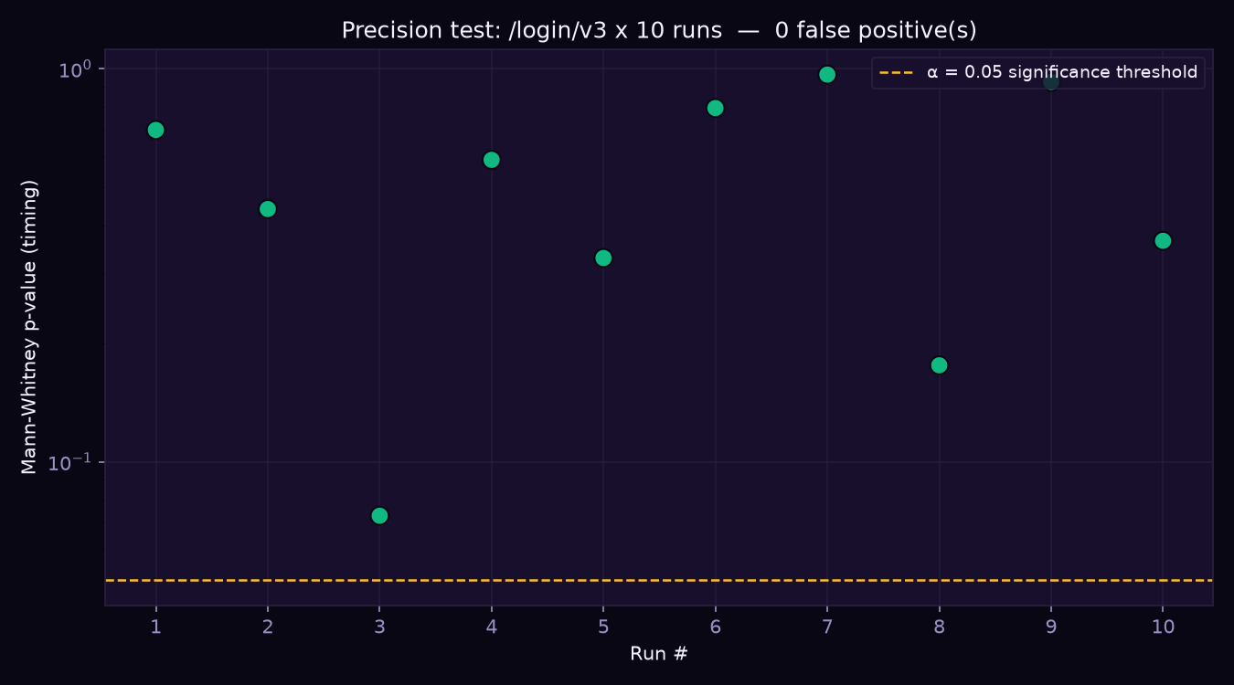
TIMELEAK
Results — Precision Test
Real data from this project's own evaluation run
0 / 10
false positives
10 repeated scans against the patched control (/login/v3). Every run correctly reported no leak — including one where Mann-Whitney alone dipped to p = 0.026, caught by the dual-test-agreement rule.
11
Notes:
Chart: each dot is one full scan's p-value. Green = correctly reported no leak. The dashed line is the α=0.05 threshold — every run stayed clear of it in the final combined verdict.

Slide 12
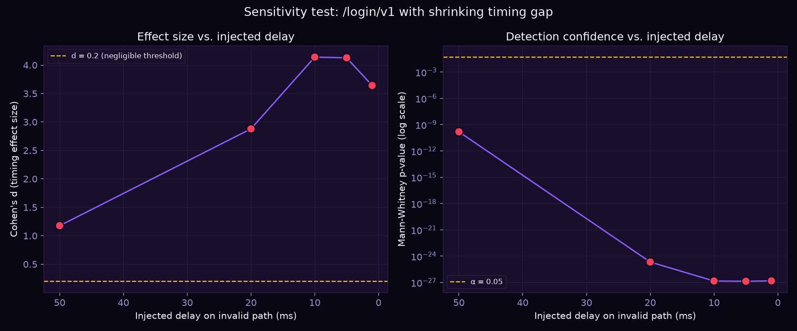
TIMELEAK
Results — Sensitivity Test
How small a leak can TimeLeak still catch?
~5 ms
5/5
smallest gap still detected
injected delays all caught
12
Notes:
We artificially padded the fast path with ?inject_delay_ms= to shrink the real timing gap. Even at 50ms of padding — reducing the real gap to ~5ms — the detector still caught it with a large effect size.

Slide 13
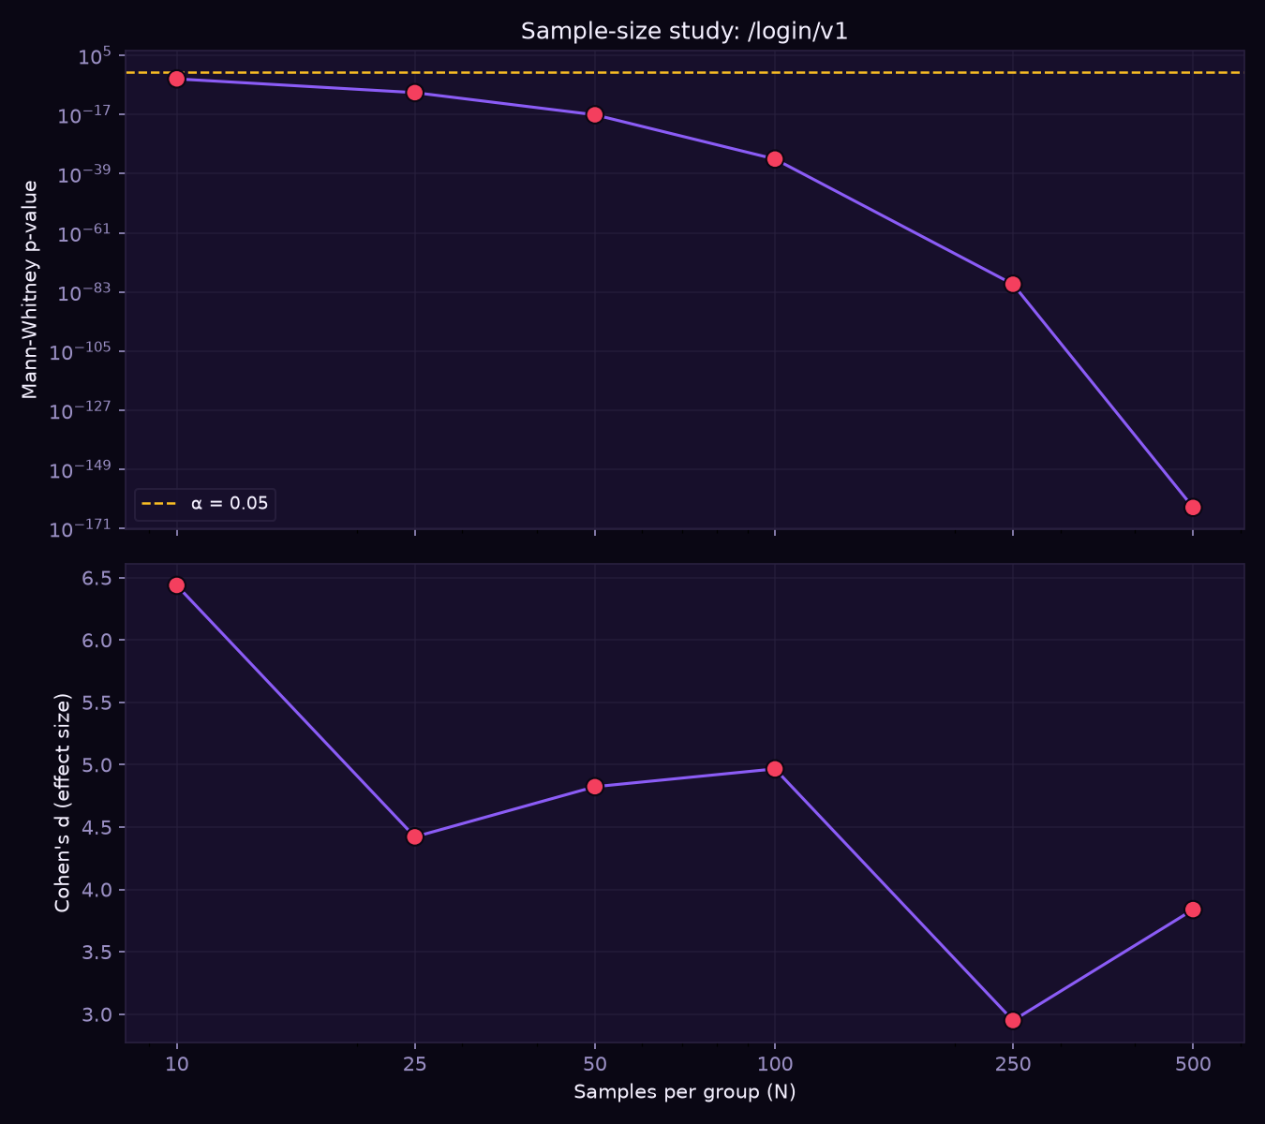
TIMELEAK
Results — Sample-Size Study
How many requests does a confident verdict need?
N = 10
samples per group is already enough
Tested N = 10, 25, 50, 100, 250, 500 against the timing-leak endpoint — every size reported a high-confidence leak. The vulnerability here is large enough that more samples mainly sharpen the p-value, not the verdict.
13
Notes:
Top panel: p-value collapses toward zero as N grows (log scale). Bottom panel: effect size stays large and roughly stable across every tested N — it's not an artifact of sample size.

Slide 14
TIMELEAK
Project Scope & Future Work
SCOPE TODAY
WHAT'S NEXT
Target users: students, junior devs, small teams
Password-reset & OTP-verification flows
Pre-deployment review of login / signup flows
Authenticated / session-based endpoints
Hands-on teaching aid for security courses
CI/CD integration — fail a build automatically
Regression check after a fix — statistical, not “looks fine”
Browser extension for live discrepancy warnings
14
Notes:
Close the scope discussion by separating what's already delivered from what's genuinely future work, so the panel sees a clear line between the two.

Slide 15
TIMELEAK
Thank You
Questions & Discussion
TimeLeak — a statistically rigorous side-channel detector for CWE-203, built, tested, and evaluated end-to-end.
Vernit Singh Rana · B.Tech CST · Dr. Akhilesh Das Gupta Institute of Professional Studies
Notes:
Invite questions. Have the live demo (localhost:5000 + a generated report) ready in case the panel wants to see it run.

