Slide 1
Sales Analysis and Reporting for a Retail Chain
Vaishnavi Desale
Bsc Computer Science – 3rd Year
Kavayitri Bahinabai Chaudhari North Maharashtra University, Jalgaon
Internship Studio
Submission Date: 06 January 2026

Slide 2
Project Overview
Calculate revenue and key metrics
Analysis Performed on 125,000 Retail Transactions Using SQL, Python and Excel.
Identify sales trends over time
Visualize trends with charts and dashboards
Summarize results for business insights

Slide 3
Data Source
Dataset: Retail Transaction Data From Kaggle
Fields: TransactionID, TransactionTime, ItemCode, ItemDescription, NumberOfItemsPurchased, CostPerItem, Country
Dataset link: https://www.kaggle.com/regivm/retailtransactiondata

Slide 4
Phase 1: Data Collection & Database Setup
Data Collection: Downloaded CSV from Kaggle
Database Used: MySQL
Database schema created and tables set up
Designed relational tables for transactions and customer responses
Imported large CSV files into MySQL using secure-file configuration
Data imported from CSV into database

Slide 5
Phase 2: Data Cleaning & Preparation
Tools Used: SQL (MySQL), Python (Pandas), Excel
Removed missing and inconsistent data
Corrected data types and handled outliers
Added calculated fields (total sales) and month/year fields
Removed 31 missing records using dropna()
Converted date fields to datetime format
Created Month and Month-Year features
Validated data types and ranges using describe()
Checked outliers using Z-score (no extreme outliers found)

Slide 6
Phase 3: Data Analysis
1 Descriptive & Sales Analysis
Monthly sales aggregation using groupby()
Top 3 highest revenue months:
  February
  October
  January
Peak monthly sales ≈ 726,775

Slide 7
2 Customer Analysis
Top customers by number of transactions:
CS4424, CS4320, CS3799
Top customers by total sales value:
  CS4424 ≈ 2933
  CS4320 ≈ 2647

Slide 8
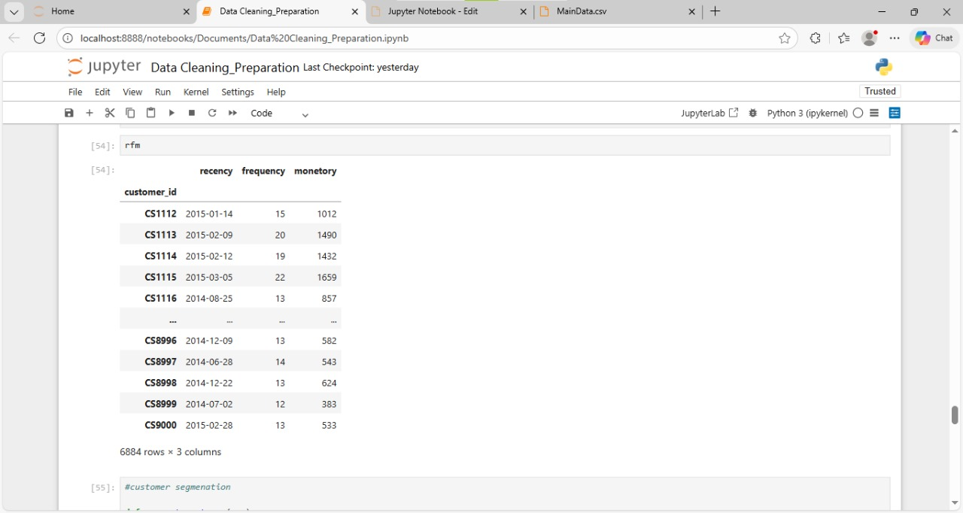
Advanced Analytics
Performed RFM (Recency, Frequency, Monetary) customer segmentation.
RFM analysis helps identify loyal and high-value customers for focused business decision.

Slide 9
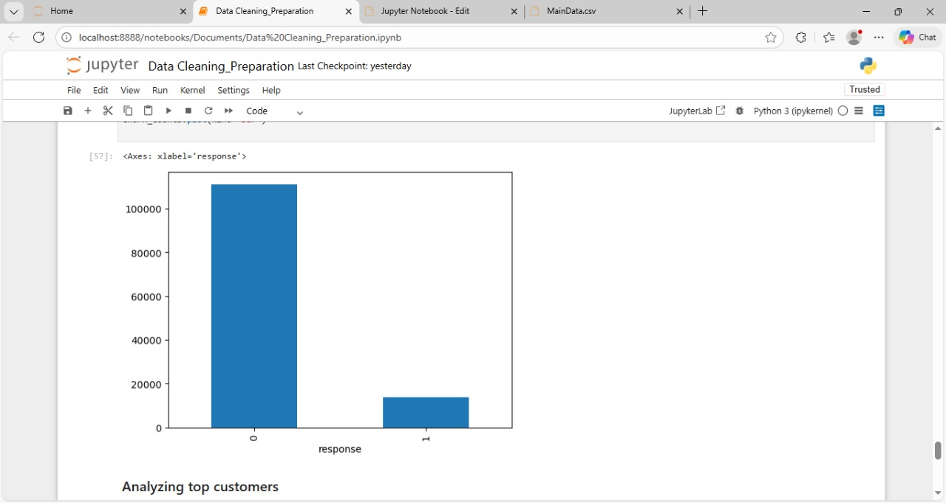
Identified high-value (P0) and low-value (P2) customer groups
Conducted churn analysis using response variable (0 = inactive, 1 = active)

Slide 10
Phase 4: Reporting
Excel summary tables
Excel dashboard with charts & KPIs
Python-generated charts included
All analysis results compiled

Slide 11
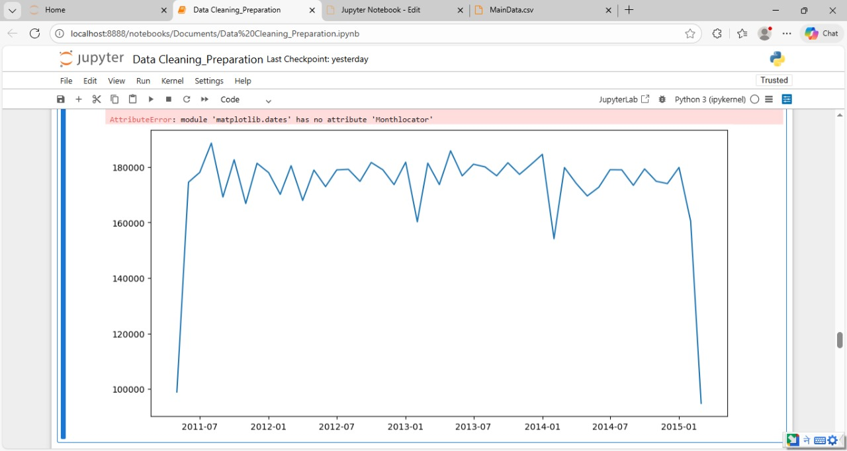
Key Findings
Highest sales months: February, October, January
Peak monthly revenue ≈ 726,775
Sales show seasonal variation over time
The line chart highlights seasonal sales patterns with consistent peaks in specific month

Slide 12
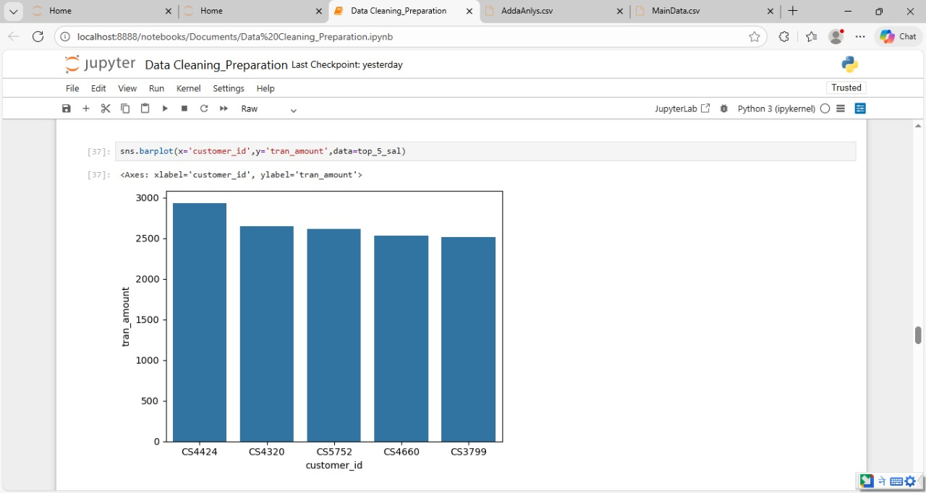
Customer CS4424 generated the highest revenue
Few customers contribute significantly to total sales
A small group of customers contributes a disproportionately high share of revenue

Slide 13
Conclusion
The project demonstrates end-to-end data analytics workflow
Combines SQL, Python, and Excel for business decision- making
Scalable framework applicable to future retail datasets

Slide 14
Thank You
Vaishnavi Desale
North Maharastrian University
Email: vaishnavidesale421@gmail.com

