Slide 1
COUNCILO
A STUDENT’S Councilor

Slide 2
THE PURPOSE
THE PURPOSE BEHIND THE PROJECT IS TO CREATE CAREER AWARENESS AMONG THE INDIAN YOUTH SO THAT THEY CAN OPT FOR THE BEST CAREER AND CAN HAVE A WONDERFUL FUTURE.
WHEN I WAS GOING IN CLASS 11 THERE WAS CONFUSION AMONG MY PEER GROUP ABOUT WHICH STREAM SHOULD THEY ACTUALLY OPT FOR THEN THE IDEA STRUCK TO ME AND THEN I CAME TO KNOW ABOUT MBTI.
THIS BROUGHT ME AWARENESS FOR CHOICE OF A CAREER VIA APTITUDE TEST. I GENERATED A TEST FOR MYSELF WHICH HELPED ME A LOT TO DECIDE FOR MY STREAM AND THEN THE IDEA FOR MKING OF COUNCILO CAME TO ME.

Slide 3
THE PROBLEM ( WRONG CAREER CHOICE)
WRONG CAREER CHOICE BY THE STUDENTS.
LACK OF CAREER AWARENESS.
SHORTAGE OF CAREER COUNCILORS.
LACK OF PROPER APTITUDE TESTS.

Slide 4
Councilo the solution
Councilo is a software which conducts aptitude test and then provide
Career solution based on a person’s aptitude.
It Uses MBTI Theory to provide results to it’s users.
It provide career solution on the basis of a person’s aptitude.
It provides the name of all the elite and world class institutes providing education in various careers.
It provides all the information about the career it suggests to a person.
It makes a roadmap for a person which is a step-by-step guidance to the person.
It provides motivation to it’s users by providing them the biographies of successful personalities in various sectors.

Slide 5
SCIENTIFIC principle involved
MBTI THEORY

Slide 6
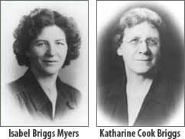
m b t i

Slide 7
explaination of mbti
COUNCILO IS BASED ON THE MYERS-BRIGGS PERSONALITY THEOREM.
PEOPLE ARE DIVIDED INTO 16 UNIQUE PERSONALITY TYPES .
THESE PERSONALITY CODES ARE CALLED MBTI CODES.
THESE ARE UNIQUE FOR A PERSON.
MBTI THEOREM HAS PROVIDED A SET OF JOBS AND CAREER FOR EVERY PERSONALITY TYPE WHICH IS DECIDED VIA THERE APTITUDE.

Slide 8
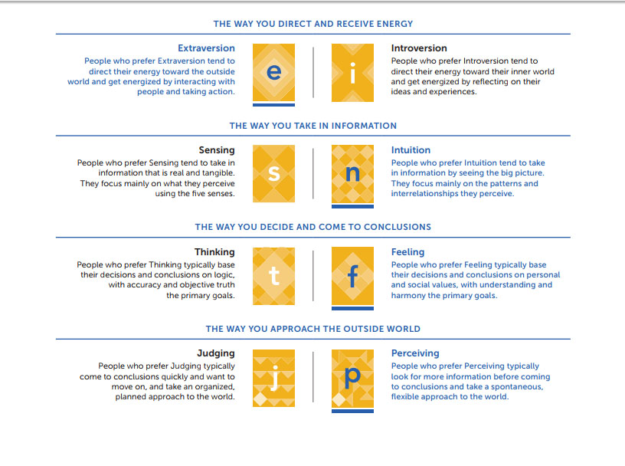
PERSONALITY CODES

Slide 9
Personality codes
MBTI HAS 8 PROPERTIES WHICH HAVE BEEN LISTED IN THE IN THE PREVIOUS SLIDE.
AMONG THIS ONLY 4 PROPERTIES CAN BE INHERITED BY A PERSON AND THEREFORE HE/SHE WILL HAVE UNIQUE PERSONALITY CODE.
THEREFORE 16 UNIQUE CODES ARE POSSIBLE FOR A PERSON WHICH IS USED FURTHER TO PROVIDE CAREER SOLUTION TO THEM.

Slide 10
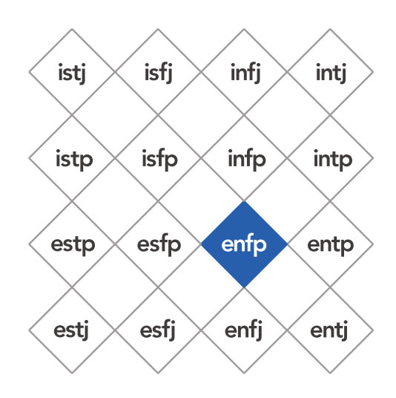
16 personality codes

Slide 11
DEVELOPMENT
COUNCILO HAS BEEN DEVELOPED WITH THE HELP OF VARIOUS TOOLS.
TEXT-EDITOR : SUBLIME TEXT3
FRONT-END SOLUTION: HTML5, CSS3 , JAVASCRIPT, PHP.
BACKEND-SOLUTION: MYSQL.

Slide 12
Working
councilo

Slide 13
Working of councilo
COUNCILO HAS DIVIDED IT’S APTITUDE TEST INTO 4 PARTS.
THE FIRST PART FINDS OUT WHETHER PERSONALITY CODE IS E OR I.
THE SECOND PART FINDS OUT WHETHER PERSONALITY CODE IS S OR N.
THE THIRD PART FINDS OUT WHETHER PERSONALITY CODE IS T OR F.
THE FOURTH PART FINDS OUT WHETHER PERSONALITY CODE IS J OR P.
COMBINING ALL THESE RESULTS IT GENERATES A PERSON’S MBTI CODE .
USING THE MBTI GUIDELINES THE DATA RELATED THE PERSON IS FETCH AND CAREER SOLUTIONS ARE PROVIDED TO HIM.

Slide 14
illustrations
councilo

Slide 16
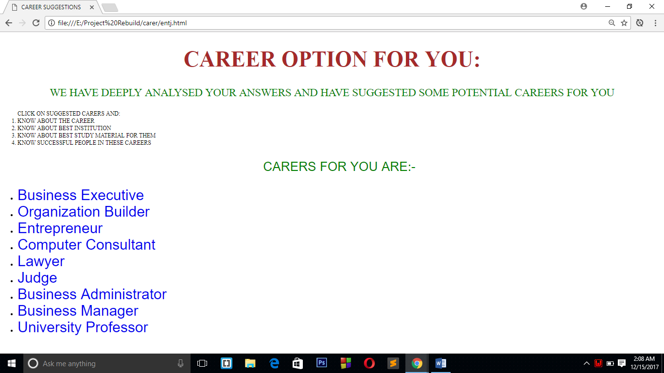
Figure 2 Councilo generating it's result

Slide 17
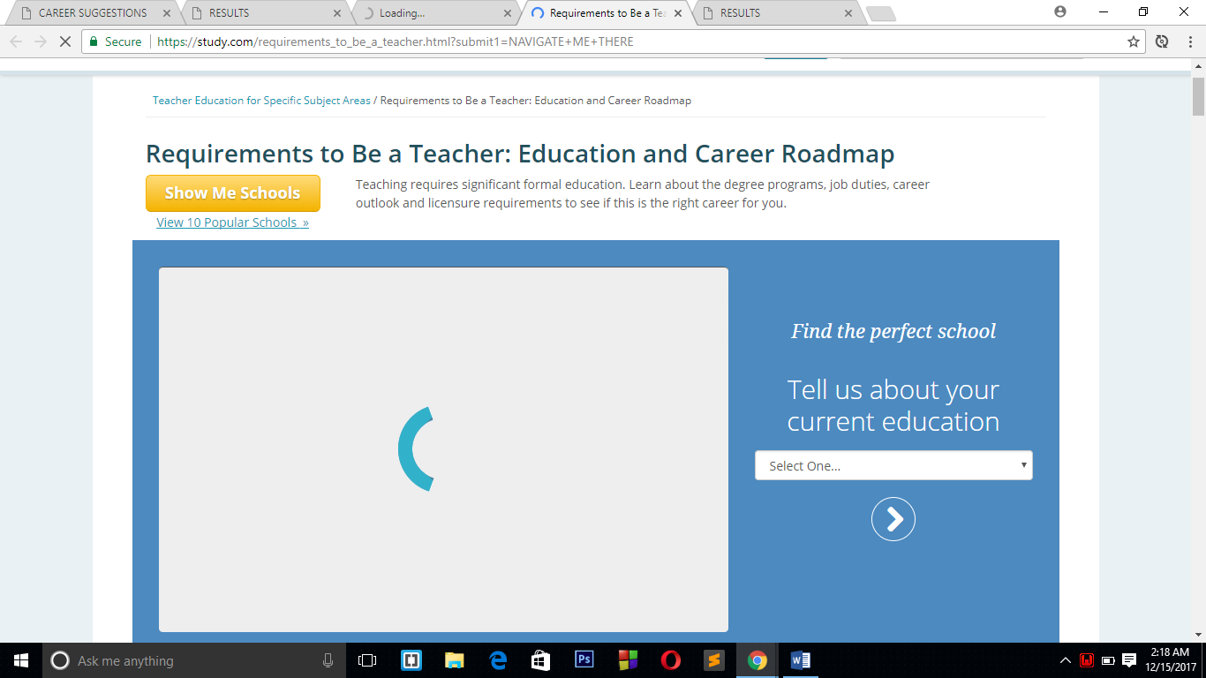
Figure 3 COUNCILO SHOWING CAREER PATH TO BECOME TEACHER

Slide 18
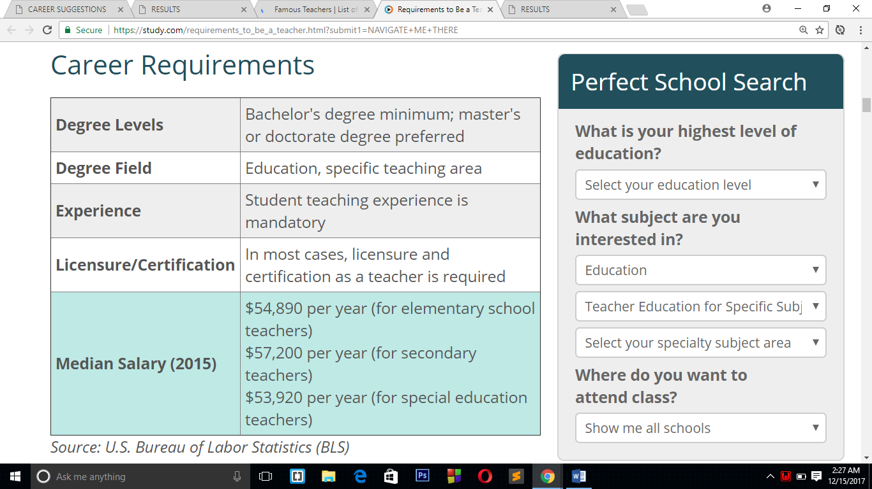
FIGURE 4 Councilo showing career requirements

Slide 19
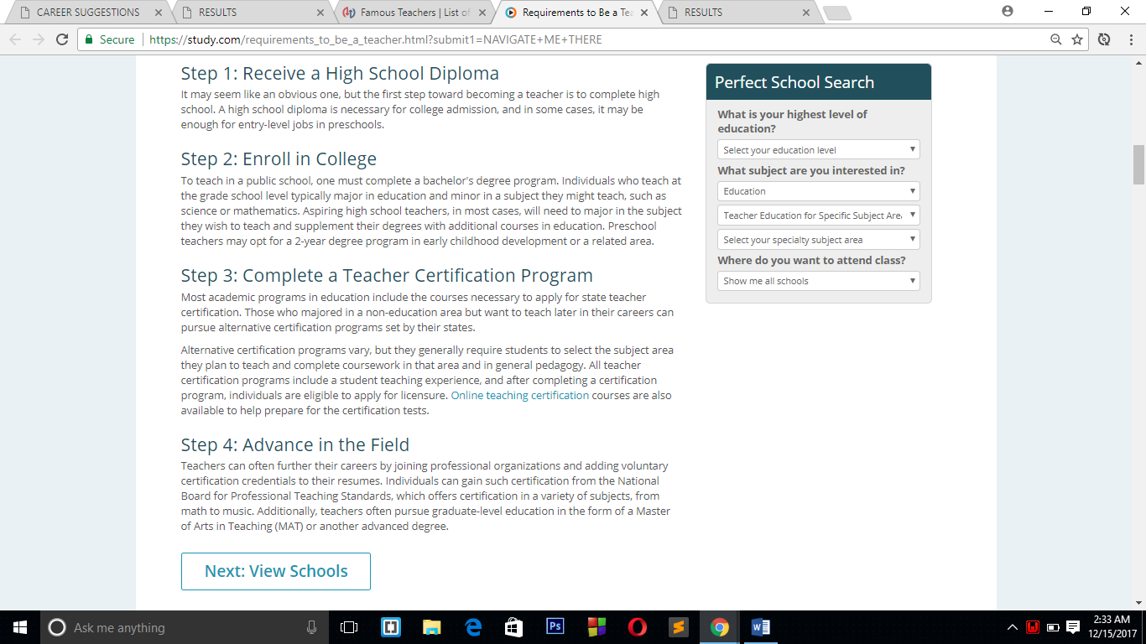
FIGURE 5 COUNCILO GIVING STEP-BY-STEP PATH TO EXCELL IN A PROFESSION.

Slide 20
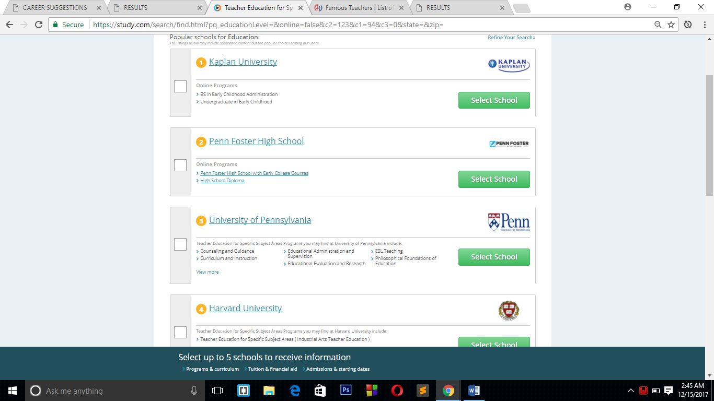
FIGURE 6 Councilo Helping Students Find Best Colleges

Slide 21
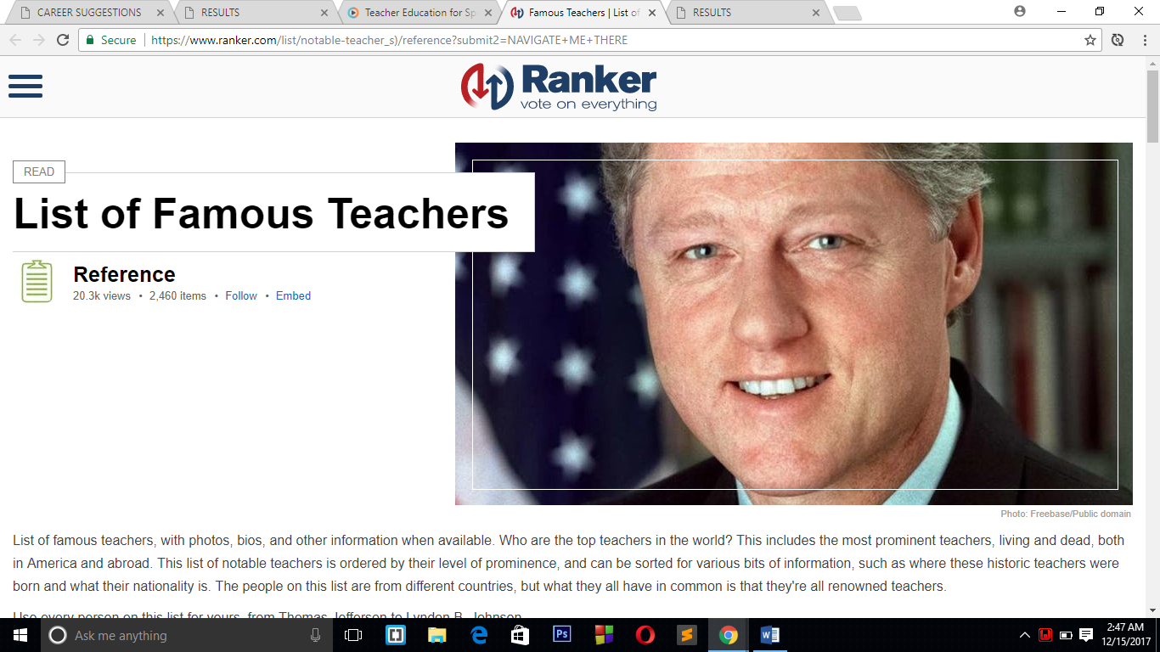
FIGURE 7: COUNCILO SHOWING BIOGRAPHIES OF FAMOUS PEOPLE FOR THE PURPOSE OF MOTIVATION.

Slide 22
result
Result of councilo is :
It is helping student’s know their Aptitude.
It is providing students by information regarding various institutions so that they can get elite education.
It is providing a step-by-step roadmap to excel in a career.
It is directly connecting institutions to students so that they can request to colleges for the purpose of admission.
It is providing Biographies of various successful personalities so that students can get motivated and can ignite their performance with passion.

