Slide 1

How to Use this Presentation
Present with ease and wow your audience
Customize with text and photos.
Add elements from the library or upload from your drive.
Apply page animations and transitions to emphasize ideas.
Use point forms and short sentences instate of long paragraphs
Use the PLP pitch deck guide and follow the protocol on slides
Lastly “PLEASE DELETE THIS SLIDE WHEN YOU ARE DONE!”
02

Slide 2



THE CHALLENGE CONQUEROR
01

Slide 3

A good number of people have a problem to over come their personal challenges
10

Slide 4

solution
The game provides the player with challenge card .
The card contains some one with the same challenge as the one the challenger had identified.
The player has to help the person to overcome the challenge.
When the player successfully overcome a challenge they get a reward by updating their challenge card this help them identify and understand their personal challenges
06

Slide 5
Product
My game tries to help different people overcome their personal challenges and build confidence
04

Slide 6



Target Market
4 out 5
Elaborate on the featured statistic.
95%
Elaborate on the featured statistic.
123 million
Elaborate on the featured statistic.
14

Slide 7
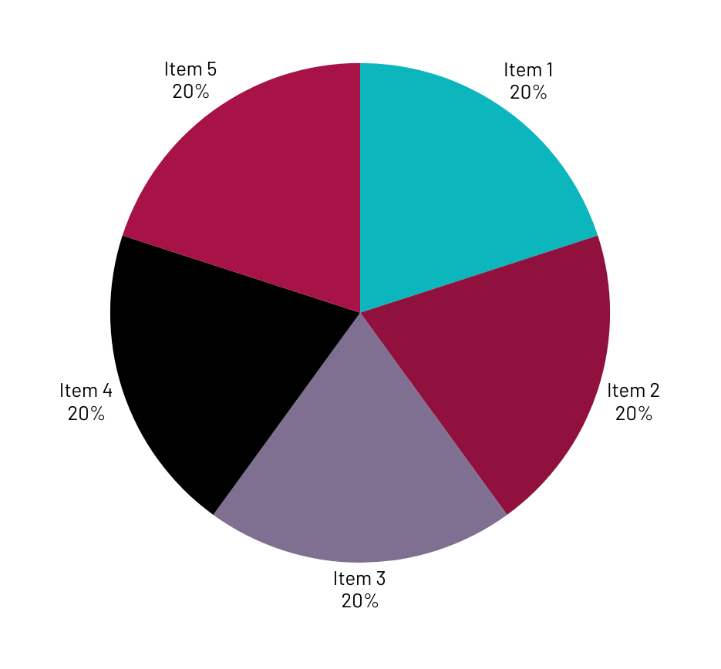
Market Size
We have to consider the targeted profit, pricing strategy and market demand which will give us an indication of the potential market size

Slide 8
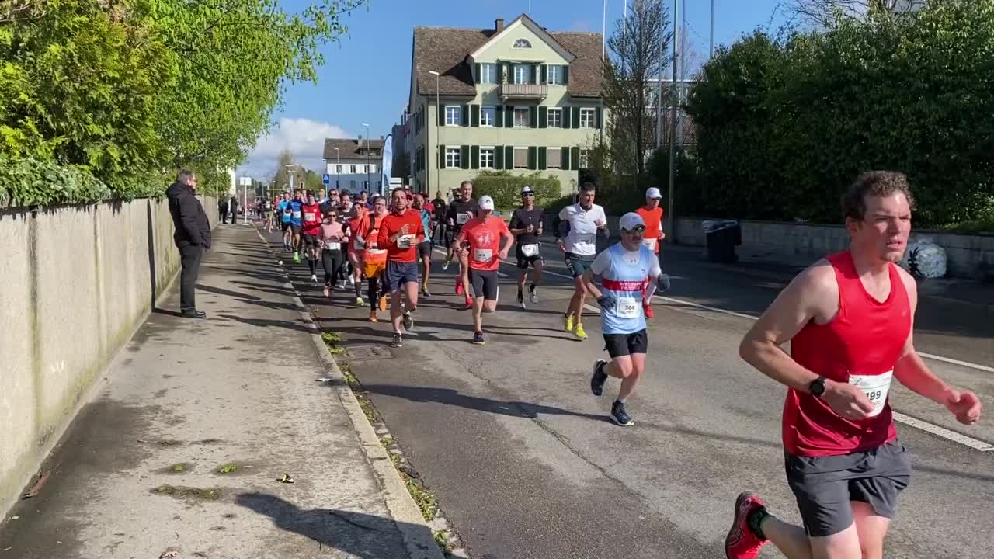
Examples of other competitors
.
THE GAME OF LIFE
CARD GAMES
Why my game is unique
it focuses on career and finances ,some versions incorporate elements of personal development , like overcoming obstacles
The game help players identify and prioritize their values , which can be crucial step in personal growth
Many existing games have a broader focus on (career,finances,general life skills) rather than specifically addressing personal challenges and building confidence.
23

Slide 9

WHAT MAKES ME UNIQUE ?
Challenger Conqueror emphasizes player agency by allowing them to define their own challenges and create personalized action plans unlike other organizations.

Slide 10
Project Traction
Tasks
Month 1
Month 2
Month 3
Month 4
Month 5
Develop the game
Test the game
Release the game
Marker the game
23

Slide 11

HOW TO GENERATE FUNDS
By direct sales-I can sell the game through online platforms
Through licensing I can license the game to educational institutions and therapy centers.
Not forgetting through corporate partnerships by partnering with companies for team building activities
Example of the margin calculation
Selling price$25per game, production cost $5 per game ,marketing and distribution cost $3 per game ,fixed cost$ 10000(rent, salary , utility)
CALCULATIONS
Revenue per unit $25
Cost of goods sold per unit $5
Gross profit per unit $20
Net profit per unit $17
Profit margin 68%
23

Slide 12
How I would reach my market.
Media out reach –I would share information about the game with local media outlets for advertisement.
I would explore partnership with local and regional distributors who can reach a wider network of retailers.
Not forgetting to utilize social media platforms( Facebook , Instagram ,Tiktok ) to promote the game ,run targeted ads

Slide 13
SOCIAL IMPACT
It will foster a supportive learning environment where individuals can develop essential life skills like problem solvingand critical thinking.
It provides gender equality since it empowers both boys and girls to overcome personal challenges and build confidence.
The game can also foster a mindset of resilience and adaptability which are crucial for navigating the challenges of the modern job market.
“CHALLENGE CONQUEROR” is a game that has a positive impact on individuals and society as a whole,contributing to a more equitable ,just and sustainable future.

Slide 14
Our Ask
I would like you to financially support me by investing in my project
I would use the funds to expand my project ; second I will hiring more game developers to expand my company to generate more games as we help our nation curb the problem of employment

Slide 15



Team Members
14
DEV PROGRAMER
Sky Treasure
GAME DESINER
Justine Trevour
UI/UX DESIGNER

Slide 16



cc
Thank you!
FOLLOW ME ON FACEBOOK @ Tamsi Sky
17

