Slide 1


Android
Project
WEATHER APP

Slide 2

Project Overview
Description
A dynamic Android weather application that provides comprehensive weather details, personalized user experiences, and engaging user interactions through gamification elements.
Key Features:
User Authentication & Multi-location Management
Real-Time Weather Data Retrieval & Display
Responsive UI Based on Material Design Guidelines
Push Notification System for Weather Alerts
Gamification through Daily Rewards and Milestone Badges

Slide 3
Technology Stack
Android & Kotlin: Main application language and platform.
Firebase: Authentication and data storage.
Weather API (Volley & Gson): Fetch and parse weather data.
XML Layouts: UI design and responsive layouts.

Slide 4


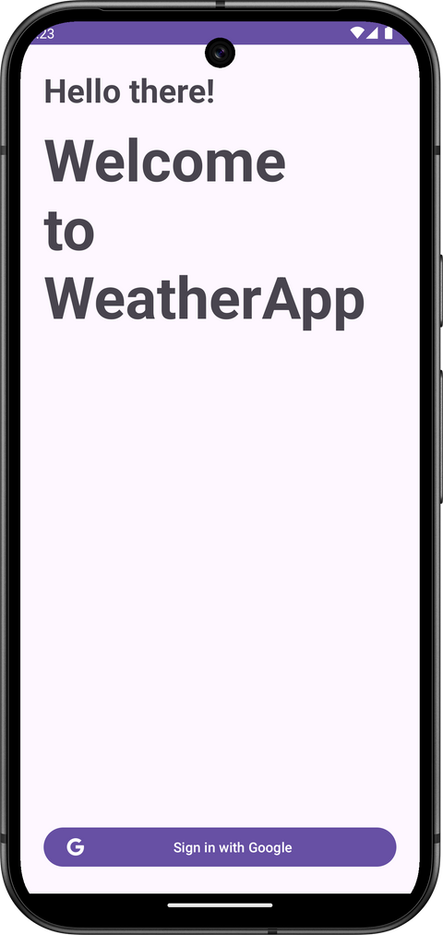
User Authentication
Google Sign-In:
Implemented via MainActivity using Credential Manager and Firebase Auth.
Ensures secure, quick, and reliable user authentication.

Slide 5

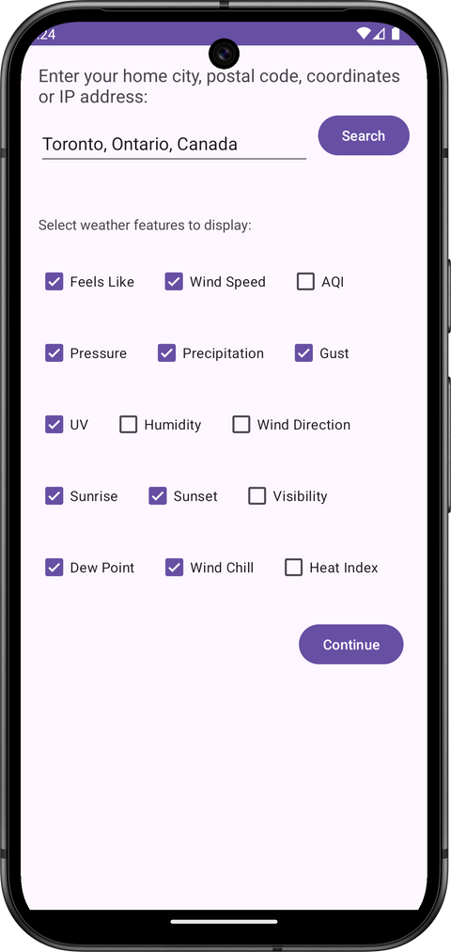
Personalized Preferences
PreferencesActivity:
Users select preferred weather details such as temperature, humidity, precipitation, AQI, UV index, etc.
Preferences saved in Firestore for personalized experience.

Slide 6
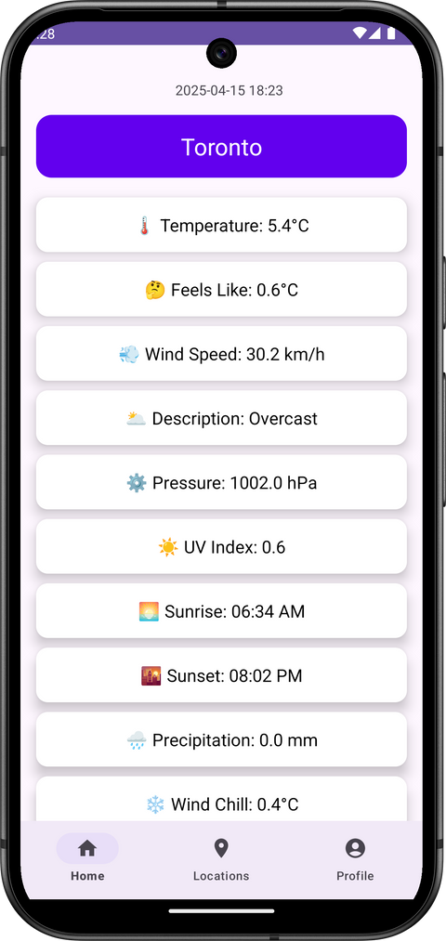


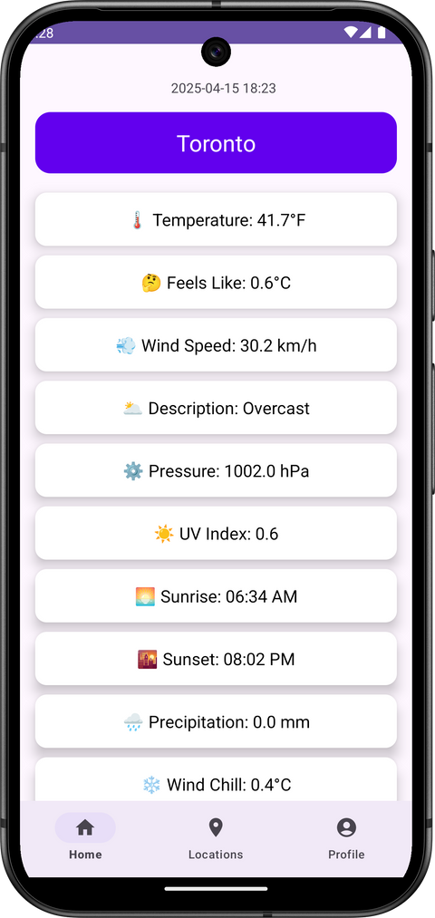
Weather Display
WeatherActivity and WeatherDetailActivity:
Real-time weather display including temperature, wind speed, visibility, sunrise/sunset, moon phases, and more.
Dynamic toggle between units (°C/°F, km/miles, etc.).

Slide 7
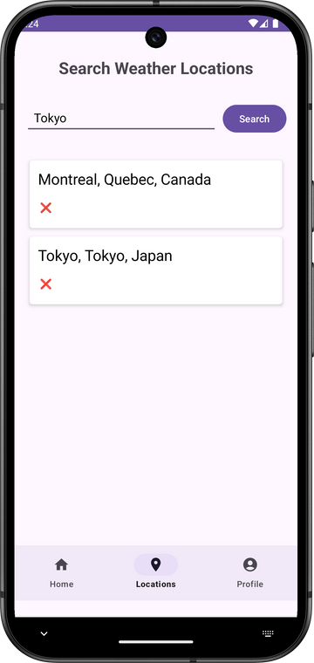
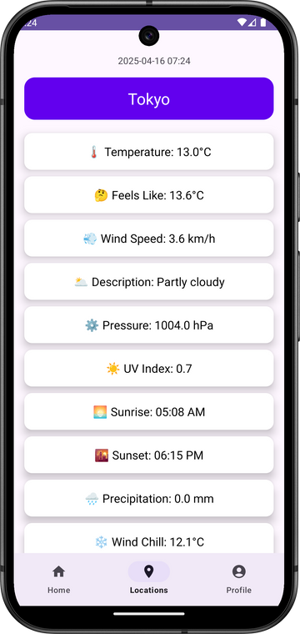
Location Management
LocationSearchActivity:
Allows searching for new locations and managing saved locations.
Locations saved locally using SharedPreferences and displayed as cards.

Slide 8
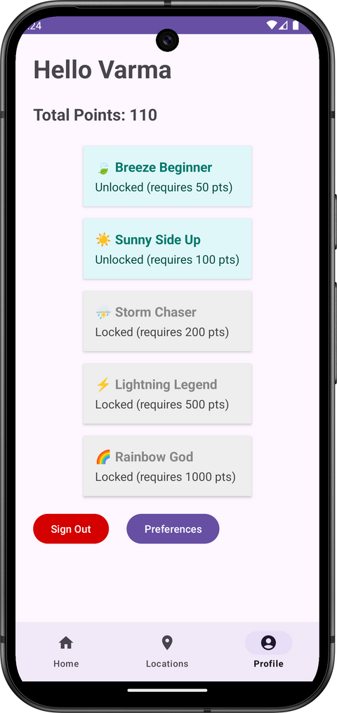
User Engagement & Gamification
Achievements System:
DailyRewardManager: Users earn daily points for using the app.
AchievementsAdapter: Displays achievements, which unlock based on accumulated points.
Gamification encourages daily app usage and engagement.

Slide 9
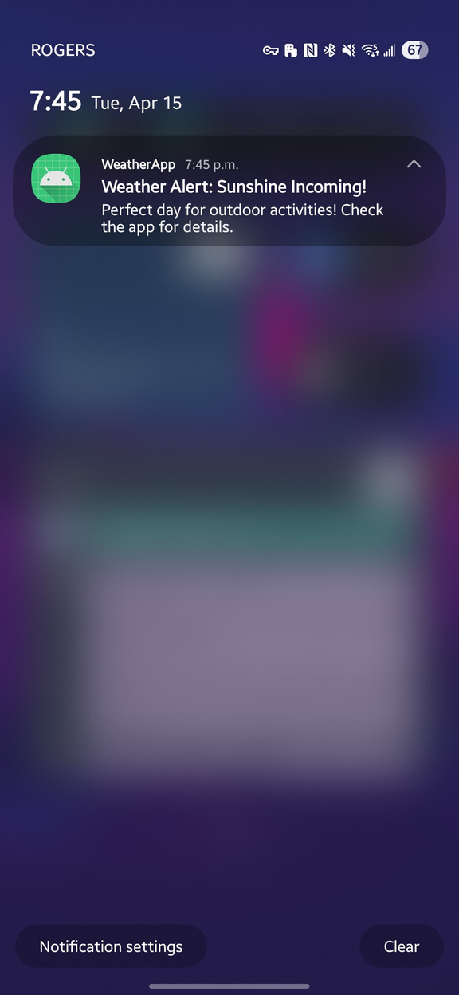
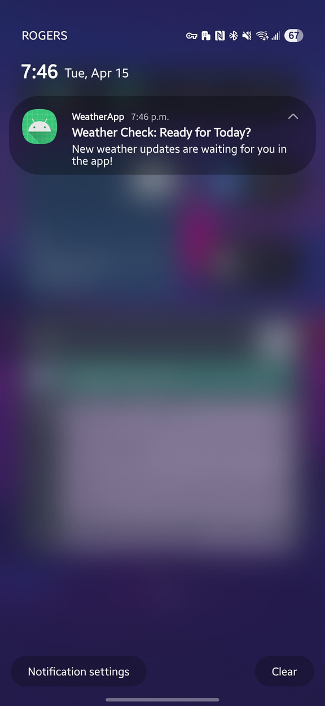
...and finally
Push Notifications
Engage users with timely weather alerts and updates directly on their devices.
Utilizes Firebase Cloud Messaging (FCM) for sending push notifications.
Implementation Details:
Notifications are triggered using a simple Node.js backend script.
User device tokens managed and stored securely via Firestore.

Slide 10
THANK YOU

