Slide 1

Analyzing the impact of organizational decisions
Team – data detectives

Slide 2
THE BASIC IDEA:
Any major decisions of a company are taken keeping in mind how it will be received by the market. A good indicator of market opinion is share prices of the company.
However the decision under consideration might not be the only reason as to why there was an unexpected rise or fall in the share price.
The project is intended to discover the impact of a decision taken while accounting for disturbances in the share market as a whole. The impact caused can potentially affect future decisions to be taken.
Objective-
Gauging the impact of strategic organizational decisions by measuring disturbances in share prices.
And to analyze if the decision had positive, negative or neutral response from the market.

Slide 3
Case Study:
- For the purpose of this project the company under consideration is GOOGLE and the NEWS item focused on is Google's LLM Bard.
- Google Bard was announced on February 6th,2023.
And based on the information interpreted from Google Trends has been most talked about over the world in the week following the official announcement.
- The following are direct screenshots people’s interest over time in a particular news item.
Its scaled to a hundred where hundred is the most searched. These line plots are closely followed by interest by regions all over the world during different time periods.

Slide 4
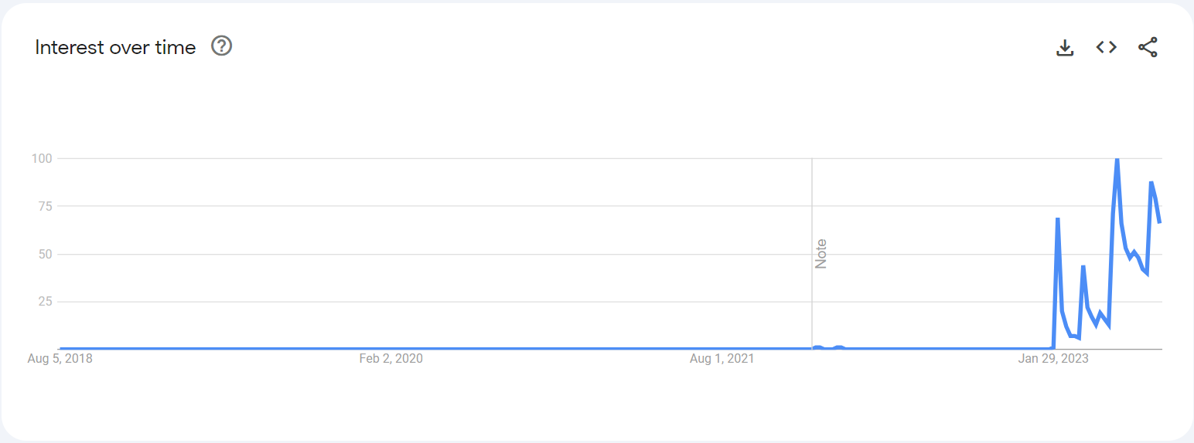
Figure : The line plot above is a direct screenshot from https://trends.google.com depicting people’s interest in Bard chatbot in the last 5 years

Slide 5
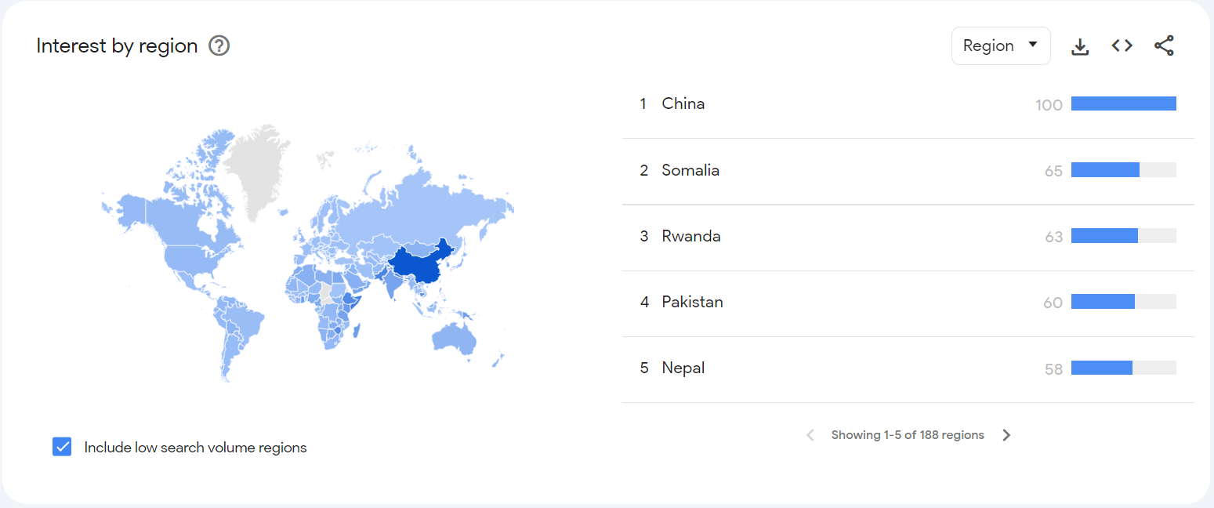
Figure : The above is the heat map of last five years the darker the shade indicates that Bard was searched for on the web more frequently and in larger volumes in the region as compared with the others.
Source: https://trends.google.com

Slide 6
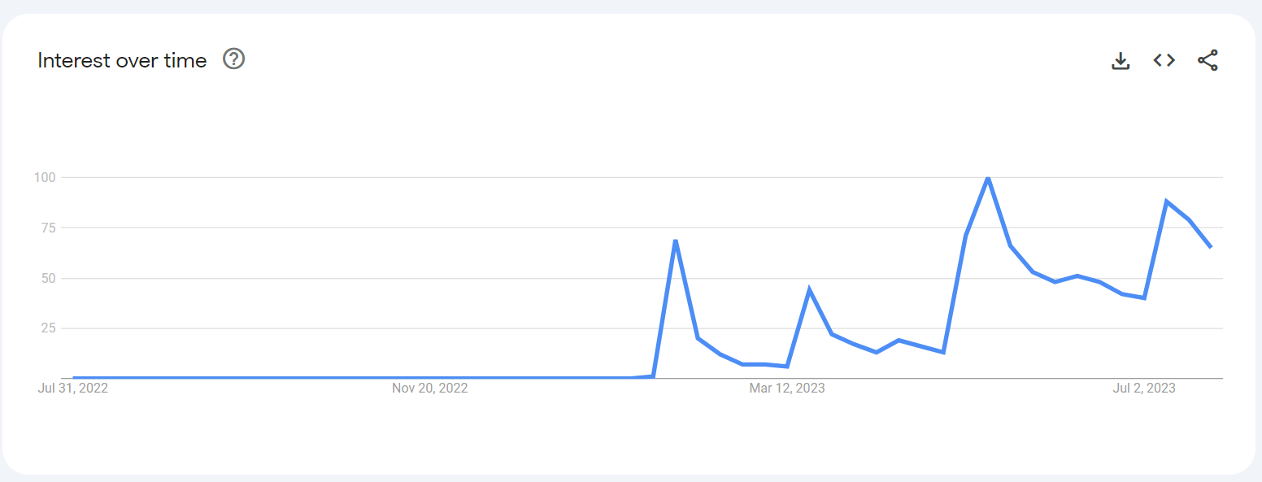
Figure : The above is the line plot for interest over the last 12 months.
Source : https://trends.google.com

Slide 7
Observation:
As is visually depicted not much has changed in over five years as the hype around Bard the LLM by Google is concentrated in these past twelve months. The Official announcement was made on February 6th ,2023.
Approach :
Keeping that in mind we trained a machine learning model over last five years worth of historic data our target being capturing the pattern that reoccurs once in a while in the closing price of stocks and then using this model to forecast the closing price in the week following the official announcement of Bard and then comparing it with the actual closing price.

Slide 8
Note :
The following plots are a better visual representations of what we did and the performance of our machine learning model. Its note worthy that polynomial regression though not very suitable for share price prediction works excellently for pattern recognition. The model has an R2 value of 0.9733. R2 value ranges from 0 to 1 where 1 represents pretty accurate and 0 represents “not really useful”.

Slide 9
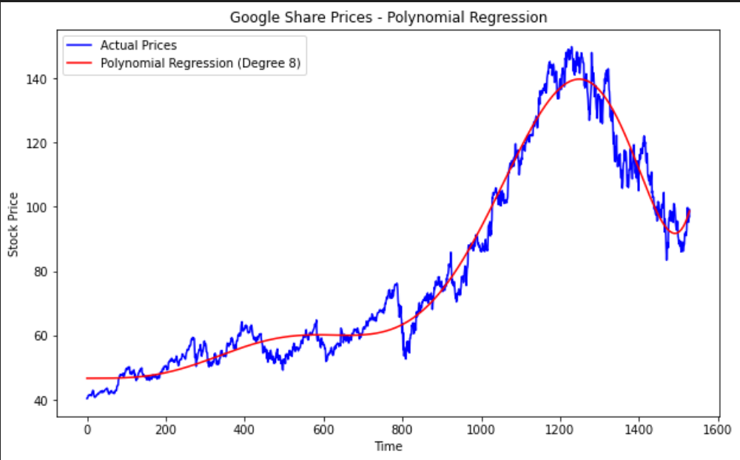
Figure : The line graph representing the regression plot
Source : The code we have written.

Slide 10
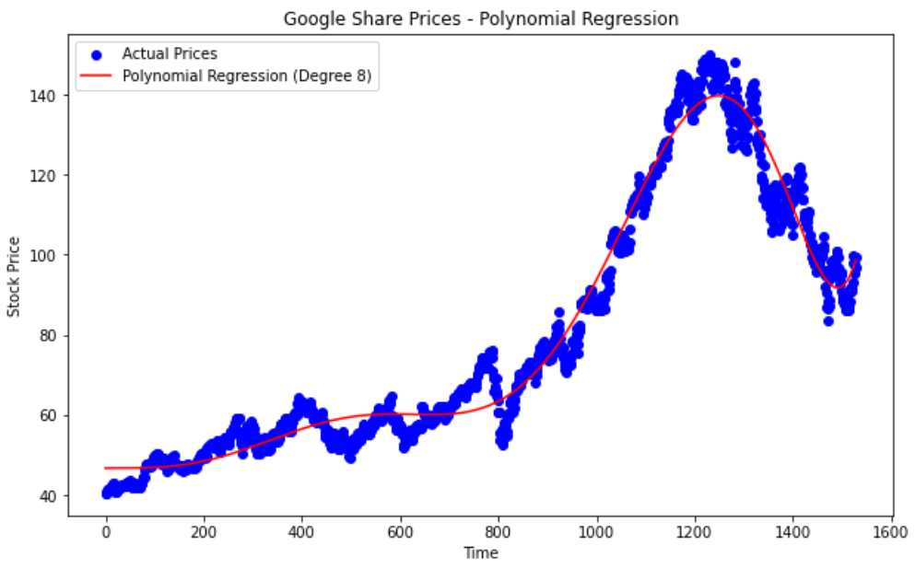
Figure : The scatter plot depicting the regression curve
where blue dots are the closing prices and the
red line is the regression curve fitted.
Source : The code we wrote.

Slide 11
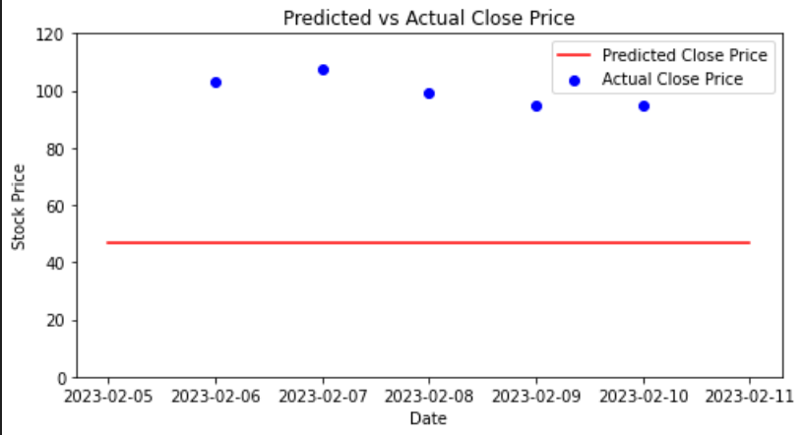
Figure : The plot above represents the actual closing price and the predicted price in the targeted week i.e. from February 5th ,2023 to February 11th ,2023.

Slide 12
Report Conclusion:
The average of closing prices from February 5th ,2023 to February 11th ,2023 turned up to be 99.898001 and the average of predicted closing price during the same time duration turned out 46.704217.
The observable difference being quite high to be ignored along with all the spotlight and NEWS coverage Google’s LLM Bard favored- it can be safely concluded that Bard was welcomed by the market with an noticeable increase in share price.
Thank you !!

Slide 13
Meet The Team :
DIKSHA AGARWAL (SPOC/TEAM LEAD)
AASTHA DAKHERA
ANUSHKA VIJAY
AYUSH JHOTA
KHUSHI GAHLOT
NISHA LOHAR
VAIBHAV GARG
VARUN SHARMA

