Slide 1
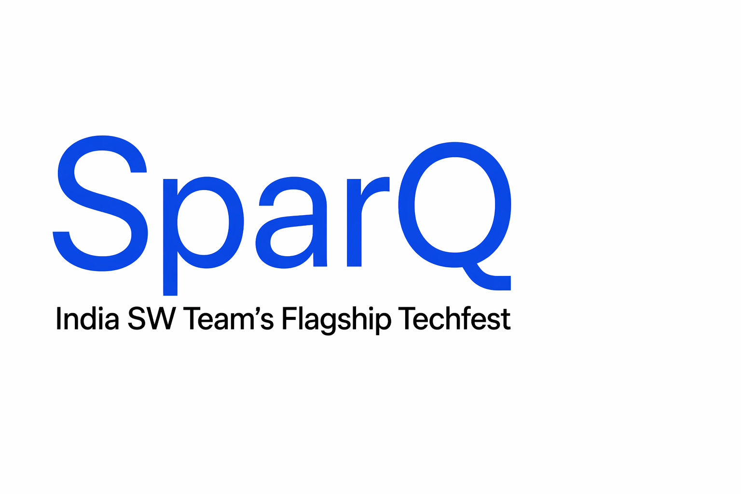
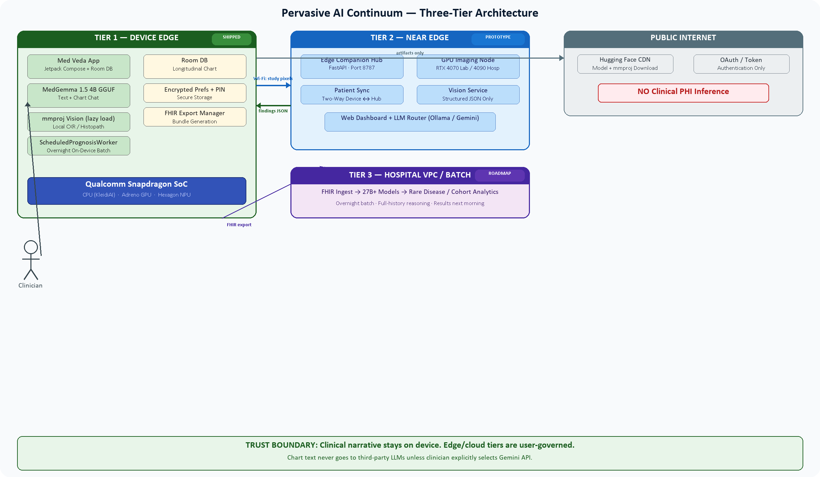
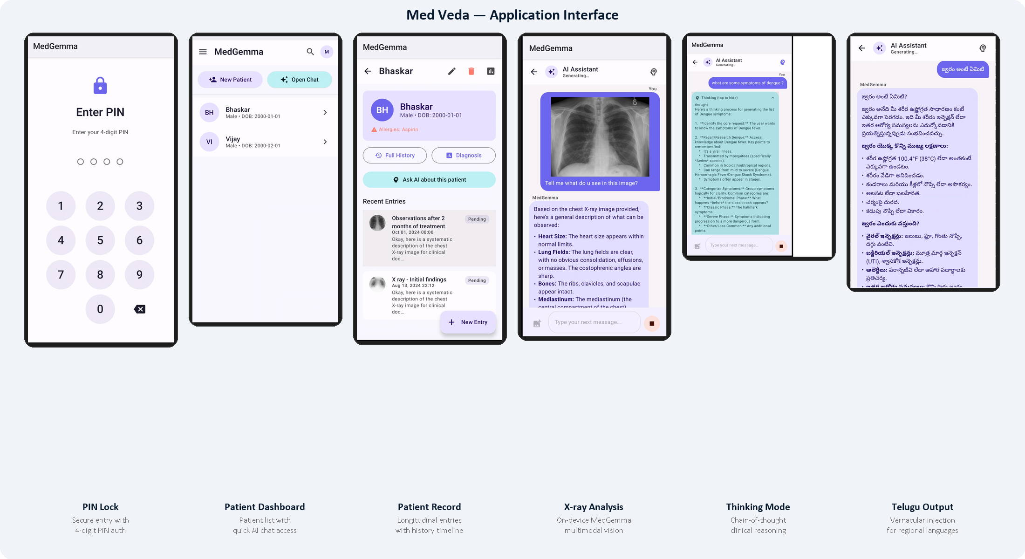
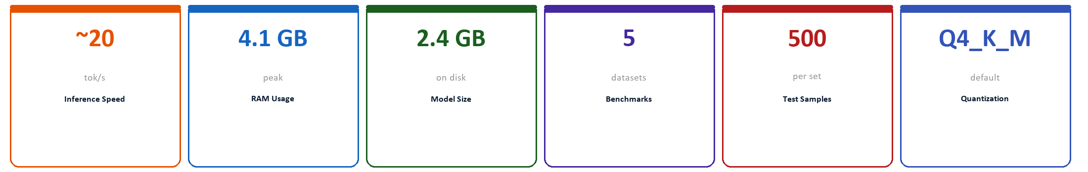
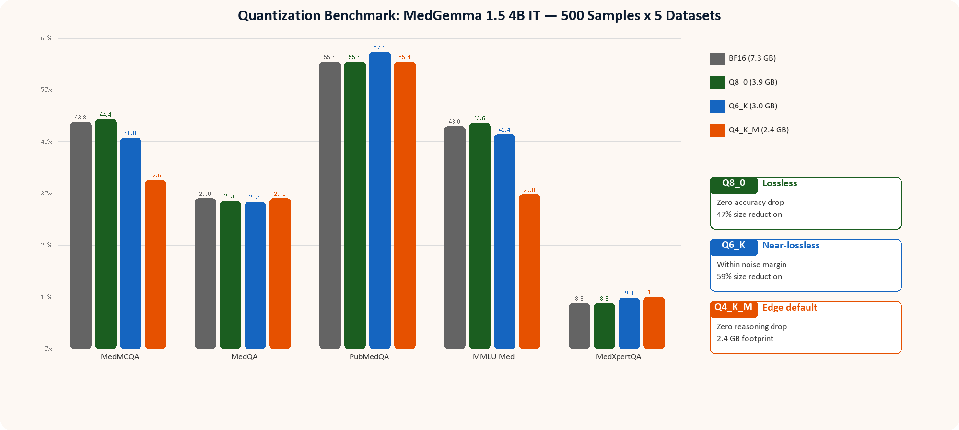
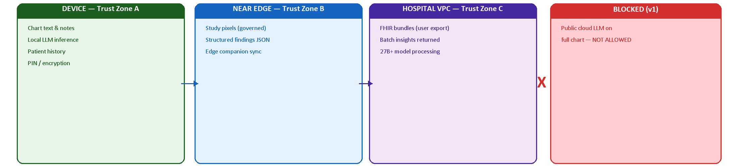
Med Veda
Pervasive Clinical AI on Snapdragon + Governed Hybrid Compute
On-device MedGemma 1.5 4B multimodal | Edge companion hub | Optional cloud APIs | Privacy-first AI as a continuum
SHIPPED
PROTOTYPE
ROADMAP
Abstract
System Architecture
Mobile clinical workflows operate under intermittent connectivity, strict latency budgets at the point of care, and thermal constraints on sustained inference. Protected health information must remain amenable to privacy-preserving processing, yet multimodal decisions still require tight coupling between longitudinal records and high-resolution imaging. Med Veda is a deployable Android clinician assistant centered on on-device Google MedGemma 1.5 4B multimodal inference. The system architecture partitions responsibility explicitly: privacy-sensitive longitudinal reasoning, chart-conditioned dialogue, and multilingual clinical generation execute locally on Snapdragon-class hardware behind a native GGUF runtime suitable for heterogeneous acceleration including NPU-assisted paths. This edge-first design preserves low-latency interaction in offline-first wards and keeps narrative PHI under local control. Compute-intensive vision stages are selectively orchestrated to enterprise imaging services under institutional credentials, returning compact structured analytics rather than open-ended cloud language generation. FHIR-oriented export enables hospital on-premises or VPC GPU clusters for deeper screening and cohort analytics while the handset remains the bedside copilot. The contribution is a production-oriented hybrid edge-cloud pattern for pervasive clinical AI: Snapdragon-edge multimodal reasoning as the default trust boundary, governed delegation for heavy vision, and standards-based extensibility for institutional compute.
Problem Statement
Application Interface
• Clinicians need longitudinal chart + imaging at the bedside, often with intermittent or no connectivity
• Cloud-bound AI introduces unacceptable latency at point of care and mandates PHI egress to third-party servers
• India's DPDP Act and global data protection laws impose strict constraints on clinical data movement
• A single device cannot handle all workloads at full speed — large imaging studies hit thermal and compute limits
• Existing solutions force a false choice: "all on phone" (slow) or "all in cloud" (privacy-violating, offline-incompatible)
Methods & Technical Approach
MedGemma 1.5 4B IT (Multimodal)
Deployed via GGUF (Q4_K_M default, 2.4 GB) through custom llama.cpp JNI wrapper (aichatlib) with lazy mmproj vision encoder loading
Heterogeneous Acceleration
CPU (KleidiAI on arm64), Adreno GPU, and Hexagon NPU runtime paths; user-selectable energy mode with 2B/4B dynamic switching
Chart-Grounded Inference
Room DB stores longitudinal patient records; system prompts inject full chart context with dated entries for temporally-aware reasoning
Hybrid Vision Pipeline
Study pixels sent to near-edge GPU (prototype: RTX 4070); only structured JSON findings return to device for local text synthesis
FHIR Interoperability
On-device LLM-assisted FHIR bundle export enables hospital VPC ingestion for batch analytics with larger models
Key Highlights & Innovations
▶ On-Device Multimodal AI: MedGemma 1.5 4B runs text + vision entirely on Snapdragon via custom llama.cpp JNI. Zero cloud inference for clinical data.
▶ Quantization Discipline: In-repo benchmarks across 5 medical datasets (500 samples each) prove Q8_0 is lossless and Q4_K_M preserves reasoning at 2.4 GB.
▶ Hybrid Vision Pipeline: Heavy imaging offloaded to near-edge GPU; only structured JSON returns. Chart text never leaves device in hybrid mode.
▶ Edge Companion Hub: FastAPI laptop server with patient sync, Ollama/Gemini chat routing, chart processing, and web dashboard.
▶ Smart Vernacular Injection: Zero-overhead regex interceptor translates medical jargon to Telugu/Hindi without degrading reasoning benchmarks.
▶ Longitudinal Intelligence: Room DB stores chronological profiles; AI bridges historical records with current symptoms via chart-grounded prompts.
Three-Tier Pervasive AI Architecture
▶ FHIR Export: On-device LLM-assisted FHIR bundle generation for hospital systems. Encrypted storage + PIN/biometric auth.
Tier 1 — Device Edge
SHIPPED
▶ Scheduled Prognosis: WorkManager overnight batch generates prognoses for all patients when charging — shipped edge version of hospital batch tier.
Android phone (Snapdragon): MedGemma 1.5 4B GGUF + mmproj; chart-grounded chat; Room DB; PIN auth; full offline operation
Benchmarks & Performance
Tier 2 — Near Edge
PROTOTYPE
Hospital / clinic LAN GPU (lab: RTX 4070): Heavy imaging → structured JSON findings; edge companion hub with web dashboard
Tier 3 — Hospital VPC / Batch
ROADMAP
Overnight batch: 27B+ models, rare-disease screens, cohort analytics via FHIR ingest. On-device ScheduledPrognosisWorker is the shipped edge version
Privacy & Trust Boundary
Clinical narrative and chart Q&A default on-device. Edge companion and cloud tiers are user-governed; chart text does not go to third-party LLMs unless the clinician explicitly selects Gemini API. Public internet is used only for model weight delivery (Hugging Face CDN) and OAuth sign-in — never for clinical inference on patient data.
Itikela Bhaskar | Vijay Aravynthan
SparQ 2026 — Pervasive AI
Qualcomm India · SparQ 2026
✓ Q8_0 is lossless: zero accuracy drop across all 5 benchmarks at ~47% size reduction
✓ Q6_K is near-lossless: within noise margin on all benchmarks at ~59% size reduction
✓ Q4_K_M trades knowledge recall for zero reasoning drop at 2.4 GB — ideal edge compromise
On-device MedGemma 1.5 4B · Edge Companion · FHIR Export · Q4_K_M GGUF

