Slide 1
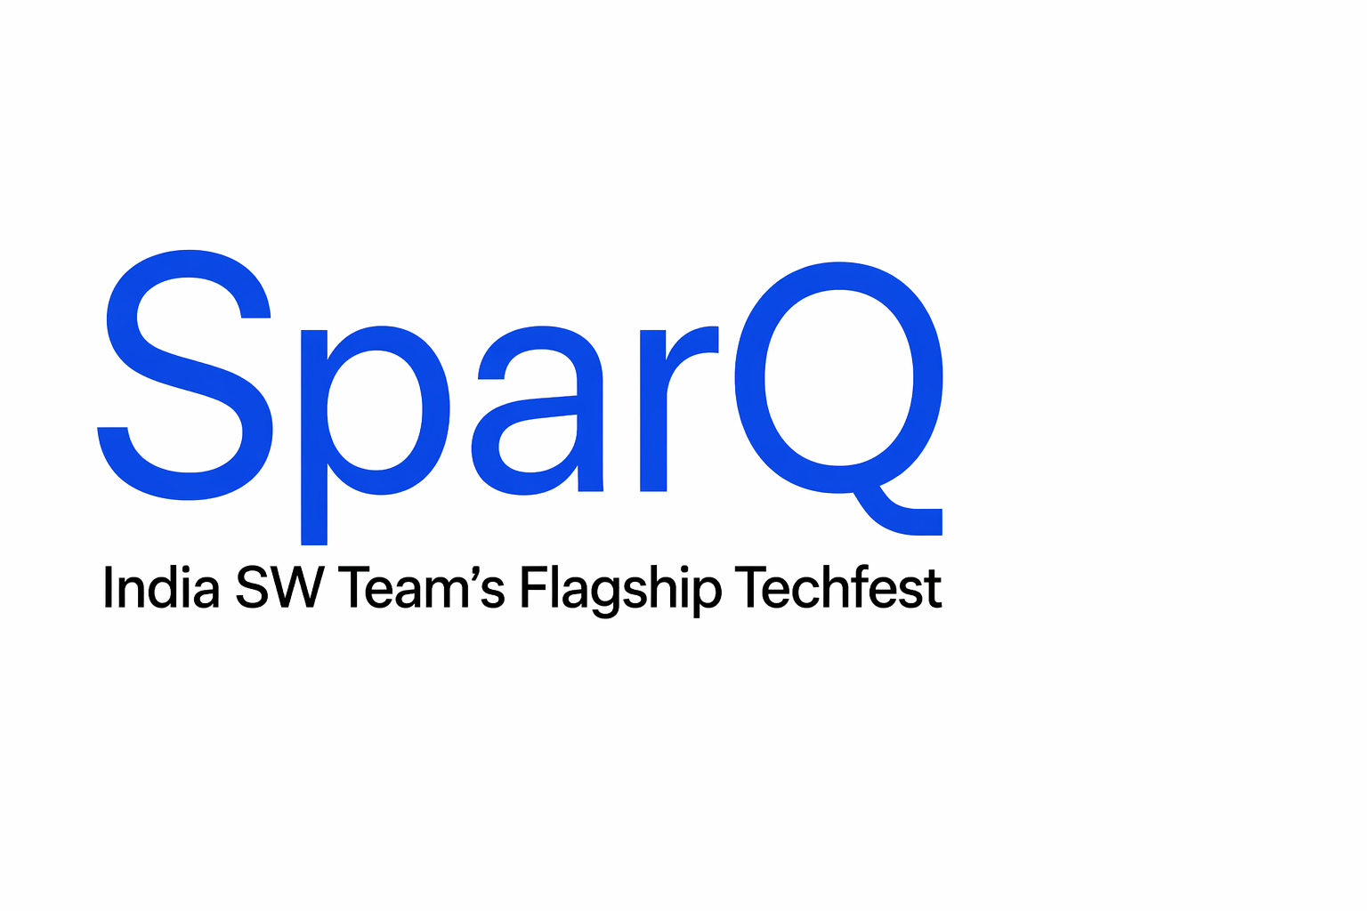
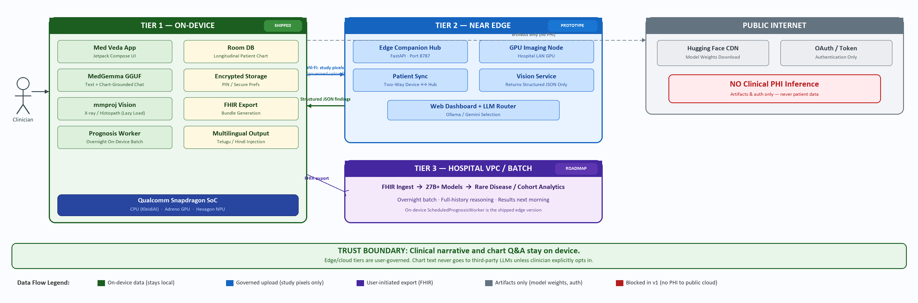
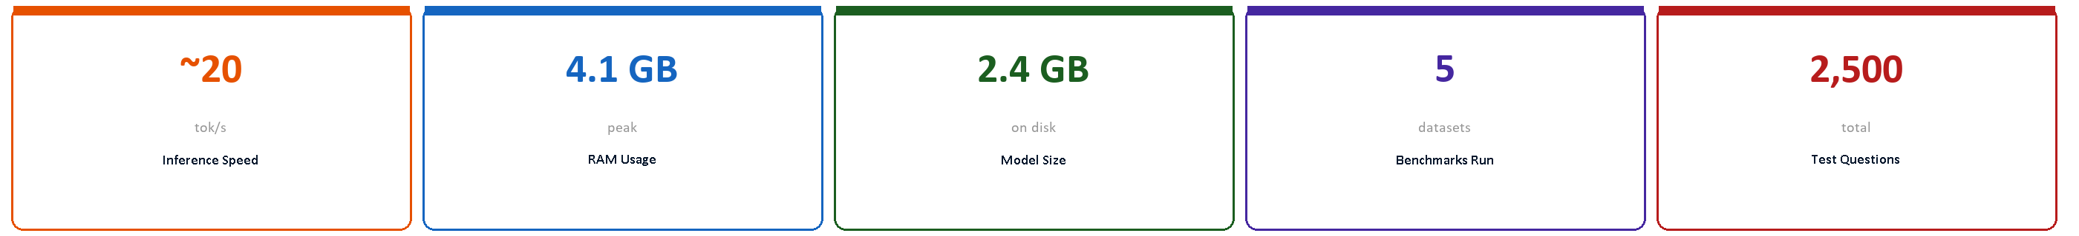
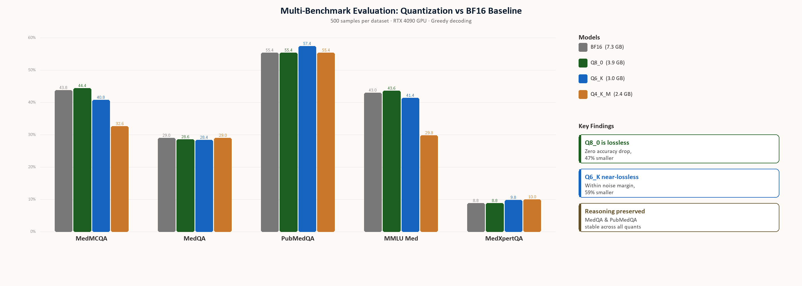
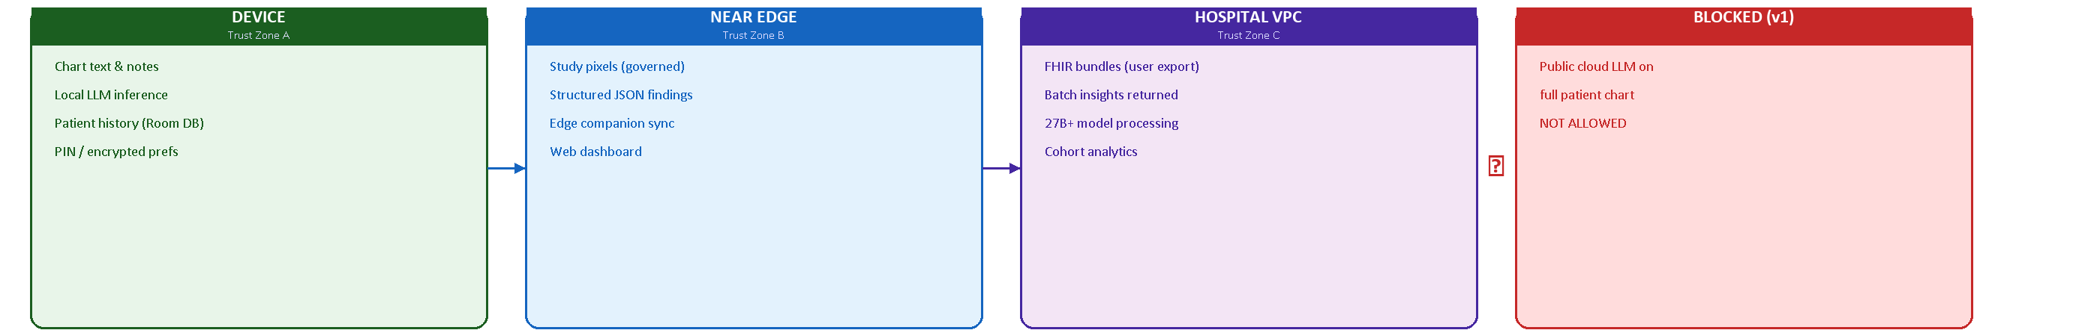
Med Veda
Pervasive Clinical AI on Snapdragon + Governed Hybrid Compute
On-device MedGemma multimodal | Edge companion hub | Governed cloud tiers | Privacy-first by design
On-Device Inference
Edge Companion
FHIR Interop
Offline-First
SHIPPED
PROTOTYPE
ROADMAP
Abstract
System Architecture — Pervasive AI Continuum
Mobile clinical workflows operate under intermittent connectivity, strict latency budgets, and thermal constraints on sustained inference. Protected health information must remain under privacy-preserving processing, yet multimodal decisions require tight coupling between longitudinal records and high-resolution imaging. Med Veda is an Android clinician assistant centered on on-device MedGemma multimodal inference. Privacy-sensitive reasoning, chart-conditioned dialogue, and multilingual generation execute locally on Snapdragon hardware via a native GGUF runtime with heterogeneous acceleration. This edge-first design preserves low-latency interaction in offline wards and keeps narrative PHI under local control. Compute-intensive vision is selectively orchestrated to institutional imaging services returning structured analytics, not open-ended cloud generation. FHIR export enables hospital VPC clusters for deeper screening and cohort analytics while the handset remains the bedside copilot. The contribution is a production-oriented hybrid edge-cloud pattern: Snapdragon-edge multimodal reasoning as the default trust boundary, governed delegation for heavy vision, and standards-based extensibility for institutional compute.
Problem Statement
Key Highlights & Innovations
– Clinicians need longitudinal chart + imaging at bedside with intermittent or no connectivity
– Cloud-bound AI introduces unacceptable latency and mandates PHI egress to third-party servers
– India's DPDP Act and global data protection laws impose strict constraints on clinical data movement
– A single device cannot handle all workloads at full speed — large imaging hits thermal and compute limits
– Existing solutions force a false choice: all-on-phone (slow) or all-in-cloud (privacy-violating, offline-incompatible)
– On-Device Multimodal AI MedGemma runs text + vision entirely on Snapdragon via custom llama.cpp JNI wrapper. Zero cloud inference for clinical data.
– Quantization Discipline In-repo benchmarks across 5 medical datasets (500 samples each) — Q8_0 is lossless at 47% size reduction; reasoning accuracy preserved across all quantization levels.
– Hybrid Vision Pipeline Heavy imaging (X-ray, histopathology) offloaded to near-edge GPU; only structured JSON returns to phone. Chart text never leaves device in hybrid mode.
– Edge Companion Hub FastAPI-based laptop server with patient sync, LLM routing (Ollama / Gemini), chart processing, and web dashboard for clinical oversight.
Methods & Technical Approach
– Smart Vernacular Injection Zero-overhead regex interceptor translates complex medical jargon to Telugu / Hindi in the output stream without degrading core reasoning benchmarks.
MedGemma Multimodal GGUF
Deployed via quantized GGUF through custom llama.cpp JNI wrapper (aichatlib) with lazy mmproj vision encoder loading
Heterogeneous Acceleration
CPU (KleidiAI arm64), Adreno GPU, and Hexagon NPU runtime paths; user-selectable energy mode with dynamic model switching
Chart-Grounded Inference
Room DB stores longitudinal records; system prompts inject full chart context with dated entries for temporally-aware reasoning
Hybrid Vision Pipeline
Study pixels sent to near-edge GPU; only structured JSON findings return to device for local text synthesis — chart never leaves phone
FHIR Interoperability
On-device LLM-assisted FHIR bundle export enables hospital VPC ingestion for batch analytics with larger models
– Longitudinal Intelligence Room DB stores chronological patient profiles; AI bridges years of historical records with current symptoms via chart-grounded prompts.
– FHIR Export & Interoperability On-device LLM-assisted FHIR bundle generation enables data flow to hospital systems without cloud intermediary. Encrypted local storage with PIN / biometric auth.
– Scheduled Prognosis Worker WorkManager-based overnight batch generates AI prognoses for all patients when device is charging — shipped edge version of the hospital batch tier.
Benchmarks & Performance
Three-Tier Pervasive AI Architecture
Tier 1 — On-Device
SHIPPED
Snapdragon phone: MedGemma GGUF + mmproj vision; chart-grounded chat; Room DB; PIN auth; full offline operation
Tier 2 — Near Edge
PROTOTYPE
Hospital / clinic LAN GPU: heavy imaging returns structured JSON findings; edge companion hub with web dashboard and patient sync
Tier 3 — Hospital VPC
ROADMAP
Overnight batch with larger models, rare-disease screens, cohort analytics via FHIR ingest; on-device prognosis worker is shipped edge version
Privacy & Trust Boundary
Quantization vs BF16 Baseline (500 samples x 5 benchmarks, RTX 4090)
Clinical narrative and chart Q&A default on-device. Edge companion and cloud tiers are user-governed — chart text does not go to third-party LLMs unless the clinician explicitly opts in. Public internet is used only for model weight delivery and OAuth sign-in — never for clinical inference on patient data.
Model | Size | MedMCQA | MedQA | PubMedQA | MMLU Med | MedXpertQA
BF16 (base) | 7.3 GB | 43.8% | 29.0% | 55.4% | 43.0% | 8.8%
Q8_0 | 3.9 GB | 44.4% | 28.6% | 55.4% | 43.6% | 8.8%
Q6_K | 3.0 GB | 40.8% | 28.4% | 57.4% | 41.4% | 9.8%
Q4_K_M | 2.4 GB | 32.6% | 29.0% | 55.4% | 29.8% | 10.0%
Itikela Bhaskar | Vijay Aravynthan
SparQ 2026 — Pervasive AI Theme
Qualcomm India · SparQ 2026
On-device MedGemma · Edge Companion · FHIR Export · GGUF Quantization

