Slide 1
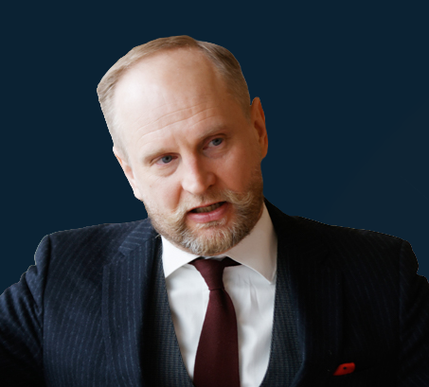


RESEARCH-LED MULTIMODAL INTELLIGENCE
8.6.2026 / Atlan / FiBAN
Datascene
Turning audiovisual material into traceable knowledge
Datascene makes audiovisual material searchable, analyzable, and reusable without losing the path back to the original evidence.
Petteri Laine
Jukka Kortti
Reko Elovainio
photo
Founder / general management
photo
Research lead
photo
Research collaborations
Petteri.Laine@helsinki.fi
+358404616659
Jukka.Kortti@helsinki.fi
+358405275153
Reko.Elovainio@helsinki.fi
+358503508268
Datascene / VAA1
Investor conversation deck
Datascene.eu

Slide 2
PROBLEM
Video is becoming institutional data, but most organizations still cannot analyze it at scale.
Lots of video everywhere
Haphazard tooling
Large underserved market
Interviews, broadcasts, hearings, meetings, archives, fieldwork, security footage, social media, production material.
Search, transcription, annotation, metadata, and evidence handling are often split across fragile workflows.
Many organizations need automated video-data analysis, but do not have usable tools for traceable, scalable work.
The gap: video is valuable, but not yet operational as reliable, reusable knowledge.
Datascene / VAA1
Investor conversation deck
Datascene.eu

Slide 3
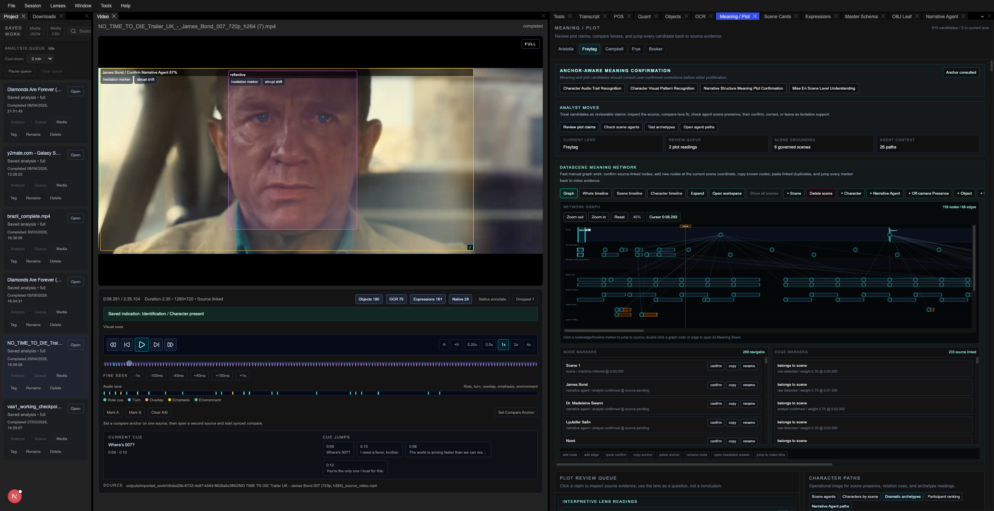
ALREADY WORKING SOLUTION
A working evidence workspace
Multimodal
Video, audio, transcript, objects, scenes, metadata, and meaning in one workspace.
Traceable
VAA1 screenshot placeholder
source video + transcript + evidence panels
Claims stay linked to timestamps, coordinates, frames, scenes, annotations, and source material.
Human-confirmed
Analyst corrections can cascade through the evidence model instead of being overwritten.
Why we win: Datascene does not hallucinate away from source. It turns audiovisual material into a navigable research and intelligence object.
Datascene / VAA1
Investor conversation deck
Datascene.eu

Slide 4
WHERE ARE WE HEADING
Datascene is being developed from a working local platform into deployable audiovisual knowledge infrastructure.
Video search engine
EU-compliant cloud
Standalone units
Search speech, scenes, objects, people, meaning, metadata, and confirmed evidence.
Hosted infrastructure aligned with European privacy, governance, and institutional needs.
Web-free deployments for sensitive users and closed environments.
The same core asset scales: Source-linked multimodal understanding of audiovisual material.
Datascene / VAA1
Investor conversation deck
Datascene.eu

Slide 5
PRE-SEED PLAN
What we are raising
200K
Deliverable 1
Deliverable 2
Web-free standalone units for sensitive users
Global EU-compliant cloud-based service
pre-seed capital
Topped with Business Finland funding and operational customer cases.
Target: By the end of the calendar year
Datascene / VAA1
Investor conversation deck
Datascene.eu

