Slide 1

Music Record Sales Analysis for Strategic Insights in the Physical Music Market
Leveraging Data to Guide Market Strategy
Vaddi Jaswant
22 OCT 2024

Slide 2
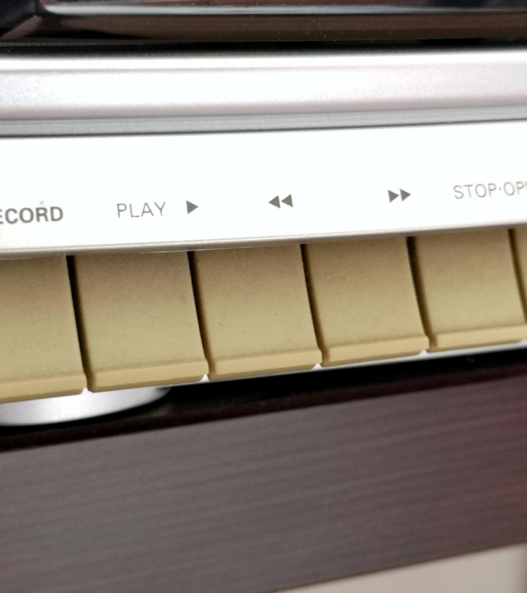
About Chinook
Chinook Music Services is a premier brand in the physical music records market, dedicated to delivering musical entertainment worldwide. With a global network of outlets and services, Chinook offers a comprehensive genre experience to its customers, ensuring diverse musical enjoyment for all.

Slide 3

Problem Statement
Sales Analysis
To analyze music record sales data to gain insights and make recommendations for the company's strategy in the physical music market.
Market Analysis
To derive insights based on the geographical location of customers and recommend strategies to increase company revenue.

Slide 4

Data Overview
This dataset allows for an in-depth understanding of Chinook’s market presence and operational scope.
The dataset consisted of 11 tables containing data related to the company.
The company has customer base from 24 different countries across the globe.
The tracks sold are of 25 different genres including Rock, Metal, Jazz & many more.
It also includes information regarding the album and the artist related to a track.
The invoice table records all the transactions in the company.

Slide 5

Methodology
Understanding The Data
Cleaning The Data
Exploring the Data
Deriving Key Insights

Slide 6
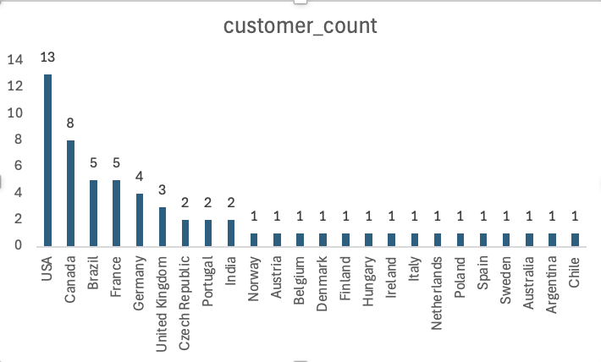
Customer demographic breakdown based on location of Chinook's customer base?
Key Takeaways: -
It shows that the customers are from 24 different countries.
The customer demographic breakdown is very diversified.
Maximum number of customers are from USA.

Slide 7
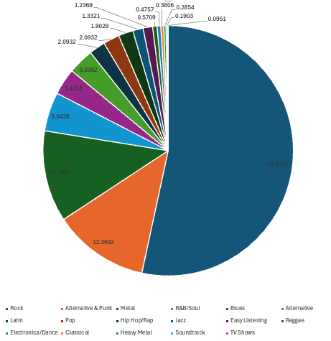
percentage of total sales contributed by each genre in the USA
Key Takeaways: -
It shows that the ROCK genre is contributing most to the sales generated in the USA.
The 2nd and 3rd most selling genres are Alternative & Punk and Metal.

Slide 8
Customer Churn Rate
1.69%
Key Takeaways: -
It shows that the customer retention is not good in the company.
The number of customers lost are high and needs immediate action to maintain the customer base.
New Promotional Campaings, Music Festivals and Sale Months should be launched so as to attract more customers.
Better customer service can also help in decreasing the churn rate.
NOTE: THIS CHURN RATE IS CALCULATED FOR THE ONE YEAR PRIOR TO MAX INVOICE DATE IN THE DATA

Slide 9
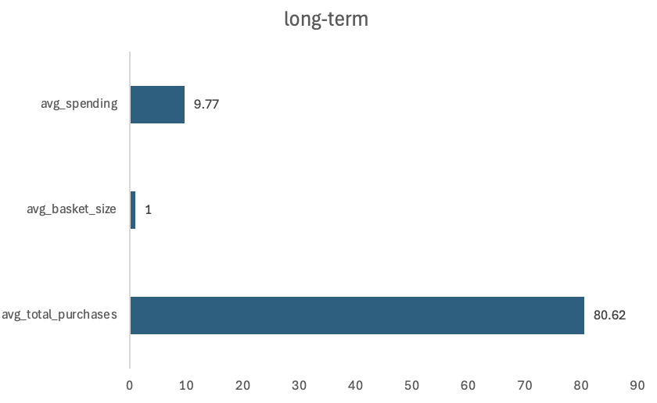
Customer Purchasing Behavior Analysis
High Engagement Among Long-Term Customers: Long-term customers have made an average of 80.62 purchases, demonstrating strong engagement and loyalty through repeat transactions.
Consistent Basket Size: An average basket size of 1.00 indicates most transactions involve a single item, presenting a potential for increasing purchase size through cross-selling or bundling.
Steady Spending Patterns: Average spending per order is $9.77, suggesting frequent but modest-value purchases. Analysing commonly purchased products can inform strategies to increase order value.

Slide 10
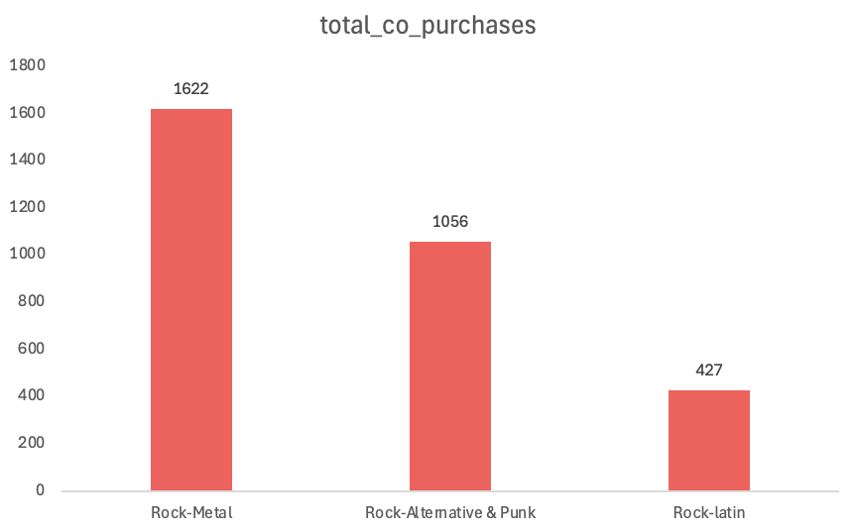
Product Affinity Analysis (Genres frequently purchased together)
Rock frequently combines with other genres such as Metal, Alternative & Punk, and Latin.
Rock is a versatile genre appealing to customers with diverse music tastes.
Customers purchasing Metal often also buy Rock, indicating a chance for cross-promotion.
Strong affinity exists between Alternative & Punk and Rock, suggesting crossover interest.
Latin music paired with Rock shows significant co-purchasing opportunities.
Potential to recommend Latin music to Rock fans, tapping into varied customer tastes.

Slide 11
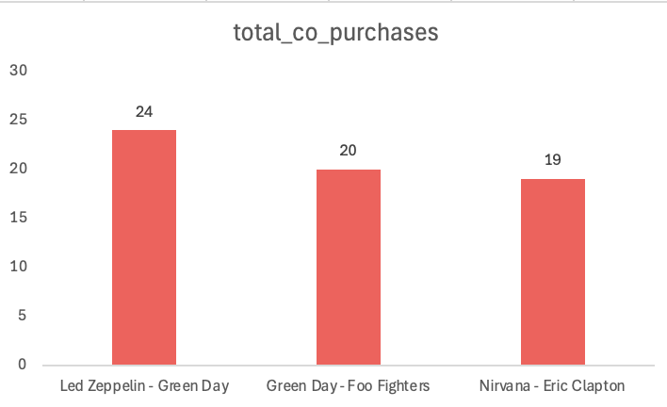
Product Affinity Analysis (Artists, frequently purchased together)
The combination of Led Zeppelin and Green Day indicates customers who enjoy classic rock also appreciate punk rock.
The pairing of Green Day and Foo Fighters suggests a connection between punk rock and modern rock fans.
Nirvana (grunge) and Eric Clapton (blues/rock) show a noteworthy co-purchase pattern among rock sub-genre enthusiasts.
Customers drawn to rock sub-genres are likely to explore different styles within rock and blues.
These insights can guide cross-selling strategies for recommending albums from Green Day and Foo Fighters to Led Zeppelin customers and vice versa.
Suggesting both modern and classic artists together can appeal to customers with a broad taste in rock music.

Slide 12
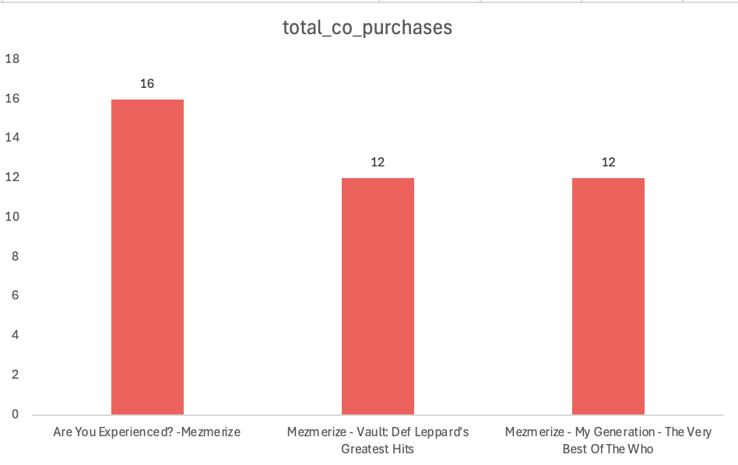
Product Affinity Analysis (Albums frequently purchased together)
Cross-Genre Appeal of Mezmerize: Mezmerize by System of a Down often appears alongside classic rock albums like Are You Experienced?, Vault, and My Generation, indicating that metal fans are also interested in classic rock across different eras.
Cross-Promotion Opportunity: This pairing suggests a chance to cross-promote metal albums with rock, particularly targeting classic rock fans who might enjoy exploring heavier, modern genres like metal.

Slide 13

Recommended Albums for Promotion in the USA
Are You Experienced? Genre: Rock Reason for Promotion: Rock is a top-performing genre in the USA, and this album is a standout, targeting a strong market with proven success, likely yielding high returns.
Get Born Genre: Alternative & Punk Reason for Promotion: With growing popularity, this genre appeals to fans of contemporary styles. Get Born has strong sales and would benefit from promotion, tapping into this momentum.
The Doors Genre: Rock Reason for Promotion: A classic rock favourite with historical significance, The Doors appeals to both new listeners and nostalgic fans, reinforcing the label’s position in the market.
13

Slide 14
Overall Strategy Recommendations for the Physical Music Market
Prioritize High-Performing Genres Rock and Alternative & Punk: These genres dominate sales, especially in the USA, making them ideal for targeted promotions. Targeted Promotion: Focus marketing on albums from these genres to leverage established demand.
2. Region-Specific Strategies USA: Emphasize Rock and Alternative album promotions. International Markets: Promote Metal and Rock in regions where they show strong co-purchase patterns and high sales.
3. Cross-Selling Opportunities Co-Purchased Genres: Cross-sell Rock and Alternative & Punk albums with Metal, leveraging frequent co-purchases. Artist Synergy: Offer bundles or deals featuring Led Zeppelin, Green Day, and Foo Fighters, based on frequent co-purchase behaviour.
4. Focus on Long-Term Customers Loyalty Programs: Engage loyal customers with exclusive releases or loyalty programs, given their higher average spending. Churn Prevention: Re-engage inactive customers with targeted emails or limited-time offers.
14

Slide 15

Music gives a soul to the universe, wings to the mind, flight to the imagination and life to everything.” ― Plato

Slide 16
Final Conclusion
Focused Genre Promotion: Prioritize high-performing genres like Rock and Alternative & Punk, especially in the USA, to maximize sales potential through targeted album promotions.
2. Cross-Selling Opportunities: Leverage product affinity by cross-selling frequently co-purchased genres, artists, and albums to boost revenue and engagement.
3. Region-Specific Targeting: Adopt tailored strategies, focusing on Rock and Alternative in the USA, while promoting Metal and Rock in international markets.
4. Customer Retention: Prevent churn among long-term customers with targeted campaigns and personalized offers to enhance lifetime value and strengthen market presence.
Final Takeaway: By promoting top genres, utilizing cross-selling, and focusing on customer retention, the company can strengthen its market position and drive growth.

