Slide 1

Strategic Insights for Restaurant Expansion: Analysing Market & Services
By: VADDI JASWANT

Slide 2


When the founders launched this website, it wasn’t called Zomato back then, it was called Foodiebay in year 2008. initially started in Delhi, then the services were extended to cities like Mumbai and Kolkata
The founders changed Foodiebay to ‘Zomato’ in 2010 to take it international and make it more prominent, to make it simple and also to eliminate any confusion with website eBay

Slide 3
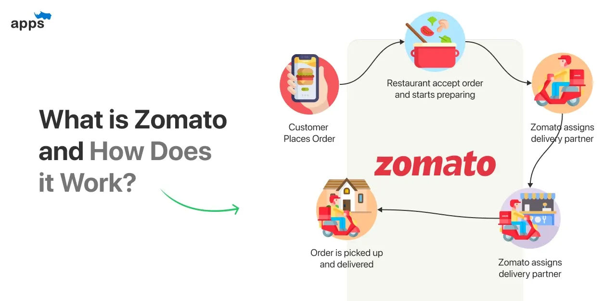
Source: internet

Slide 4

Problem Statement:
Identifying Optimal Locations for Restaurant Expansion in Competitive Markets
As the global restaurant industry becomes more competitive, it's essential to strategically identify regions where new ventures can thrive. The challenge is to select countries and cities with:
Low Market Saturation: Fewer existing restaurants, indicating lower competition.
Underserved Markets: Places where the average restaurant rating is low, suggesting an opportunity to introduce higher-quality dining options.
Customer Preferences: Understanding the culinary needs and service expectations of customers in these regions.
Objective: To leverage data-driven insights to identify the most promising countries and cities for opening new restaurants, where we can effectively compete by offering value-driven, high-quality dining experiences.

Slide 5

RESTAURANTS MARKETPLACE DATA SNAPSHOT
Our dataset includes 9,551 restaurants across various regions, offering a broad sample size to identify regional trends and preferences effectively.
Each restaurant is described by approximately 22 attributes, covering key aspects such as name and address, price range, customer ratings, and average cost for two, providing crucial insights for geographical, market, and customer analysis.
This diverse and detailed data is essential for in-depth analysis, allowing us to explore market dynamics comprehensively and make informed, data-driven decisions for strategic planning.

Slide 6
RESTAURANTS MARKETPLACE DATA SNAPSHOT
Data Cleaning and Preprocessing
Cross checked for duplicate rows and removed if any
Filled in the blank cells in cuisines Column, to make the data consistent and enhance data integrity
Converted the average cost for two to same currency which will help to analyse the data more clearly
This broad data set allows for an in-depth understanding of restaurants market and operations
High quality data is crucial for analysing the different customers preferences from different places

Slide 7



Analytical Approach and tools
Data Cleaning: Used Excel’s remove duplicate function for accuracy.
Data Enrichment: Added variables with VLOOKUP and XLOOKUP.
Descriptive Analysis: Summarized data with Pivot tables to identify restaurant and customer preferences.
Graphical Analysis: Created bar charts, pie charts, and scatter plots to show data relationships.
Visualization: Developed dynamic charts and dashboards for interactive exploration.

Slide 8
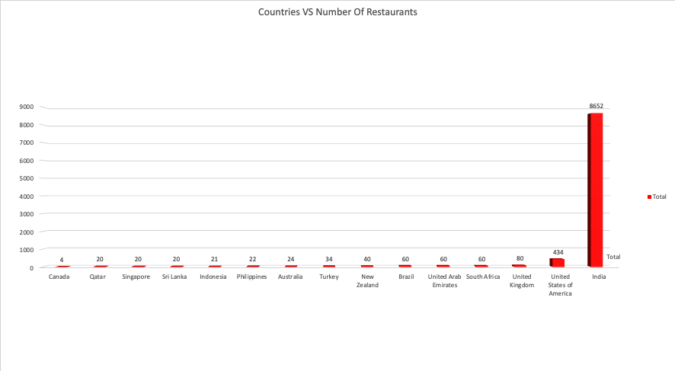
Restaurant Distribution by Country
India dominates with 8,652 restaurants.
The USA follows with 434 restaurants, showing a significant gap.
Understanding distribution helps identify potential markets with less competition.

Slide 9
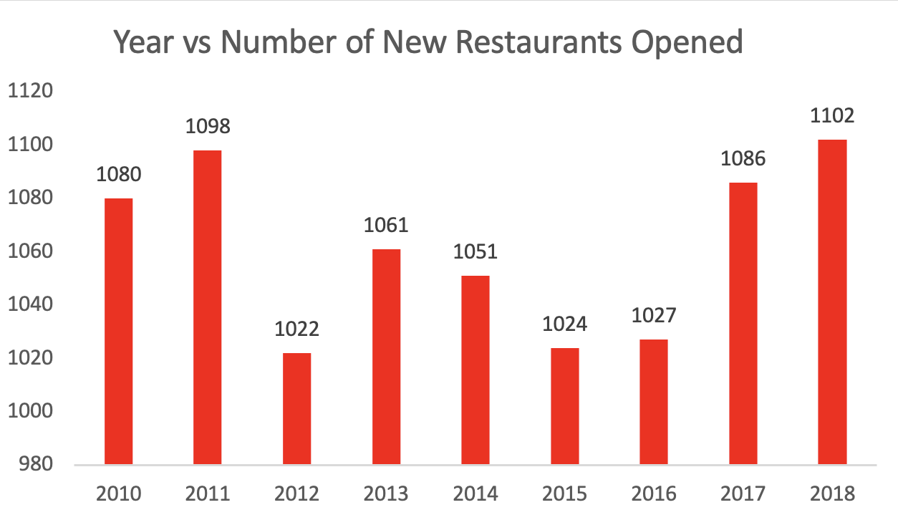
Trends in Restaurant Openings Over the Years
2012 Decline: Significant drop in new restaurants, potentially due to market uncertainty.
Recovery & Growth: Steady rise from 2016, reaching a peak in 2018, showing regained confidence.
Market Dynamics: The fluctuations highlight the impact of economic and market conditions on restaurant openings.

Slide 10
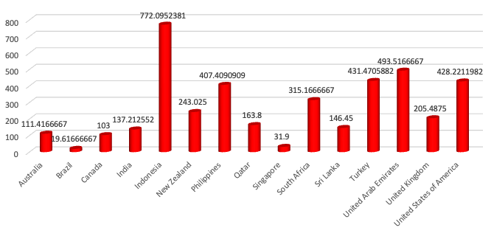
Average Number of Voters Per Country
Highest Engagement: Indonesia leads in voter participation, indicating strong customer interaction.
Lowest Engagement: Brazil shows the least engagement, which might suggest areas for improvement.
Market Insight: Understanding voter numbers helps identify countries with more active customer bases.

Slide 11


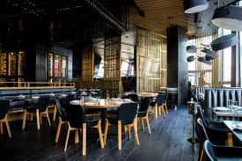
INDENTIFYING LESS COMPETITIVE MARKETS
Countries and cities with less number of restaurants
Countries and cities with fewer restaurants represent lower competition, offering a prime opportunity to establish a strong market presence
Countries and cities with low average rating
Countries and cities with lower average ratings present an opportunity to elevate standards and quickly gain a competitive edge.

Slide 12
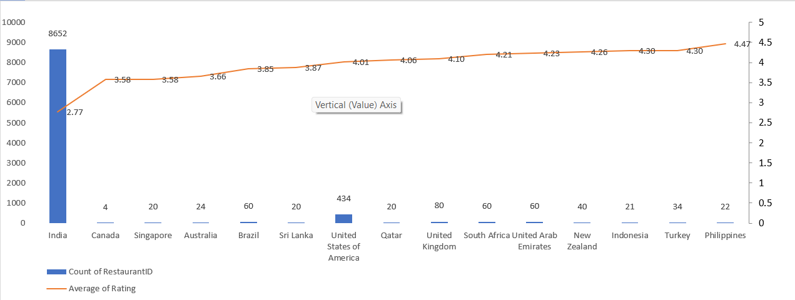
Selecting Optimal Countries for New Restaurant Openings
Balanced Competition: Canada, Singapore, Australia, and Sri Lanka have a moderate number of restaurants, offering an optimal balance between market presence and competition.
High Ratings: These countries maintain average ratings above 3.5, indicating strong customer satisfaction and potential for new entrants.
Strategic Opportunity: By avoiding highly saturated markets like India and Brazil, where competition is fierce, we can focus on markets where there's room to grow and establish a strong foothold.

Slide 13
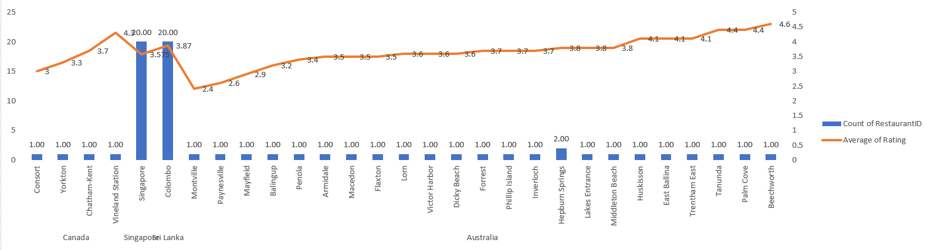
City-Level Analysis for New Restaurant Openings
Less Saturation: Cities like Consort (Canada), Singapore(Singapore), Montville (Australia), and Colombo (Sri Lanka) have fewer restaurants, presenting lower competition.
Opportunities for Growth: These cities also exhibit lower average ratings, indicating room for improvement and potential to capture market share with better offerings.
Strategic Focus: Targeting these cities allows for the establishment of new restaurants in under-served areas, enhancing visibility and customer reach.

Slide 14
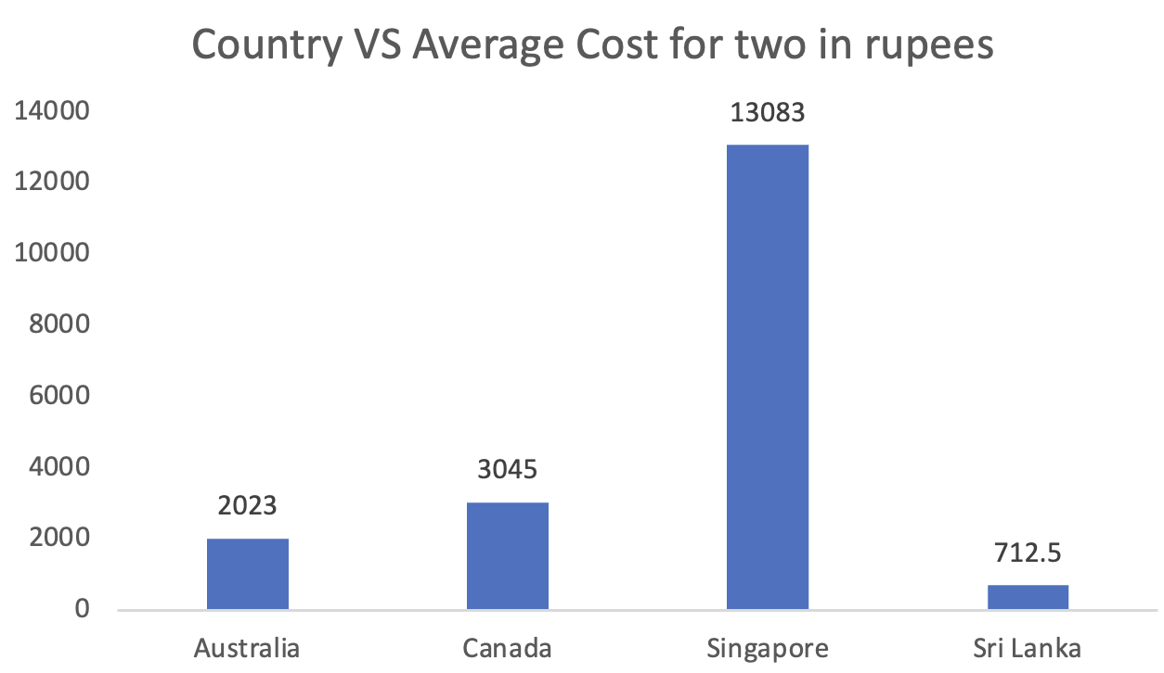
Cost Analysis for Selected Markets
Diverse Pricing: The average cost for two varies significantly across the selected countries, with Singapore at the highest (13,083 INR) and Sri Lanka at the lowest (712.5 INR). This highlights diverse market segments.
Targeted Pricing Strategy: Understanding these cost differences enables us to tailor pricing strategies. For example, premium pricing in Singapore might align with customer expectations, while a value-driven approach could be more effective in Sri Lanka.
Optimizing Market Entry: By aligning our pricing strategy with the local market dynamics, we can better position our restaurants to meet customer expectations and maximize profitability in each region.

Slide 15
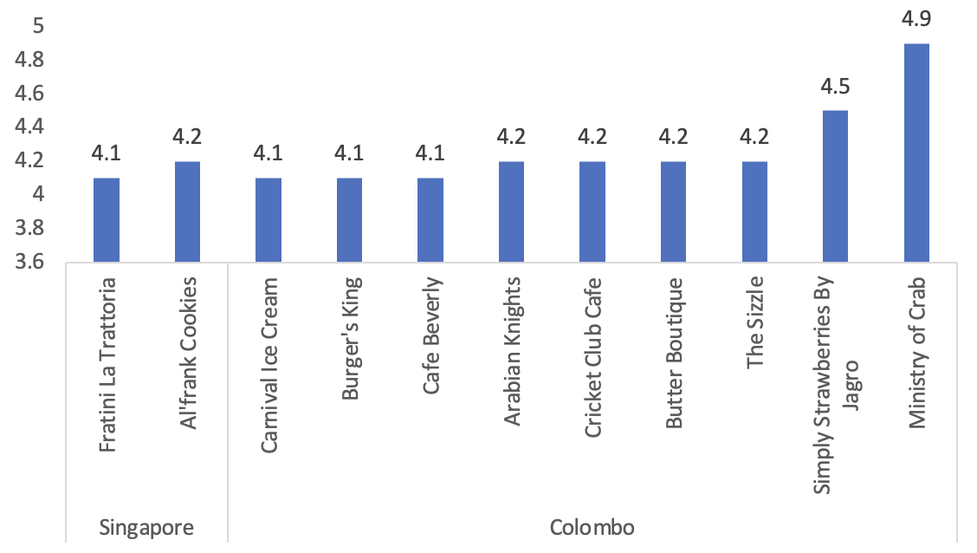
Analysing Top Competitors in Selected Markets
High-Quality Contenders: The restaurants in Colombo and Singapore with average ratings above 4 are our primary competitors, indicating strong customer satisfaction and well-established brands.
Concentrated Excellence: Colombo stands out with a higher concentration of top-rated restaurants like "Ministry of Crab" and "Simply Strawberries By Jagro," suggesting a competitive but rewarding market.
Strategic Focus: To compete effectively, focusing on differentiating our offerings and matching the high standards set by these top-rated establishments is crucial for success in these cities.

Slide 16
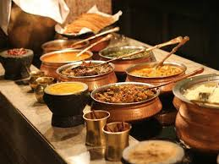


Top-Rated Cuisines In Selected Cities
SINGAPORE: Bakery, Italian, American, Steak, Chinese
COLOMBO: Seafood, Juices, Desserts, Middle Eastern, Arabian

Slide 17
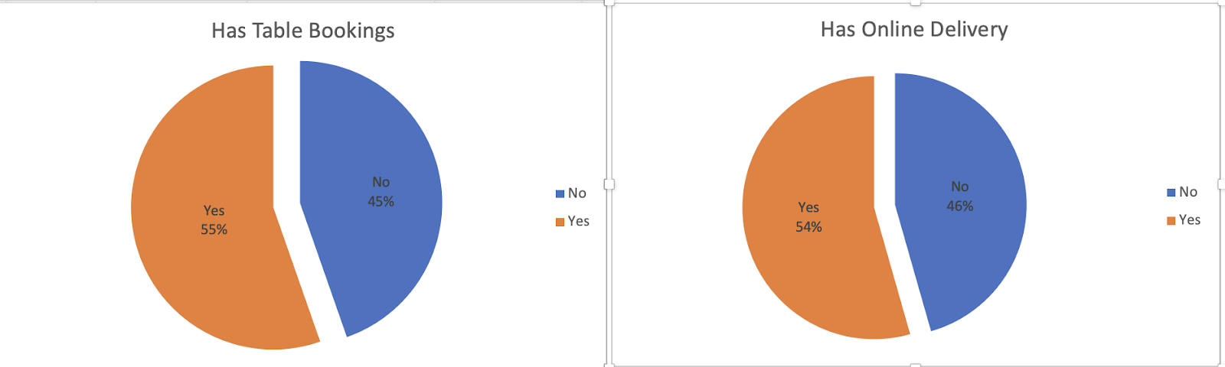
Impact of Additional Services on Restaurant Ratings
Higher Customer Satisfaction: Restaurants that offer online table booking and online delivery services tend to have higher average ratings. This suggests that these additional services are not just conveniences but critical factors in enhancing the overall dining experience.
Competitive Advantage: By offering these services, restaurants can differentiate themselves in the market, attract more customers, and build loyalty, ultimately leading to better reviews and higher ratings.
Strategic Recommendation: Implementing online table booking and online delivery should be considered essential for restaurants looking to improve their ratings and stay competitive in today’s digital-first environment.

Slide 18
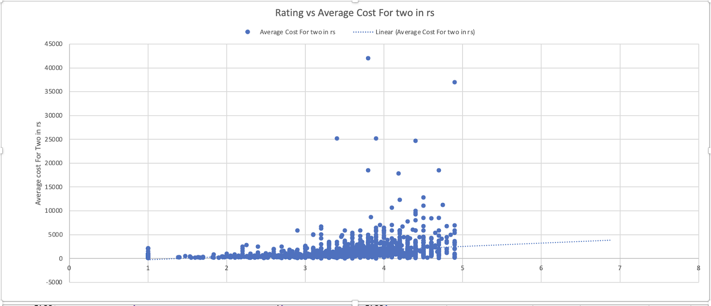
Pricing Strategy Insights: Analysing Cost for two vs. Ratings
WEAK CORRELATION: The correlation between these two metrics is 0.2782 which is a weak positive correlation which means there is a slight upward trend
IMPACT: keeping the rate of cuisines higher may have a slight positive impact on customer feedback, but it's unlikely to be the primary factor influencing customer satisfaction.overall dining experience, may play a more significant role in shaping customer feedback.

Slide 19
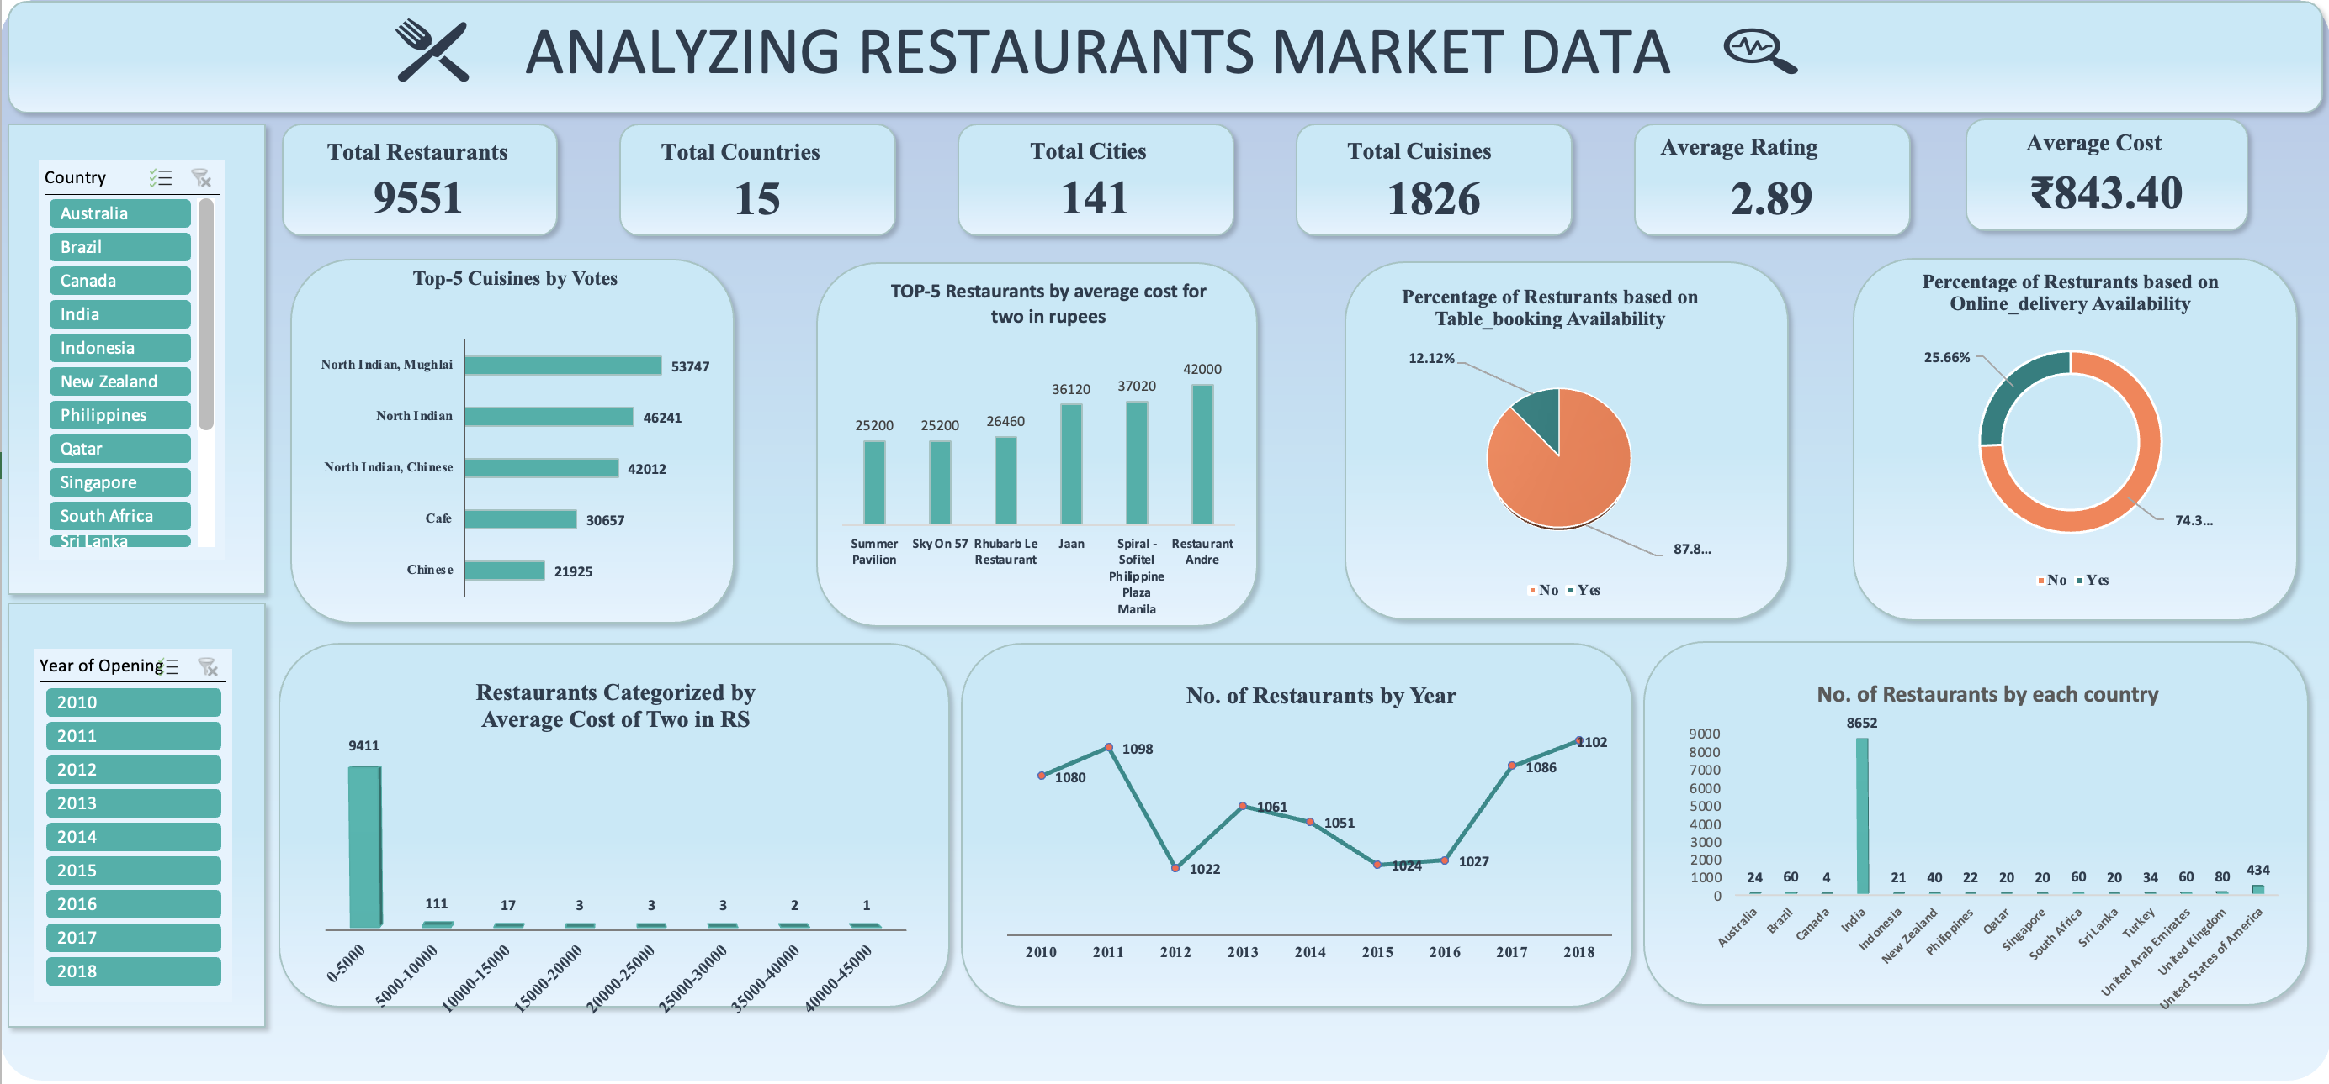

Slide 20

Conclusion
Country and City Selection Strategy:
Low Rating and Restaurant Density:
Focus on entering markets with lower restaurant ratings and fewer competitors, targeting underserved areas to establish a strong presence with minimal competition
Cuisine Recommendations by City:
Colombo:
Recommended Cuisines: Seafood, Juices, Desserts, Middle Eastern Rationale: These cuisines cater to local tastes and market gaps, aiming to attract customers with competitive pricing and quality.
Singapore:
Recommended Cuisines: Bakery, Italian, American, Steak Rationale: These popular cuisines align with current trends, catering to diverse customer preferences and enhancing market appeal.
Montiville and Consort:
Recommended Strategy: Focus on unique, high-quality food options to differentiate and attract customers in these cities with fewer high-rated cuisines.
Main Strategy:
Market Penetration: Target cities with lower ratings and fewer restaurants to establish a strong presence. Focus on popular, high-quality cuisines in Colombo and Singapore, while offering distinctive options in Montiville and Consort to drive growth.

Slide 21

VADDI JASWANT +91 7013007541 vaddijaswant@gmail.com

