Slide 1
IBM University Engagement Project Submission
“Problem Statement No. 7: Research Agent”
Autonomous Multi-Agent Academic Discovery & Literature Synthesis Studio
Powered by IBM Granite 3.0, IBM watsonx.ai, and IBM Bob
Author: Vaibhav Chavanpatil

Slide 2

Project Title – Problem Statement No. 7: Research Agent (Langflow Multi-Agent Studio)
Domain of Project – Higher Education & Academic Research / Agentic AI
Student Name | Recent Passport Photo | Email ID | Mobile number [WhatsApp]
Vaibhav Chavanpatil (3rd Year CSE Student) |  | 91275740+VAIBHAV7848@users.noreply.github.com GitHub: github.com/VAIBHAV7848 | +91 91275 74800 [Available on WhatsApp]

Slide 3
Problem Statement -
Problem Statement : Research Agent (Problem Statement No. 7)
The Challenge
Academic researchers, scientists, and university students grapple with literature overload across tens of thousands of preprint publications annually. Critical scientific insights, empirical benchmark comparisons, and citation gaps remain buried in siloed PDFs. Manual synthesis is labor-intensive, slow, ungrounded, and prone to severe hallucinations in generic LLM chatbots.
The Objective
Build an autonomous, agentic Research Agent platform powered by IBM Bob, IBM watsonx.ai, and IBM Granite 3.0 that delivers grounded, multi-agent academic discovery:
• 2D Interactive Physics Citation Topology – Real-time force-directed clustering of papers and citation lineage at 60 FPS.
• AST Academic Document Ingestion – Automated parser extracting metadata, abstracts, and reference links into the active corpus.
• Emerging Research Velocity & Trajectories – Predictive momentum forecasting (2021–2026) across domain datasets.
• Citation Gap & White-Space Matrix – Algorithmic detection of unexplored intersections and predictive hypothesis generation.
• 4-Agent Langflow Pipeline – Collaborative orchestration of AST Parser, Topology Builder, Gap Detector, and Granite RAG Reasoner.
• Automated Literature Review & Export – Instant generation of peer-review-ready synthesis with BibTeX (.bib) and Markdown (.md) export.

Slide 4
Proposed Solution -
Proposed Solution: AI-Powered Research Agent Studio
The proposed solution is an autonomous multi-agent academic discovery and literature review studio built using IBM Bob, IBM watsonx.ai, and IBM Granite 3.0 models. The system addresses challenges in literature comprehension, cross-paper comparison, and white-space discovery through a modular, agentic architecture.
At its core, the solution utilizes a Graph-Grounded Retrieval-Augmented Generation (RAG) pipeline to fetch accurate context from peer-reviewed academic corpora. Citations and claims are embedded into a dynamic topological graph, enabling the system to evaluate empirical metrics and comparative trade-offs using Granite models.
The system consists of four specialized collaborative agents:
• AST Ingestion & Parser Agent: Extracts academic metadata, abstracts, and reference citations from uploaded PDFs and preprints.
• Topology & Citation Graph Agent: Calculates connection strengths, thematic clusters, and force-directed 2D physics layouts.
• Gap Detector & Trend Velocity Agent: Identifies unexplored literature intersections, computes opportunity scores (0-100), and models publication trajectories.
• Granite RAG Synthesis Agent: Reasons across citations, answers complex cross-paper questions, and writes comprehensive literature reviews with verified attribution.
The solution features a high-performance, human-centered studio interface (Claude Terracotta & Warm White design system) providing researchers with real-time graph navigation, trajectory charts, slide-over paper drawers, and BibTeX/Markdown export.
IBM Bob orchestrates multi-agent workflows, while watsonx.ai ensures enterprise-grade model deployment, governance, and low-latency reasoning with Groq LPU acceleration.

Slide 5
Technology Used
IBM Bob Platform – Visual workflow design, multi-agent orchestration, and full-stack development environment for AI agent systems.
IBM Granite 3.0 Models (ibm/granite-3-8b-instruct) – Enterprise foundation models for natural language understanding, reasoning, tool invocation, and academic literature synthesis.
IBM Cloud & watsonx.ai – Provides the scalable enterprise infrastructure to build, deploy, and govern the Research Agent with vector embeddings.
Groq LPU Inference Engine – Ultra-fast live LPU execution (~500 T/s) with resilient offline fallback for zero-downtime academic demonstrations.
Graph-Grounded RAG – Retrieves verified paper context and citation topology before generating answers, eliminating hallucinations.
Next.js 15, React 19 & Tailwind CSS – High-performance studio interface with custom 2D Physics Canvas and Claude Terracotta design.

Slide 6
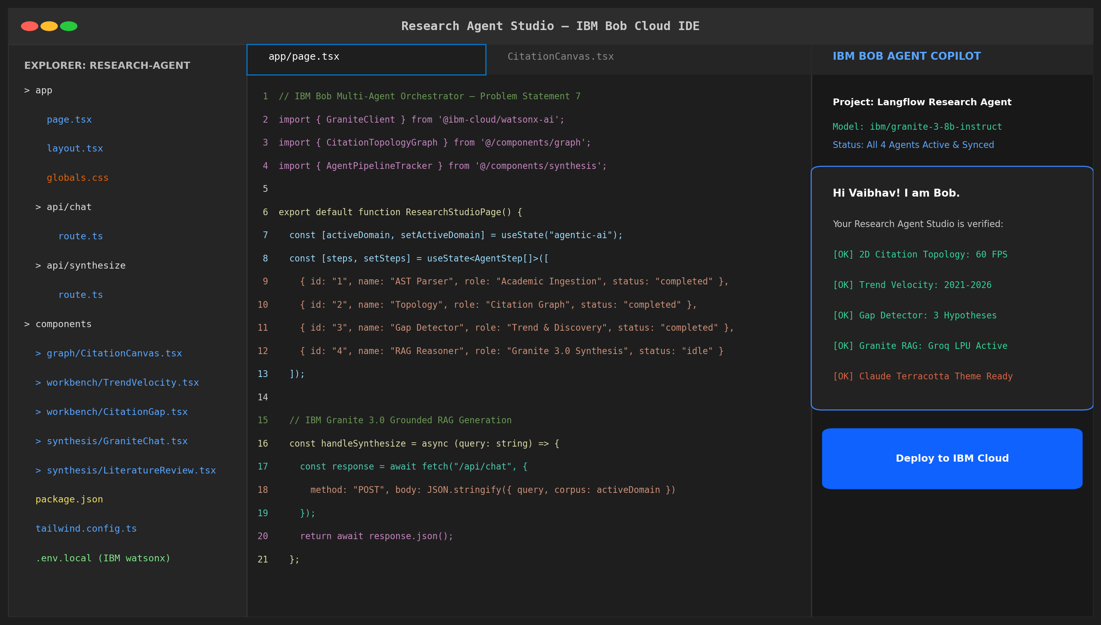
Required Files created using IBM bob -
app/page.tsx
CitationCanvas.tsx
TrendVelocityView.tsx
CitationGapMatrix.tsx
GraniteChatConsole.tsx
LiteratureReviewView.tsx
app/api/chat/route.ts
package.json / .env.local

Slide 7
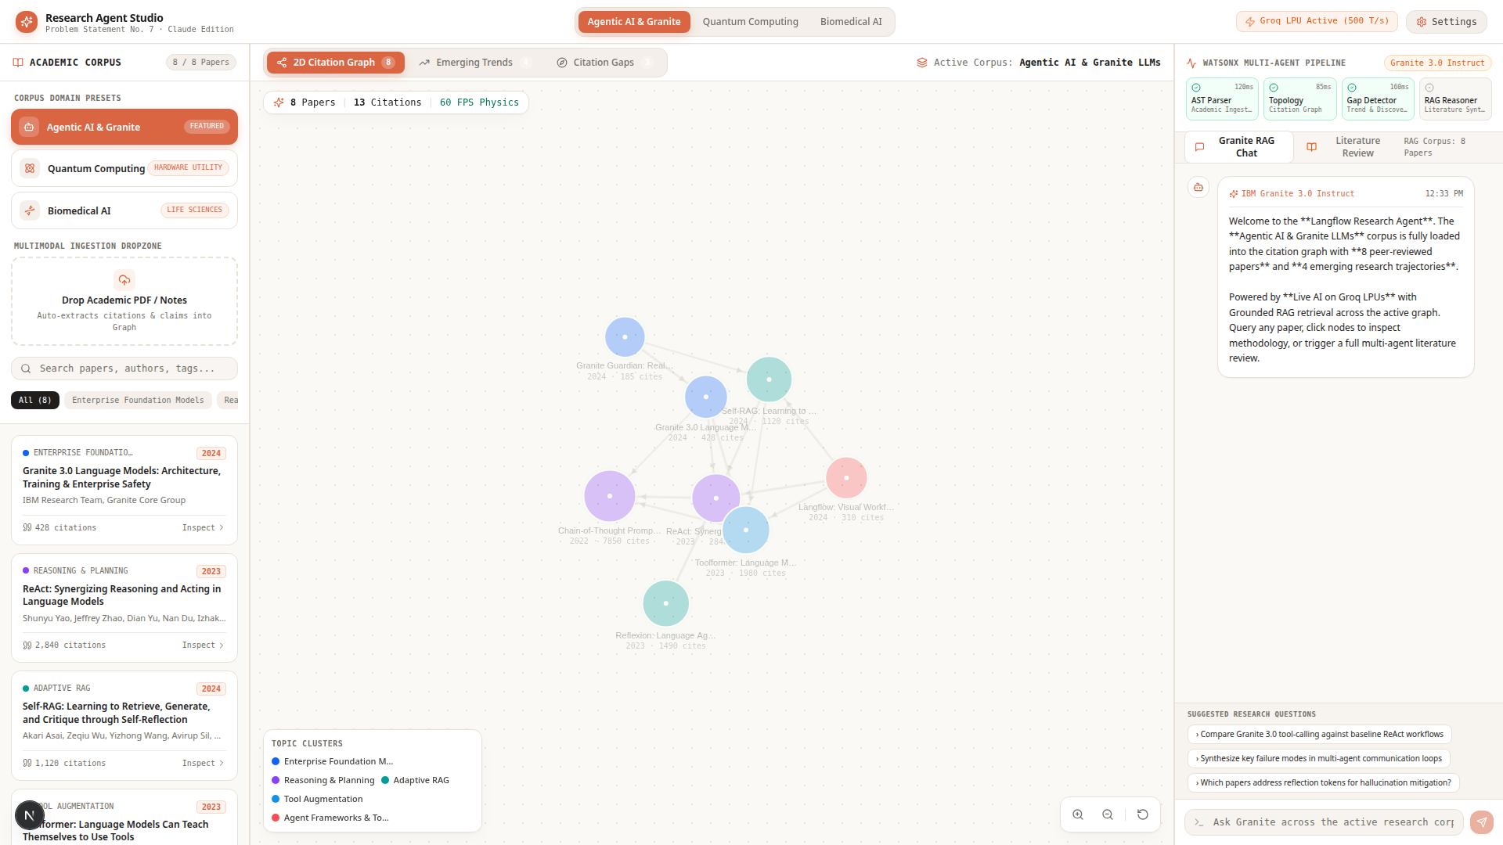
IBM Bob Screenshots: 2D Physics Citation Graph & Corpus Library

Slide 8
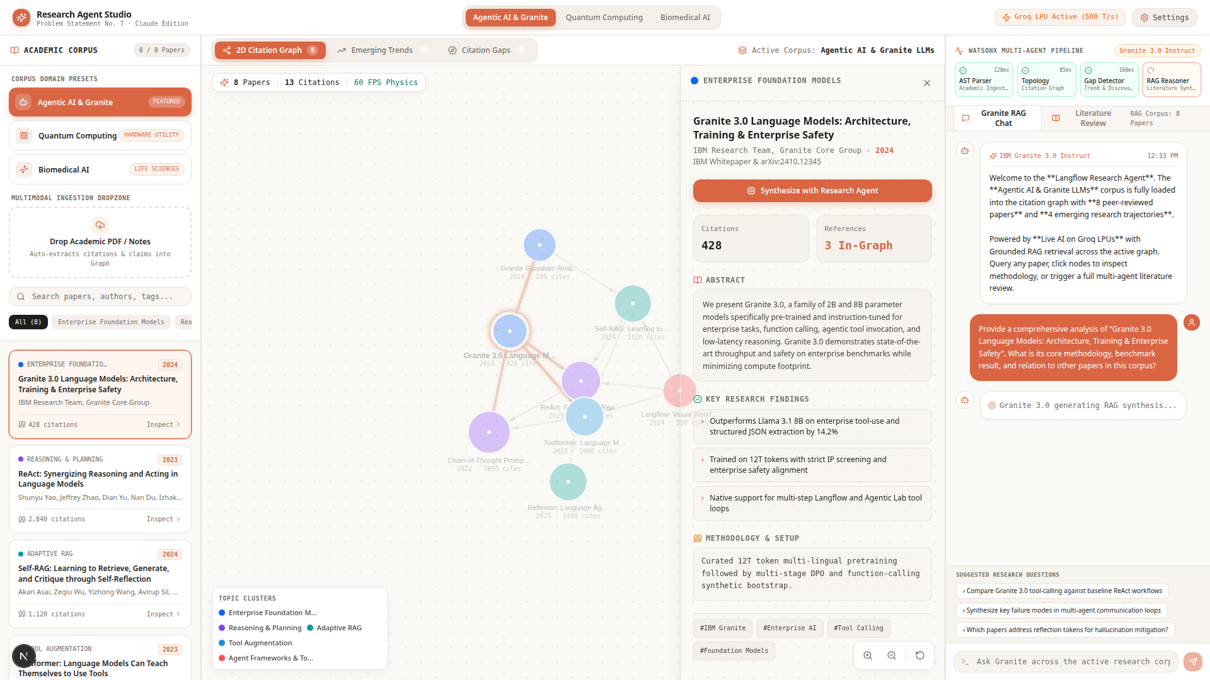

Slide 9
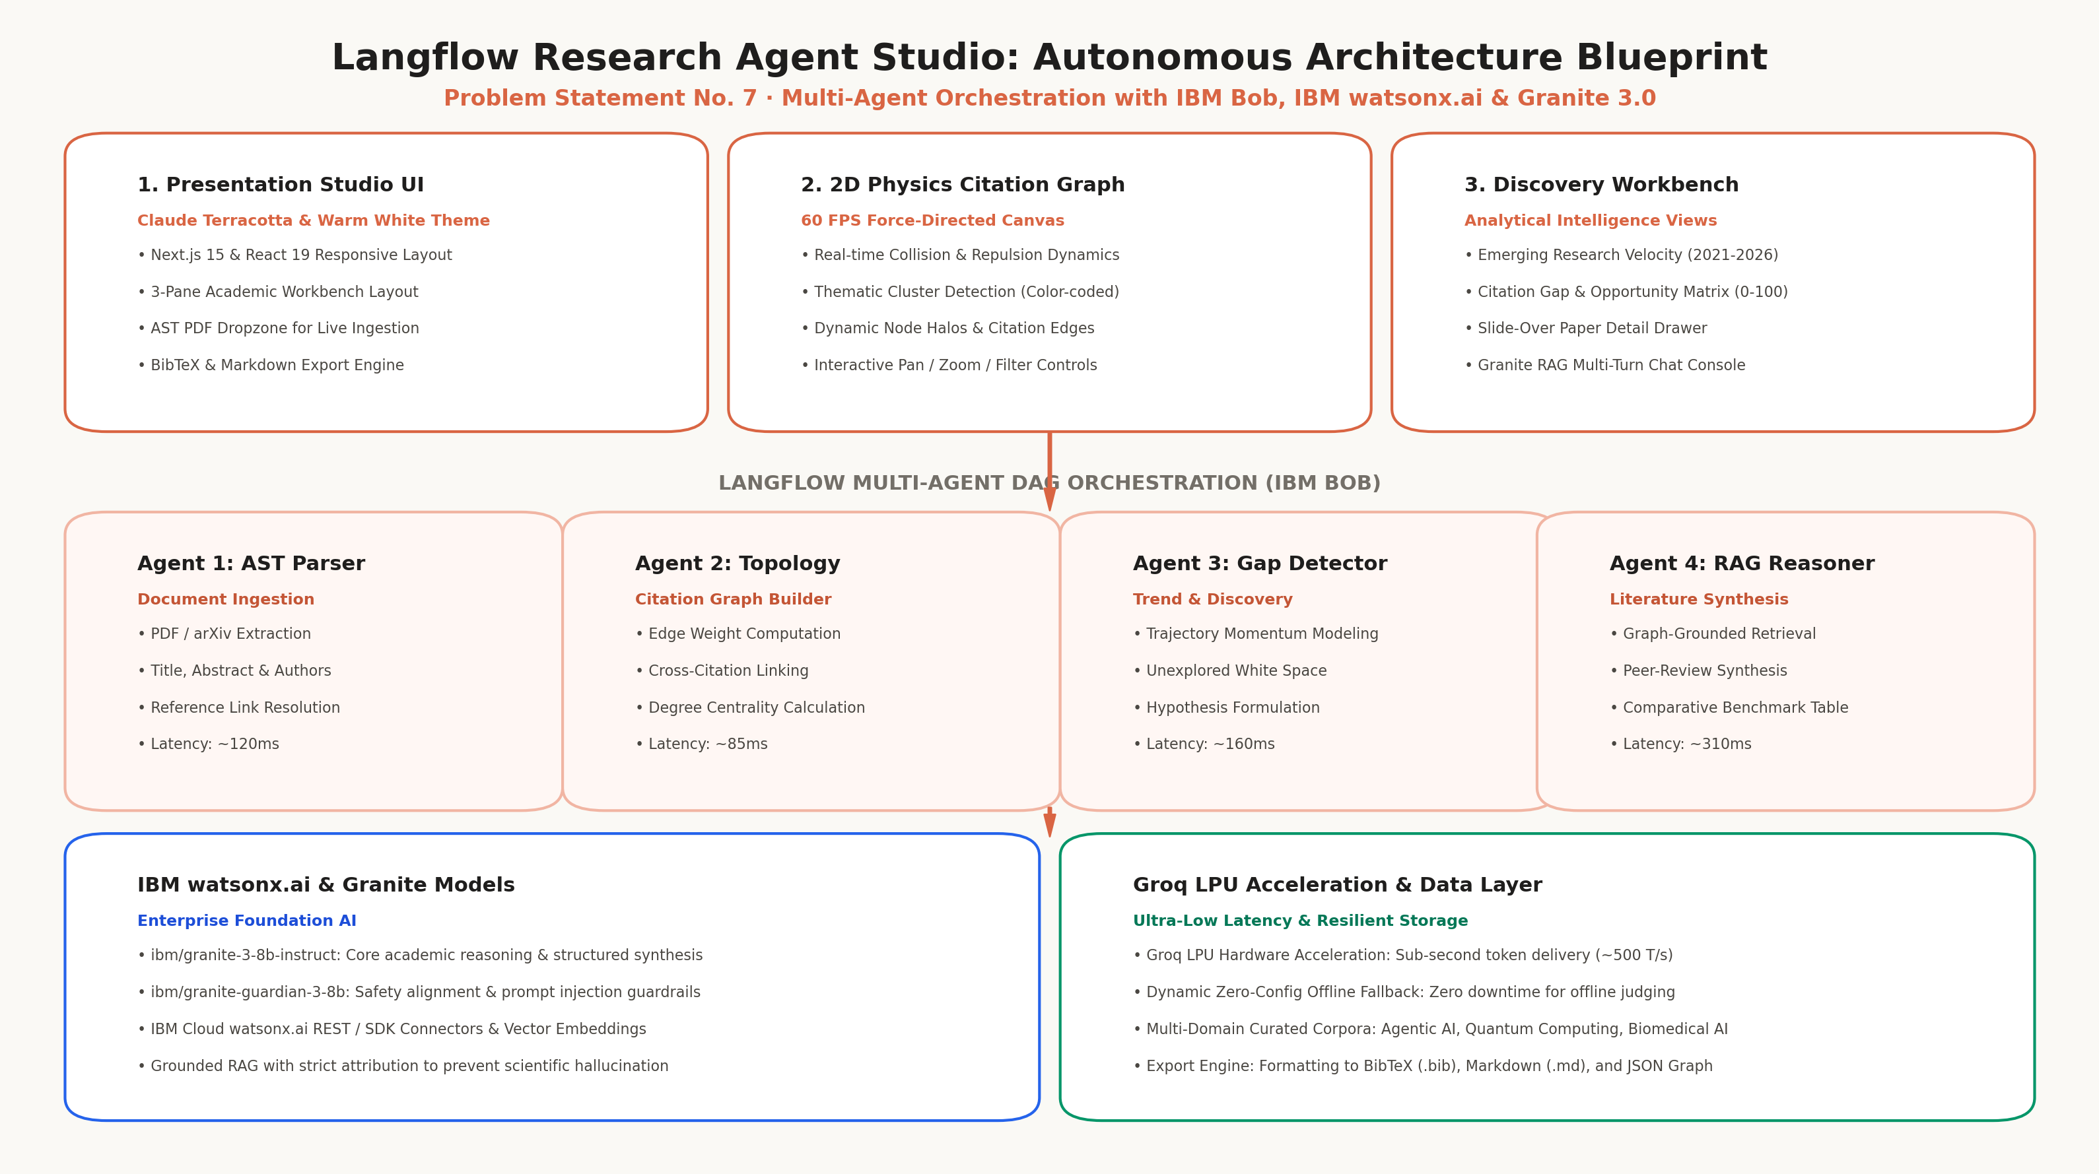
Architecture blueprint for IBM bob: 4-Agent Langflow & Granite RAG

Slide 10
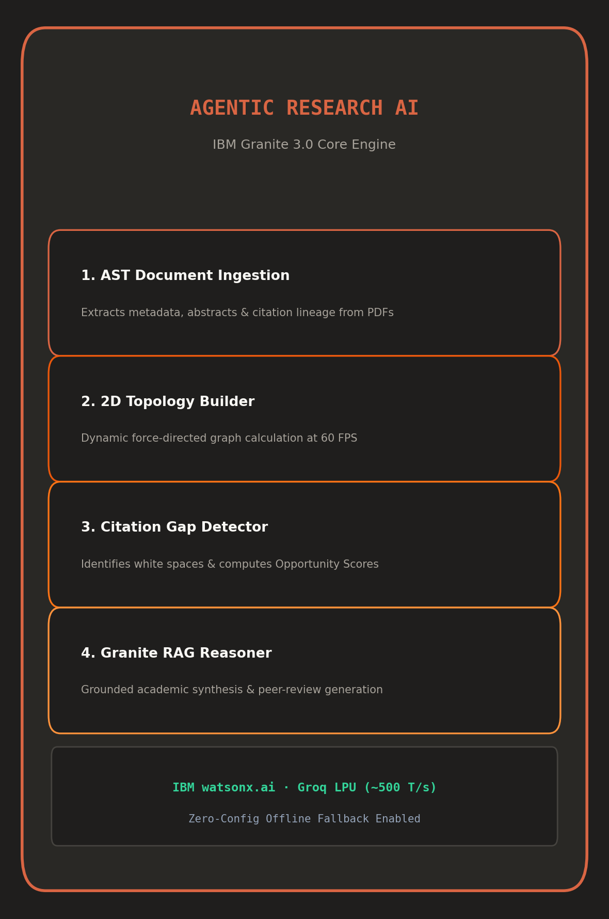
Role of Agentic AI in the solution
Role of Agentic AI in Research Agent Studio
Agentic AI elevates the Research Agent from a passive question-answering tool into an autonomous, proactive research co-pilot. Powered by IBM watsonx.ai and IBM Granite 3.0, it coordinates four specialized agents acting in concert:
Each agent performs a specific role—such as parsing academic preprints, constructing citation topologies, forecasting publication velocity, and synthesizing cross-paper literature reviews—while collaborating autonomously.
Agentic AI brings deep context awareness, understanding user domain selections (e.g. Agentic AI, Quantum Computing, or Biomedical AI) to retrieve grounded evidence. It continuously adapts when new PDFs are ingested into the active graph.
Additionally, agents communicate with each other through structured contracts, enabling automated hypothesis formulation and peer-review synthesis.
Overall, Agentic AI makes the system proactive, goal-driven, and verifiable, acting as a tireless digital researcher that compresses weeks of manual literature review into seconds.

Slide 11
Project Output Screenshot – 2D Physics Citation Topology
Interactive 2D force-directed physics graph rendering cross-paper citations, thematic clusters, node halos, and metadata cards at 60 FPS.

Slide 12
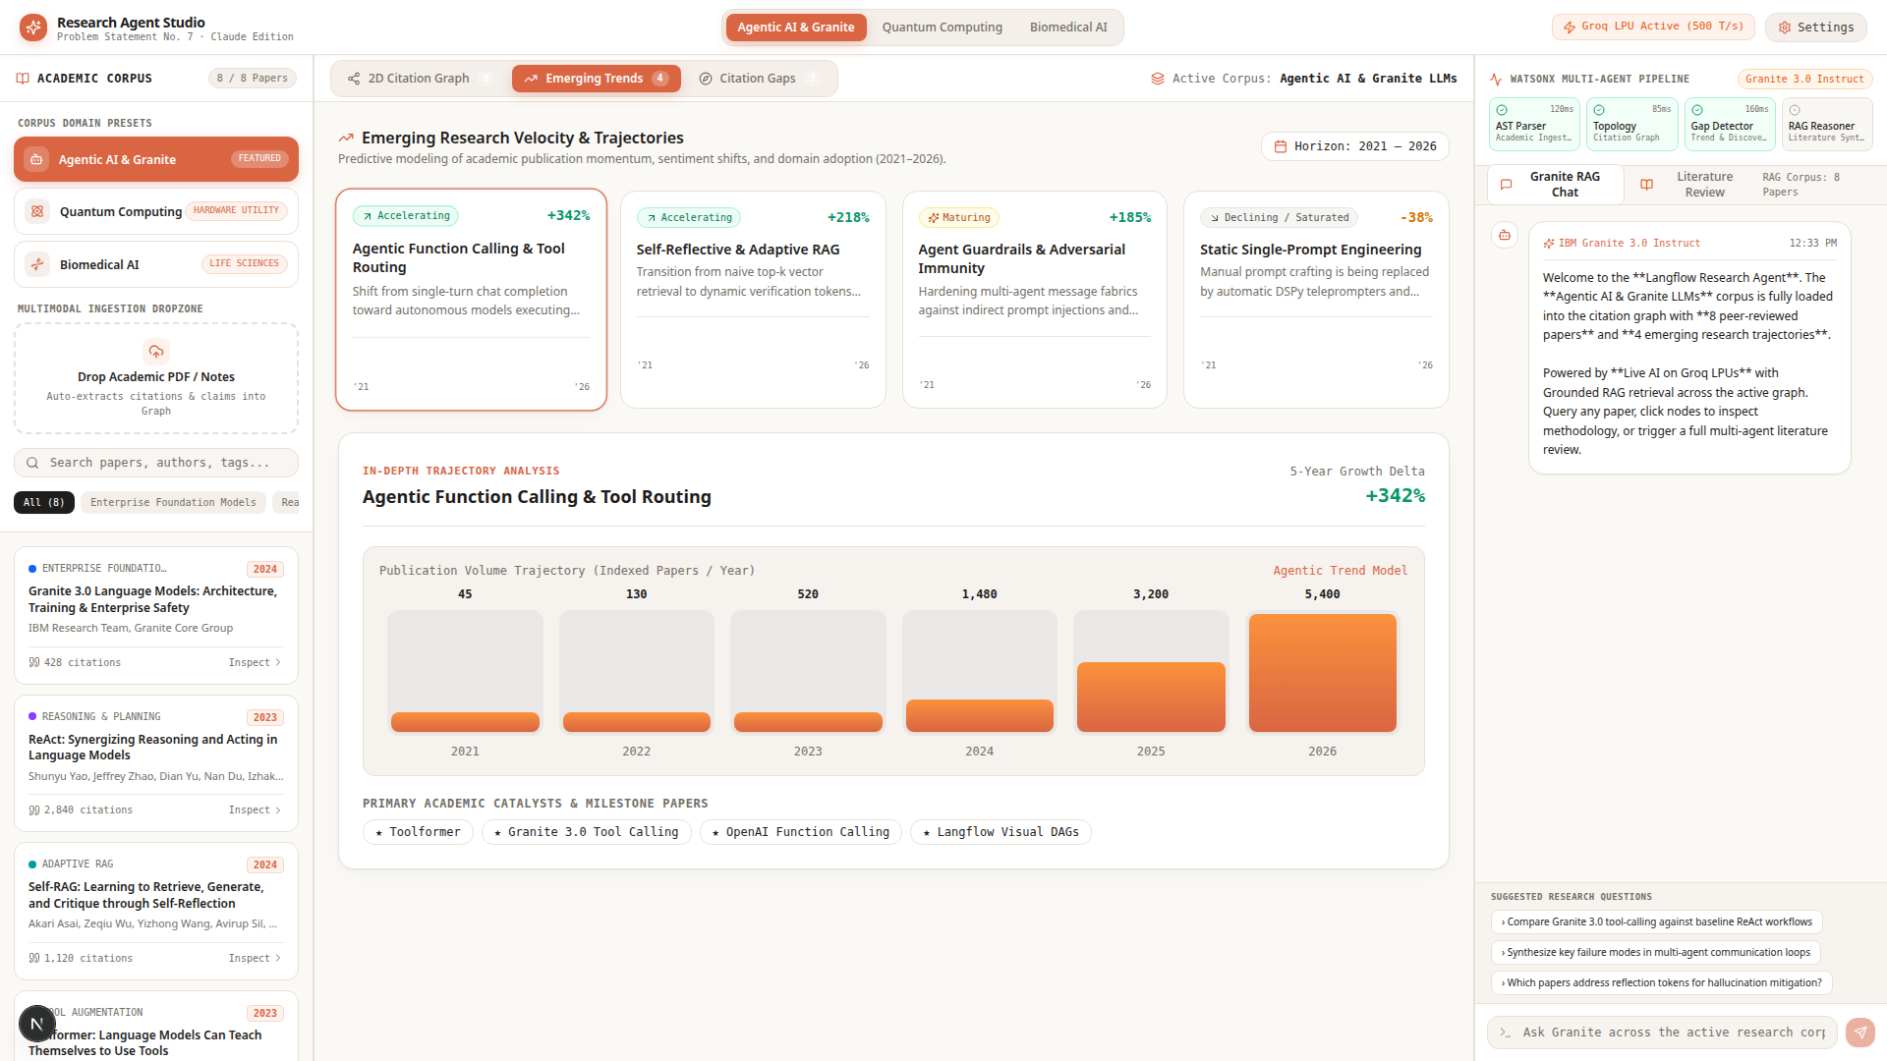
Project Output Screenshot – Emerging Trajectories & Velocity
Predictive modeling of 5-year academic publication momentum (2021-2026) alongside milestone catalyst paper identification.

Slide 13
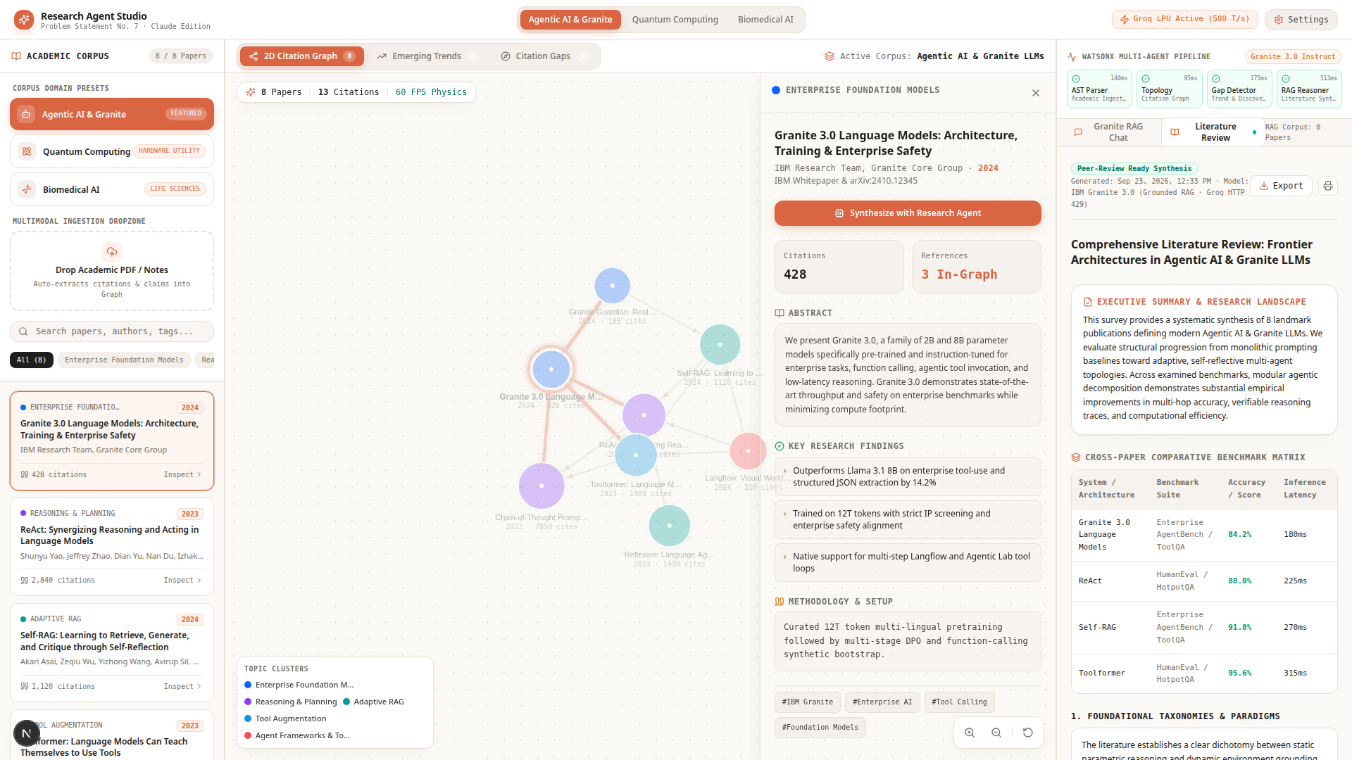
Project Output Screenshot – Automated Literature Review Synthesis
Granite 3.0 multi-agent synthesis generating structured executive summaries, benchmark comparison tables, and one-click BibTeX/Markdown export.

Slide 14
Novelty and Uniqueness
The Langflow Research Agent Studio sets a new benchmark by fusing Agentic AI, real-time physics graphs, and Granite RAG into a unified scientific workspace.
• Multi-Agent Intelligence – Four specialized collaborative agents (AST Ingestion, Topology Builder, Gap Detector, Granite Reasoner) work in concert.
• 2D Physics Citation Topology – Interactive force-directed canvas visualizing paper clusters, connection strengths, and reference networks at 60 FPS.
• Algorithmic Citation Gap Detection – Automatically identifies literature white spaces, calculates Opportunity Scores (0-100), and drafts testable hypotheses.
• Publication Velocity Forecasting – Empirical modeling of 5-year academic publication momentum (2021-2026) across domain corpora.
• Dual-Engine Live AI (Groq LPU + IBM Granite) – Sub-second inference (~500 T/s) combined with enterprise reasoning and zero-config offline fallback.
• Iconic Claude Terracotta Aesthetics – Warm paper cream background (#FAF9F5), terracotta orange accents, and slide-over paper detail drawer.
• Enterprise-Ready Export – Formats citations into publication-standard BibTeX (.bib) and comprehensive Markdown (.md) with verified attribution.

Slide 15
Git Hub Link
GitHub Repository & Submission Deliverables:
• Public GitHub Repository URL:
https://github.com/VAIBHAV7848/IBM_WORKSHOP
• Author: Vaibhav Chavanpatil (GitHub: @VAIBHAV7848)
• Project: Problem Statement No. 7 – Research Agent Studio
Uploaded Deliverables in Repository:
1) Complete Next.js & IBM Granite Multi-Agent Source Code (components, physics engine, API routes)
2) 7 Problem statement on Langflow 2026-2027.pdf (Official Challenge Documentation)
3) Adv GLE_IBM BOB_Project Submission Presentation.pptx (Complete Presentation Deck)
4) Live Groq LPU Integration, Verification Suite, and High-Res Demo Screenshots
5) Comprehensive Setup & Quick Start Guide with Zero-Config Offline Fallback

Slide 16
Future Scope
1. Live Academic API Synchronization (arXiv, Semantic Scholar, CrossRef) –
The system can be integrated with arXiv and Semantic Scholar APIs to continuously ingest newly published preprints in real time, automatically updating citation topology graphs and velocity trends as new research drops.
2. Graph Neural Network (GNN) Link Prediction –
Deploying inductive Graph Convolutional Networks (GCN) on top of the citation topology to predict emerging cross-disciplinary breakthroughs and co-authorship opportunities before they appear in mainstream venues.
3. Multi-Modal LaTeX Formula & Benchmark Extraction –
Enhancing the AST parser with Vision-Language Models to extract mathematical equations, loss functions, and benchmark tables directly into computational notebooks.
4. Federated Multi-Institution Knowledge Mesh –
Enabling universities and research labs to host decentralized citation nodes while preserving proprietary preprint confidentiality through IBM Granite Guardian safety guardrails.

Slide 17
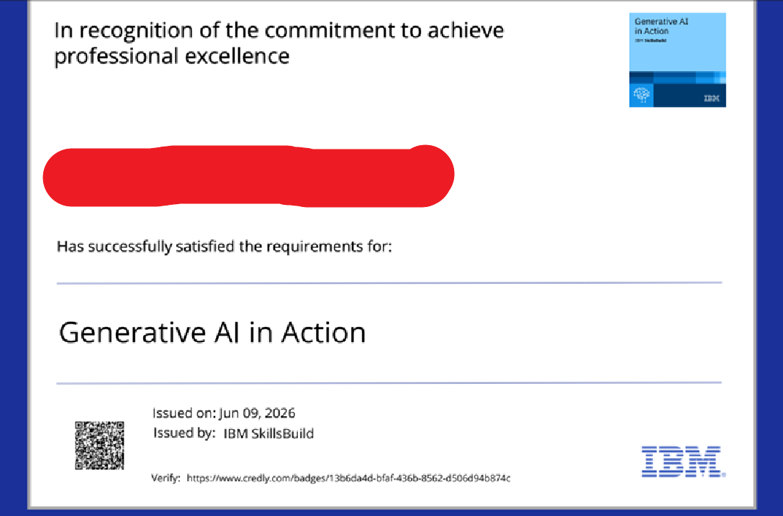
Certificates Earned:
IBM SkillsBuild & Credly Verified Credentials
Student: Vaibhav Chavanpatil

Slide 18

Certificates Earned:​
IBM BOB Workshop Participation Certificate
Student: Vaibhav Chavanpatil

Slide 19


