Slide 1

Mini Project
Milestone-Based Escrow & Dispute Resolution Workflow
Team: 07 | Theme: 01 | Engine Decomposition
Data Structures & Algorithms
Database Management Systems
Operating Systems
Software Engineering (SE)
Web Technologies
Discrete Mathematics (Supporting)
Team Members
Vaibhav Chavanpatil (02FE24BCS013) | Purvi Sammatshetti (02FE24BCS022)
Darshan Kittur (02FE24BCS053) | Vaishnavi Modekar (02FE24BCS060)
Department of Computer Science and Engineering,
KLE Technological University's Dr. M. S. Sheshgiri College of Engineering and Technology, Belagavi

Slide 2
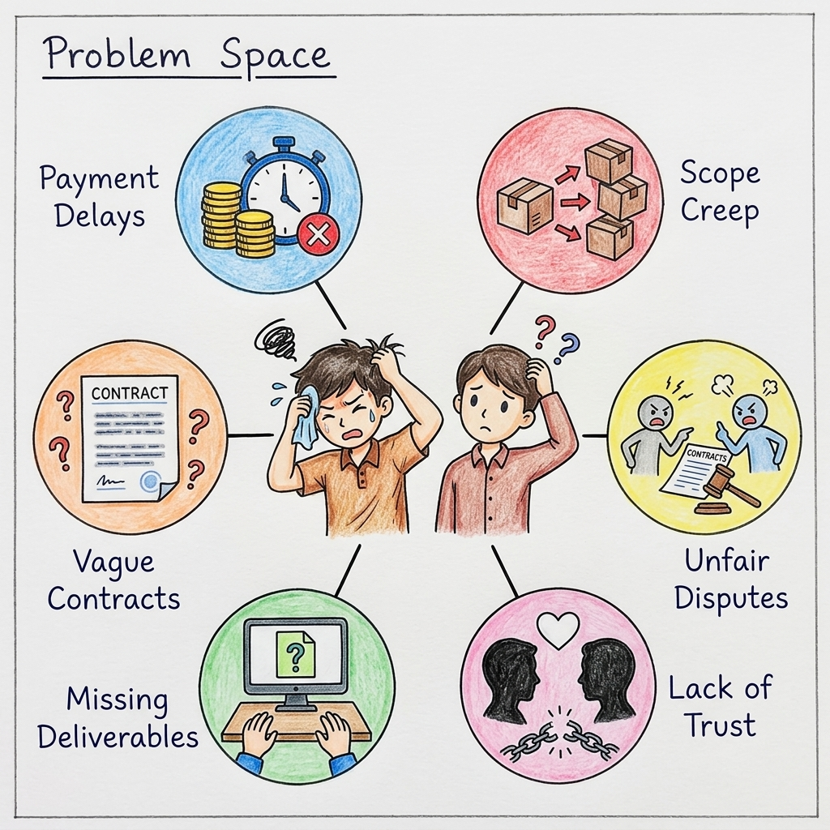
The Freelance Problem Space
PROBLEM IDENTIFICATION — Key pain points in the marketplace that require a secure escrow solution.
Payment Delays & Fraud
Freelancers often face late payments, unpaid invoices, or clients who disappear after receiving the work.
Scope Creep
Clients continuously add new requirements outside the original agreement without adjusting the budget.
Unfair Disputes
When disagreements occur, there is no transparent, evidence-based system to resolve the conflict fairly.
Lack of Trust
Both parties operate with high risk—clients fear paying for bad work, and developers fear working for free.
Department of Computer Science and Engineering | Team 07 — Milestone-Based Escrow & Dispute Resolution
2

Slide 3
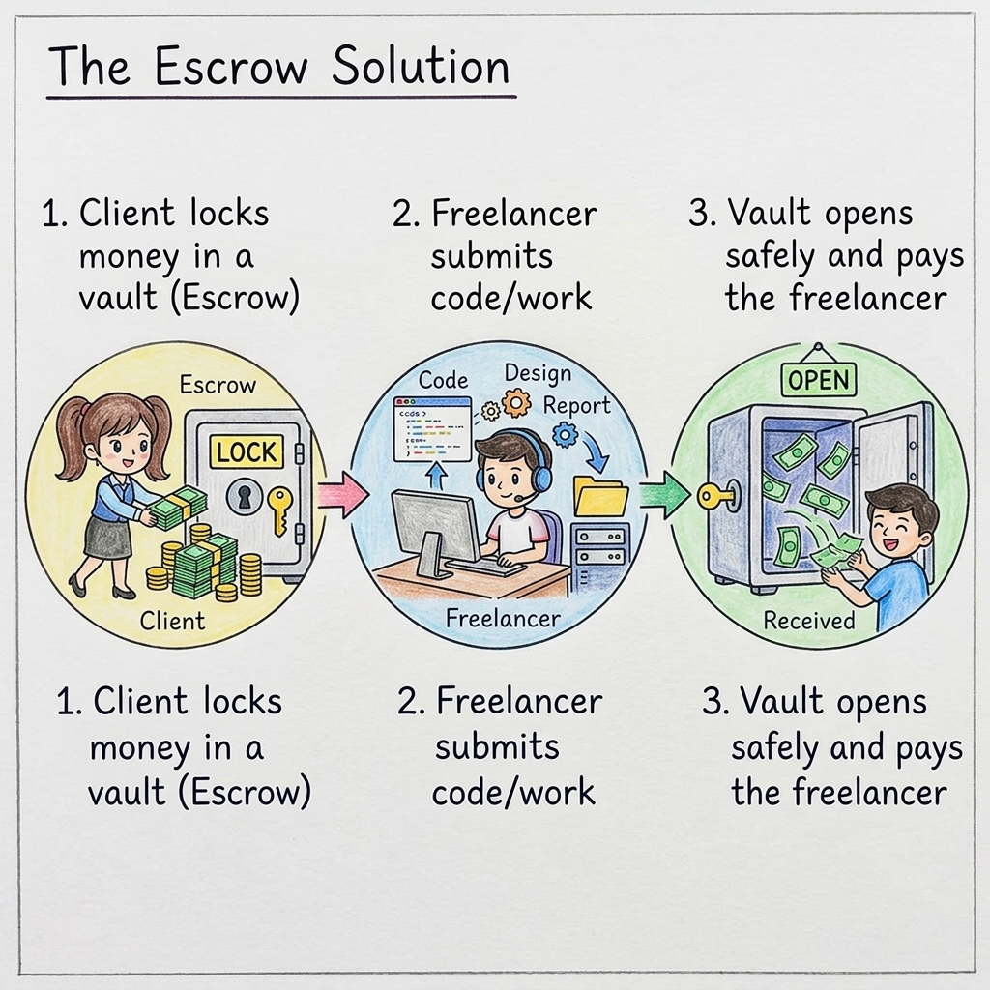
The Escrow & Milestone Mechanism
SOLUTION WORKFLOW — Securing trust through verified deliverables and locked funds.
1. Secure Fund Locking
The client deposits the total project budget into a secure escrow vault before any work begins, eliminating payment risk.
2. Milestone Submissions
The developer submits code and deliverables for specific, agreed-upon milestones. Artifacts are hashed for integrity.
3. Verification & Release
Once the client reviews and approves the submission, the smart FSM automatically releases the locked funds to the developer.
Dispute Adjudication
If approval fails, reviewers use the cryptographic evidence tree to fairly resolve the issue.
Department of Computer Science and Engineering | Team 07 — Milestone-Based Escrow & Dispute Resolution
3

Slide 4
Zero-Copy Memory Management Principles
The following high-level engineering principles guide how memory and data buffers should be considered across the scheduling, persistence, and dashboard paths of the system.
1
Goal: minimize avoidable copies across scheduling, routing, database, and dashboard paths.
2
Pass immutable views, handles, or offsets instead of cloning large payloads.
3
Consider shared memory, mapped files, ring buffers, pooling, and scatter/gather I/O when useful.
4
Assign one owner for allocation, mutation, release, backpressure, and cleanup.
5
Specify buffer lifetime, alignment, bounds, mutability, versioning, and fallback behaviour.
6
Optimize selectively; small control messages may favor simplicity.
7
Instrument copy count, allocations, CPU, latency, throughput, and peak memory.
8
Acceptance: preserve correctness under load and document every fallback copy.
Department of Computer Science and Engineering | Team 07 — Milestone-Based Escrow & Dispute Resolution
4

Slide 5
Rudimentary Security Principles
The following baseline security principles apply across all engines and system layers.
1
Authenticate users and services; authorize every action with role-based, least-privilege access.
2
Protect network traffic with TLS and reject insecure or untrusted service connections.
3
Validate type, length, range, state, and ownership at every API and buffer boundary.
4
Use parameterized database queries, output encoding, and safe error messages without sensitive data.
5
Keep credentials and keys outside source code; rotate secrets and separate student, admin, and service roles.
6
Record tamper-aware audit events with actor, action, timestamp, outcome, and correlation ID.
7
Apply timeouts, rate limits, dependency checks, secure defaults, backups, and recovery tests.
8
Acceptance evidence: negative tests show no unauthorized access, injection, secret leakage, or unsafe retry.
Department of Computer Science and Engineering | Team 07 — Milestone-Based Escrow & Dispute Resolution
5

Slide 6
SECTION A — ENGINE DECOMPOSITION EXAMPLE
Department of Computer Science and Engineering | Team 07 — Milestone-Based Escrow & Dispute Resolution
6

Slide 7
SECTION B — WEEK 4 AND GATE 1
Department of Computer Science and Engineering | Team 07 — Milestone-Based Escrow & Dispute Resolution
7

Slide 8

AN ENGINE-BASED MINI-PROJECT FRAMEWORK WITH HYBRID SDLC
Milestone-Based Escrow & Dispute Resolution
Team 07 | Decomposing the freelance platform into four engineering engines.
Operating Systems
DSA & Software Engineering
DBMS
Web Technologies
Department of Computer Science and Engineering | Team 07 — Milestone-Based Escrow & Dispute Resolution
8

Slide 9
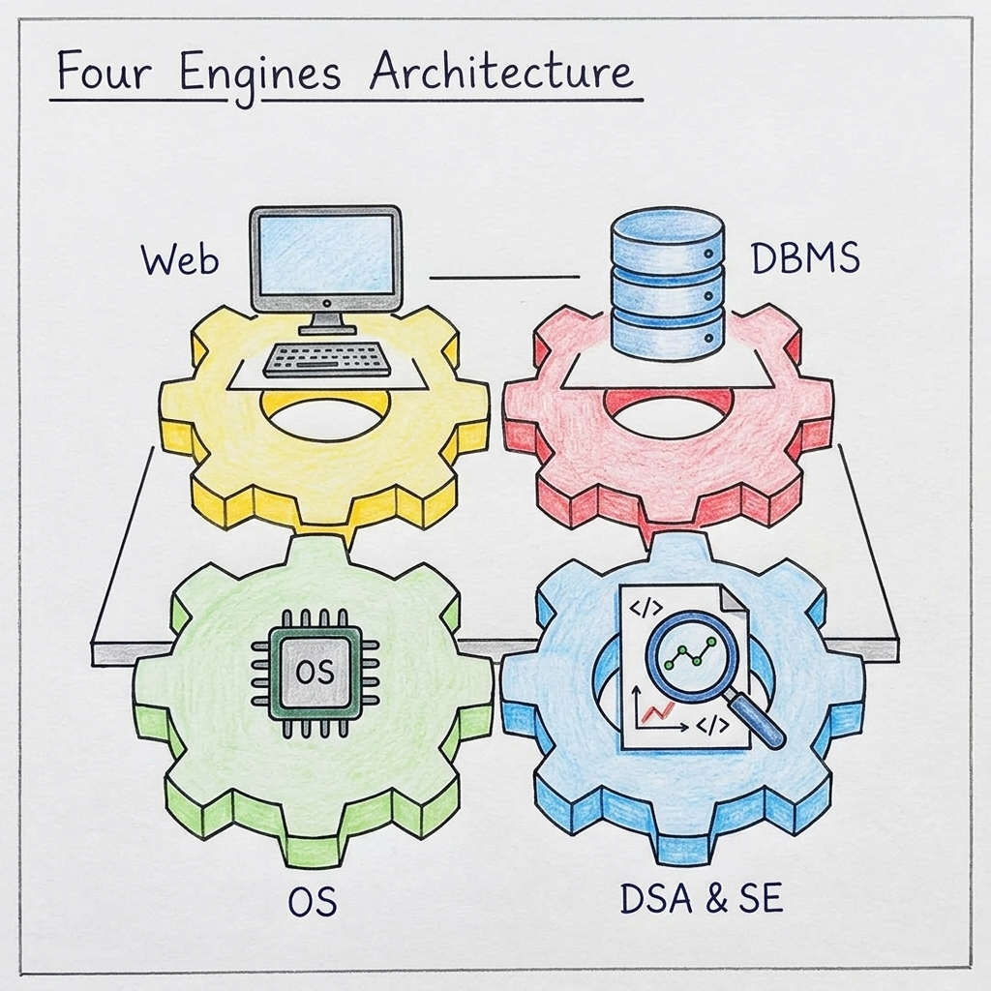
Four Engines Visualization
SYSTEM ARCHITECTURE — Four distinct engineering domains powering a single unified platform.
OS Engine (Escrow FSM)
Manages the deterministic state transitions of the escrow vault, ensuring atomic locks and safe fund releases.
DSA & SE Engine (Evidence)
Handles SHA-256 cryptographic hashing, requirements traceability, and evidence tree structures for dispute resolution.
DBMS Engine (Ledger)
Executes ACID-compliant relational transactions and maintains tamper-resistant audit logs of all platform activity.
Web Engine (Dashboard)
Provides the Role-Based Access Control (RBAC) frontend for Clients, Freelancers, and Reviewers to interact with the system.
Department of Computer Science and Engineering | Team 07 — Milestone-Based Escrow & Dispute Resolution
9

Slide 10
Four Engines, One Integrated System
PROJECT ARCHITECTURE — Each engine is independently ownable and testable, while contributing to the integrated Milestone-Based Escrow & Dispute Resolution platform.
01
Escrow & State Scheduler
OS ENGINE · Vaishnavi
Simulates escrow locks and milestone state transitions.
02
Verification & Evidence Engine
DSA & SOFTWARE ENG · Darshan
Manages cryptographic verification, artifact integrity, and evidence trees for disputes.
03
Transaction Ledger
DBMS ENGINE · Purvi
Handles ACID milestone payments and audit logs.
04
Role-Based Workflow Dashboard
WEB TECHNOLOGIES · Vaibhav
Responsive UI for clients, freelancers, and reviewers with RBAC and dispute workflows.
Department of Computer Science and Engineering | Team 07 — Milestone-Based Escrow & Dispute Resolution
10

Slide 11
Requirements to Engines
ENGINE DECOMPOSITION — Requirement clusters derive the four engines
Requirements
Requirement Clusters
Derived Engines
1. Escrow fund locking
2. Milestone tracking
3. File hashing & uploads
4. ACID payments
5. Dispute workflows
6. User auth & RBAC
7. Role-specific dashboards
Cluster A: Escrow Governance (Manage state transitions)
→
E1: OS Engine Owner: Vaishnavi
Cluster B: Evidence & Verification
(Cryptographic hashing & artifact traceability)
→
E2: DSA & SE Engine
Owner: Darshan
→
Cluster C: Ledger Persistence (ACID transactions)
→
E3: DBMS Engine Owner: Purvi
Cluster D: Multi-Role UI
(Auth, RBAC, dispute forms)
→
E4: Web Engine
Owner: Vaibhav
Department of Computer Science and Engineering | Team 07 — Milestone-Based Escrow & Dispute Resolution
11

Slide 12
Engine 01 — Escrow & State Scheduler
OPERATING SYSTEMS ENGINE — Owner: Vaishnavi Modekar
What it does
What students should do
• Manages milestone states (Funded, In-Progress, Released).
• Enforces atomic locks on funds to prevent double-spending.
• Handles timeouts for delayed client reviews.
• Implement state transition logic.
• Write mutex/semaphore controls to avoid race conditions.
• Test timeout scenarios and deadlock prevention.
Academic focus & foundational link
Foundational course area | Concepts exercised by this engine
Operating Systems | Process/thread scheduling, semaphores, deadlock-free allocation, memory mgmt
Data Structures & Algorithms | Priority queues, circular queues (Round Robin), heaps
Object-Oriented Programming | Process classes, scheduler inheritance hierarchy
Software Engineering | Requirements spec, module design, state-transition diagrams
Computer Networks | IPC, socket-based inter-engine communication
Department of Computer Science and Engineering | Team 07 — Milestone-Based Escrow & Dispute Resolution
12

Slide 13
Engine 02 — Evidence & Quality Assurance Engine
DSA & SOFTWARE ENGINEERING — Owner: Darshan Kittur
What it does
What students should do
• Applies cryptographic SHA-256 hashing for deliverable verification.
• Organizes evidence files in tamper-evident trees (DSA).
• Enforces requirements traceability and V&V pipelines (SE).
• Implement verification (V&V) pipelines for deliverables.
• Design artifact traceability structures linking to hash proofs.
• Optimize evidence tree traversal for fast dispute resolution.
Academic focus & foundational link
Foundational course area | Concepts exercised by this engine
Software Engineering | V&V, requirements traceability, artifact management, test design
Data Structures & Algorithms | Hash maps, tree structures for evidence indexing, traversal optimization
Computer Networks | Secure deliverable transmission, HTTP/REST upload validation
Object-Oriented Programming | Graph node/edge classes, adapter pattern for interfaces
Software Engineering | Algorithm complexity analysis, performance benchmarking
Department of Computer Science and Engineering | Team 07 — Milestone-Based Escrow & Dispute Resolution
13

Slide 14
Engine 03 — Transaction & Contract Manager
DBMS ENGINE — Owner: Purvi Sammatshetti
What it does
What students should do
• Manages all relational records (Users, Contracts, Milestones, Payments).
• Executes ACID transactions to ensure escrow transfers are atomic (no double spending).
• Maintains tamper-resistant audit logs of every state change for dispute resolution.
• Design normalized schemas (BCNF).
• Write parameterized SQL queries to prevent injection.
• Implement database triggers for audit logging.
Academic focus & foundational link
Foundational course area | Concepts exercised by this engine
Database Management Systems | Schema design, normalization, ACID, indexing, triggers, views
Data Structures & Algorithms | B-Tree indexing, hash maps, transaction log structures
Computer Networks | Secure data transmission, client-server connectivity, REST APIs
Software Engineering | ER modeling, UML diagrams, transaction test design
Operating Systems | File system integration for backup, buffer management
Department of Computer Science and Engineering | Team 07 — Milestone-Based Escrow & Dispute Resolution
14

Slide 15
Engine 04 — Role-Based Workflow Dashboard
WEB TECHNOLOGIES ENGINE — Owner: Vaibhav Chavanpatil
What it does
What students should do
• Provides responsive dashboards for clients, freelancers, and reviewers.
• Visualizes real-time milestone progress.
• Handles user authentication and dispute forms.
• Build the UI using React/Next.js.
• Implement DOM updates and asynchronous API calls.
• Ensure role-based access control (RBAC).
Academic focus & foundational link
Foundational course area | Concepts exercised by this engine
Web Technologies | HTML5 semantic markup, CSS3 animations/transitions
Computer Networks | HTTP/HTTPS protocols, RESTful API consumption
Software Engineering | UI/UX principles, responsive design, accessibility, testing
Database Management Systems | Form validation, SQL injection prevention, data binding
Data Structures & Algorithms | Event queues, sorting/filtering for dashboard data
Department of Computer Science and Engineering | Team 07 — Milestone-Based Escrow & Dispute Resolution
15

Slide 16
Four-Engine Integrated Platform Architecture
SYSTEM ARCHITECTURE — Full-stack milestone escrow and dispute resolution platform architecture and data flow.
Technology stack & layer design
Engine decomposition & runtime flow
Presentation Layer: Next.js 16 (App Router), React 19, Tailwind CSS 4, Lucide Icons
Application Layer: Next.js Server Route Handlers, TypeScript 5, Zod 4 Validation
Domain Engine: Escrow FSM validator (escrow-engine.ts), AI Matcher (ai-matcher.ts)
Security & Hashing: Node.js Crypto (SHA-256 deliverable checksums), RBAC Middleware
Persistence Layer: Prisma 5.22 ORM, SQLite relational database, ACID transactions
Inter-Engine Comms: Async RESTful JSON APIs, parameterized queries, structured envelopes
E1 · OS Engine (Vaishnavi)
Escrow State Scheduler — Enforces atomic funds lock and deterministic state transitions: AWAITING_DEPOSIT → FUNDED → IN_PROGRESS → UNDER_REVIEW → RELEASED.
E2 · DSA & SE Engine (Darshan)
Evidence & Quality Assurance Engine — Verifies deliverable integrity via SHA-256 hash generation, indexes dispute artifacts in evidence trees, ensures requirements traceability.
E3 · DBMS Engine (Purvi)
Transaction & Contract Manager — Manages relational contracts, bids, and milestones; executes ACID payments; logs tamper-resistant audit trails.
E4 · Web Engine (Vaibhav)
Role-Based Workflow Dashboard — Delivers responsive dashboards for Client, Developer, and Reviewer; handles user auth, RBAC, dispute forms, and real-time FSM visualization.
Department of Computer Science and Engineering | Team 07 — Milestone-Based Escrow & Dispute Resolution
16

Slide 17
RESTful Endpoints & Inter-Engine Contract Protocol
API ARCHITECTURE — Modular API routes implemented with Next.js Route Handlers, structured JSON envelopes, and error handling.
Endpoint | Method | Owning Engine | Description & Response Contract
/api/projects | GET, POST | E3 · DBMS / E4 · Web | List open projects or create new project with budget and skill tags; returns Project schema.
/api/proposals | POST | E3 · DBMS / E2 · DSA/SE | Submit developer proposal; triggers AI Matcher (aiMatchScore, skills overlap analysis).
/api/contracts | GET, POST | E1 · OS / E3 · DBMS | Fetch active contracts; execute SUBMIT_MILESTONE, APPROVE_MILESTONE, RELEASE_ESCROW.
/api/gigs | GET, POST | E4 · Web / E3 · DBMS | Query marketplace services by category/query; create tiered packages (Basic/Std/Prem).
/api/gigs/[id] | GET | E4 · Web | Fetch single gig details with seller profile, verification badges, and completed reviews.
/api/orders | GET, POST | E1 · OS / E3 · DBMS | Place and track gig orders with deliverable URLs, delivery due dates, and status.
/api/developers | GET | E4 · Web / E3 · DBMS | List developers with parsed skills, hourly rates, availability, and GitHub scores.
/api/analyze-github | POST | E2 · SE / E4 · Web | Verify developer GitHub profile; calculate developer score, repository metrics, top languages.
CORE CONTRACT ACTION PROTOCOL (POST /api/contracts)
SUBMIT_MILESTONE: Developer uploads deliverable code/URL → crypto.createHash('sha256') checksum generated → Milestone status becomes SUBMITTED → Contract moves to UNDER_REVIEW.
APPROVE_MILESTONE: Client reviews deliverable and checksum → marks Milestone as APPROVED → triggers release validation.
RELEASE_ESCROW: validateEscrowTransition(current, 'RELEASED') checks FSM compliance → releases locked funds → contract marked RELEASED.
Department of Computer Science and Engineering | Team 07 — Milestone-Based Escrow & Dispute Resolution
17

Slide 18
Functional Requirements Specification (FRS)
REQUIREMENTS BASELINE — Detailed functional requirements mapped to owning engines with observable acceptance criteria.
FR-ID | Requirement Title | Detailed Functional Description | Owning Engine | Acceptance Criteria
FR-01 | Escrow Fund Locking | The system shall atomically lock client funds upon contract agreement. | E1 · OS | Funds locked in escrow balance.
FR-02 | Milestone State Tracking | The system shall enforce sequential milestone states. | E1 · OS | Invalid status jumps rejected by FSM.
FR-03 | Cryptographic Checksums | The system shall generate a SHA-256 checksum for deliverables. | E2 · DSA/SE | Checksum verified upon review.
FR-04 | Evidence Trees | The system shall organize artifacts into tamper-evident tree structures. | E2 · DSA/SE | Dispute case loads tree hierarchy.
FR-05 | ACID Payment Processing | The system shall process milestone payments via ACID transactions. | E3 · DBMS | Zero balance discrepancy.
FR-06 | Tamper-Resistant Audit Log | The system shall record all changes in an append-only audit log. | E3 · DBMS | Audit log records actor/action/hash.
FR-07 | Role-Based Dashboards | The system shall render tailored dashboards for Client/Dev/Reviewer. | E4 · Web | Users see specific role tools.
FR-08 | Authentication & RBAC | The system shall authenticate users and enforce RBAC. | E4 · Web | Unauthorized access returns 401/403.
FR-09 | Dispute Workflow | The system shall provide dispute filing forms and tracking. | E4 · Web | Users can track disputes.
FR-10 | FSM Progress UI | The system shall render real-time milestone trackers. | E4 · Web | UI displays backend state visually.
FR-11 | AI Semantic Match | The system shall compute match scores between tags and devs. | E2 / E3 | Proposals display match score.
FR-12 | Contract Lifecycle | The system shall orchestrate the contract lifecycle. | E1 · OS | Contract transitions cleanly.
Department of Computer Science and Engineering | Team 07 — Milestone-Based Escrow & Dispute Resolution
18

Slide 19
Non-Functional Requirements Specification (NFRS)
QUALITY ATTRIBUTES — Target quality attributes, system constraints, measurable KPI targets, and verification methodologies.
NFR-ID | Category | Quality Attribute Target | Measurable KPI Target | Verification Method
NFR-01 | Performance | REST API endpoint latency under standard operational workload. | ≤ 500 ms p95 response time | Automated latency bench
NFR-02 | Security | Least-privilege role-based access control. | 100% protected routes enforce checks | Negative security tests
NFR-03 | Data Integrity | Cryptographic verification of all submitted deliverables. | SHA-256 mismatch detection = 100% | File tampering injection
NFR-04 | Input Validation | Strict boundary validation and injection prevention. | 100% payloads validated via Zod | Fuzz testing (SQLi/XSS)
NFR-05 | FSM Reliability | Deterministic escrow and milestone state machine execution. | 0 invalid transitions permitted | FSM model checker tests
NFR-06 | Responsiveness | Responsive UI rendering across heterogeneous display viewports. | Layout adapts cleanly to mobile | Viewport responsive audit
NFR-07 | Maintainability | Clean engine modularity with isolated subject boundaries. | 4 independently ownable engines | Static architecture lint
NFR-08 | Consistency | ACID transactional guarantees across escrow transfers. | 0 double-allocation anomalies | Concurrent stress testing
NFR-09 | Auditability | Tamper-resistant historical trace for all adjudications. | 100% state transitions recorded | Audit trail verification
NFR-10 | Fault Tolerance | Graceful system degradation and structured error responses. | Zero unhandled exceptions | Chaos testing
Department of Computer Science and Engineering | Team 07 — Milestone-Based Escrow & Dispute Resolution
19

Slide 20
Mini Project Kick-off: Week 4 & Gate 1
Stage included: S1 only
Your focus is to convert the approved problem into clear, testable and traceable system requirements before architecture or coding begins.
WEEK 4
S1 – Requirements Engineering
REQUIREMENTS
FR + NFR + Use Cases
ENGINE DECOMPOSITION
Requirements Clustering -> Engine
WEEK 5
GATE 1 - Requirement Baseline
→
→
→
Week 4 includes
1. Requirements Baseline
SRS with Functional and Non-Functional Requirements, constraints and external interactions.
2. Traceability & Acceptance
Use cases / user stories, acceptance criteria and initial Requirements Traceability Matrix.
3. Engine Decomposition
Cluster related requirements, identify technical responsibilities, derive engines and assign ownership.
4. CO2
Formulate structured, testable and traceable software requirements before system design begins.
Do NOT do in Week 1
No coding • No database creation • No UI screens • No API implementation • No architecture finalization before Gate 1 approval
Department of Computer Science and Engineering | Team 07 — Milestone-Based Escrow & Dispute Resolution
20

Slide 21
Formulating a Strong Requirements Baseline
S1 – Functional Requirements Engineering | Gate 1 – Requirements Baseline
Strong Requirement = Stakeholder Need + Specific Behaviour + Constraint + Acceptance Criteria + Traceability
1 Derive
2 Specify
3 Validate
4 Decompose
5 Map
From approved problem
stakeholder needs
Functional requirements
non-functional requirements
Use cases / user stories
acceptance criteria
Requirement clustering
technical responsibilities
Engine ownership
RTM + measurable KPIs
Requirement Definition Template
Avoid in Week 4
FR: The system shall [perform behaviour] for [actor] when [condition/trigger], producing [expected outcome].
NFR: The system shall achieve [quality attribute] of [measurable target] under [defined workload/condition].
Acceptance: Accepted when [observable pass/fail condition] is satisfied.
• Vague requirements such as “system should be fast”
• Starting code, UI, database or API implementation
• Defining engines before analysing requirements
• Dividing work as Frontend / Backend / Database
• Requirements without acceptance criteria or S0 traceability
Evidence to present at Gate 1
SRS – FR & NFR
Use Cases / User Stories
Acceptance Criteria
Requirements Traceability Matrix
Requirement Clustering Sheet
Engine Decomposition Matrix
Requirement-to-Engine Mapping
KPI / Measurement Sheet
Key message: Gate 1 approves what the system must do, how success will be measured, and who owns each technical responsibility — not the implementation.
Department of Computer Science and Engineering | Team 07 — Milestone-Based Escrow & Dispute Resolution
21

Slide 22
Week 4 Preparation: Building the Requirements Baseline
S1 – Functional Requirements Engineering
Prepare the requirements baseline first. Your document should answer “What must the system do, how will it be measured, and who owns each technical responsibility?”
# | Evidence to prepare | What it must clearly show
1 | SRS – FR & NFR | Specific functional behaviour and measurable non-functional targets; no vague requirement statements.
2 | Use Cases / User Stories | Actors, triggers, normal flow, alternate flow, exception flow and expected outcome.
3 | Acceptance Criteria | Clear observable pass/fail conditions for every major requirement.
4 | Requirements Traceability Matrix | Each requirement traces to S0 need, use case/story, acceptance criterion and owner.
5 | Requirement Clustering | Related requirements grouped by common technical responsibility, not by UI feature.
6 | Engine Decomposition + Ownership | Requirement → Cluster → Technical Responsibility → Engine → Student Owner.
7 | KPI / Measurement Sheet + CO2 | Mandatory KPIs, system KPIs, challenge KPIs, workload, metric and measurement method.
Before Week 5: ensure every S1 document is dated, committed, traceable and corrected before Gate 1.
Department of Computer Science and Engineering | Team 07 — Milestone-Based Escrow & Dispute Resolution
22

Slide 23
Gate 1 Evidence Package: Requirements Baseline
Requirements Baseline Review
Gate 1 checks whether the requirements baseline is ready for S2. It checks FR/NFR, traceability, engine decomposition and ownership — not implementation.
1
SRS — FR & NFR
Functional and non-functional requirements are complete, specific and testable.
2
Use Cases / User Stories
Main, alternate, boundary and exception flows are documented.
3
Acceptance Criteria
Each major requirement has observable pass/fail conditions.
4
Requirements Traceability Matrix
S0 need → requirement → use case/story → acceptance criterion → owner.
5
Requirement Clustering Sheet
Related requirements are grouped by common technical responsibility.
6
Engine Decomposition Matrix
Engines have responsibility, I/O, state, mechanism, failure cases and owner.
7
Requirement-to-Engine Mapping
Each major requirement has one primary owning engine and supporting dependencies.
8
KPI / Measurement Sheet
Mandatory, system and challenge KPIs have workload, metric and measurement method.
Gate 1 rule: Present the requirements baseline only. Do not present architecture diagrams, UI screens, code, API implementation or database tables as Gate 1 evidence.
Department of Computer Science and Engineering | Team 07 — Milestone-Based Escrow & Dispute Resolution
23

Slide 24
Gate 1 Readiness: 10-Mark Review Checklist
10 marks • individual understanding
Gate 1 outcome: Proceed to S2 only when FR/NFR, use cases, acceptance criteria, RTM, engine decomposition, ownership and measurable KPIs are approved.
10-mark Gate 1 focus
Be ready to answer
6
SRS: FR/NFR, use cases & acceptance criteria
• What must the system do for each stakeholder?
• Which FRs and NFRs are measurable and testable?
• What use case or user story proves each requirement?
• What is the acceptance criterion for each major requirement?
• How does each requirement trace back to the approved problem?
• Which requirements are clustered into which engine?
• Who owns each engine and why?
• Which KPIs will later prove success?
2
Requirements Traceability Matrix (RTM)
2
Engine decomposition & individual ownership
Pass condition
Requirements baseline is complete, traceable, measurable and explainable by every student.
Next stage after approval
S2 – Shared Architecture: system structure, engine boundaries, interfaces and design rationale.
Core message: Gate 1 approves the requirements baseline and engine ownership — not the architecture, not code.
Department of Computer Science and Engineering | Team 07 — Milestone-Based Escrow & Dispute Resolution
24

Slide 25
Thank You
Milestone-Based Escrow & Dispute Resolution
Team 07 | Theme 01
Vaibhav • Purvi • Darshan • Vaishnavi
Department of Computer Science and Engineering,
KLE Technological University's Dr. M. S. Sheshgiri College of Engineering and Technology, Belagavi

