Slide 1

Data Science Applications & Use Cases
Instructor: Ekpe Okorafor
Accenture – Big Data Academy
Computer Science African University of Science &
Technology

Slide 2
Objectives
Objectives
Understand Big Data Challenges
What exactly is Data Science and what do Data
Scientists do
Data Science contrasted with other disciplines
Case Study & Use Cases

Slide 3
Outline
Big Data & Challenges
What is Data Science
Data Science & Academia
Data Science & Others
Case Studies
Essential points
Conclusion

Slide 4
Data All Around
Lots of data is being collected and warehoused
Scientific Experiments
Internet of Things
Web data, e-commerce
Financial transactions, bank/credit transactions
Online trading and purchasing
Social Network
……many more!

Slide 5
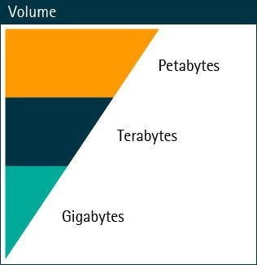
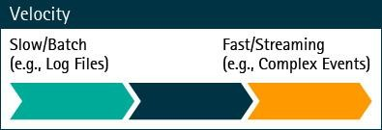
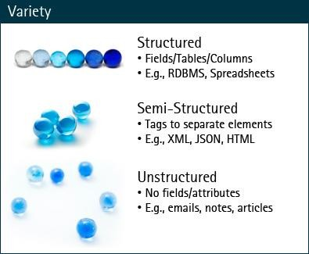
Big Data
Big Data are data sets so large or so complex that traditional methods of storing, accessing, and analyzing their breakdown are too expensive. However, there is a lot of potential value hidden in this data, so organizations are eager to harness it to drive innovation and competitive advantage.
Big Data technologies and approaches are used to drive value out of data rich environments in ways that traditional analytics tools and methods cannot.

Slide 6
What To Do With These Data?
Aggregation and Statistics
Data warehousing and OLAP
Indexing, Searching, and Querying
Keyword based search
Pattern matching (XML/RDF)
Knowledge discovery
Data Mining
Statistical Modeling
Data Driven
Predictive Analytics
Deep Learning

Slide 7
Big Data & Data Science
“… the sexy job in the next 10 years will be statisticians,” Hal Varian, Google Chief Economist
The U.S. will need 140,000-190,000 predictive analysts and 1.5 million managers/analysts by 2018.
McKinsey Global Institute’s June 2011
New Data Science institutes being created or repurposed – NYU, Columbia, Washington, UCB,...
New degree programs, courses, boot-camps:
e.g., at Berkeley: Stats, I-School, CS, Astronomy…
One proposal (elsewhere) for an MS in “Big Data Science”
Plans for Data Science Stream at AUST
RDA-CODATA School of Research Data Science

Slide 8
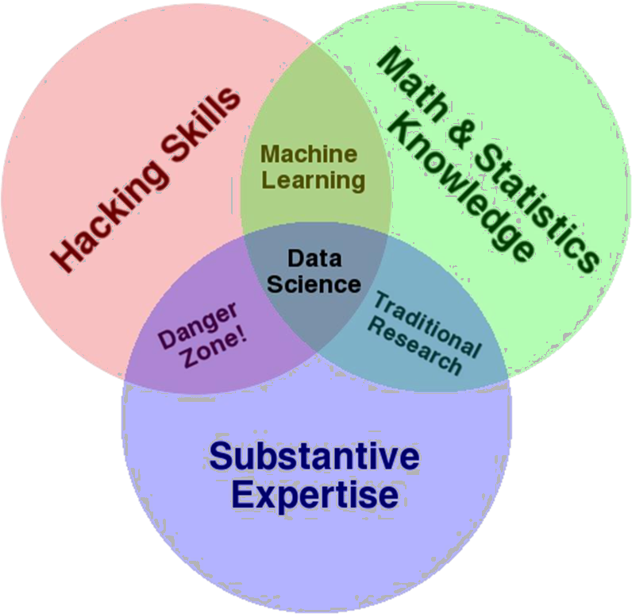
What is Data Science?
Some definitions link computational, statistical, and substantive expertise.

Slide 9
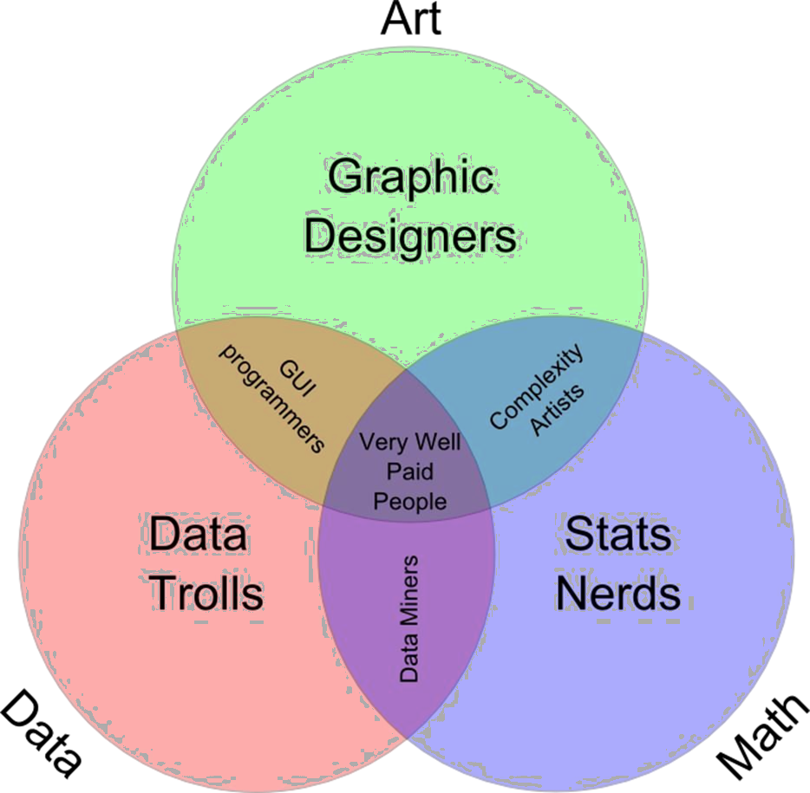
What is Data Science?
Other definitions focus more on technical skills alone.

Slide 10
What is Data Science?
An area that manages, manipulates, extracts, and interprets knowledge from tremendous amount of data
Data science (DS) is a multidisciplinary field of study with goal to address the challenges in big data
Data science principles apply to all data – big and small

Slide 11
What is Data Science?
Theories and techniques from many fields and disciplines are used to investigate and analyze a large amount of data to help decision makers in many industries such as science, engineering, economics, politics, finance, and education
Computer Science
Pattern recognition, visualization, data warehousing, High performance computing, Databases, AI
Mathematics
Mathematical Modeling
Statistics
Statistical and Stochastic modeling, Probability.

Slide 12
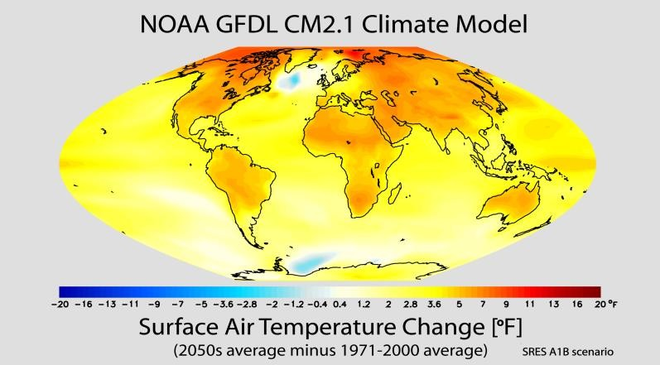

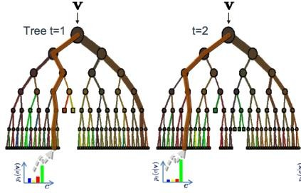

Contrast: Scientific Computing
Image
General purpose classifier
Supernova
Not
Nugent group / C3 LBL
Scientific Modeling
Physics-based models
Problem-Structured
Mostly deterministic, precise
Run on Supercomputer or High-end Computing Cluster
Data-Driven Approach
General inference engine replaces model
Structure not related to problem
Statistical models handle true randomness, and un-modeled complexity.
Run on cheaper computer Clusters (EC2)

Slide 13
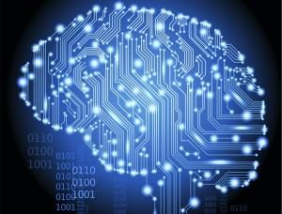
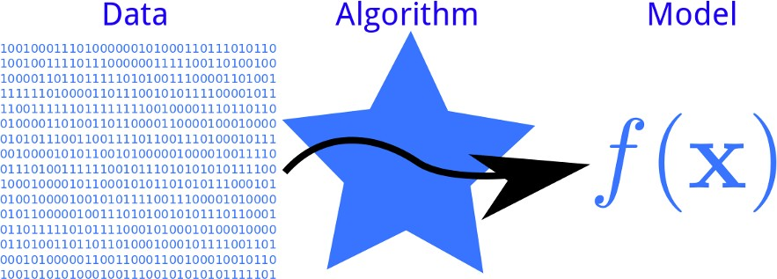
Contrast: Machine Learning
Machine Learning
Develop new (individual) models
Prove mathematical properties of models
Improve/validate on a few, relatively clean, small datasets
Publish a paper ☺
Data Science
Explore many models, build and tune hybrids
Understand empirical properties of models
Develop/use tools that can handle massive datasets
Take action!
14

Slide 14
Contrast: Data Engineering
 | Data Science | Data Engineering
Approach | Scientific (Exploration) | Engineering (Development)
Problems | Unbounded | Bounded
Path to Solution | Iterative, exploratory, nonlinear | Mostly linear
Education | More is better (PhD’s common) | BS and/or self-trained
Presentation Skills | Important | Not as important
Research Experience | Important | Not as important
Programming Skills | Not as important | Important
Data Skills | Important | Important
14

Slide 15
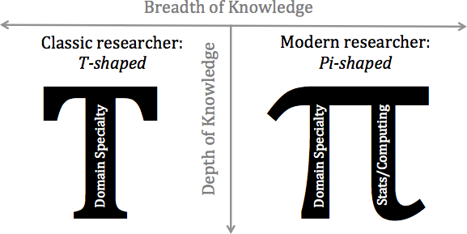
Data Science & Academia
In the words of Alex Szalay, these sorts of researchers must be "Pi-shaped" as opposed to the more traditional "T-shaped" researcher. In Szalay's view, a classic PhD program generates T-shaped researchers: scientists with wide- but-shallow general knowledge, but deep skill and expertise in one particular area. The new breed of scientific researchers, the data scientists, must be Pi- shaped: that is, they maintain the same wide breadth, but push deeper both in their own subject area and in the statistical or computational methods that help drive modern research:
15

Slide 16
Data Science & Academia
In a post by Jake Vanderplas in 2014 related to SciFoo discussion on: Academia and Data Science, the following questions below were discussed.
I encourage you to develop your own thoughts on them and come up with your assessment
Where does Data Science fit within the current structure of the
university & research institutions?
What is it that academic data scientists want from their career? How can academia offer that?
What drivers might shift academia toward recognizing & rewarding
data scientists in domain fields?
Recognizing that graduates will go on to work in both academia and industry, how do we best prepare them for success in both worlds?
16

Slide 17
Data Science Applications
 | Business | Health Care | Urban Leaving
Summary | From car design to insurance to pizza delivery, businesses are using data science to optimize their operations and better meet their customers’ expectations. | Tomorrow’s healthcare may look more efficient thanks to things like electronic health records. It also may look a lot more effective. Reduced readmissions, better care, and earlier detection are on the horizon. | For the first time in human history, more people live in cities than in suburban or rural areas. An emerging field called “urban informatics” combines data science with the unique challenges facing the world’s growing cities
What is happening? | Two-Way Street for the Ford Focus Electric Car | Reducing Hospital Readmissions | Taking on Megacity Traffic
 | Better Fraud Detection Boosts Customer Satisfaction | Better Point-of-Care Decisions | Fighting Crime with Data "predictive policing"
 | E-Commerce Insights: Domino’s Secret Sauce
What is possible | Using Social Data to Select Successful Retail Locations . | Medical Exams by Bathroom Mirrors | Instrumenting cities
17

Slide 18

Contrast: Computational Sciences
Is there a contrast between Data Science and Computational Science?
18

Slide 19
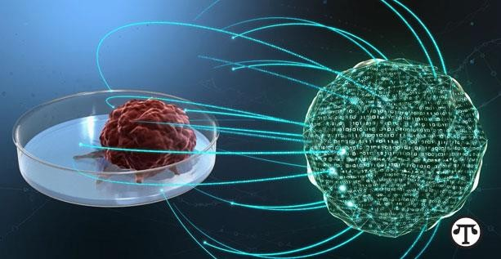
Data Science: Case Study Cancer Research
Cancer is an incredibly complex disease; a single tumor can have more than 100 billion cells, and each cell can acquire mutations individually. The disease is always changing, evolving, and adapting.
Employ the power of big data analytics and high-performance computing.
Leverage sophisticated pattern and machine learning algorithms to
identify patterns that are potentially linked to cancer
Huge amount of data processing and recognition
19

Slide 20
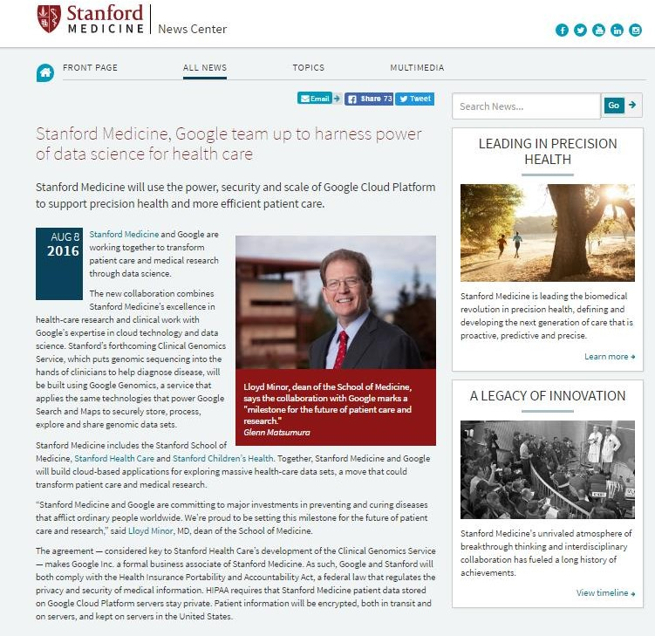
Data Science: Case Study Health Care
Stanford Medicine, Google team up to harness power of data science for health care
Stanford Medicine will use the power, security and scale of Google Cloud Platform to support precision health and more efficient patient care.
Analyzing genetic data
Focusing on precision health
Data as the engine that
drives research
http://med.stanford.edu/news/all-news/2016/08/stanford-medicine-google-team-up-to-harness-power-of-data-science.html
20

Slide 21
Data Science: Case Study Elections
The Obama campaigns in 2008 and 2012 are credited for their successful use of social media and data mining.
Micro-targeting in 2012
http://www.theatlantic.com/politics/archive/2012/04/the- creepiness-factor-how-obama-and-romney-are-getting-to-know- you/255499/
http://www.mediabizbloggers.com/group-m/How-Data-and-Micro- Targeting-Won-the-2012-Election-for-Obama---Antony-Young- Mindshare-North-America.html
Micro-profiles built from multiple sources accessed by aps, real- time updating data based on door-to-door visits, focused media buys, e-mails and Facebook messages highly targeted.
1 million people installed the Obama Facebook app that gave access to info on “friends”.
22

Slide 22
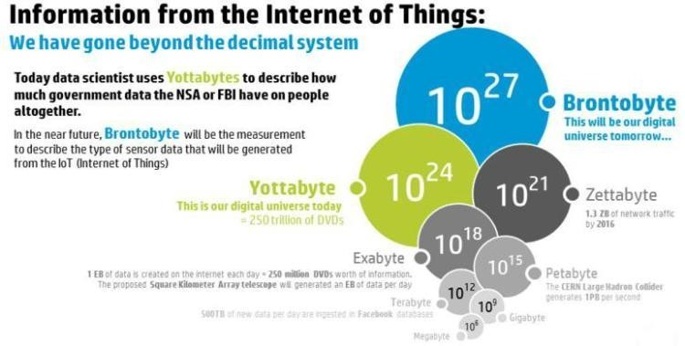
Data Science: Case Study Internet of Things (IoT)
The Internet of Things is rapidly growing. It is predicted that more than 25 billion devices will be connected by 2020.
The Internet of Things (IOT) will soon produce a massive volume and variety of data at unprecedented velocity. If "Big Data" is the product of the IOT, "Data Science" is it's soul.
23

Slide 23
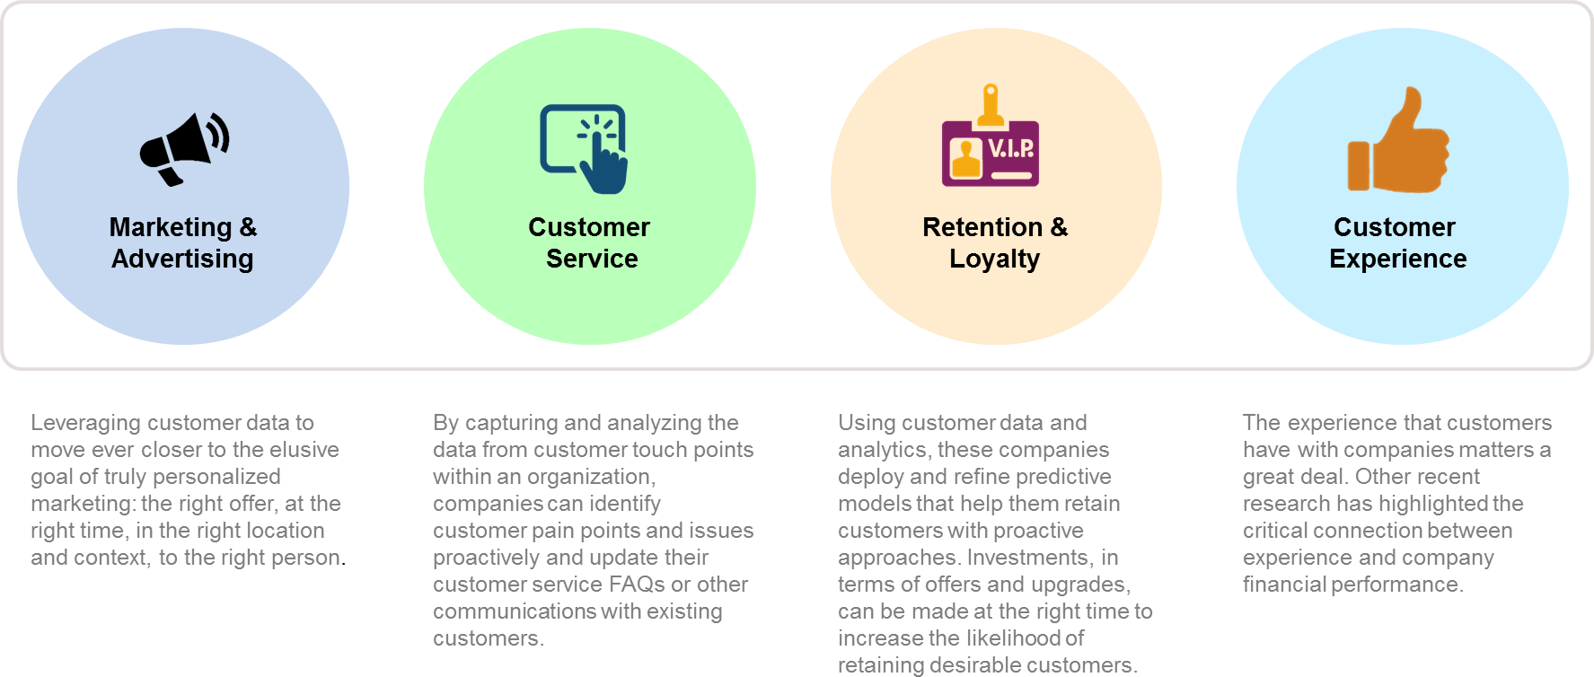
Data Science: Case Study Customer Analytics
23

Slide 24
Essential Points
Big Data has given rise to Data Science
Data science is rooted in solid foundations of mathematics and statistics, computer science, and domain knowledge
Sexy profession – Data Scientists ☺
Not every thing with data or science is Data Science!
The use cases for Data Science are compelling
24

Slide 25
Conclusion
In this section you have learned
What Big Data Challenges are
What exactly is Data Science and what do Data
Scientists do
Data Science contrasted with other disciplines
Case Study & Use Cases
25

