Slide 1
Welcome to Event Bloom
Presented by:
InnovateX
(Online event application)

Slide 2
Team members:
Vaibhav Srivastava(Lead)
Karan
Humera Fatima
Abhishek Reddy
Jennifer
Gouthami Thakur
Asma
Geetha G
Adyatha

Slide 3
Introduction
Welcome to EventBloom, your one-stop destination for all your event planning needs. Our online event planning website is designed to streamline the event planning process, whether you're organizing a corporate conference, a wedding, a birthday party, or any other special occasion. With a range of user-friendly features and a vast network of vendors, EventBloom empowers you to create unforgettable events with ease.
Joining Event Bloom isn't just about being part of a community; it's about investing in your growth and success as an event planner. Let's bloom together!

Slide 4
Join the EventBloom Community:
Within the Event Bloom Community, you'll find a thriving ecosystem of creative event planners. Immerse yourself in a world of innovative ideas and concepts that can elevate your event planning game. Event Bloom is not just a community; it's a resource hub. Access templates, checklists, and tools that simplify your event planning process, saving you time and effort . Join our growing community of event organizers, vendors, and enthusiasts who are transforming the way events are planned and executed. Start planning your next unforgettable event with EventBloom today!

Slide 5
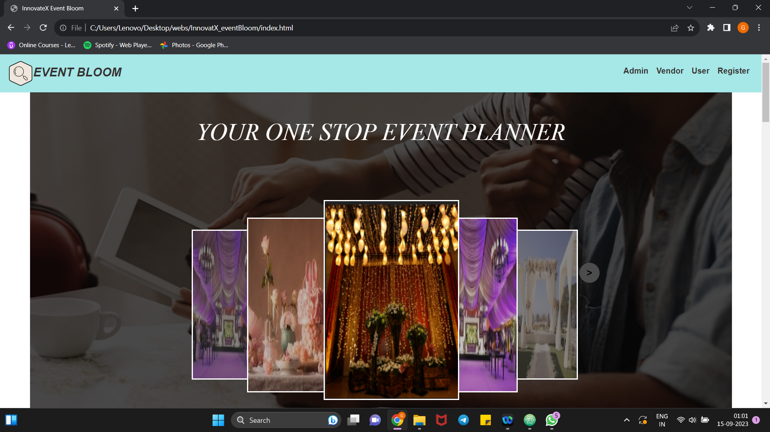
Our Home Page

Slide 6
Key Features:
Vendor Directory:
Explore our extensive vendor directory featuring top-notch service providers, including caterers, photographers, decorators, and more.
Vendor can add different packages such as basic, premium and classic one’s.
User Profiles:
Create a personalized user profile with UserID, providing essential information such as your name, contact details, and event preferences.
Access your profile to manage your event planning activities and track your event history.
Event Planning Tools:
Plan events effortlessly with our user-friendly event planning tools.
Use our vendor selection tool to browse and compare vendors, view their portfolios, and request quotations.

Slide 7
4.Plan Requests:
Send plan requests to multiple vendors simultaneously, specifying your event details and requirements.
On basis of users plan requests Vendor will generate different quotation's .
From which user will compares quotations conveniently within your EventBloom dashboard.
5.Package Options:
Explore various event packages to simplify your planning process.
Customize packages based on your preferences, or create your own package tailored to your event's needs.

Slide 8
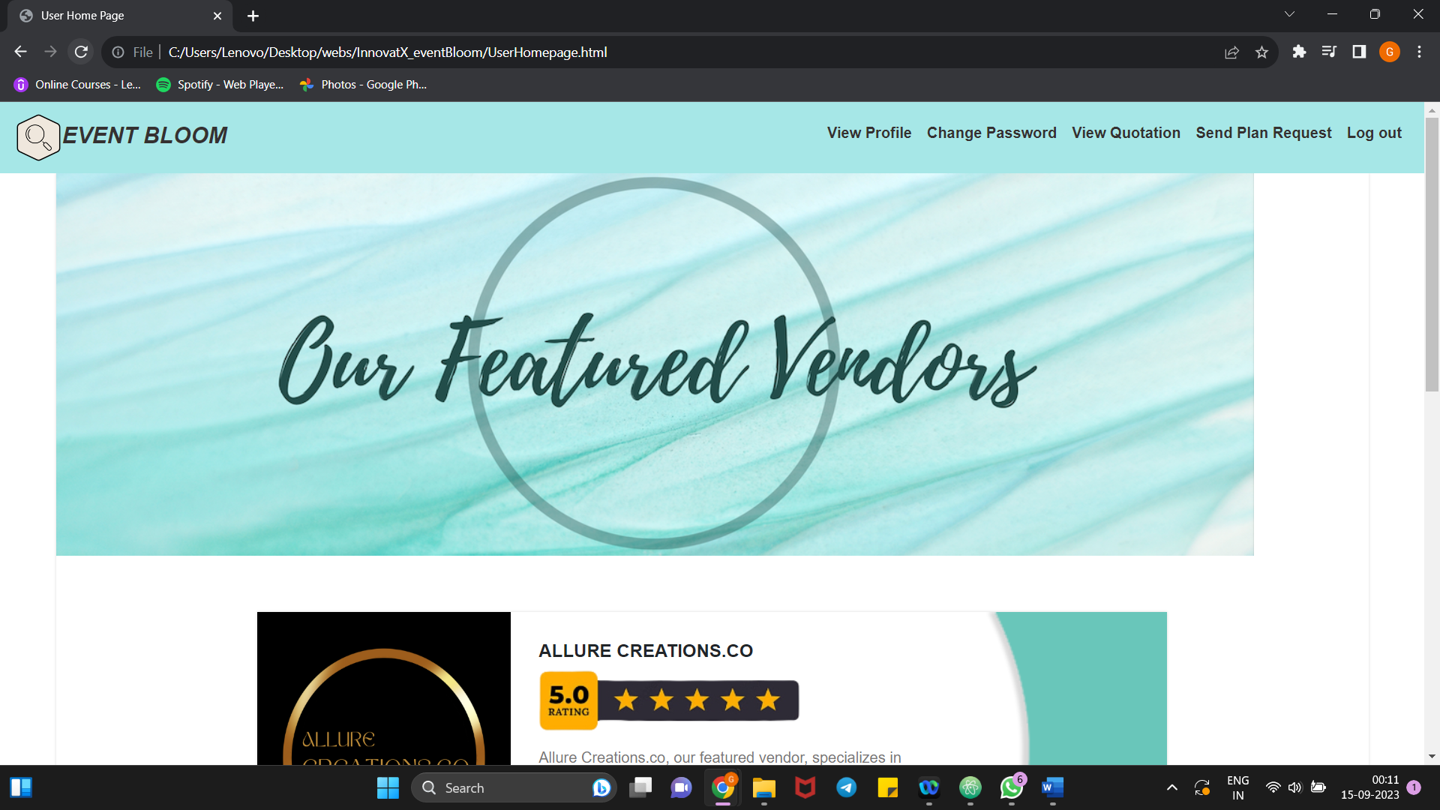

Slide 9
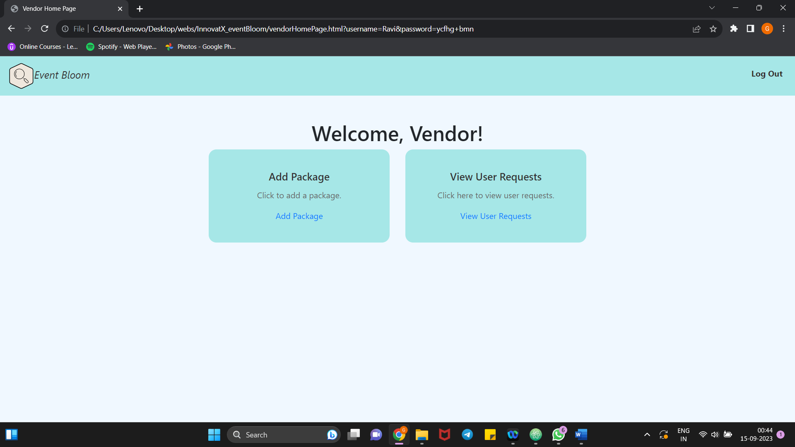

Slide 10
Frontend
In the frontend part, we have created the application using Html,CSS, Javascript and Bootstrap .
We have created home page and it views 3 login pages and user registration form.
The Admin page adds vendor and can view vendor order list.
The Vendor page adds packages and creates quotation on user request.
The User Login page views quotations and send request to vendors.

Slide 11
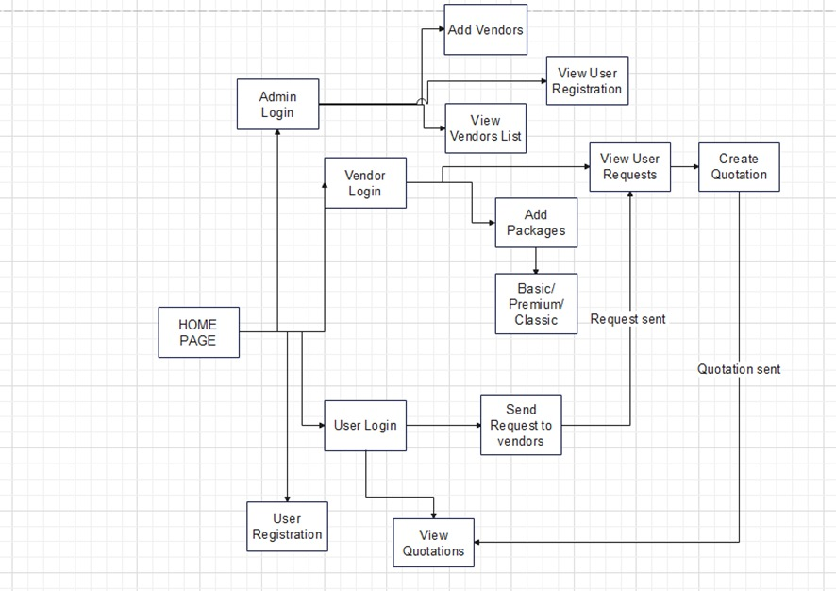
Fig : Flowchart for Frontend

Slide 12
Backend
In the backend part , we created the application using java, jdbc, MySql.
We created a main method to test with all values in the database.
Layered Architecture was used to create the application.
There are 3 DAO layers, i.e. Admin, View and User Dao layers
(i)Admin Dao layer: It is responsible for managing the administrative functions of the event planning system.
(ii)View Dao layer: It is the user interface (UI) of the event planning system that users interact with.
(iii)User Dao layer: This layer is responsible for handling user data within the system.

Slide 13
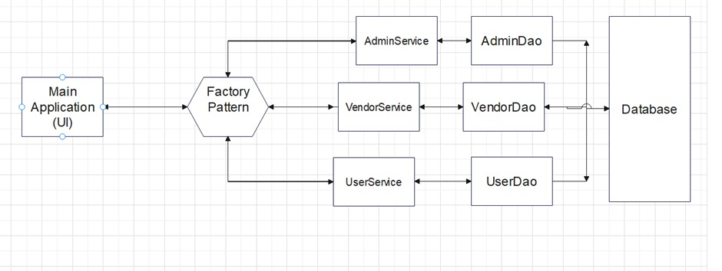
Fig : Flowchart for Backend

Slide 14
Thank you !
We look forward to working with you and making your upcoming event a success!

