Slide 1
Stay Fit with
FiTcalculator
Group 02 Valmiera eit 2020

Slide 2
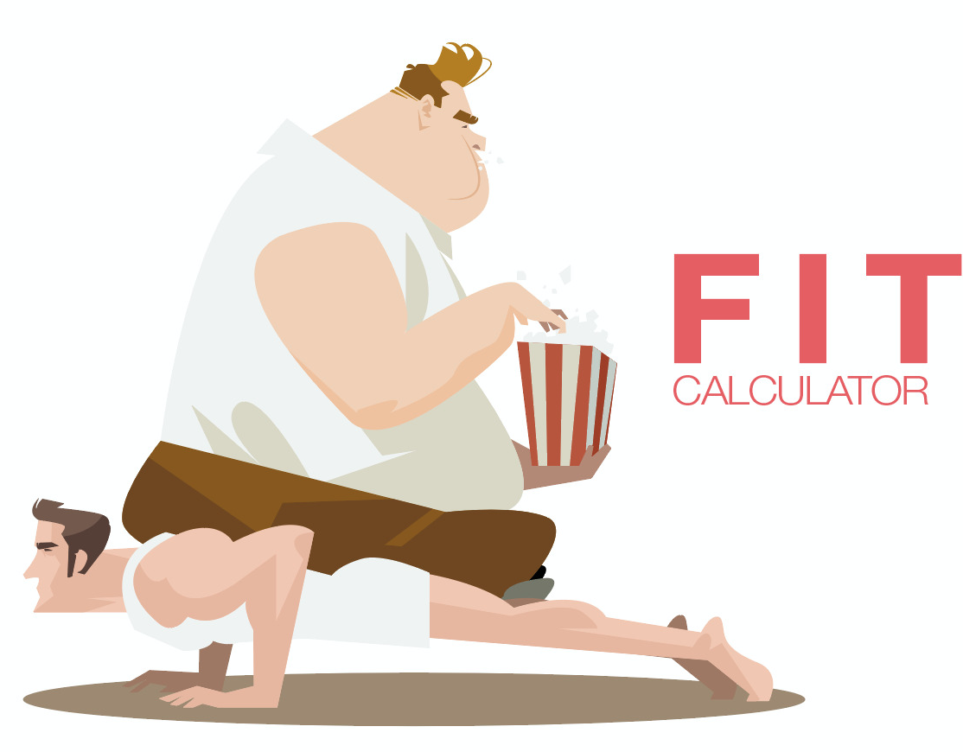
wan’t stay
FIT..
Just DO it!!
but better with our APP

Slide 3
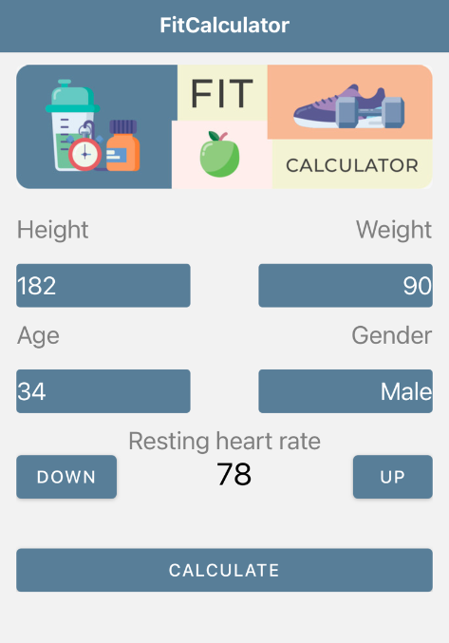
Just 5 info
fields about you!
to know it ALL!!
DATA what we need!
HEIGHT
WEIGHT
AGE
GENDER
RHR ♥️
IMT Group 02 Eit 2020 valmiera

Slide 4
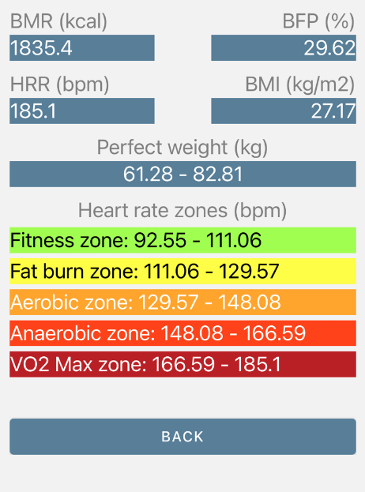
NOW YOU KNOW!
Data what we give to you!
BMR (kCal)
BFP (%)
HRR (bpm)
BMI
Perfect weight (kg)
Heart rate zones (bpm)
IMT Group 02 Eit 2020 valmiera

Slide 5
BUT THAT’S NOT ALL

Slide 6
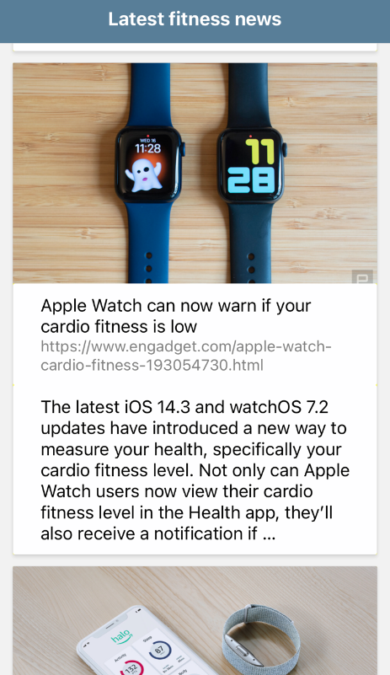
LaTEst news!
With integrated API service
Health
Trends
Related tech
And much more..
IMT Group 02 Eit 2020 valmiera

Slide 7
Download TODAY!
Thanks!
♥️
IMT Group 02 Eit 2020 valmiera

