Slide 1
Day 1 - Mar 23
Intro
Control statement, arrays
OOPS
JVM
OS

Slide 2
JRE
JDK
Basics of Java
FOR
IF
SWITCH
Do while
While

Slide 3
Array vs ArrayList
Contiguous memory location
DEV
SIT
UAT
PERF
PROD

Slide 4
OOPS
Inheritance
Composition
Aggregation
Data hiding
Abstraction
Encapsulation
Polymorphism

Slide 5
Front end
Java web app
App DB

Slide 6
Front end
Java web app
App DB
html
Front end
Java web app
App DB
json

Slide 7
Day 2 - Mar 24
String
Object
OOPS

Slide 8
Projects
IRCTC – Prince
Zomato – Ranvir
Swiggy – Saiyam
Job portal – Harshit
Instagram – Himanshu
Retail banking – HDFC/ICICI - Sumit
Make my trip - Poorva
Amazon ecommerce - Utkarsh
College ERP – Amiya
News AI – Vishal Singh
Book my show – Vaishnavi
OYO – Tarun
Exam portal - Shrey

Slide 9
Projects
Retail banking – HDFC/ICICI - Sumit
Functionalities:
Customer authentication
Dashboard
Account summary
Payment history
Fund transfer
Customer support
Statements
Alerts
Logoff

Slide 10
Projects
Retail banking – HDFC/ICICI - Sumit
DB design
Customer
Account
Payment
Transfer
Alert

Slide 11
Projects
IRCTC – Prince
Functionalities:
Public page:
Search availability
PNR Inquiry
Post login:
Customer authentication
Logoff
Search availability
History
Cancellation
PNR inquiry
Upcoming trips
Probability of confirmation
Payment gateway

Slide 12
Day 3 - Mar 27
Keywords:
static
final
super
this
Enum
Nested classes
Inner class
Local class
Anonymous class
Constructor
Destructor

Slide 13
Static:
variable
method (class, interface)
block
static inner class
Static inner class can access only static variables, methods of the enclosing class.

Slide 14
final:
variable
method
class

Slide 15
Nested class
Inner class – example – Inside a class
Static class – example – Inside a class
Local class – example – Inside a method
Anonymous class – without name – Event driven programming

Slide 16
Exception handling
Compile time
Run time
Try catch finally
Throw
Throws
Exception swallowing
Exception cascading
Design of custom exceptions

Slide 17
Day 4 - Mar 28
Exceptions recap
ArrayList
Hashmap
Hashset
Queue
Exceptions

Slide 18
Exceptions – Some validations needs to be done or some logic is failing. Raise exceptions
Try{
}catch(){
}
Finally{
}

Slide 19
ArrayList

Slide 20
ArrayList
-add
-get
-indexof
-isEmpty
-iterator
-remove
-size
-toarray

Slide 21
Hashmap
-key, value
-containskey
-get
-put
-remove
-size
-values
-keyset
-isempty

Slide 22
Day 5 - Mar 29
Advance collection
Files
List
T1
T2

Slide 23
ConcurrentHashMap
CopyOnWriteArrayList
CopyOnWriteArraySet
Thread safe apis
Read will take copies.
Write can be done.
Unlike non concurrent collections, exceptions will not be thrown for read/write operations.
Demo attached.

Slide 24
Files
Text
Binary
Compute the tax of employees.
Data is in File.
Example
Name of the employee
ID of the employee
Location
Salary
Bonus
Sample. CSV file
John, 123,NC,5200.50,12500.25
Julie, 238,OH,3400.50,7500.25
Each state will have separate tax slabs
Bonus gets 32% tax deduction
Do the processing for 50 employees.
Compute the tax and create an output file. Tax is appended at the last.

Slide 25
Day 6 - Mar 30
Functional Interface
Lambda Expression
Default Method in Interface
Static Method in Interface
Method References
Stream API
Collectors
For each Loop

Slide 26
Functional interface – only one method in a interface.
Interface print{
Void printMsg(String s);
}

Slide 27
Lambda expression
Inline implementation of functional interface

Slide 28
Default method in interface
Implementation provided in the interface.

Slide 29
Static method in interface
Static keyword. Same like classname.staticmethod

Slide 30
Method references
Classname::staticmethodname
Instance::staticmethodname

Slide 31
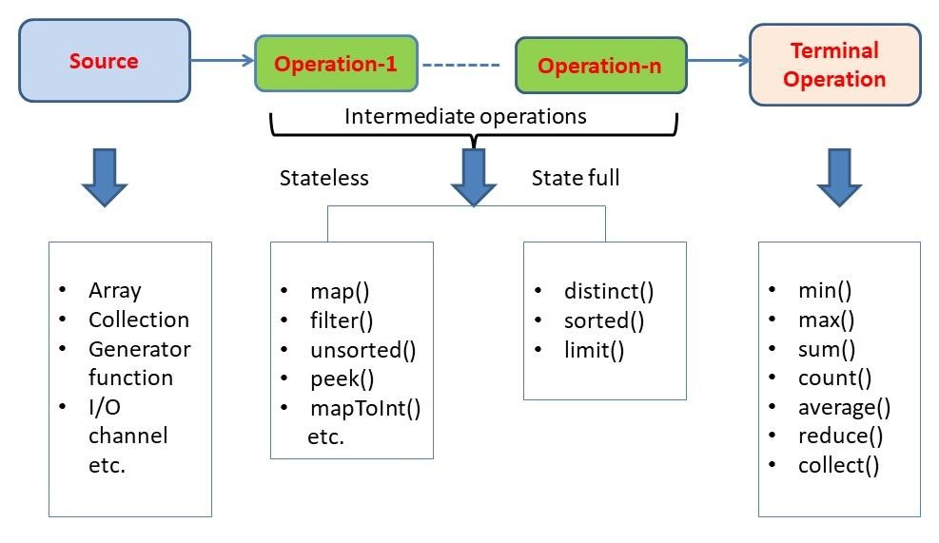
Stream API
Stream will not modify the source

Slide 32
Collectors
Repackaging elements to some data structures and applying some additional logic, concatenating them, etc. on data elements held in a Stream instance.
Collectors.toList demo

Slide 33
Foreach
Iterate over a collection.

Slide 34
Back up assignment – Take a back up of 5 files in a given folder. Application has to be keep running. Any changes in files has to be detected and backed up. You can extend this to files and folders. For detecting the changes, go recursively and back up the files.
Use OpenCSV to read the employees salaries csv file and compute the tax. Same as March 29 assignment. Use the third party library, maven style project.

Slide 35
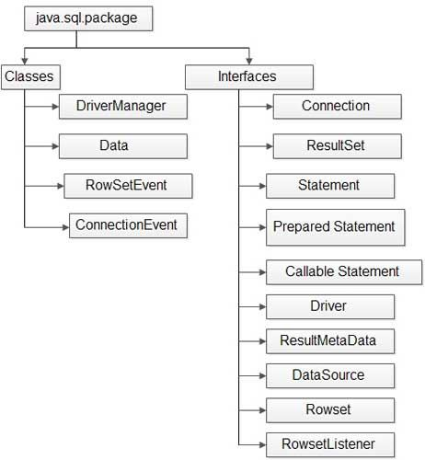
Day 7 - Mar 31
JDBC

Slide 36
Assignments: March 31 2023
Create DB tables for your respective project.
Write insert, select, update, delete SQL queries and execute them from JDBC code. (Note: Save all these explicit hard coded insert statements, create table commands, etc etc in a .sql file.
Read image files from file system and store them in some tables of your choice.
Read text files from file system and store them in some tables of your choice.
Read image files from DB and save them as files in local disk.
Read text files from DB and save them as files in local disk.
Create any stored procedures in DB tables. Use IN, OUT, INOUT parameters.
Call the stored procedures from JDBC code.
Create views in DB tables.
Call the views from JDBC code.

Slide 37
Day 8 - Apr 3
Spring framework introduction
DI and IOC container
Work with different types of Configuration
XML, Java, Annotation configuration
https://spring.io
HTML, CSS, JS
Spring MVC, JSP, SERVLETS, JDBC
DB
POSTMAN
Spring Boot, Hibernate, JPA
DB

Slide 38
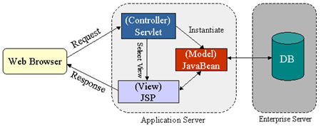
Web application
Eclipse IDE for Enterprise Java and Web Developers - 2022-09
https://www.eclipse.org/downloads/download.php?file=/technology/epp/downloads/release/2022-09/R/eclipse-jee-2022-09-R-win32-x86_64.zip
Demo application: D:\work2\springmvc\SpringMVCTest

Slide 39
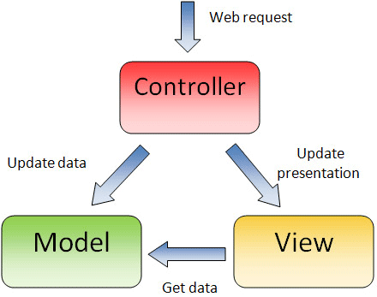
MVC pattern

Slide 40
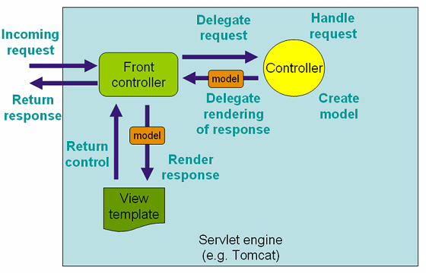
Spring MVC

Slide 41
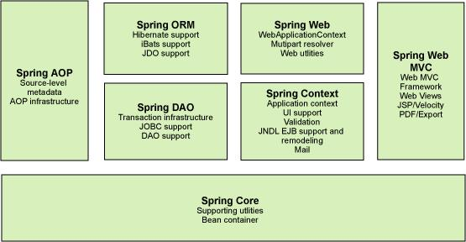
Spring framework

Slide 42
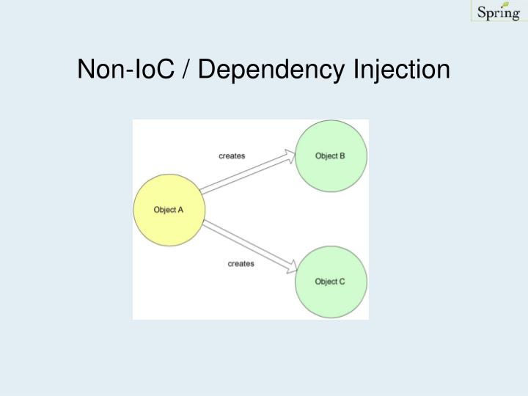
Spring IOC, Configurations

Slide 43
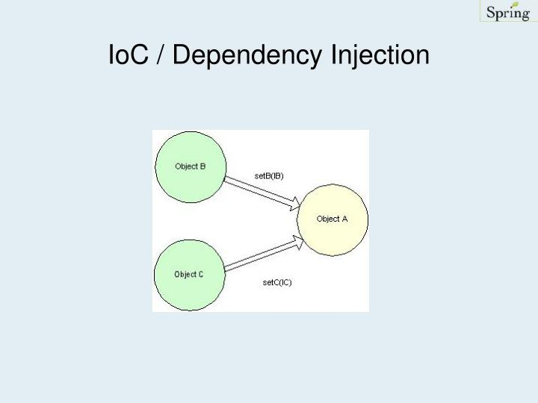
Spring IOC, Configurations

Slide 44
Spring IOC, Configurations
Application start
Application Context
Beans
Beans
Config Instructions

Slide 45
Spring IOC, Configurations
XML based
<?xml version="1.0" encoding="UTF-8"?>
<beans xmlns="http://www.springframework.org/schema/beans" xmlns:xsi="http://www.w3.org/2001/XMLSchema-instance" xsi:schemaLocation="http://www.springframework.org/schema/beans https://www.springframework.org/schema/beans/spring-beans.xsd">
<bean id="..." class="...">
<!-- collaborators and configuration for this bean go here -->
</bean>
<bean id="..." class="...">
<!-- collaborators and configuration for this bean go here -->
</bean> <!-- more bean definitions go here -->
</beans>

Slide 46
Spring IOC, Configurations
Annotation based and Java config based
@ComponentScan
@Configuration → Fully java based configs
@Bean
@Component
@Autowired
@Lazy
@Qualifier
@Value
@Required
<?xml version="1.0" encoding="UTF-8"?>
<beans xmlns="http://www.springframework.org/schema/beans" xmlns:xsi="http://www.w3.org/2001/XMLSchema-instance" xsi:schemaLocation="http://www.springframework.org/schema/beans https://www.springframework.org/schema/beans/spring-beans.xsd">
<context:annotation-config/>
</beans>

Slide 47
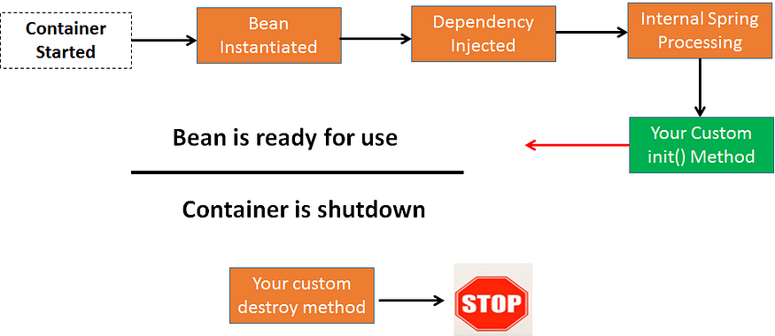
Day 9 - Apr 4
Understand bean lifecycle
Understand bean scopes
Create Singleton and Prototype scoped beans
Demo application: D:\work2\springmvc\SpringMVCTest

Slide 48
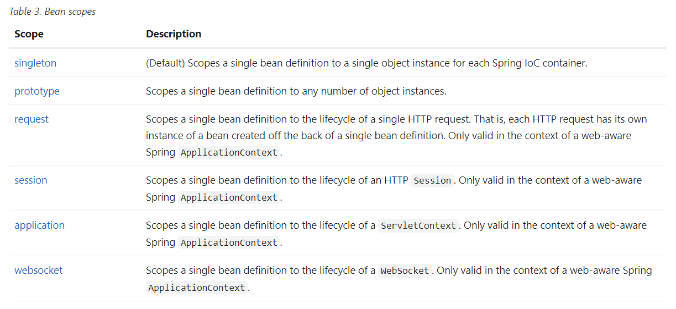

Slide 49

s1
s1
s2
s3
s2
s3

Slide 50
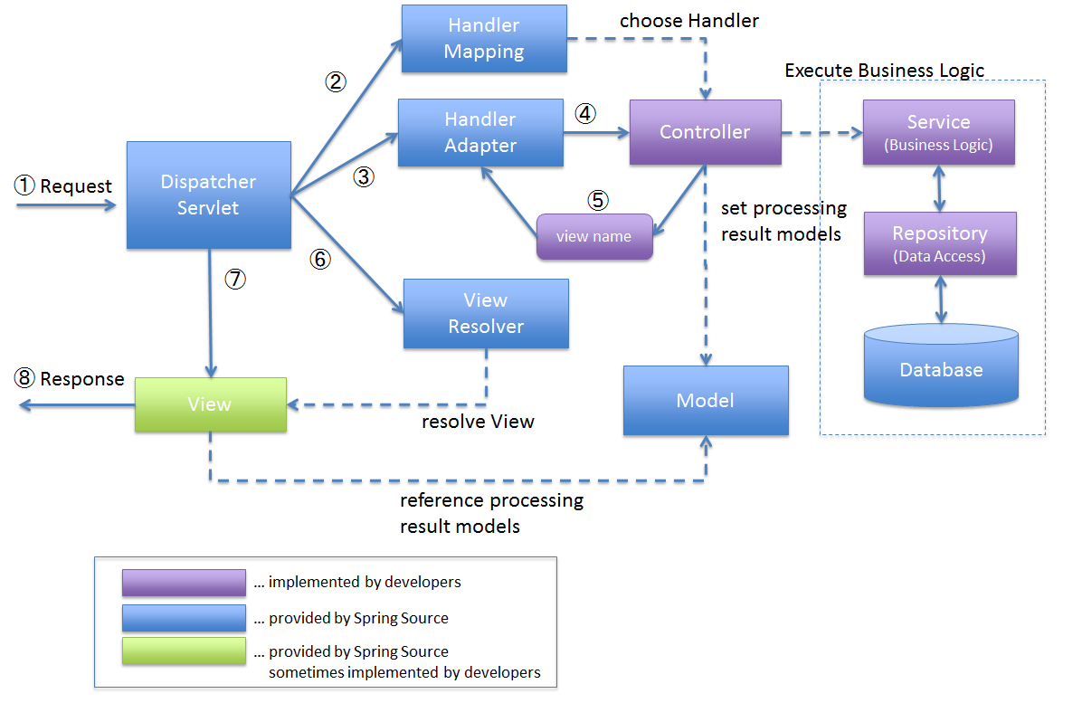
Understanding Spring MVC
Creating a Spring MVC application
Demo application: D:\work2\springmvc\SpringMVCTest

Slide 51
Concept of web server – static content – HTML, css, image, js
Concept of app server – Dynamic content – Servlets, JSP, Spring framework - tomcat
Concept of DB server - rdbms
war
war
war
Browser
DB
Tomcat

Slide 52
Concept of servlet
Concept of JSP page

Slide 53
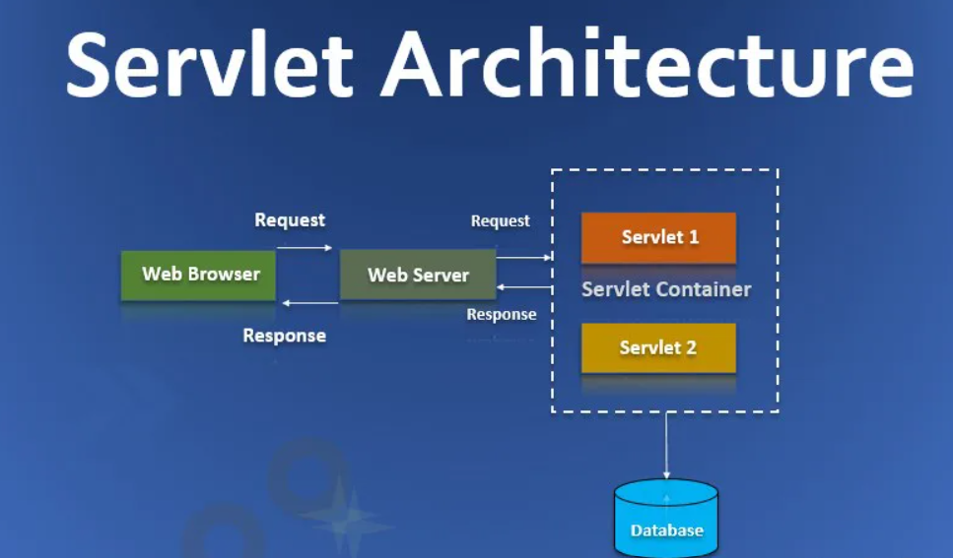
Day 10 - Apr 5
Concept of servlet
Concept of filter
Annotations in Spring IOC, MVC
Demo application: D:\work2\springmvc\SpringMVCTest

Slide 54
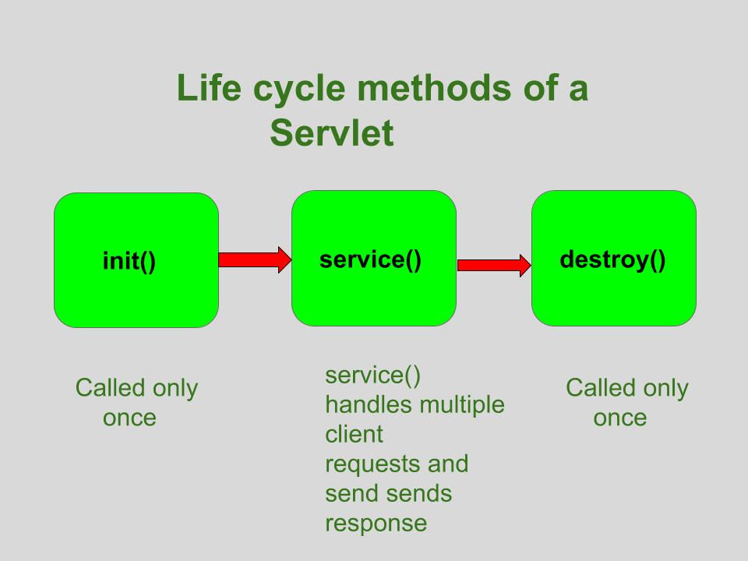

Slide 55
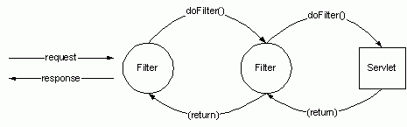

Slide 56
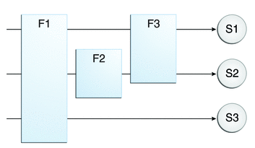

Slide 57
@Configuration
Java-based configuration
import org.springframework.context.annotation.*;
@Configuration
public class MyConfig {
@Bean
public SpringBean myBean(){
return new SpringBean();
}
}

Slide 58
@ComponentScan
@Component, @Service, and @Controller in the specified package

Slide 59
@Bean
This is commonly used in the classes which are annotated with @Configuration annotation on the Java-based configuration in Spring.
Even third-party classes into Spring beans.
@Configuration
public class MyConfig {
@Bean
public MyService myService() {
return new MyServiceImpl();
}
}

Slide 60
@Autowired
Dependency injection to wire an appropriate bean into the marked class member.

Slide 61
@Value
@Value("INDIA")
private String residingCountryName;
#{systemProperties.myProp}
DEV
U,P
war
SIT
App-dev.properties
App-sit.properties
App-prod.properties
U,P
U,P
PROD

Slide 62
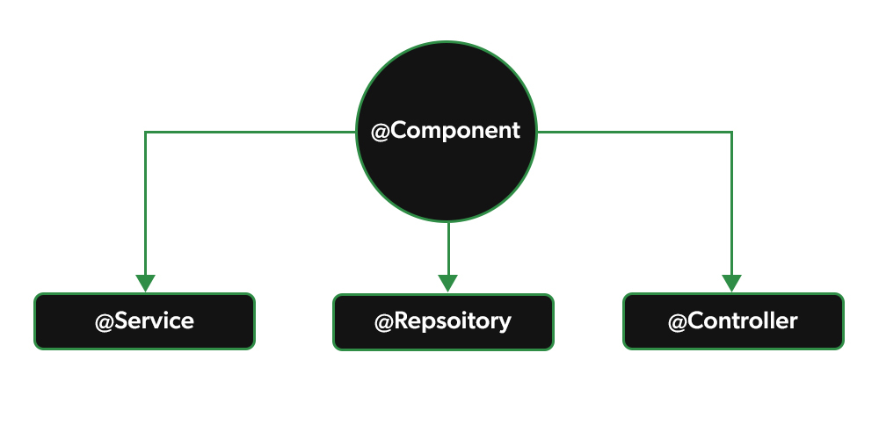
@Service - Generic business functionality
@Controller - MVC
@Repository - DAO
@Component - very generic

Slide 63
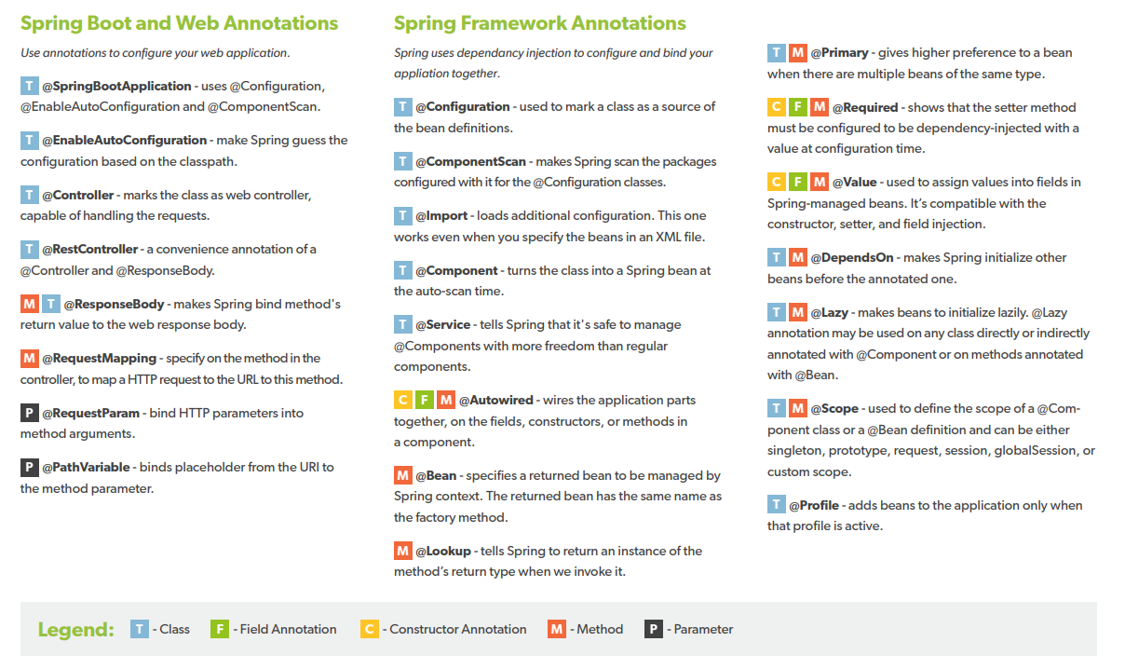

Slide 64
Day 11 - Apr 6
Creating a HTTP session
Destroying a HTTP session
Hibernate
Concept of Entity.
Customer is an entity. It can be saved in Customer table. Simple and straightforward.
Demo application: D:\work\hibernatework\hibernatehw

Slide 65
Mapping
One to One
One to Many
Many to One
Many to Many

Slide 66
How entities are related.
IndianCitizen has one Aadhaar Card (1:1)
@OneToOne notation.
Citizen
1
1
Aadhaar

Slide 67
Customer
1
n
Accounts

Slide 68
Readers
m
n
Subscriptions

Slide 69
Reader can subscribe to Time of India, New York times.
Times of India has multiple readers.
Readers
Join table
m
n
Subscriptions

Slide 70
HQL query
Named query
Named Native query
Criteria queries

Slide 71
Welcome to ABC Company – Employee Onboarding
First Name
List
Last Name
Mobile Number
Delete
Submit

Slide 72
Welcome to ABC Company – Employee Onboarding - List
ID | First name | Last name | Mobile number
123 | John | A | 9983448990
456 | Teresa | Lies | 8377289833
334 | Vivek | Sara | 8380120934
Add Employee

Slide 73
Welcome to ABC Company – Employee Onboarding - Delete
Employee ID
Delete
Home

Slide 74
After adding an employee, the form should show list page.
After deleting an employee, the same page(delete) should display again. On the top , a message can be displayed showing the employee can be deleted.
If mobile number has alphabets, error message should be displayed. This validation can be done at the controller class or Filter class.
For all the DB CRUD operations, you should use Hibernate.
@controller, @service annotations has to be used.
The list has to put the employees list in session object.
When the add employee is completed, the employee list in session has to be changed.
When the delete employee is completed, the employee list in session has to be changed.

