Slide 1
STUDENT SCHOLARSHIP APPLICATION
AND DISBURSEMENT TRACKER
A record for every application, the stage it has reached, and how long it has been waiting there.
SIH 2026 Internal Practical Assessment · VAISHNAVI M · Reg 411724205053 · PSVPEC · IT · Year III

Slide 2
THE PROBLEM
A student cannot be told where their
application has reached
Scholarship applications move through a clerk's register, a document check, a section review, and a sanction step - and each stage is recorded on a separate piece of paper or a separate register.
Who is affected
Students
waiting on money they've already been told they're eligible for
Scholarship section staff
who have no easy way to see what's stuck
Eligible-but-needy students most of all
- the ones least able to keep chasing the office
The result: applications quietly stall at one stage for months, and nobody in the section notices until a student comes and asks.
Student Scholarship Application and Disbursement Tracker · SIH 2026
2

Slide 3
THE SOLUTION
A simple web tracker that records every scholarship application, shows exactly how long it has been sitting at its current stage, and lets any student's status be answered in one search.
Student Scholarship Application and Disbursement Tracker · SIH 2026
3

Slide 4
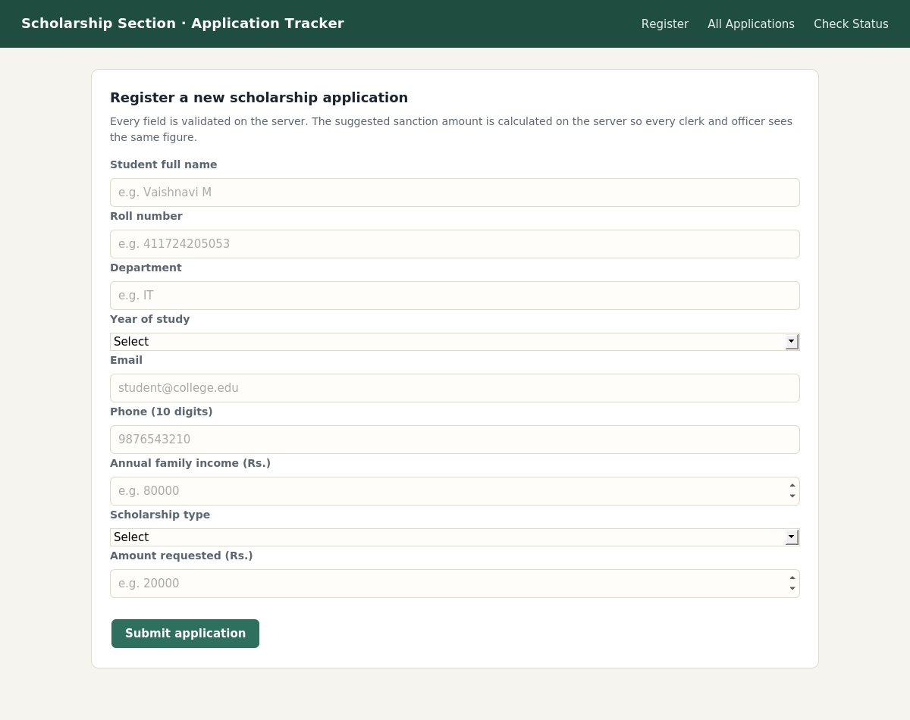
THE SYSTEM
Register screen - one action, start to finish
Clerk fills the form -> server validates every field -> suggested sanction amount is calculated on the server -> saved to SQLite -> shown back on screen.
Stack: HTML/CSS/JS frontend + Flask (Python) backend + SQLite database
4 tables: students, scholarship_applications, application_stage_history (keeps every stage change, never overwritten), document_verifications.
Screenshot: own working solution (index.html + Flask API)
Student Scholarship Application and Disbursement Tracker · SIH 2026
4

Slide 5
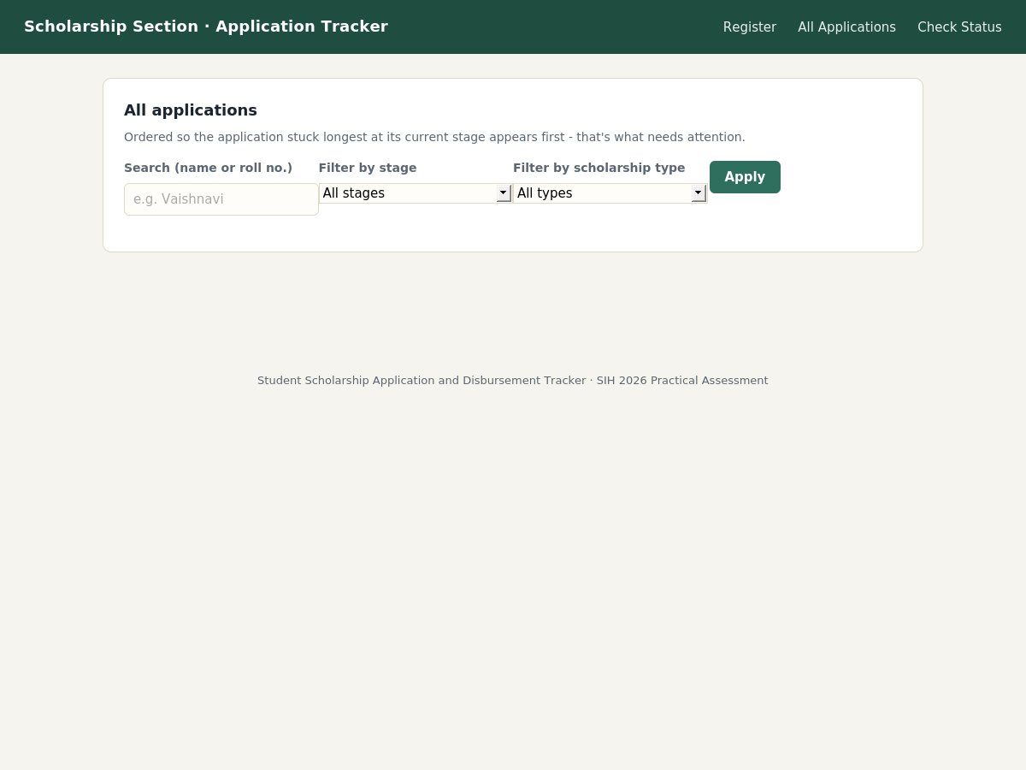
THE SYSTEM
Listing - what needs attention appears first
Applications are ordered by days spent at the current stage (longest first), with search and stage/type filters, and the result count always shown.
How the suggested sanction amount is calculated (server-side)
Annual family income | Suggested sanction
< Rs. 1,00,000 | 100% of amount requested
Rs. 1,00,000 - 2,49,999 | 75% of amount requested
>= Rs. 2,50,000 | 50% of amount requested
Screenshot: own working solution (list.html)
Student Scholarship Application and Disbursement Tracker · SIH 2026
5

Slide 6
THE CLASSIFIER
Document photo quality check
80 labelled document-photo images (clear / unclear), generated with controlled blur, brightness and noise, split by the underlying document so the same document never appears on both sides.
Approach: fine-tune a pretrained MobileNetV2 (ImageNet weights) - only the final classification layer is retrained, not the whole network from scratch.
Honest note on this build
The development sandbox used to build this project blocks downloads from download.pytorch.org, so the pretrained ImageNet weights could not be fetched here - the shipped model fell back to random initialisation, and its demo accuracy is low as a result. train.py is written correctly for real transfer learning: running it on a normal machine with internet access downloads the real pretrained weights automatically and needs no code change. Low-confidence predictions are never forced either way - they're left blank for manual review.
Student Scholarship Application and Disbursement Tracker · SIH 2026
6

Slide 7
STATUS
What works, and what's left
Working end to end
Not yet done / next step
Register -> validate -> calculate -> store -> display
4-table schema with a full stage-history table
Classifier pipeline: dataset, source-disjoint split, fine-tuning, confidence threshold
Search, filter, and "stuck longest" ordering on the listing screen
23/23 automated integration tests passing (main flow, every invalid insert, empty/error states)
No login / role-based access yet - anyone with the URL can act as clerk or officer
Classifier needs a real internet connection at training time to use true pretrained weights (see previous slide)
Next improvement: add authentication so only the right role can advance a stage
Student Scholarship Application and Disbursement Tracker · SIH 2026
7

Slide 8
Thank you
Full source, README, ER diagram, tests, and this presentation are in one public GitHub repository.
VAISHNAVI M · Reg 411724205053 · PSVPEC · IT · Year III · SIH 2026

