Slide 1
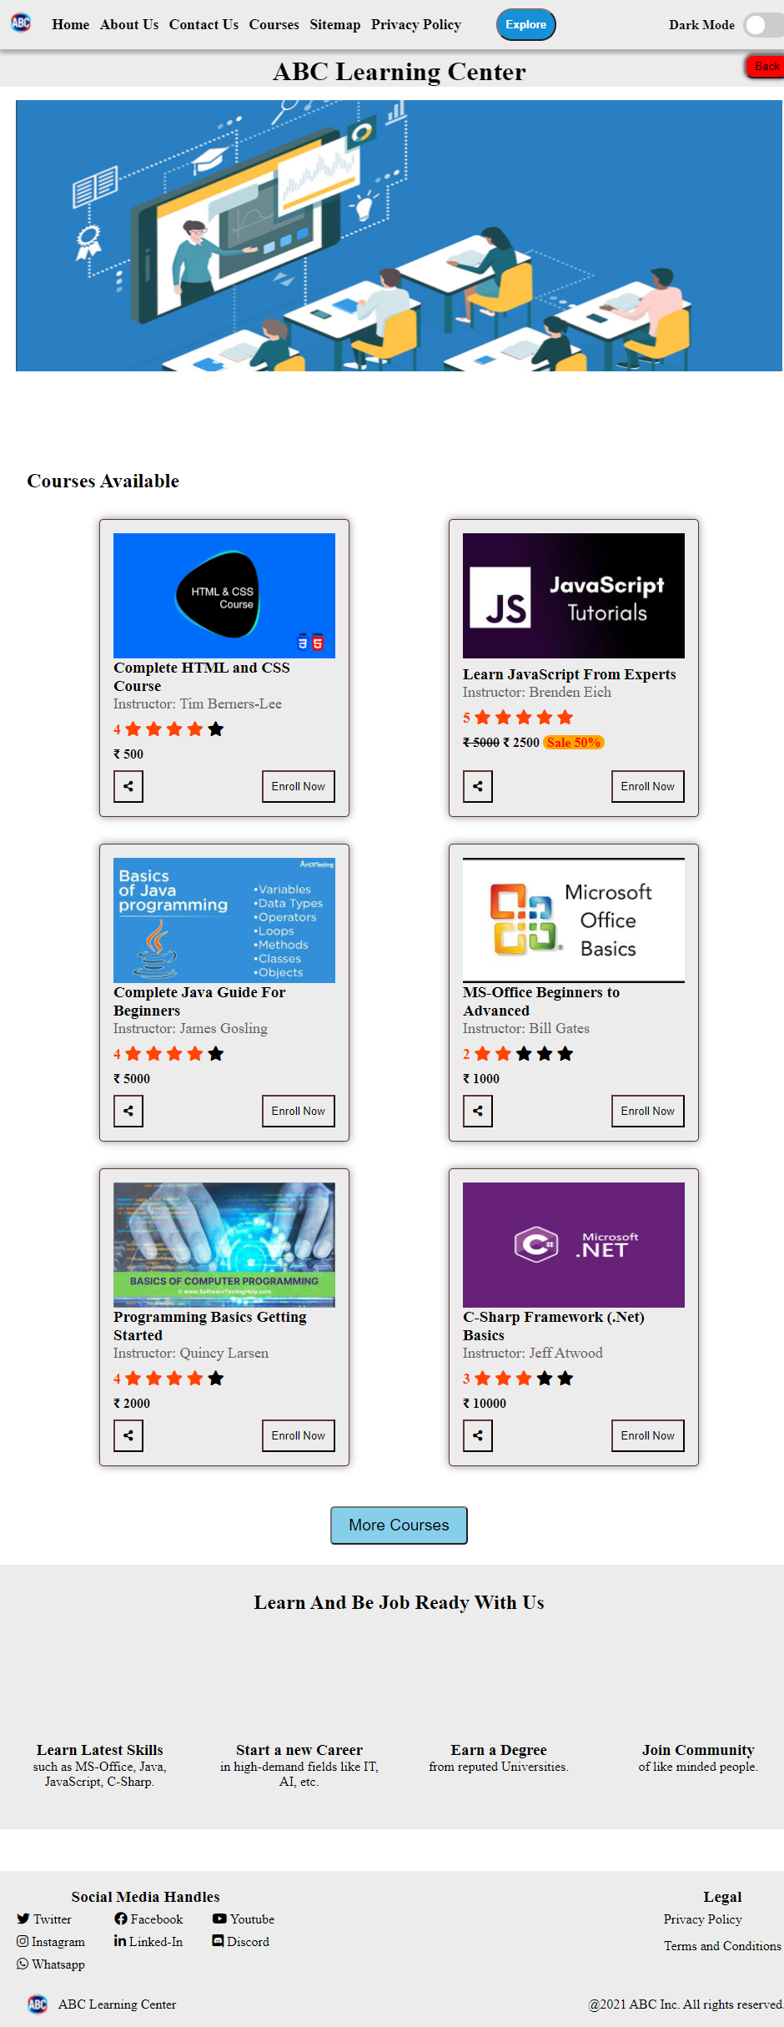
Home Page

Slide 2

About Us

Slide 3
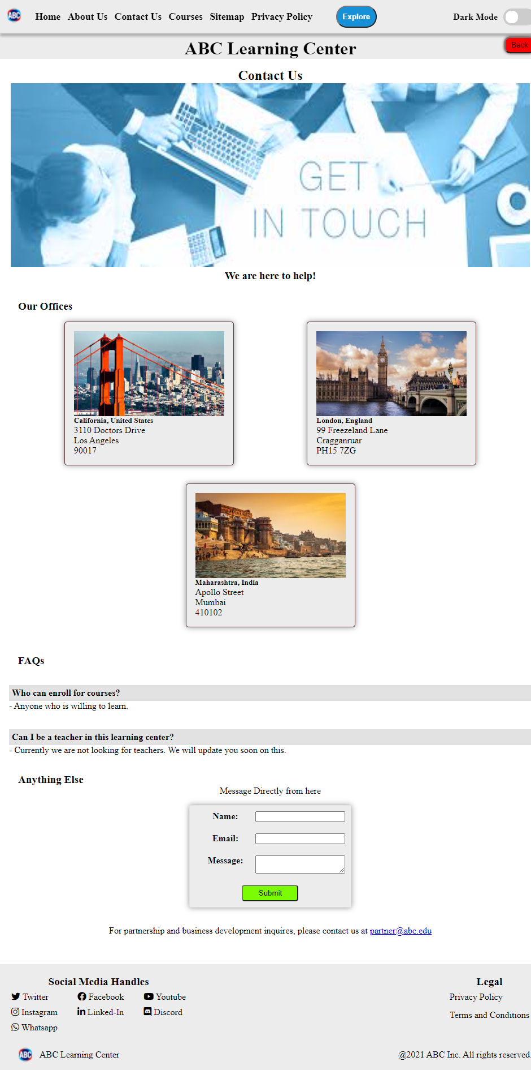
Contact Us

Slide 4
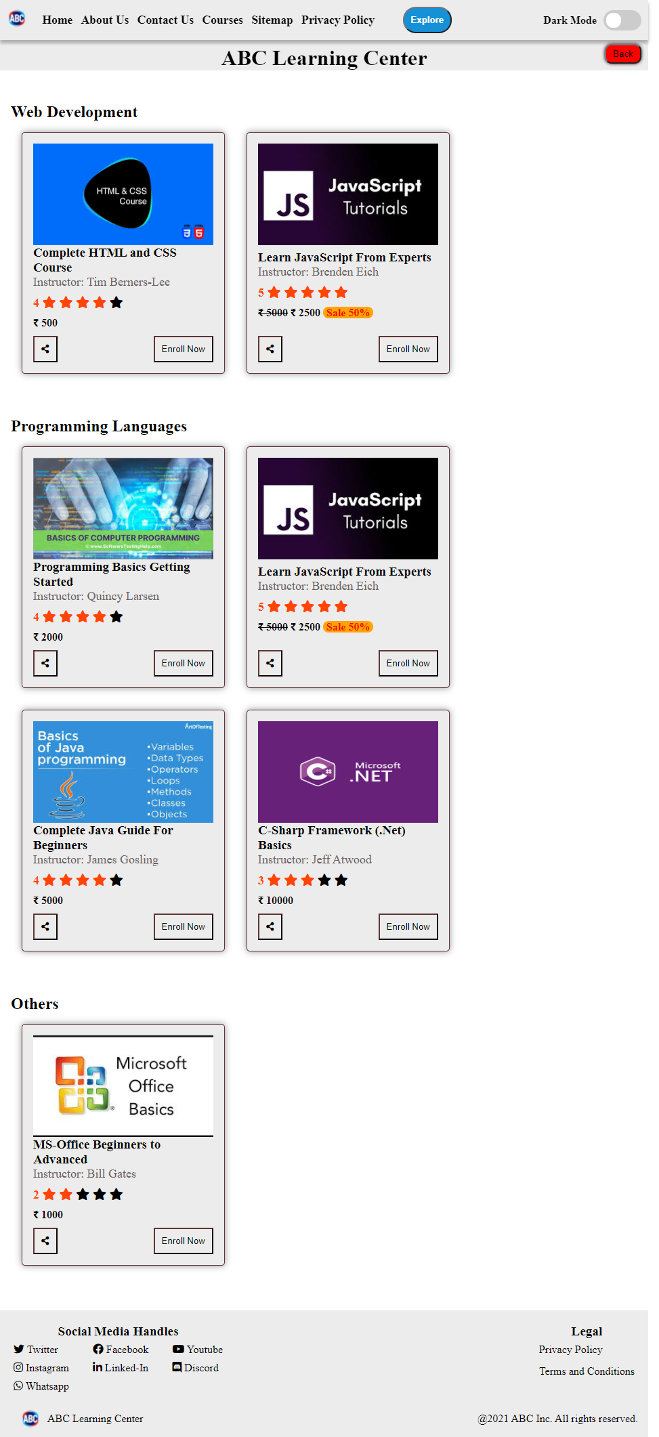
Course Listing

Slide 5
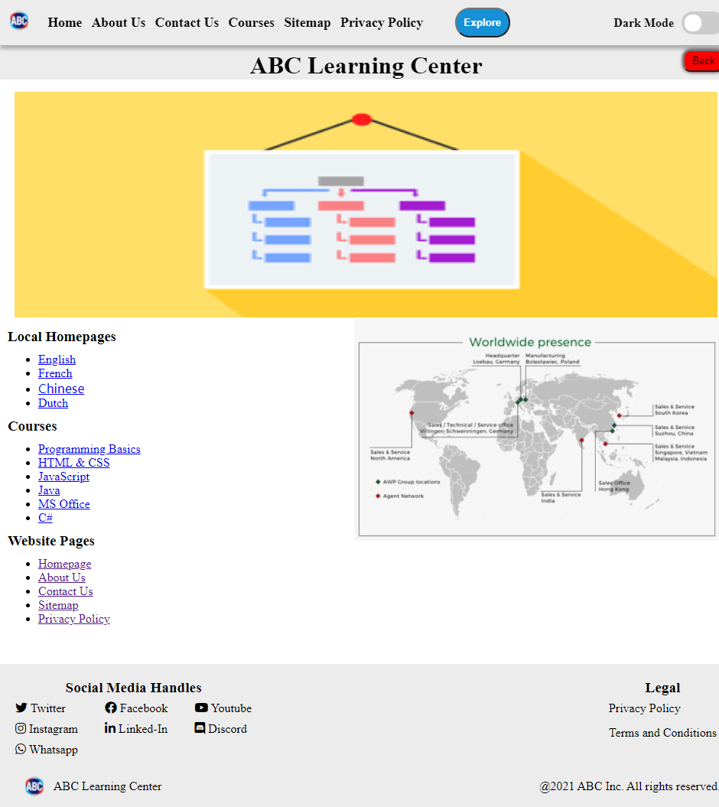
Sitemap

Slide 6
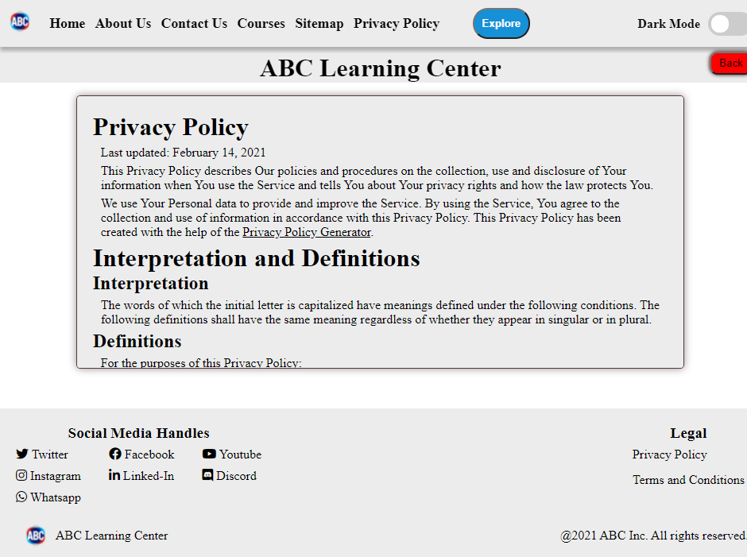
Privacy Policy

Slide 7
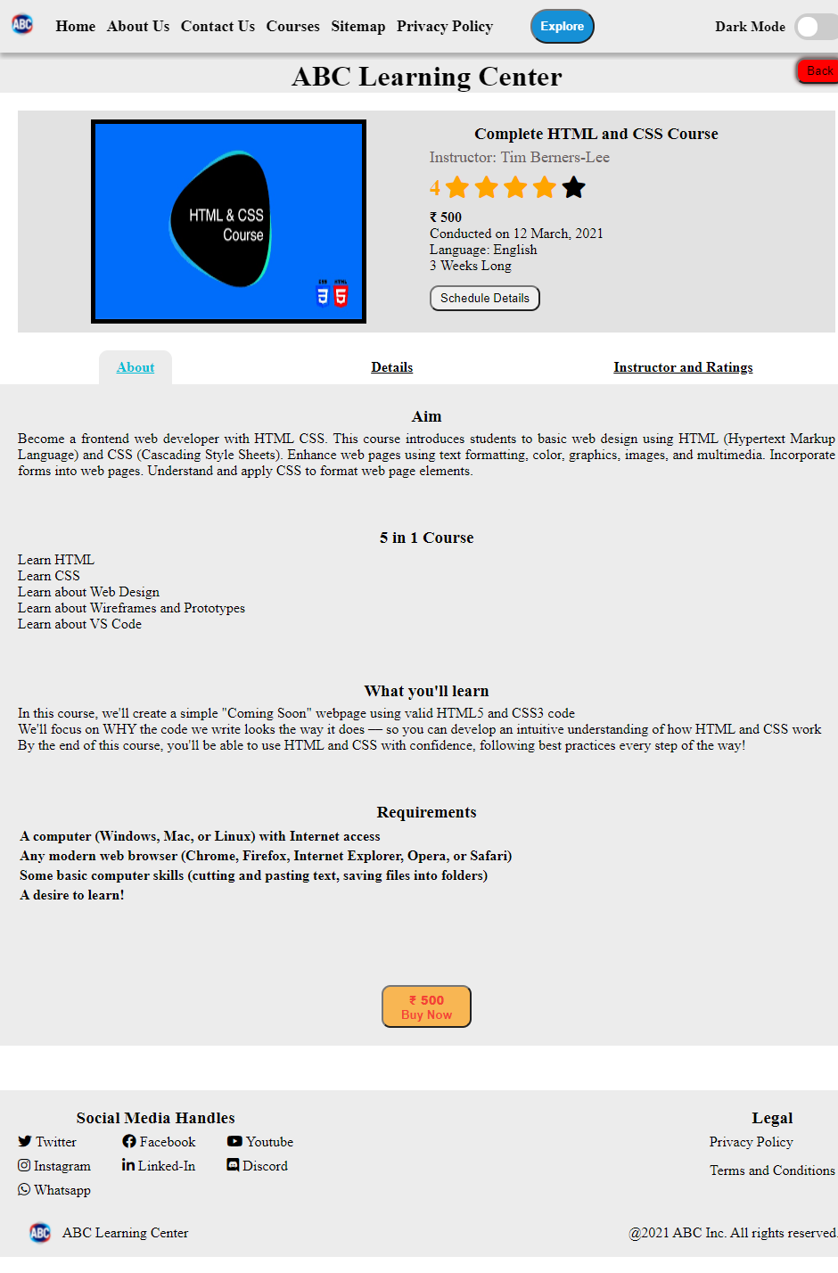
HTML Course Details

Slide 8
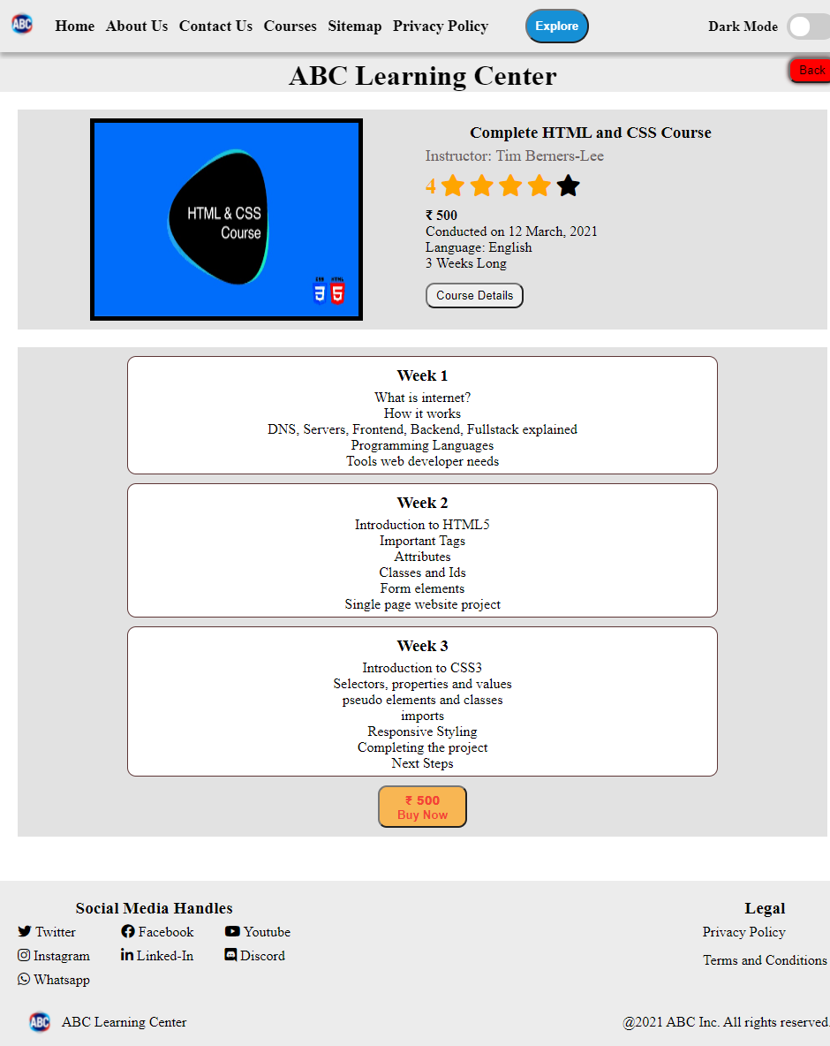
HTML Course Schedule

Slide 9
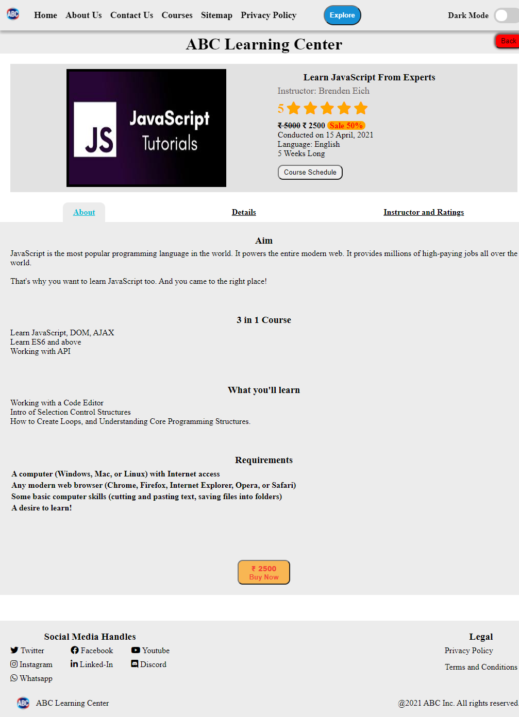
JavaScript Course Details

Slide 10
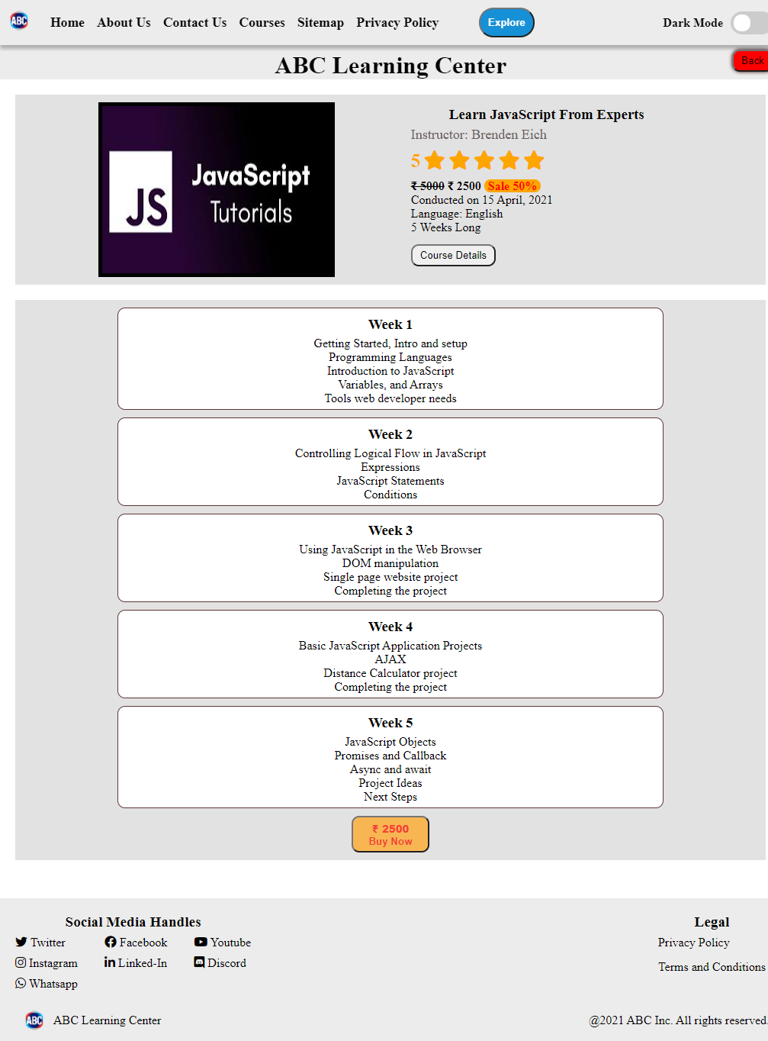
JavaScript Course Schedule

