Slide 1
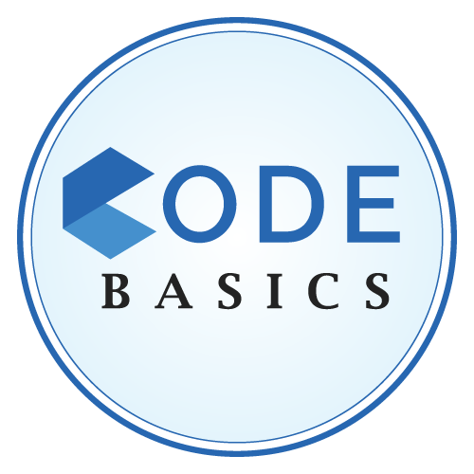


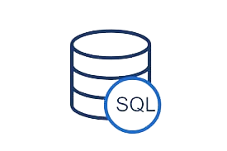
AtliQ Grands Hospitality Analysis
Domain: Hospitality
A
A

Slide 2
Agenda
1
Company Background
2
Problem Statement
3
Project Overview
4
Insights
5
Dashboard Showcase
6
Recommendations

Slide 3
Company Background
AtliQ Grands owns multiple five-star hotels across India. They have been in the hospitality industry for the past 20 years.
ATLIQ GRANDS
Data
May,2022
June,2022
July,2022
City
Delhi
Mumbai
Hyderabad
Bangalore
Property_Names
Atliq Bay
Atliq Blu
Atliq City
Atliq Exotica
Atliq Grands
Atliq Place
Atliq Seasons
Category
Luxury
Business
Room_Class
Standard
Elite
Premium
Presidential

Slide 4
Problem Statement
AtliQ Grands owns multiple five-star hotels across India. They have been in the hospitality industry for the past 20 years.
Challenges Faced
Strategic Move
Data Analytics Expertise
Increased competition from other hospitality providers is impacting their market share. Ineffective decision-making within management is contributing to revenue decline.
The managing director of AtliQ Grands recognizes the need for data-driven insights to regain market share and revenue. They have a vision to leverage "Business and Data Intelligence".
AtliQ Grands lacks an in-house data analytics team to provide the required insights. They seek a third-party service provider to analyze their historical data and deliver valuable insights.

Slide 5

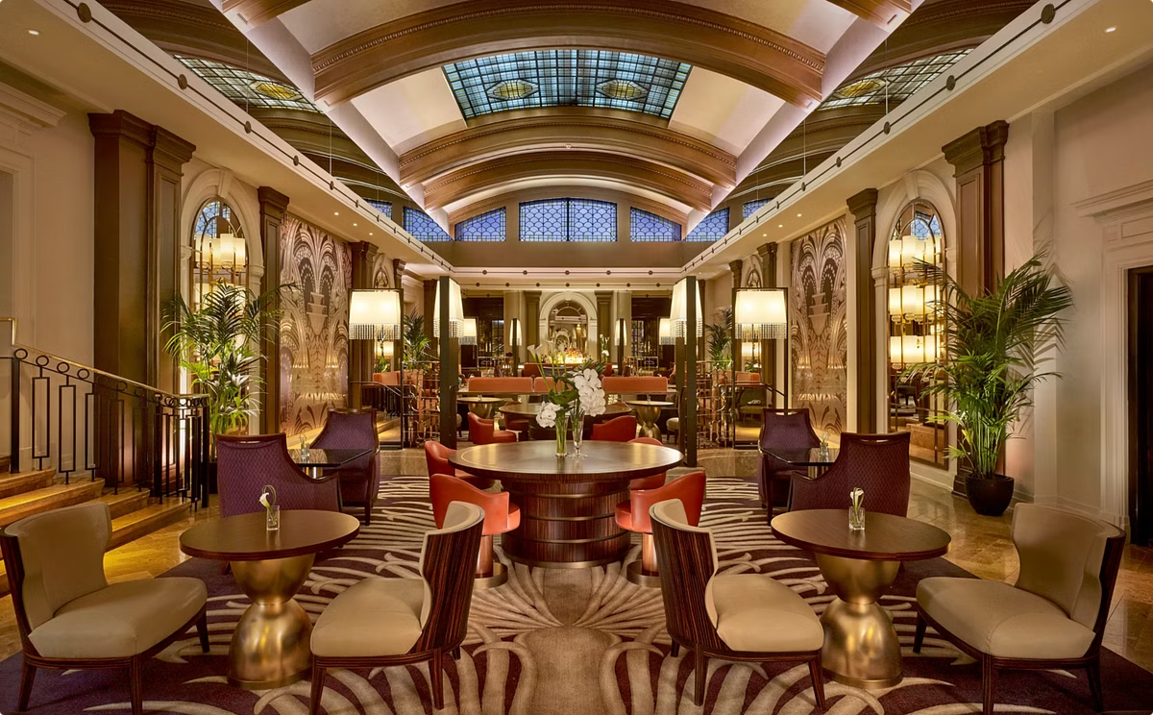
Project Overview
1
Objective
To conduct a comprehensive analysis of the AtliQ Grands' hotel and room datasets.
2
Focus
Analyzing revenue, occupancy, and average rating from booking data, considering city and property_name details.
3
Data Sets
Leveraging detailed information from tables including dim_date, dim_hotels, dim_rooms, fact_aggregate_bookings, and fact_bookings.
4
Data Corrections
Ensuring data integrity by converting the date data type from text to date in all relevant tables.

Slide 6
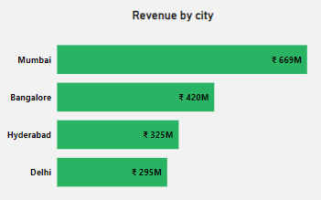
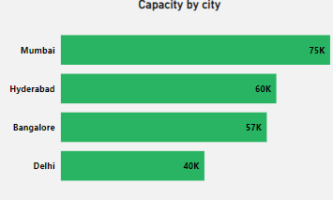
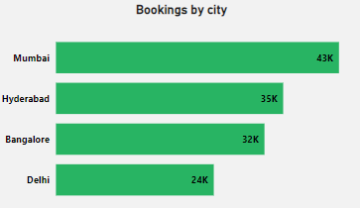
Insights
Mumbai City Have Highest Revenue (669M) ,Booking (43K) and Capacity (75K).

Slide 7
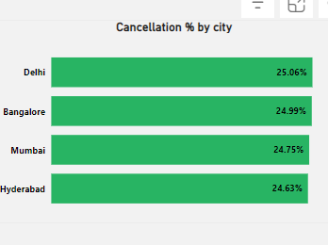
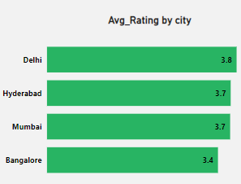
Insights
Delhi City Have Highest Cancellation % (25.06%) and Avg_Rating (3.8)

Slide 8
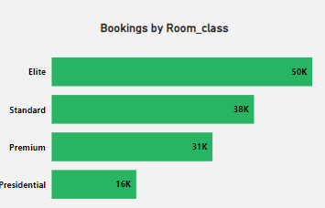
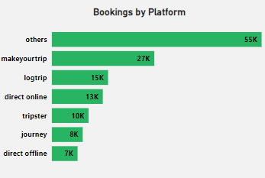
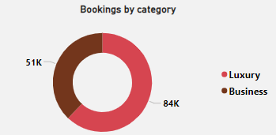
Insights
In Room class Elite Have Highest Bookings (50K)
Maximum of the Customers Booking Rooms via Others Platform (55K)
Most of the Customers Booking Luxury Hotels (84K)

Slide 9
Dashboard
Click Here To Dashboard

Slide 10




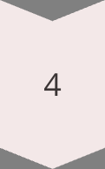
Recommendations
Targeted Marketing
Utilize customer insights to develop targeted marketing campaigns that attract specific customer segments, maximizing the effectiveness of marketing spend.
Optimized Pricing Strategies
Dynamically adjust pricing based on seasonal trends, demand fluctuations, and competitor pricing, ensuring that AtliQ Grands captures maximum revenue.
Enhanced Customer Service
Address customer feedback proactively and implement strategies to improve guest satisfaction, fostering loyalty and positive word-of-mouth marketing.
Data-Driven Decision-Making
Continuously monitor key performance indicators, analyze trends, and make data-driven decisions to optimize operations and drive growth.

Slide 11
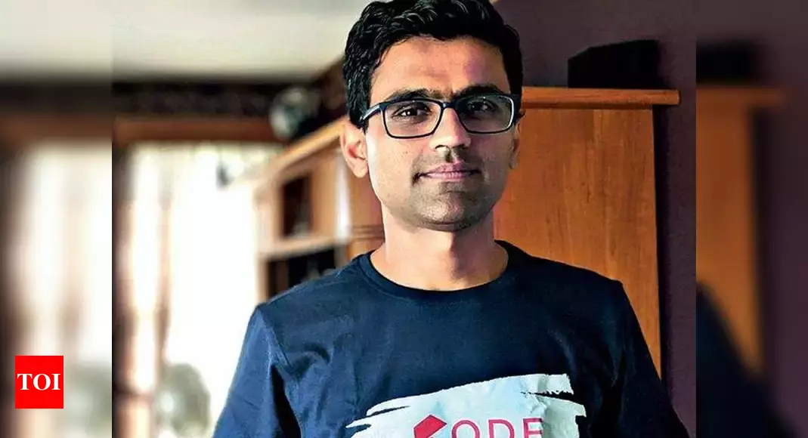
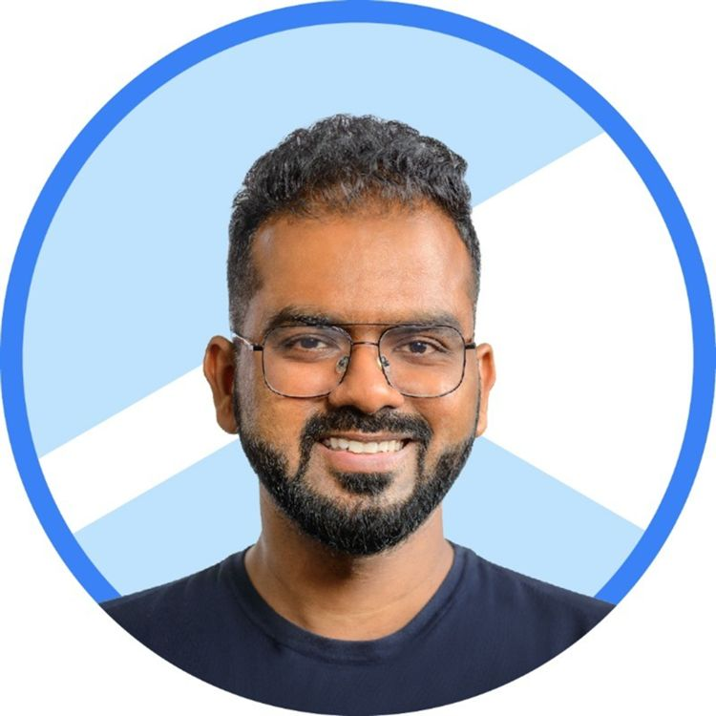
Thank You
HEMANAND SIR
DHAVAL PATEL SIR

