Slide 1
California Housing Price Prediction
California Housing Dataset | 20,640 Observations
The Team
Assumpta Mwikali 134022
Olive Mideva Muloma 135792
Trevor Anjeyo Vuhyah 224038
Valerie Jerono 222331

Slide 2
Research Questions
RQ 1
RQ 2
RQ 3
Can ensemble nonlinear models outperform linear regression in predicting California house prices?
What are the most important nonlinear interactions between location and income?
Which model family (GNPR, Parametric, or Machine Learning) provides the best predictive accuracy?

Slide 3
Data Understanding
20,640
9
0.6330
0.8505
Entries
Variables (8 predictors + 1 target)
OLS Baseline R²
Best Model R² (XGBoost)
Variable | Description
longitude / latitude | Latitude and Longitude coordinates
housing_median_age | Median age of houses
total_rooms / bedrooms | Total number of rooms/ bedrooms
population / households | Population of block/ Number of households
median_income | Median income of residents
median_house_value | Target variable: Median house value

Slide 4
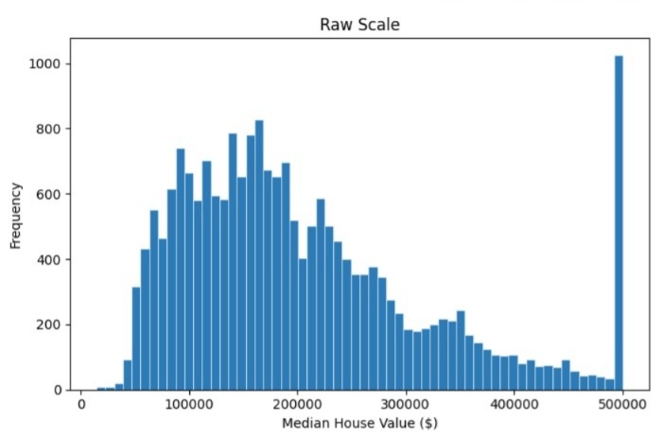
EDA: Distribution of Median House Values
Key observations:
Distribution is positively skewed.
Most houses are within the lower – middle price ranges
The data contains a few highly priced houses.
Interpretation:
This suggests that the target variable is not completely normally distributed

Slide 5
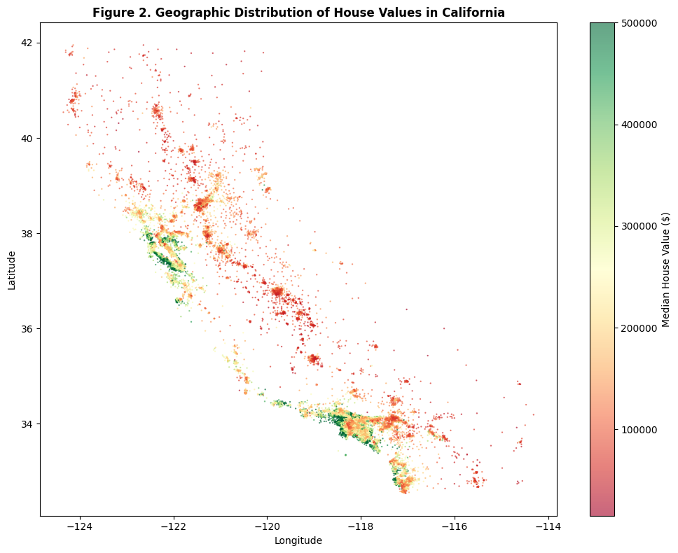
EDA: Geographic Distribution of House Values
Key observations:
Coastal regions (longitude -122 to -121 and latitude 37 to 38), generally show higher property values.
Inland areas (longitude -121 to -118 and latitude 35 to 37), tend to have comparatively lower housing prices.
Spatial clustering across different latitude and longitude ranges suggests that geographic location plays a major role in determining house value.

Slide 6
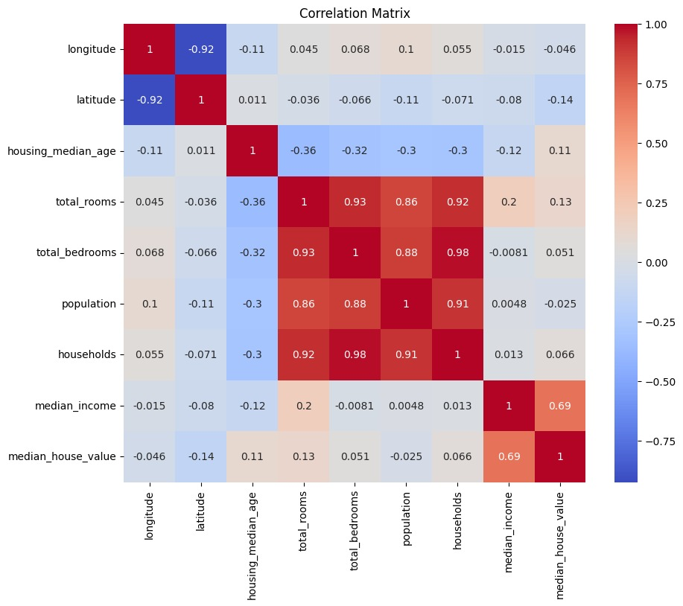
Correlation Analysis
Key observations:
Median income has the strongest positive correlation with house prices.
Latitude and longitude show geographic influence.
Total rooms and households are highly correlated.
Population related variables exhibit multicollinearity.
Interpretation:
The relationships are not entirely linear, hence justifying the use of GAMs, Random Forest and XGBoost.

Slide 7
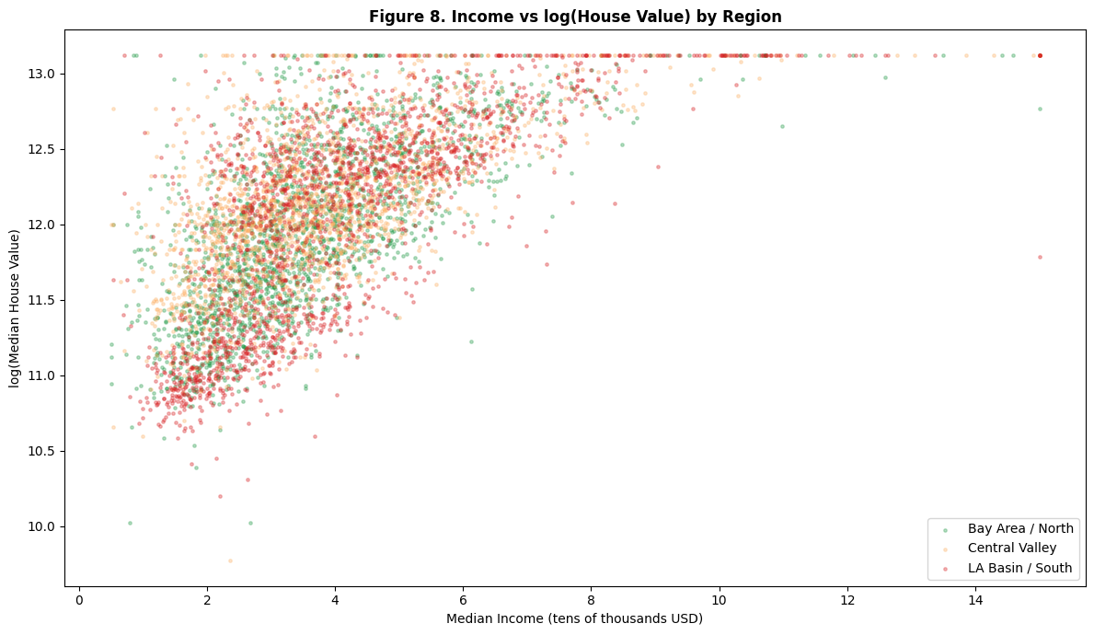
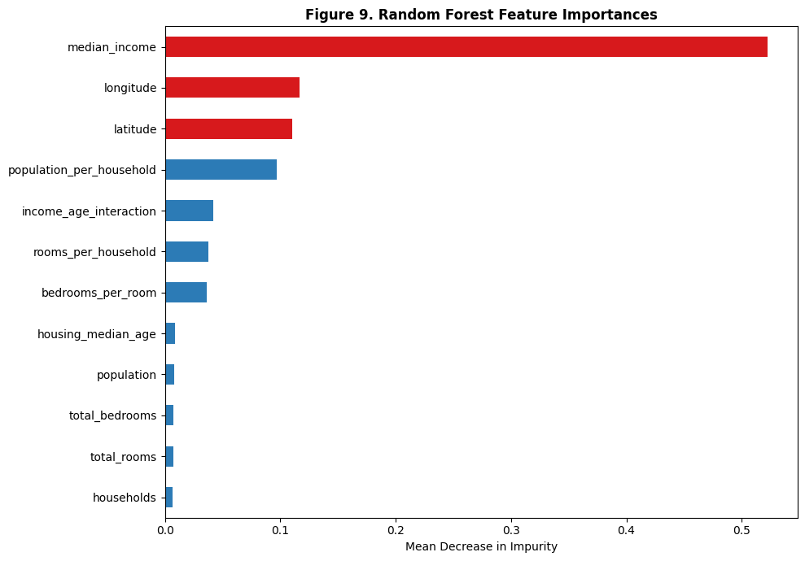
RQ 2: The Income and Location Interaction
What are the most important nonlinear interactions between location and income?
Fig 8 | Income vs log(House Value) by Region
Fig 9 | RF Feature Importances
median_income ranks first in feature importance (importance > 0.52), followed by longitude and latitude (~0.11 each). The income effect is not uniform; Bay Area block groups sit higher on the value axis at every income level, confirming a non-additive spatial interaction.

Slide 8
Feature Engineering: New Variables Created
Variable | Use
rooms_per_household | Household density
bedrooms_per_room | Housing structure
population_per_household | Number of people in the household

Slide 9
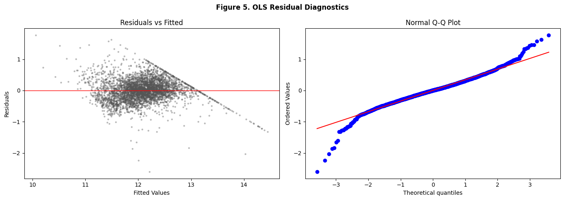
RQ 1: The OLS Baseline: What It Sees and What It Misses
Can ensemble nonlinear models outperform linear regression?
Fig 5 | OLS Residual Diagnostics
0.6330
OLS R² (test set)
0.3451
OLS RMSE (log scale)
What OLS Misses
Nonlinear income effect (concave, not linear)
The residual fan confirms heteroscedasticity. The Q-Q plot shows tail departures from normality. These are not minor violations; they are the signature of a model at the limit of its representational capacity.
Geographic premium (coastal underprediction)
Interaction between location and income
Heteroscedastic variance structure

Slide 10
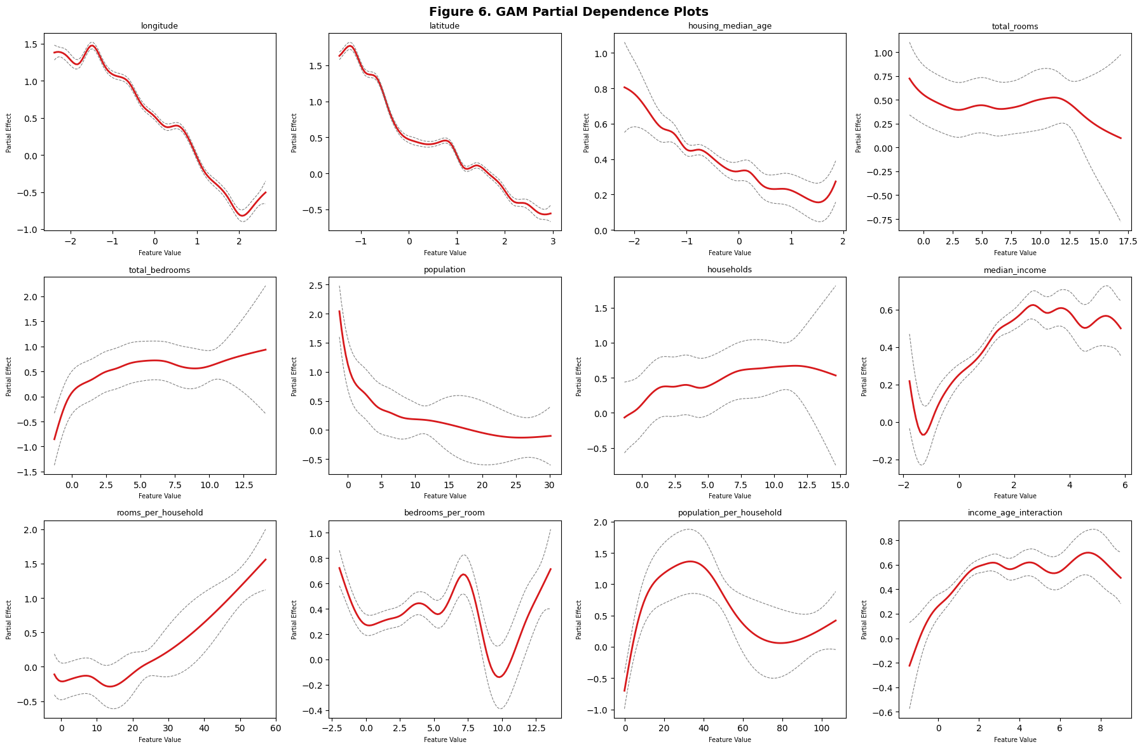
GNPR: GAM Partial Dependence Plots
The shape of each predictor's marginal contribution: interpretability at its richest
Fig 6 | GAM Partial Dependence: All 12 Features (Penalised Splines)
GAM Findings
median_income
Concave relationship. Marginal returns to income diminish above the median.
latitude
Sharp discontinuity around lat 37.5; the Bay Area premium is visible as a structural break.
longitude
Non-monotone coastal effect. LA Basin shows a distinct westward premium.
rooms_per_household
Positive and near-linear; more space per household raises value predictably.
GAM R² = 0.7591 | AIC = 3777.61

Slide 11
GNPR Models: Splines and the Generalised Additive Model
Spline Regression
Generalised Additive Model
Uses smooth curves to model nonlinear relationships between predictors and house prices.
R² = 0.7175
Models house prices as the sum of smooth nonlinear effects from each predictor variable to show how each feature influences the predictors.
R² = 0.7591
Key finding from GAM partial dependence plots: the income-to-price relationship is concave. The marginal return to income diminishes at high income levels. This is a qualitatively richer finding than any linear coefficient can express.

Slide 12
Ensemble Methods: Random Forest and XGBoost
Random Forest
XGBoost
200 trees | Bootstrap aggregation | Random feature subsets
400 estimators | Learning rate 0.05 | L1 + L2 regularisation
Each tree sees a bootstrapped sample and a random subset of features at each split.
Trees are built sequentially, each fitting the residuals of the prior ensemble.
Final prediction is the average across all trees, reducing variance by design.
Column subsampling and regularisation prevent overfitting on tabular data.
Naturally captures nonlinear relationships and interaction effects without analyst specification.
The workhorse of applied ML on structured datasets. Competitive by design.
R² = 0.8228
R² = 0.8505

Slide 13
RQ 3: GNPR vs Parametric vs Machine Learning
Which model family provides the best predictive accuracy?
ML Ensemble
Best R² = 0.8505
Model
RMSE
MAE
R²
Highest accuracy. Interactions discovered automatically. Best for prediction.
XGBoost
0.2203
0.1507
0.8505
ML Ensemble
Grad. Boosting
0.2302
0.1597
0.8368
ML Ensemble
Random Forest
0.2398
0.1640
0.8228
ML Ensemble
GNPR (GAM / Splines)
GAM
0.2796
0.2012
0.7591
GNPR
Neural Net (MLP)
0.2876
0.2096
0.7452
ML Deep
Best R² = 0.7591
Spline Regression
0.3028
0.2228
0.7175
GNPR
Interpretable shapes. Partial dependence reveals structure. Best trade-off.
Ridge / OLS
0.3451
0.2577
0.6330
Parametric
Lasso
0.3519
0.2577
0.6185
Parametric
Family
Parametric (OLS etc.)
Best R² = 0.6330
Legible coefficients. Inferential and policy use. Bounded by linearity.

Slide 14
The Competition: GNPR vs. Parametric vs. Machine Learning
Research Question 3: answered.
Model Families
Parametric
GNPR
ML Ensemble
ML Deep
The hierarchy is clear.
ML ensembles lead on accuracy. GNPR models lead on accuracy-interpretability balance. Parametric models lead for inference.
The choice of model is a choice about purpose.

Slide 15
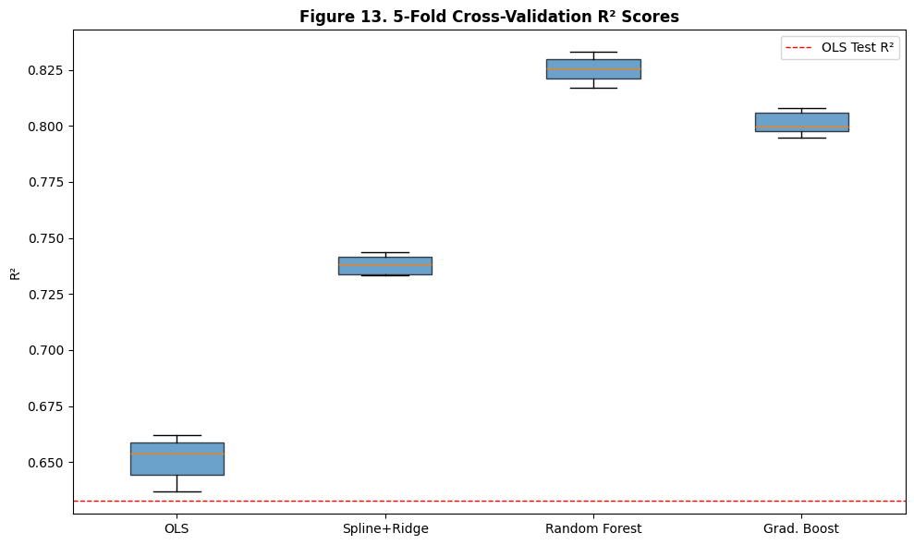
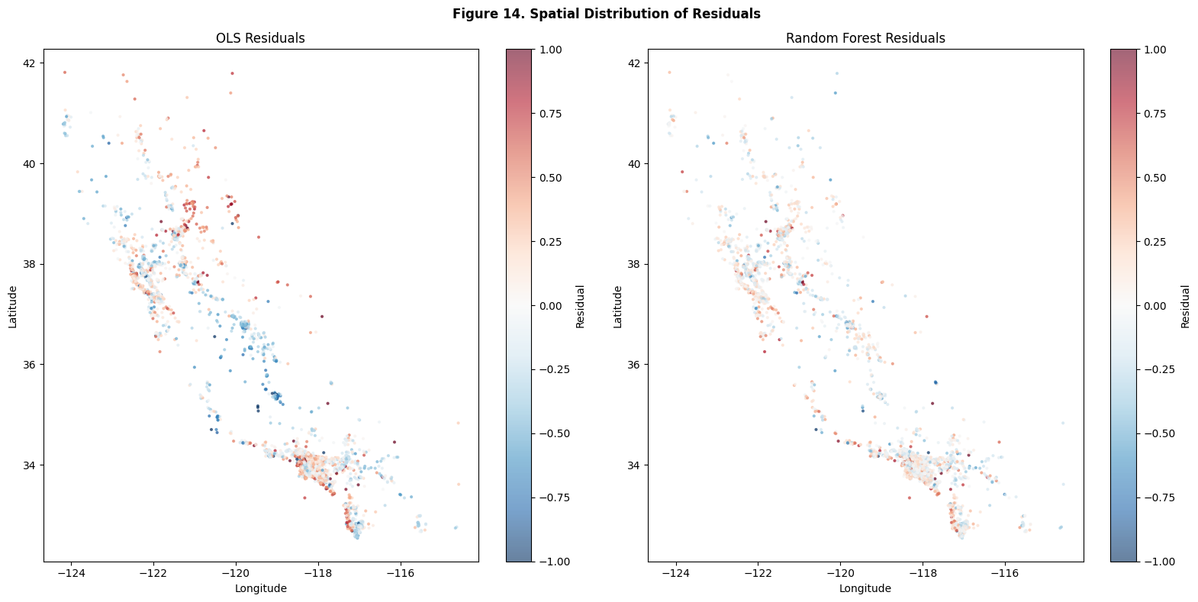
Stability and Spatial Diagnostics
5-fold cross-validation and residual geography
Fig 13 | 5-Fold Cross-Validation R² Scores
Fig 14 | Spatial Distribution of Residuals: OLS vs Random Forest
Model
CV R²
OLS
0.6511
± 0.0093
Spline + Ridge
0.7382
Std Dev
± 0.0041
Grad. Boost
0.8011
± 0.0049
OLS residuals show visible coastal clustering (systematic underprediction). Random Forest residuals are more evenly dispersed, though spatial autocorrelation is not eliminated; an invitation for geographically weighted extensions.
Random Forest
0.8253
± 0.0057

Slide 16
Spatial Residual Diagnostics: What the Models Still Miss
OLS Residuals
Random Forest Residuals
High positive residuals (systematic underprediction) cluster visibly along the coast. The Bay Area and LA Basin are consistently missed. This is not noise. It is the fingerprint of the coastal premium that a non-spatial linear model cannot absorb.
The coastal clusters are substantially attenuated. The error map is far more dispersed. The ensemble has learned to partially account for the geographic signal, though spatial autocorrelation is not eliminated.
Spatial pattern visible
Pattern attenuated, not eliminated

Slide 17
CONCLUSIONS
Research Questions Answered
RQ 1
Can ensemble models outperform OLS?
Yes. XGBoost achieves R² = 0.8505 versus OLS at 0.6330. The improvement is stable across 5-fold cross-validation (RF CV R² = 0.8253 ± 0.0057). The gap is not marginal; it is the difference between capturing the signal and approximating it.
RQ 2
What are the key nonlinear interactions?
The most important nonlinear interaction is between latitude and income. The Bay Area commands a structural premium at every income level and shows a steeper income slope than any other region.
RQ 3
Which model family performs best?
ML ensembles lead on accuracy (XGBoost RMSE = 0.2203). GNPR models lead on the accuracy-interpretability trade-off (GAM R² = 0.7591, AIC = 3777.61). Parametric regression leads for inference. Purpose determines the optimal choice.
California housing is a nonlinear world. The question of how to act on that knowledge belongs to the next chapter.

Slide 18
Open Questions and Future Work
01
Spatial Regression
02
Deep Learning with Geographic Embeddings
Moran's I test on OLS residuals would formally quantify spatial autocorrelation. Geographically Weighted Regression would allow coefficients to vary by location, a natural response to the geographic modulation of the income effect.
A properly regularised neural network with learned embeddings for geographic coordinates may surpass the XGBoost benchmark. Coordinate embedding via positional encoding is a natural adaptation from sequence modelling.
03
Uncertainty Quantification
04
The Ceiling Effect
This project reports point predictions. Conformal prediction or quantile regression forests would provide prediction intervals, essential for any practical deployment in housing market analysis or investment appraisal.
The value $500,001 appears 965 times in the dataset. This is not noise; it is censoring. Tobit regression or a survival analysis framing could model this truncation explicitly and recover unbiased coefficient estimates for the upper tail.

