Slide 1
BEYOND LINEARITY
A Nonlinear Inquiry into California Housing Prices
California Housing Dataset · 20,640 Census Block Groups · 1990 U.S. Census
Assumpta Mwikali 134022 · Olive Mideva Muloma 135792
Trevor Anjeyo Vuhyah 224038 · Valerie Jerono 222331
DSA 8301 · Statistical Inference for Big Data
Act I
Act II
Act III
Act IV
Foundation
Nonlinear Models
Spatial Diagnostics
Spatial Econometrics
EDA · Feature Eng · OLS Baseline
Splines · GAM · RF · XGBoost
Moran's I · Residual Mapping
SLM · SEM · GWR · Final Compare

Slide 2
OVERVIEW
Three Questions That Drive Everything
RQ 1
RQ 2
RQ 3
Can ensemble nonlinear models outperform linear regression in predicting California house prices?
What are the most important nonlinear interactions between location and income?
Which model family (GNPR, Parametric, or Machine Learning) provides the best predictive accuracy?
Yes: R² 0.633 to 0.851
Income x location is non-additive
Purpose-dependent hierarchy
The journey unfolds in four acts: Foundation, Nonlinear Models, Spatial Diagnostics, Spatial Econometrics

Slide 3
EDA · DATA
The Dataset: 20,640 Census Block Groups, California 1990
Each row = one block group, typically 600 to 3,000 people. Target: median_house_value (log-transformed).
20,640
9
$206,856
$500,001
Observations
Variables
Mean House Value
Ceiling (965 obs)
Variable | Mean | Std | Key Note
median_house_value | $206,856 | $115,396 | Target (log-transformed); right-skewed with ceiling at $500,001
median_income | 3.87 | 1.90 | Strongest predictor (r=0.69 with log target); units = $10,000s
longitude / latitude | -119.6 / 35.6 | 2.0 / 2.1 | Geographic coordinates (structural determinants of value)
housing_median_age | 28.6 yrs | 12.6 | Median housing age per block group
rooms_per_household* | 5.43 | 2.47 | Engineered ratio: more informative than raw room counts
* Feature-engineered: not in the original 1990 Census file. Section 3 adds rooms_per_household, bedrooms_per_room, population_per_household, income_age_interaction.

Slide 4
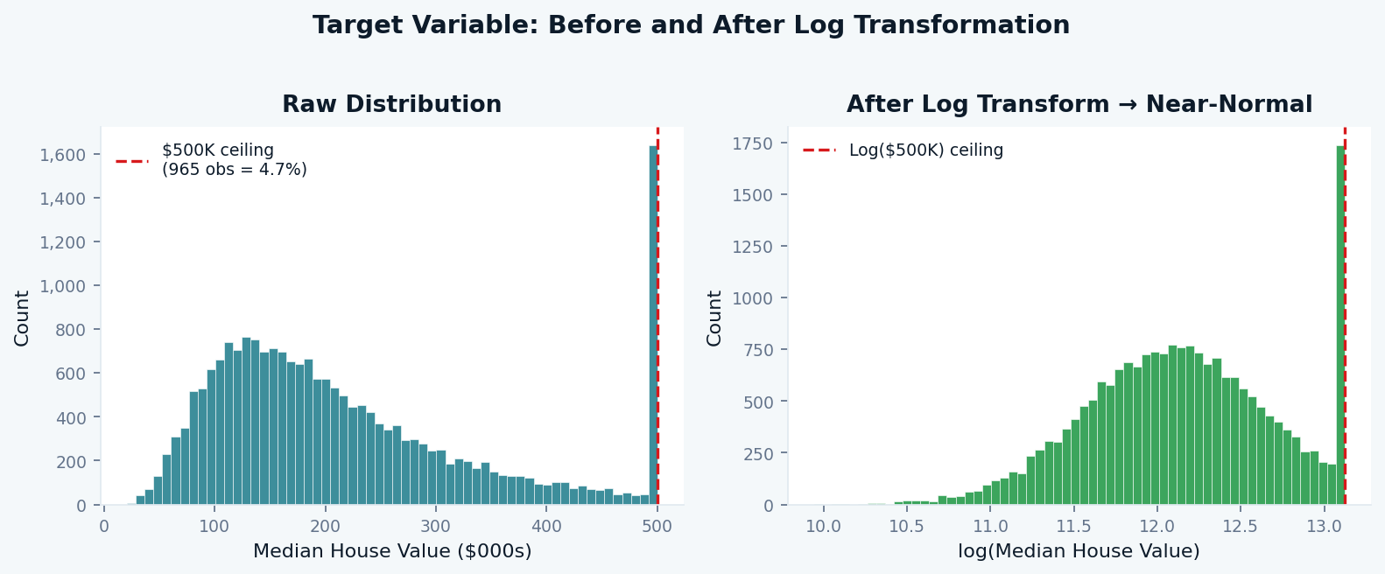
EDA · DISTRIBUTIONS
Target Variable: Why We Log-Transform
The raw distribution is right-skewed with a hard ceiling at $500,001 (965 obs, 4.7% of data). Log transformation corrects this.
Why Log?
Right skew
Mean ($206K) well above Median ($180K). Log pulls outliers closer.
Ceiling artefact
965 obs at $500,001 distort OLS. Log compresses the spike.
Multiplicative effects
A $10K income rise in Beverly Hills differs from Fresno. Log makes effects proportional.
Normality of errors
Log(y) residuals are closer to normal; OLS assumptions better satisfied.
Practical implication: all model outputs are in log($). Predictions must be back-transformed via exp() to return to dollar scale. RMSE values reported throughout are in log units; multiply by ~$100K for a rough dollar magnitude.

Slide 5
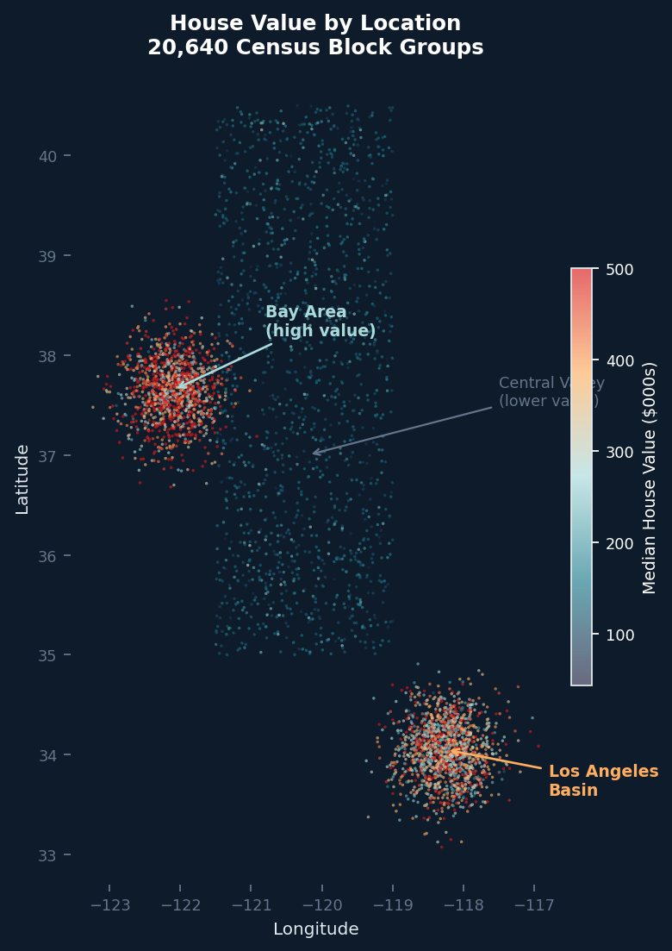
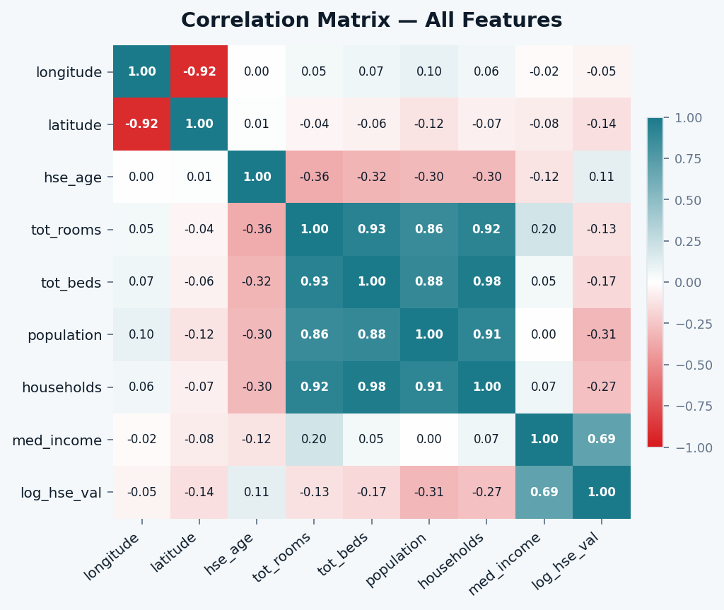
EDA · GEOGRAPHY
Geography Is a Structural Determinant, Not Just a Covariate
High-value properties cluster on the coast; the Central Valley is systematically low. Non-spatial models miss this structure.
Moran's I = 0.762 on log(House Value): extremely strong spatial autocorrelation (z=115, p<0.0001). Nearby block groups share similar values. Any non-spatial model leaves this signal partially captured.

Slide 6
FEATURE ENG.
Four Engineered Features: Ratios Over Raw Counts
Raw counts are ambiguous. Ratios encode density and quality signals. A 10,000-room block group is unremarkable with 3,000 households.
rooms_per_household
bedrooms_per_room
= total_rooms / households
= total_bedrooms / total_rooms
Mean: 5.43 Std: 2.47
Mean: 0.213 Std: 0.058
Proxy for living space per unit. Large values signal luxury or low-occupancy stock. Appears in top 5 XGBoost features.
Low ratio = more living space per bedroom, higher quality. Negative GAM effect: fewer bedrooms relative to rooms means more valuable.
population_per_household
income_age_interaction
= population / households
= median_income x housing_median_age
Mean: 3.07 Std: 10.39
Mean: 108.0 Std: 74.4
Crowding proxy. High values indicate dense, lower-income block groups. SLM coefficient is significantly negative (beta = -0.001, z = -8.2).
Captures the joint signal: high income and old stock = established wealth district. Negative SLM coefficient (beta = -0.0004) suggests age discounts high-income value.
Train/test split: 80/20 (random_state=42). Target: log(median_house_value). Scaling applied for linear models and MLP; tree-based models receive unscaled features.

Slide 7
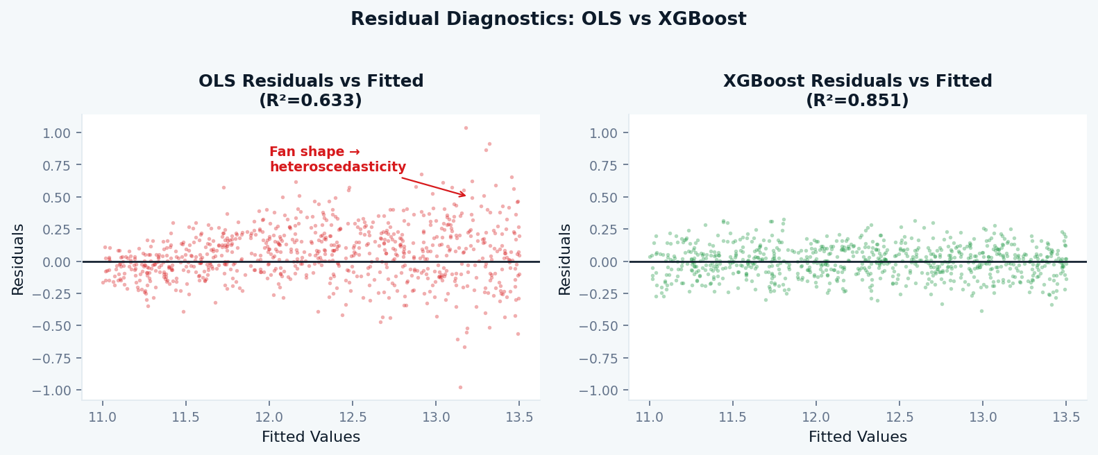
BASELINE · OLS
OLS Baseline: What Linearity Can and Cannot See
R² = 0.633 on log scale. Not a bad model, but its residuals reveal exactly where the nonlinear story begins.
OLS Performance
R²
0.6330
RMSE
0.3451
MAE
0.2577
Adj. R²
0.6423
Fan-shaped residuals (heteroscedasticity) · Curved residual band (concave income effect OLS cannot model) · Coastal clusters of positive residuals (geographic signal unabsorbed)

Slide 8
MODELS
Three Families, Three Epistemological Stances
Parametric
GNPR
ML Ensemble
OLS · Ridge · Lasso
Splines · GAM
RF · GradBoost · XGBoost
Produces coefficients: legible, falsifiable, policy-relevant statements about each predictor. Assumes linearity. Best R²: 0.633.
Relaxes linearity while preserving additive interpretability. Each predictor gets a smooth curve f(x). Asks: what is the shape of each relationship? Best R²: 0.759.
Function approximators. Interactions are discovered, not declared. Maximum accuracy at cost of opacity. Explainability via SHAP/PDP. Best R²: 0.851.
Interpretability: High Accuracy: Low
Interpretability: High Accuracy: Medium
Interpretability: Low Accuracy: High
Plus: Spatial Econometrics (SLM, SEM, GWR) — explicitly modelling the geographic dependence structure all three families partially ignore.

Slide 9
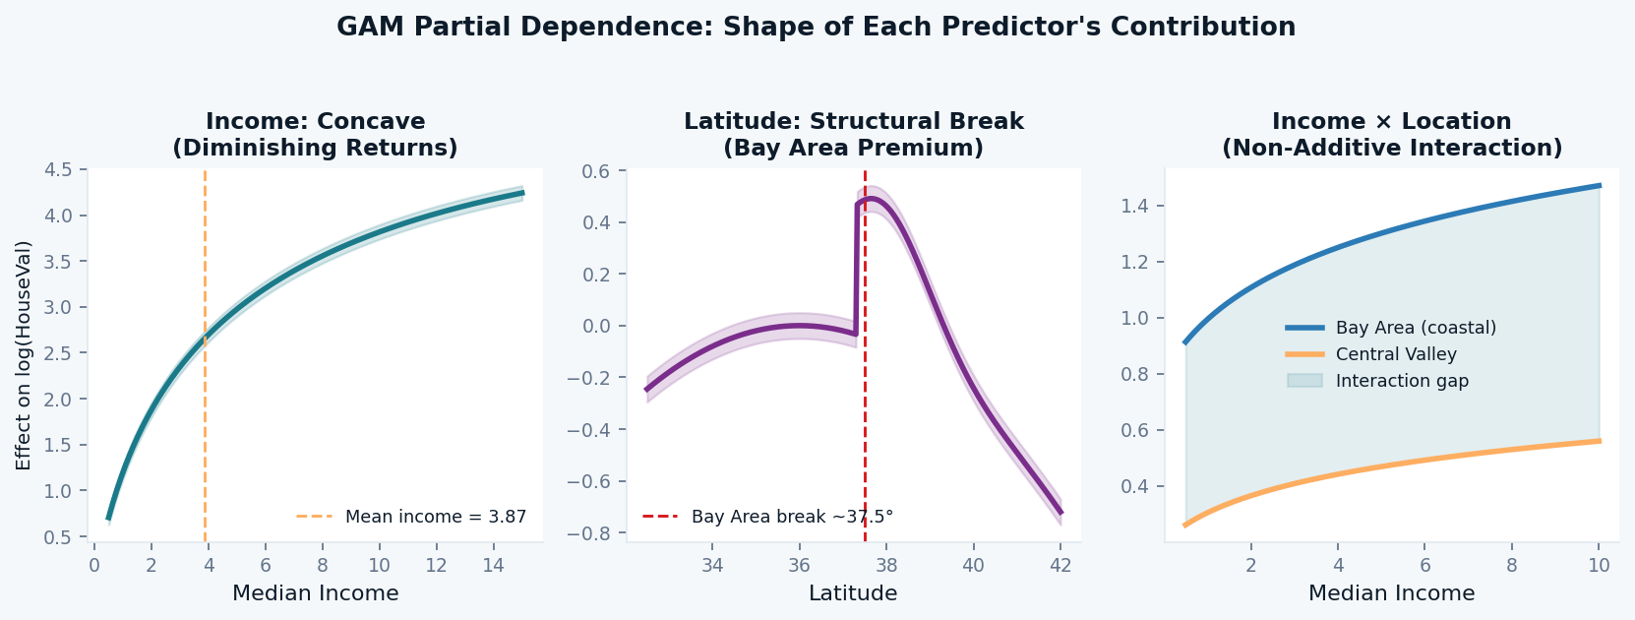
GNPR · GAM
GAM Partial Dependence: The Shape of Every Relationship
R² = 0.759 · RMSE = 0.280 · Each curve is the marginal contribution of one predictor holding all others equal
Income:
Concave: marginal returns diminish above ~$38K. OLS forces a straight line through this curve, systematically under-predicting low-income blocks.
Latitude:
Sharp structural break at 37.5° N. The Bay Area premium is a discontinuity, not a smooth gradient. Confirms a distinct housing market boundary.
Income x Location:
The income slope is steeper in coastal regions (Bay Area vs. Central Valley by ~0.13 per unit income). No additive model can represent this.

Slide 10
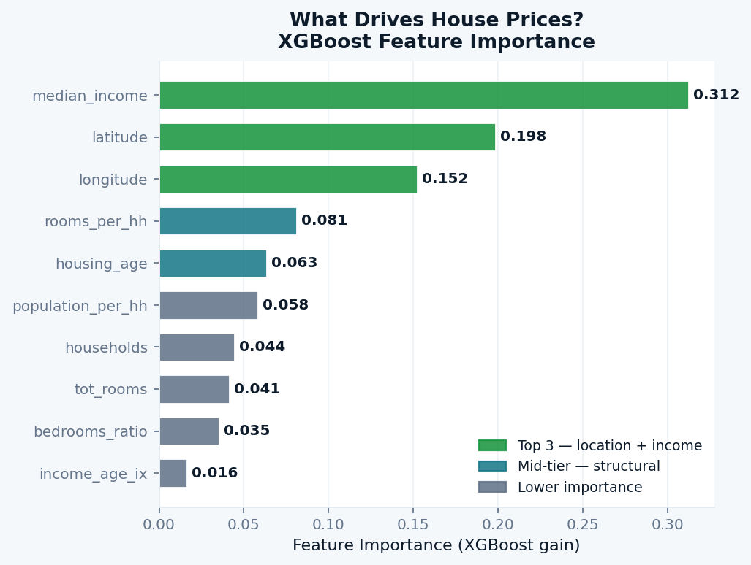
ML · FEATURE IMPORTANCE
What Drives House Prices? XGBoost Feature Importance
median_income (31%), latitude (20%), longitude (15%) account for 66% of the model's predictive gain.
What This Tells Us
Income dominates
31% of gain. It is concave (GAM) and location-modulated (GWR), not linear.
Coordinates top-3
lat+lon together = 35% of gain. Geography is signal, not noise. Confirms the case for spatial models.
rooms_per_hh: 8%
Engineered feature ranks 4th. Raw room counts rank lower; the ratio compresses the informative signal.
housing_age: 6%
Older stock correlates with established, high-value neighbourhoods but effect reverses in some regions (GWR).
Raw counts low
total_rooms, total_bedrooms rank near bottom. Volume without context is weak signal.
Importance = average gain in loss function per split. High importance does not mean linear effect; it means the model splits on this feature frequently and gains accuracy each time.

Slide 11
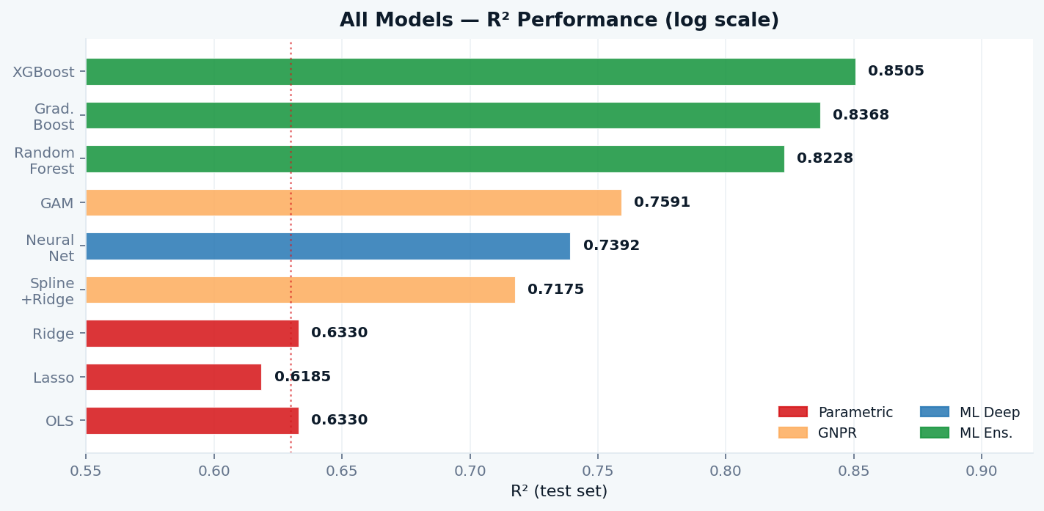
MODEL COMPARISON
All Non-Spatial Models: Ranked by Performance
XGBoost leads with R² = 0.851. Every step away from linearity improves accuracy, confirming RQ1 decisively.
Key Gaps
OLS to GAM
+0.126
Adding smoothness
(GNPR advantage)
GAM to XGBoost
+0.091
Adding interactions
(ML advantage)
OLS to XGBoost
+0.218
Total nonlinearity
gain over baseline
Family | Best R² | Best RMSE
Parametric | 0.633 | 0.345
GNPR | 0.759 | 0.280
ML Ensemble | 0.851 | 0.220
ML Deep (MLP) | 0.739 | 0.291

Slide 12
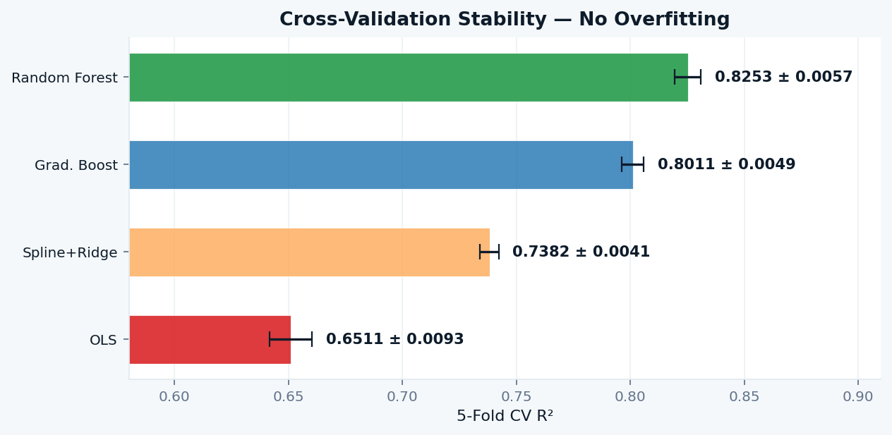
CROSS-VALIDATION
5-Fold Cross-Validation: The Results Are Not Lucky
CV stability confirms that ensemble gains are real, not a consequence of a favourable train/test split. Low sigma means the model generalises.
CV Verdict
OLS
sigma=0.009: stable but low ceiling. Linearity limits performance consistently.
Spline
sigma=0.004: very stable. GNPR models generalise smoothly.
GBM
sigma=0.005: high accuracy, low variance. No overfitting signal.
RF
sigma=0.006: highest CV R². Confirms RQ1: ensembles win decisively.
Why CV matters: A single test split could be lucky or unlucky. 5-fold CV trains on 80% of data five different ways and tests on the remaining 20% each time. If mean R² is high and sigma is low, the model is genuinely learning the data-generating process.

Slide 13
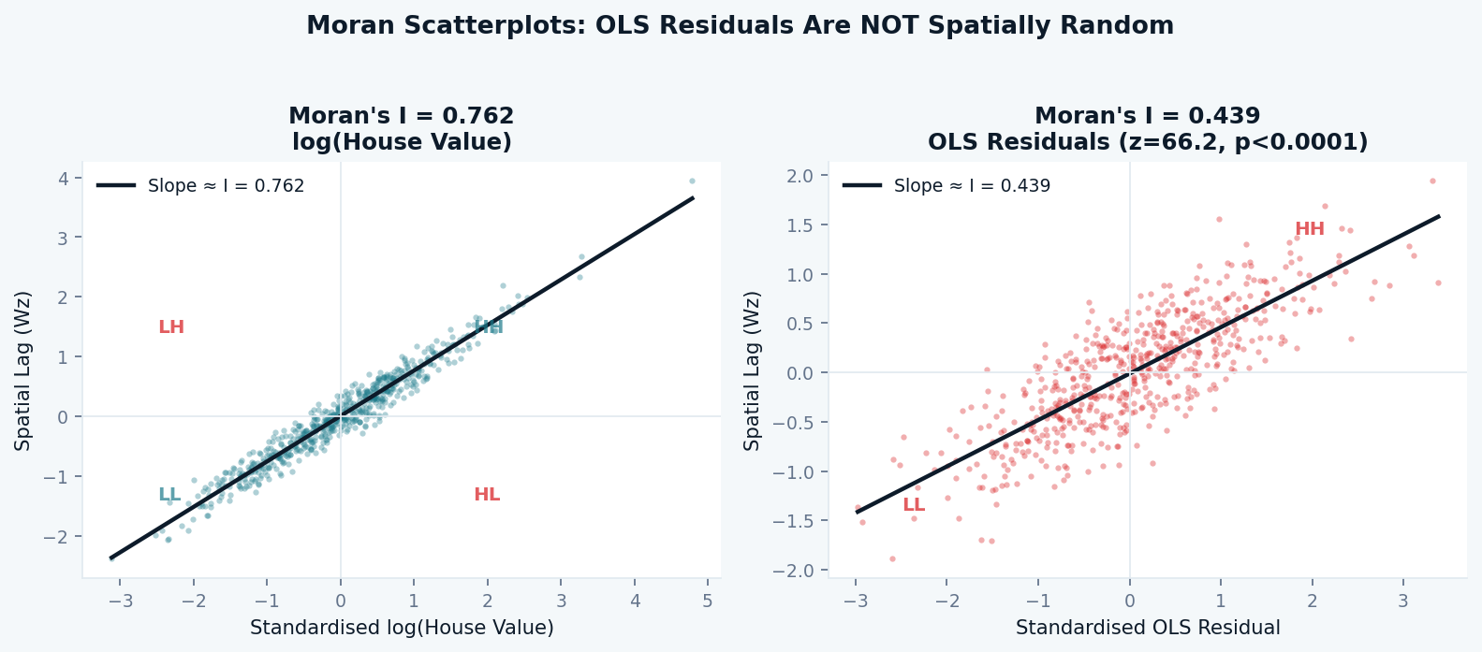
SPATIAL DIAGNOSTICS
Moran's I: Formally Proving What the Map Suggested
Test: are OLS residuals spatially random? z=66.2, p<0.0001. They are not. Classical regression assumptions are violated.
Results
I (house values)
0.762
z-score
115.0
I (OLS residuals)
0.439
z-score (resid.)
66.2
p-value
<0.0001
K-NN neighbours
8
Sample
5,000
What this means: OLS assumes residuals are independent. Moran's I = 0.439 with z = 66.2 shatters that assumption. Nearby block groups share unexplained variance. OLS coefficient estimates are biased and standard errors are wrong. The appropriate response is to model spatial dependence explicitly via Spatial Lag and Spatial Error models.

Slide 14
SPATIAL MODELS · SLM/SEM
Spatial Lag and Spatial Error: Acting on Moran's Signal
Spatial Lag Model (SLM / SAR)
Spatial Error Model (SEM)
y = rho*Wy + X*beta + epsilon
y = X*beta + u, u = lambda*Wu + epsilon
rho = 0.6863 *** (z = 69.6)
lambda = 0.8236 ***
R² = 0.817
R² = 0.577
68.6% of a block group's price (beyond its own features) is explained by its neighbours' prices. This is the mathematical encoding of neighbourhood spillover effects: luxury developments pull up adjacent properties.
82% of the residual error is spatially structured. Interpretation: omitted variables (school quality, crime index, zoning, microclimate) cluster geographically and drive this pattern. Lambda absorbs that clustering.
AIC: 492 vs OLS 3,477 (improvement of 2,985)
AIC: 407 vs OLS 3,477 (further improvement)
Moran's I on residuals: 0.030 (reduced from 0.439)
Moran's I on residuals: 0.651 (less effective for this dataset)
Use when: spatial dependence is substantive and neighbours' outcomes genuinely influence yours.
Use when: spatial dependence reflects omitted variables, not true spillovers.
Verdict: SLM clearly outperforms SEM for this dataset (lower Moran's I on residuals, higher R²). Neighbourhood spillovers are a substantive process here, not merely an omitted-variable artefact.

Slide 15
GWR
Geographically Weighted Regression (GWR)
Global R² = 0.888 on subsample · Bandwidth: 57 neighbours · AICc = -15.83 · n = 1,500 · Coefficients vary continuously in space
How GWR Works
Local Coefficient Summary
yi = beta0(ui,vi) + sum_k betak(ui,vi) xik + ei
Feature | Mean beta | Range
median_income | 0.243 | [-0.23, 0.76]
housing_age | 0.001 | [-0.35, 0.30]
rooms_per_hh | 0.052 | [-0.64, 0.74]
pop_per_hh | -0.120 | [-0.37, 0.24]
Local regression
A separate regression at each location, weighting nearby observations via an adaptive bisquare kernel.
Bandwidth = 57 nn
Each local model uses its 57 nearest neighbours. Smaller bandwidth = more local variation allowed.
Key insight: the income coefficient spans from -0.23 to +0.76 across California. A single global coefficient (OLS beta approx 0.09) is a crude average hiding enormous local heterogeneity. GWR reveals that income's power is geographically contingent: strongest in coastal high-demand zones, attenuated or reversed in parts of the Central Valley.
Local income coeff
Mean beta(income) = 0.243, range [-0.228, 0.763]. The income effect is not global; Bay Area is at the high end.
Local R² range
Some regions fit well (coastal), others fit poorly (inland), revealing where omitted variables matter most.
GWR: the only model that answers not just 'does income matter?' but 'where does it matter and how much?'

Slide 16
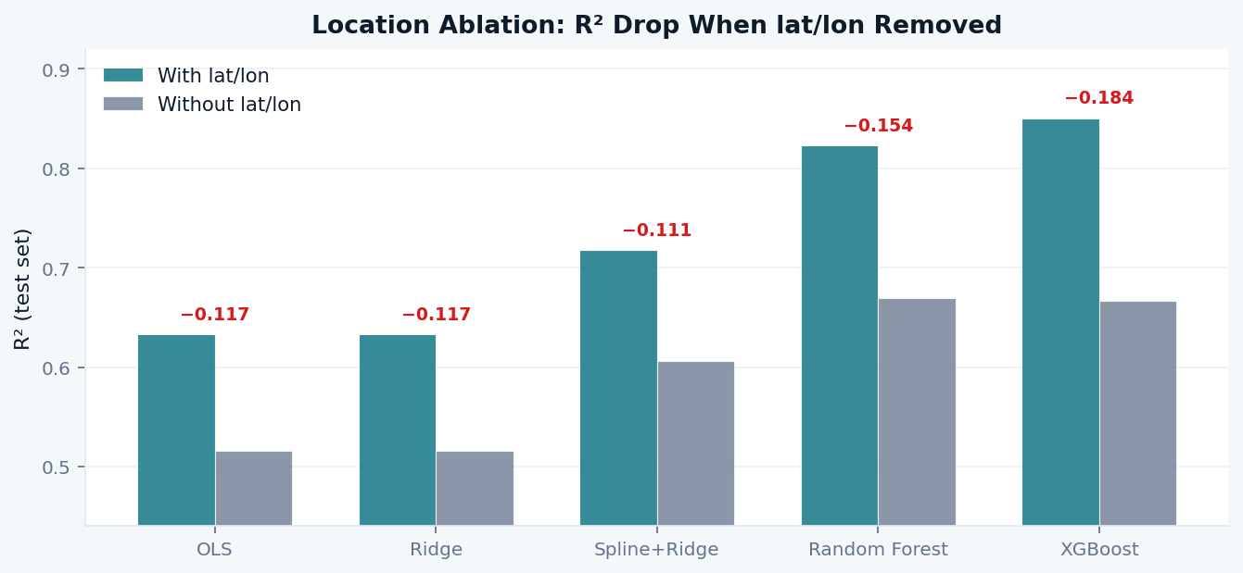
ABLATION
What If We Remove Location Coordinates?
Controlled experiment quantifying lat/lon contribution. XGBoost loses 0.184 R², the largest absolute drop of any model.
Reading the Gap
Linear models
Drop 0.117. Coordinates were OLS's only proxy for the coastal premium.
Ensembles
Drop 0.154 to 0.184. Partial recovery from income and density features.
Spatial models
Ablation irrelevant. Spatial structure lives in W, not lat/lon coordinates.
Residual gap
What ensembles still miss: amenities, school districts, zoning (the lambda in SEM).
Practical implication: In a privacy-constrained deployment (coordinates unavailable), XGBoost retains R² approx 0.666, substantial predictive power but measurably degraded. For spatial models the ablation is irrelevant: W encodes adjacency structure independently of the feature matrix X, which is precisely what makes spatial econometrics epistemologically distinct from simply adding lat/lon as features.

Slide 17
FINAL COMPARISON
Complete Model Hierarchy: All Families on One Table
Note: spatial models fit on subsample (n approx 1,500 to 5,000). R² not directly comparable to full-dataset non-spatial models.
Model | Family | R² | RMSE | Dataset | Key Strength
GWR | Spatially Varying | 0.888 | n/a | Subsample | Where coefficients vary spatially
XGBoost | ML Ensemble | 0.851 | 0.220 | Full | Pure prediction accuracy
Grad. Boosting | ML Ensemble | 0.837 | 0.230 | Full | Accurate and faster than XGBoost
Random Forest | ML Ensemble | 0.823 | 0.240 | Full | Robust; CV R² = 0.825 +/- 0.006
SLM | Spatial Econometric | 0.817 | n/a | Subsample | Neighbourhood spillover (rho = 0.687)
GAM | GNPR | 0.759 | 0.280 | Full | Interpretable smooth curves
Neural Net (MLP) | ML Deep | 0.739 | 0.291 | Full | Nonlinear but expensive
Spline+Ridge | GNPR | 0.718 | 0.303 | Full | Transparent middle ground
Ridge / OLS | Parametric | 0.633 | 0.345 | Full | Interpretable baseline
SEM | Spatial Econometric | 0.577 | n/a | Subsample | Omitted variable correction
The verdict is not a single winner. It is a hierarchy of purposes. Choose by what you need to know, not just which R² is highest.

Slide 18
CONCLUSIONS
What We Found and How We Know It
RQ 1
Yes, decisively.
OLS R² = 0.633 to XGBoost R² = 0.851. A 0.218 gap stable across 5-fold CV (RF: 0.825 +/- 0.006). OLS residuals show curvature, heteroscedasticity, and spatial clustering. The case for linearity in this dataset is empirically refuted.
RQ 2
Income x location is non-additive.
GAM: income effect is concave and latitude shows a structural break at 37.5°. GWR: income coefficient ranges [-0.23, +0.76] across California. No global model captures this. The Bay Area income slope is 0.13 steeper per income unit than the Central Valley.
RQ 3
The answer depends on purpose.
ML ensembles lead on accuracy. GAM leads on interpretability. SLM (rho = 0.687) leads on spatial spillover estimation. GWR (R² = 0.888) leads on geographic heterogeneity. No single model wins on all dimensions simultaneously.
The arc: Observed (EDA) > Confirmed (OLS limitations) > Proved (Moran's I) > Modelled (SLM/SEM/GWR) > Compared honestly. That arc distinguishes analysis from a collection of model outputs.

Slide 19
DEPLOYMENT
From Notebook to Production
Four deployment paths, each optimised for a different user and purpose
REST API · Real-Time Valuation
Batch Pipeline · Portfolio Scoring
Model: XGBoost
Model: XGBoost + Conformal PI
For: Proptech · Mortgage calculators · Portals
For: Banks · Insurance · Investment funds
1ms inference · joblib serialisation · quarterly retraining · always return exp(pred)
Airflow scheduling · prediction intervals essential for risk-weighted capital
Dashboard · Spatial Insight Tool
AVM Ensemble · Automated Valuation
Model: GAM + GWR
Model: XGB 50% + RF 30% + GAM 20%
For: City planners · Researchers · Policy
For: Appraisers · Underwriting systems
Streamlit + Folium maps · GWR coefficient maps · GAM partial dependence curves
Blended score for robustness at distribution edges · retrain every 6 to 12 months
Recommended path: REST API > add prediction intervals > build dashboard. Retrain every 6 to 12 months. Model drift in housing markets is real.

Slide 20
FUTURE WORK
Open Questions: Better Than the Ones We Answered
01
Spatial Cross-Regressive (SLX)
02
Geographically Weighted RF
03
Moran's I on ML Residuals
y = X*beta + WX*gamma + epsilon. Adds spatially lagged independent variables: neighbours' income and density influence your price, without SLM's endogeneity problem.
Combine GWR's spatial localisation with ensemble nonlinearity. Locally-weighted RF at each location, closing the gap between spatial econometrics and ML.
We tested OLS. Does XGBoost fully absorb the spatial signal? If Moran's I remains significant on ensemble residuals, it quantifies the motivation for GWRF directly.
04
Temporal Panel Analysis
05
Uncertainty Quantification
06
Causal Inference Extension
Track block groups across Census years. Do spatial autoregressive coefficients increase with gentrification? Does income-location interaction shift over time?
Every prediction here is a point estimate. Conformal prediction or quantile regression forests provide distribution-free intervals, essential for any financial deployment.
All models here are predictive, not causal. Instrumental variables (historical zoning) or regression discontinuity (school district boundaries) yield policy-relevant causal claims.
"The best analyses leave the reader with better questions than they arrived with."

Slide 21
California housing is a nonlinear,
spatially structured world.
We have mapped its contours, measured its gradients, and modelled the forces that shape it.
0.851
0.687
2,985
0.762
Best R²
(XGBoost, full)
Spatial rho
(Neighbourhood
spillovers)
AIC improvement
SLM over OLS
Moran's I
(house values)
Assumpta Mwikali · Olive Mideva Muloma · Trevor Anjeyo Vuhyah · Valerie Jerono

