Slide 1
Collaborating with VAMDC
Guy Rixon
RADAM database workshop, Caen, October 2013

Slide 2
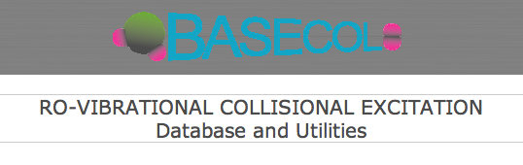
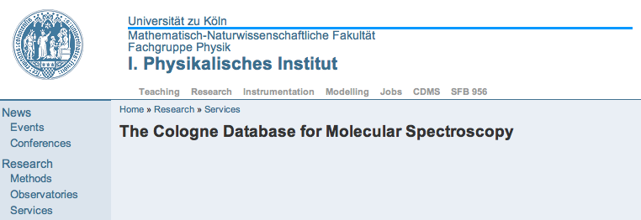
Original use-case
Standard
query protocol
Energy-level matching
Standard
data-format
Model atmosphere calculations

Slide 3
More use cases...
Composite spectrum for molecule
Combine parameters for atomic lines
Compare observation with theory
Compare separate calculations of same levels
Same modelling code uses multiple DBs
New applications work with all DBs
Self-describing format for data
Bibliography of data sources
etc...

Slide 4
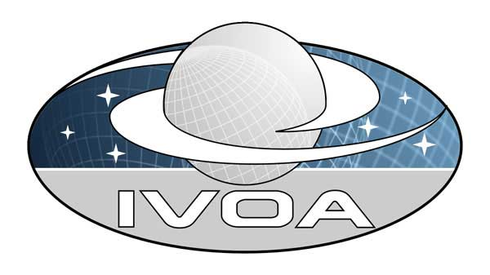


Synthesis of parts
VALD
CDMS
HITRAN
CHIANTI
BASECOL
Existing databases
Web-service protocols
XSAMS data-format
???

Slide 5
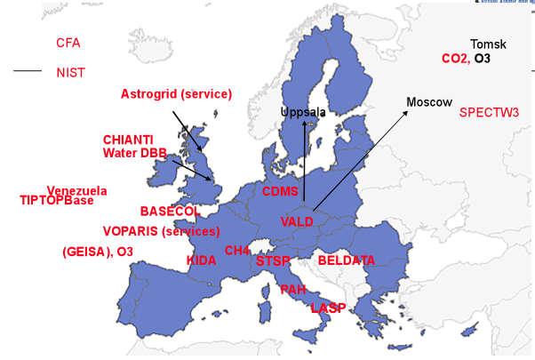
Original VAMDC project
EU FP7 funding, 2009-2012
15 partners, 21 institutions
7 EU countries
+ Russian Federation
+ Venezula
~22 databases proposed initially

Slide 6
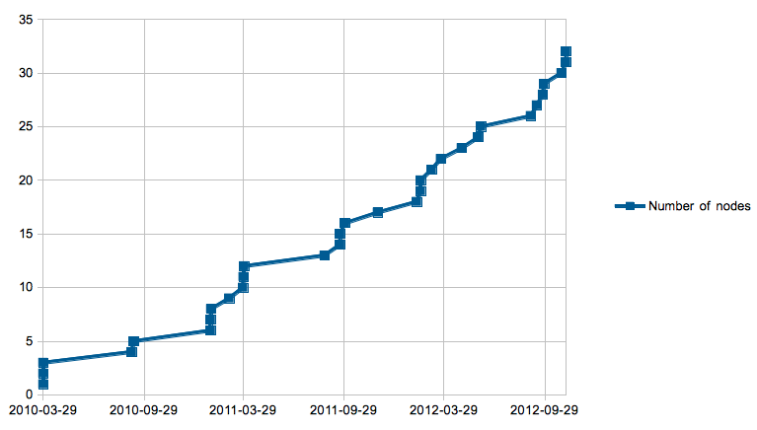
Database growth
Nodes complete as per original, VAMDC proposal

Slide 7

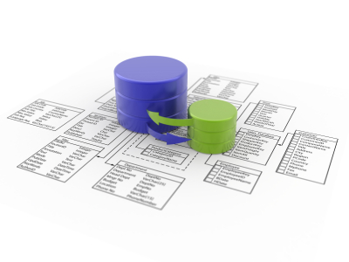


A flock of databases
Science application
VAMDC
data
nodes
Your
DB
here
Notes:
VAMDC is divided into data nodes, each containing a database attached to a web site. Applications talk to these nodes separately and can either hide or expose the separation in the UI. Most current applications expose the separation - e.g. they show the user separate results from each node.
Results from nodes are in a common format and can be compared or combined - this is the point of VAMDC. Where results overlap (e.g. two nodes give different energies for the same level of an atom), then either the user or the application has to decide which data are best. Currently, nothing in VAMDC selects between equivalent data.

Slide 8
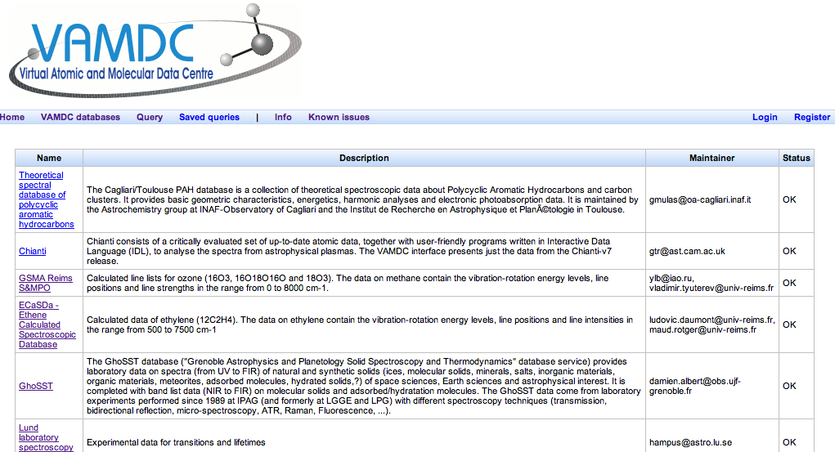
For list of databases see:
http://portal.vamdc.eu/vamdc_portal_test/nodes.seam

Slide 9
DBs relevant to RADAM
IDEADB
RADAM template database, Caen
BASECOL?
Kinetic Database for Astrochemistry (KIDA)?
ALADDIN-2 (IEAE)?
UMIST Database for Astrochemistry (UDfA)?
Various electron-molecule data to come from India, Korea, Japan?

Slide 10
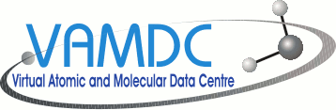


Many UIs
web sites
VAMDC web-portal
Your software here
scripts
applications
Notes:
The cloudy part of VAMDC can be accessed through many UIs. We provide a general portal on the web, but other web sites can connect too (e.g. CDMS have links from their site). Applications can connect directly; we have written some and adapted others. We encourage users and communities to connect their own software.

Slide 11
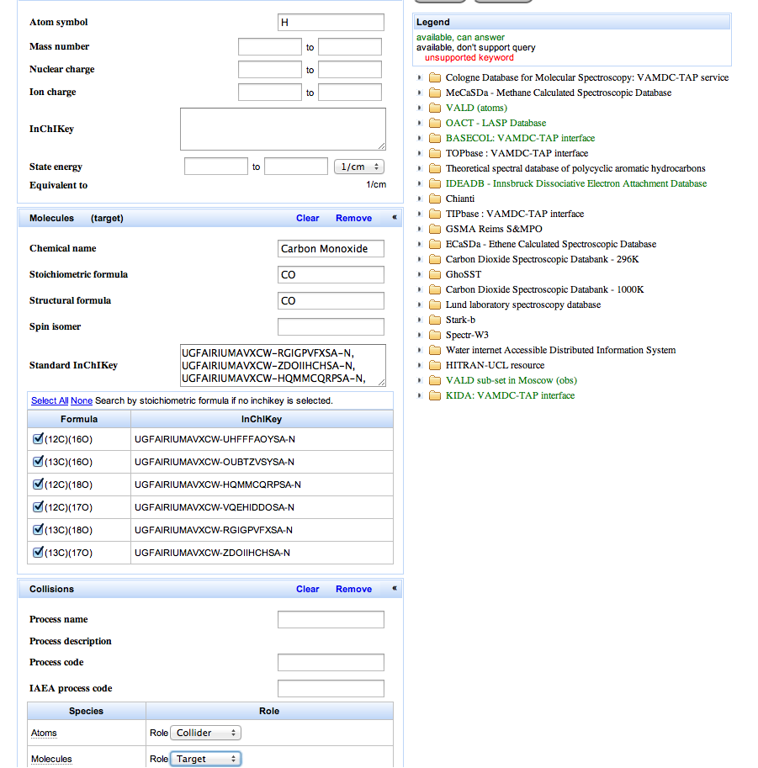
VAMDC web portal: query

Slide 12
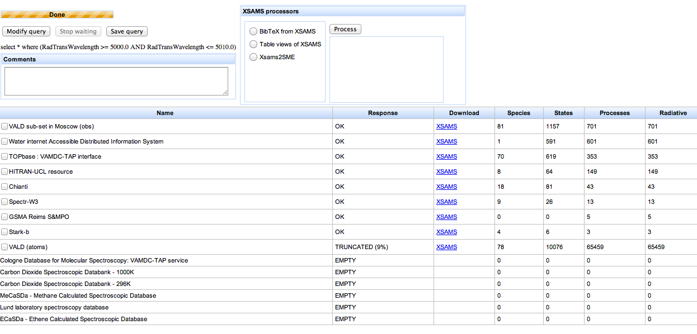
VAMDC web-portal: results

Slide 13
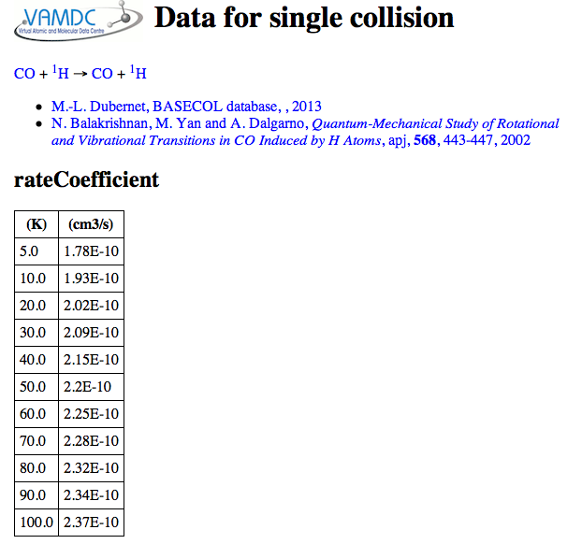
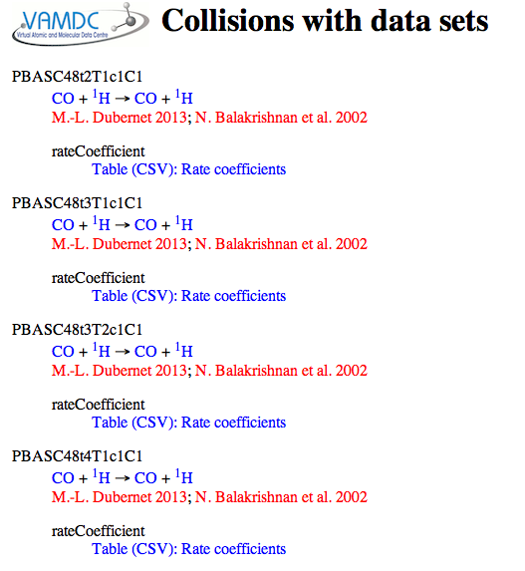
VAMDC web-portal: display

Slide 14

Portal, nodes & processors
http://portal.vamdc.eu/
Portal
Registry
XSAMS
Data node
Processor
Data node
Data node
Data node
Data node
http://registry.vamdc.eu/
Independent services,
can be used with any UI
Notes:
VAMDC provides a web portal as a proxy for a connected application. The user drives the portal with a web browser and forms the queries interactively, typically routing the results to a processor for transformation into a desired format. The results are saved on disc and then offered to a local application.
In a system, there is one portal, many data nodes and many processors, all on different sites.

Slide 15
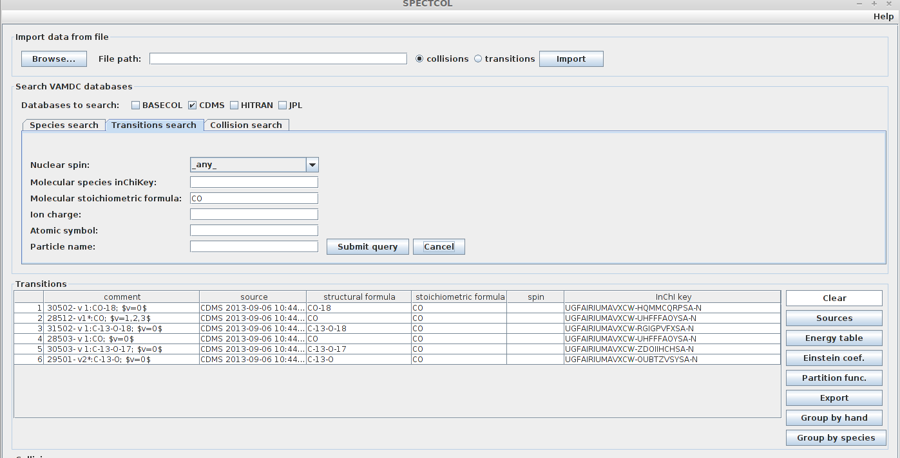
SpectCol application
Implements the original use case for matching spectroscopic and collisional data

Slide 16
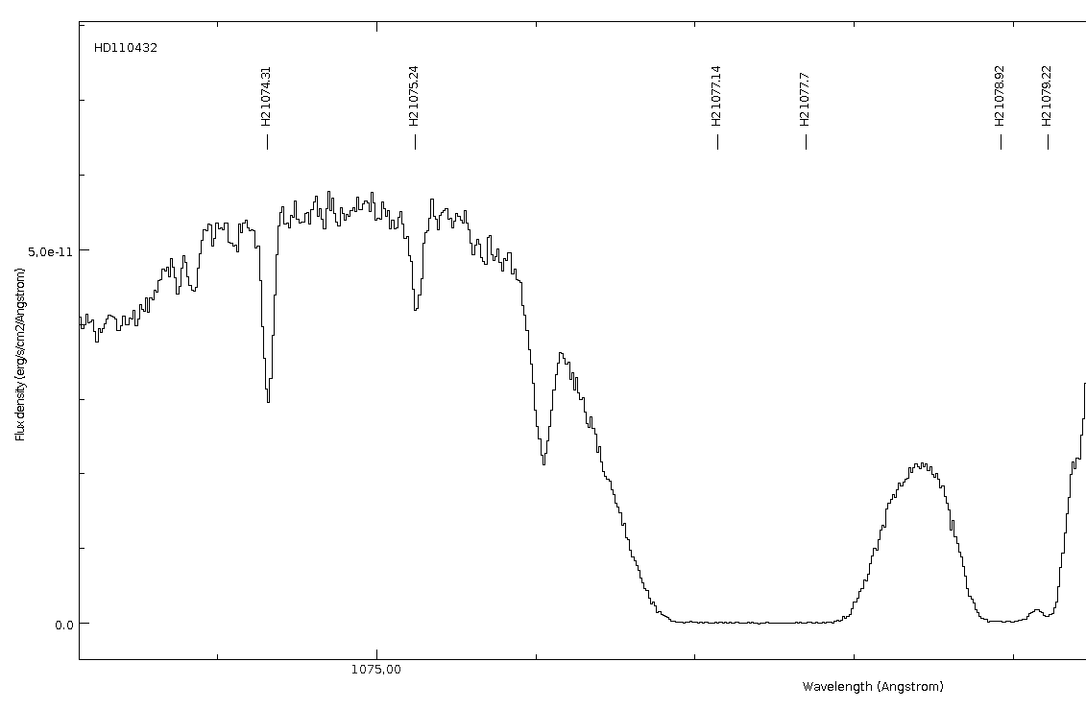
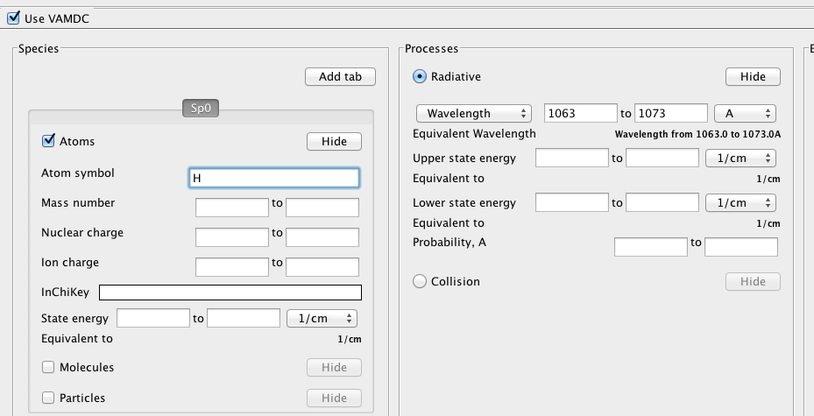
Specview application
Line IDs for
astronomy:
VAMDC data
added to existing
application
This query UI available as a Java library

Slide 17
SUP@VAMDC: successor project
Further EU funding, 2012-2014
6 of 15 original VAMDC partners involved
New partners in India, Korea, South Africa
External partners in USA, Brazil, Australia, Japan, Austria
Most nodes connected from outside the project
Focused on support for users, data-providers

Slide 18
Coding support
Class libraries for Java
Module and small-app collection for Python
Open-source licensing

Slide 19
Tutorials
http://www.vamdc.eu/usersupport/tutorials
Introductory papers
Self-paced exercises
Video guides
Reference manuals

Slide 20
Support after SUP@VAMDC
VAMDC consortium continues support:
  consortium of universities signatory to a MOU;
  contains the active members of the SUP@VAMDC project, plus some others;
  maintains the infrastructure for users and node-operators;
  separate MOU between consortium and that node operators;
  node operators do not need to join the consortium to get support;
  consortium will seek grants to continue the work;
  consortium → legal entity; EU recognition as a body rather than an ephemeral collaboration.

Slide 21
Three-way cooperation
VAMDC consortium
(core infrastructure,
general user support,
tech standards)
Partner projects
(nodes, UIs, applications,
specialized user support)
Data providers
(data nodes)

Slide 22
Summary
Collaborate with VAMDC to get:
  standards for distributed databases;
  established network of services for same;
  technical support;
  user training.
Collaborate by:
  making data nodes and XSAMS processors;
  making UIs for VAMDC services;
  acknowledging VAMDC.
Collaborate with:
  VAMDC consortium;
  currently supported by SUP@VAMDC project;
  later established as legal entity with grant/subscription support.

