Slide 1
VAMDC infrastructure
VAMDC 7th Developer’s workshop
Guy Rixon

Slide 2
Project goals
Easier to get data out of DBs
Easier to read data got from DBs
Easier to make new DBs

Slide 3
“ Easier to get data out of DBs”
Everything on the WWW
Queryable via the web
Common terms for query
Single UI for all DBs

Slide 4
“Easier to read data got from DBs”
Same format for all DBs: XSAMS
Self-describing: lots of metadata
Inclusive and general:
  Can express most data
  Leave out the parts that don’t apply

Slide 5
“Easier to make new DBs”
Tools provided to ingest data from ASCII
Code provided to connect DBs to WWW
Guidelines to schema of DBs

Slide 6
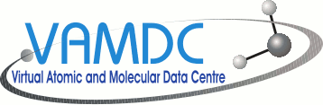
Web-service network
Web browser
GUI application
Script
Modelling code
WWW
Data service
Data service
Data service
Notes:
We are building, primarily, a network of web services that give access to A&M data. We intend these to be used by Web portals, GUI applications, scripts and modelling codes. VAMDC provides those parts that are standard and generic. The user communities provide the specialized clients.

Slide 7
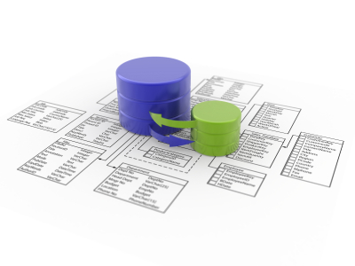
One service per DB
Application
WWW
Data service
(“Node Software”)
Data service
(“Node Software”)
Data service
(“Node Software”)
Data service
(“Node Software”)
e.g.
VALD
Chianti
HITRAN
CDMS
Notes:
Each database has its own data service. The service implementation, or “node software” hides the specific implementation of the database and provides a common view of the data based on VAMDC standards. The databases may be large (e.g. VALD, HITRAN) or small (e.g. the PAH database at IAC). A new site joining VAMDC does so by setting up a data service on its databases, normally using the node software provided by the VAMDC project.

Slide 8
Data URLs
The address of the service
(this one for CDMS)
http://cdms.ph1.uni-koeln.de:8090/DjCDMS/tap/sync?REQUEST=doQuery&LANG=VSS1&FORMAT=XSAMS
&QUERY=SELECT+ALL+WHERE+MoleculeStoichiometricFormula+%3D+%27CO%27
The data to be extracted
Call these with HTTP GET
Notes:
Our service protocol embeds the query language which in turn embeds terms from the dictionary. This lets us form a URL for an data extract. These URLs are easy to use - HTTP GET or POST - so we don’t need libraries to implement the protocol.

Slide 9
Service model
Application
Dictionary
VAMDC-TAP
VSS1/2
XSAMS
Query in VSS1/VSS2
Results in XSAMS
VAMDC-TAP
HTTP
Data service
Notes:
Our data services are RESTful web services characterised by a service protocol, a data model and serialization format, a query language and a dictionary of terms.

Slide 10
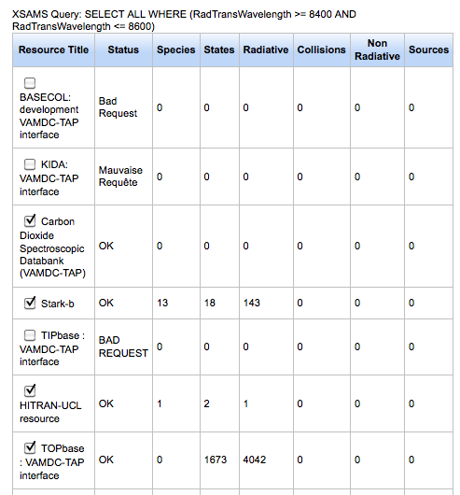

HTTP HEAD for preview
Choose query
HTTP HEAD
(quick)
These numbers;
no data
HTTP HEAD
(slow)
Data

Slide 11
UI = web portal
Web browser
Sciencey
WWW
Web portal
VAMDC-TAP
Geeky
Query in VSS1/VSS2
Results in XSAMS
Data service
Data service
Data service

Slide 12
Which nodes, and where?
Description
Owner contact
Service URL
Version of standards
Version of node software
Sample queries
“Returnables”: returned in a query
“Restrictables”: constrained in query
Application
{
IVOA
Registry
Query in XQuery
Metadata in XML
VAMDC registry

Slide 13
XSAMS consumers
Consumer
web-service
Visualizations
Web portal
Consumer
web-service
Consumer
web-service
Data URLs
Mergers
Filtered XSAMS
Other formats
Look up services
Load data (GET)
Find data (HEAD)
(These still to be made -
see later in this w/s)
VAMDC registry
Data service
Data service
Data service

Slide 14
Connecting your code: 1
Select data using VAMDC portal
Download data to desktop using portal
Possibly translate to other format using XSAMS-consumer service
Run your code on downloaded/translated data

Slide 15
Connecting your code: 2
Get data URLs, possibly from portal
Adapt/wrap your code to call those URLs directly

Slide 16
Connecting your code: 3
Adapt your code to find VAMDC nodes via VAMDC registry
⇒ no need to use VAMDC portal

Slide 17
Connecting your code: 4
Write an XSAMS-consumer service that runs your code
Publish the service
Users can then route data direct from portal to your code

