Slide 1
Using VAMDC: tutorial introduction
Guy Rixon
VAMDC annual meeting 2013, Open University

Slide 2
Tutorial agenda
09:45 - 10:00 Context of using VAMDC
10:00 - 11:00 Demonstrations
11:00 - 12:30 Hands-on exercises
12:30 - 13:00 Discussion

Slide 3

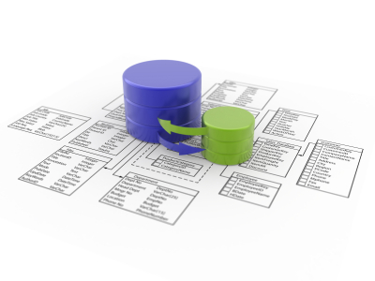

VAMDC is in the cloud
Query
Extract
Notes:
It’s a collection of DBs and the DBs stay in the cloud. Used always by querying to extract extracts of the DBs - no option to download “VAMDC” or “one of the VAMDC databases”.

Slide 4

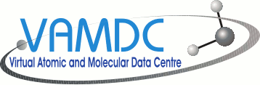

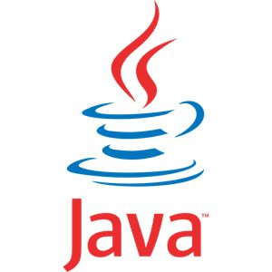
Many UIs
web sites
VAMDC web-portal
Your software here
scripts
applications
Notes:
The cloudy part of VAMDC can be accessed through many UIs. We provide a general portal on the web, but other web sites can connect too (e.g. CDMS have links from their site). Applications can connect directly; we have written some and adapted others. We encourage users and communities to connect their own software.

Slide 5
A flock of databases
Science application
VAMDC
data
nodes
Notes:
VAMDC is divided into data nodes, each containing a database attached to a web site. Applications talk to these nodes separately and can either hide or expose the separation in the UI. Most current applications expose the separation - e.g. they show the user separate results from each node.
Results from nodes are in a common format and can be compared or combined - this is the point of VAMDC. Where results overlap (e.g. two nodes give different energies for the same level of an atom), then either the user or the application has to decide which data are best. Currently, nothing in VAMDC selects between equivalent data.

Slide 6
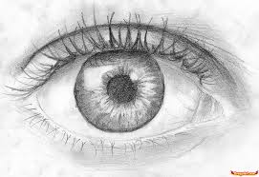


Two-stage selection
Select
Filter and extract
OR
XSAMS
Science code
Notes:
Almost every use of VAMDC involves selecting some data from the nodes in the XSAMS interchange format, then extracting part of the information from XSAMS and using that second extract. This happens whether you are just looking at the results on a display or passing them to a science code. You may not see the two stages (the UI may hide them) but they are always there.
XSAMS is a rich format with a lot of metadata to explain what has been returned. The ideas is that you easily get enough data+metadata for whatever need to do, but you don’t always need all the information.

Slide 7
XSAMS
XML Schema for Atoms, Molecules and Solids
IAEA originally; developed by VAMDC
Rich ⇒ good for transforming to other formats
See http://www.vamdc.eu/documents/standards/dataModel/vamdcxsams/index.html
Notes:
XSAMS defines the envelope of what data can be got out of VAMDC. Only programmers need to learn the details of XSAMS, but other users might care to look at the genera structure.

Slide 8
Some UIs and applications
VAMDC web portal - the starting point
SpectCol - combine spectroscopy and collisions
Specview - STScI’s spectrum viewer with VAMDC support
Query Builder - app to generate queries for scripting
VAMDC as IVOA PDL service - astronomy integration
Taverna - workflow engine with VAMDC plug-in
Selection of Python scripts from VAMDC
Various XSAMS-processing web-services

Slide 9
Finding things: registry
Application
2: Discover
3: Query
Registry web-service
Data node
1: Register
Avoids hard-coding addresses: data nodes may move

Slide 10
Demonstrations...

Slide 11
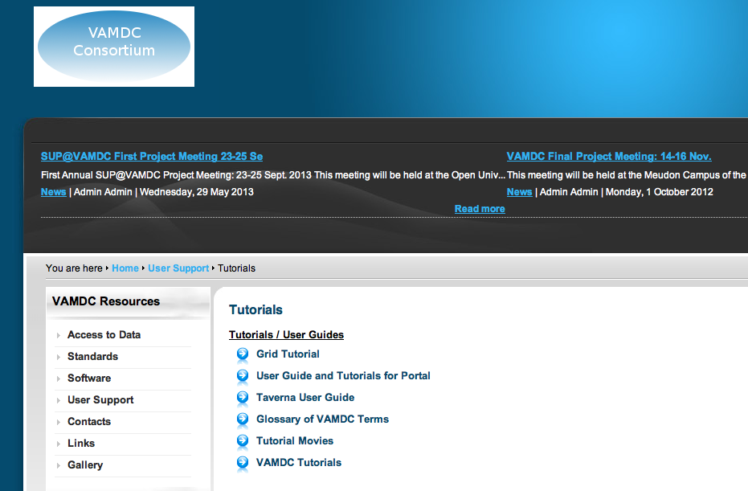
Hands-on exercises
http://www.vamdc.eu/usersupport/tutorials

Slide 12
For those using OU’s PCs
Log on to windows as vamdc
Start VirtualBox VM - it runs Ubuntu Linux
Log on to VM as vamdc
System Python has relevant modules
Look in ~/resources for some pre-installed apps
Copy anything you want to keep before end of day

