Slide 1
VAMDC Implementation
VAMDC workshop, ICAMDATA 2012
Guy Rixon

Slide 2
Technical policy
No centralization
Everything searchable on WWW
Access from web browsers and applications
Self-describing data

Slide 3
“No centralization”
“VAMDC nodes”
CDMS
(Köln)
VALD
(Uppsala)
VAMDC-TAP
protocol*
Application
Application
Application
HITRAN
(London)
BASECOL
(Paris)
* http://www.vamdc.org/documents/standards/dataAccessProtocol/index.html
etc.

Slide 4
“Searchable on the WWW”
http://some.server/some/data?QUERY=select ...
Address of database
Query to DB
Example queries:
  SELECT * WHERE RadTransWavelength > 4500 AND RadTransWavelength < 5500
  SELECT Collisions WHERE ((target.InchiKey = 'UGFAIRIUMAVXCW-HQMMCQRPSA-N')) AND ((collider.AtomSymbol = 'He'))
  SELECT Species
See: http://www.vamdc.org/documents/standards/queryLanguage/index.html

Slide 5
“Browser and applications”
Web browser
Science
application
n
Web site
(portal)
Web service
(node)

Slide 6
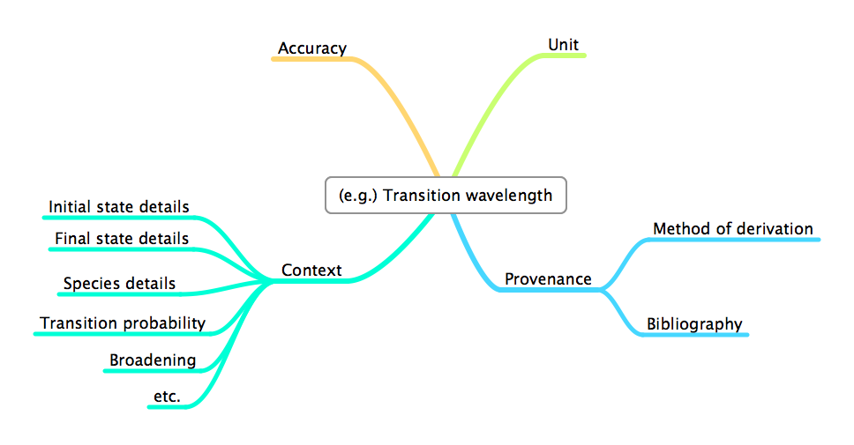
“Self describing data”
XML Schema for Atoms, Molecules and Solids (XSAMS)
See http://www.vamdc.org/documents/standards/dataModel/vamdcxsams/index.html

Slide 7
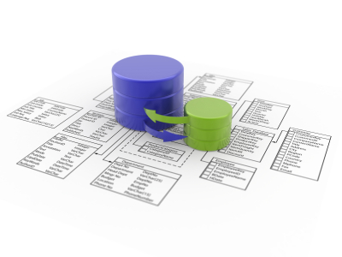
Nodes translate data models
Application
Standard data-model
(XSAMS + VAMDC dictionary*)
Node ≈ DB + data model + node software
Application
Application
VAMDC
node-
software
Local data-model
Web portal
Taverna
XSAMS processor
XSAMS processor
XSAMS processor
* See http://dictionary.vamdc.org/

Slide 8


Usage: portal & processors
http://portal.vamdc.eu/
Portal
Registry
XSAMS
Data node
Processor
Data node
Data node
Data node
Data node
Notes:
Narrow arrows represent commands, broad arrows represent data flows.
The data nodes are web services giving access to the VAMDC databases. They emit data in XSAMS format in response to queries.
The processor web-services take in XSAMS and emit a range of formats - HTML, ASCII tables, graphics. It is also possible to save the XSAMS to the desktop, without using a processor.
In a system, there is one portal, many data nodes and many processors, all on different sites.

Slide 9

Usage: code as service
+
Taverna
Registry
XSAMS
Data node
Processor
code as service
Data node
Data node
Notes:
Science codes can be wrapped as web-services and run using the Taverna workflow-system.
These services would not be part of the VAMDC system itself, but Taverna can compose calls to VAMDC services with call to the the code; it needs a VAMDC plug-in for this and that plug-in is a released, VAMDC product.

Slide 10
Usage: code as client
Wrapper script
code
XSAMS
Registry
Data node
Processor
Data node
Data node
Notes:
Normally, a science code is run on a user’s own computer. It is possible to use VAMDC facilities with these codes by writing a wrapper script, which can be a simple shell script or a small porgram in, e.g., Python. All VAMDC services can be called easily from scripts.

Slide 11
Data nodes available
BASECOL
Cagliari/Toulouse PAH
Carbon Dioxide Spectroscopic Databank
Chianti
Cologne Database for Molecular Spectroscopy
GSMA Reims S&MPO
GSMA Reims Ethylene
GhoSST
HITRAN-UCL resource
IDEADB - Innsbruck Dissociative Electron Attachment Database ICB Dijon Methane
KIDA
Lund laboratory spectroscopy database
OACT - LASP Database
Spectr-W3
Stark-B
TIPbase
TOPbase
VALD (atoms)
VALD sub-set in Moscow (obs)
Water internet Accessible Distributed Information System
Notes:
21 nodes in total.
Links in the list above go to the web-pages describing each database.

Slide 12
Participating as an app author
Option 1
Option 2
Wrapper script
Your application
Your application
Filter library
Your format
Query
Query
Filter service
XSAMS
XSAMS
VAMDC node
VAMDC node
VAMDC node
VAMDC node
VAMDC node
VAMDC node

Slide 13
Advantages of adapting your code
Use with wider range of data
Wider range of potential users
Easier to acquire data
Data always up-to-date

Slide 14

Participating as a data provider
Option 1
Option 2
Option 3
Your site
Partner site
Partner site
New node
New node
Existing node
Web server
Node s/w
Data model
Transfer
Data model
Transfer
Ingest
Ingest
Notes:
Option 1: run your own node, on your site. You manage all the components.
Option 2: develop a new node but get it deployed on a partner site. You manage the database and the data model; partner manages the web server.
Option 3: donate your data to an existing, aggregating node (e.g. VALD, CDMS). You document your data to aid ingestion; node owner manages all the software.

Slide 15
Inside a node
Provided by node owner; help available from
VAMDC
Local
data
model
Reusable
node
software
From VAMDC;
code in GitHub;
docs on vamdc.org site
Django
Generated by node owner; may be existing DB
MySQL
Python
httpd/
WSGI
Readily available;
usually as optional
package in Linux
distro

Slide 16
Node example: Chianti
Ingest DB
Y
Working?
N
???
Code Python modules
Test with portal
Test: internal server + TAP validator
Register
Working?
Deploy on server
Y
N
Tweakable?
Y
(Data provided by DAMPT, Cambridge;
ingestion and node set-up by IoA, Cambridge;
eventual hosting by MSSL)
Profanity
N

Slide 17
Chianti example (cont.)
RHEL
Chianti DB
Re-ingested for VAMDC; 6 tables
Apache httpd
settings.py
Connects Django to Chianti DB.
Written for Chianti DB; 39 lines
MySQL server
vamdctap
Implements VAMDC-TAP protocol.
Provided by VAMDC; ~2400 lines
Python 2.7
models.py
Describes DB schema to Python.
Written for Chianti DB; 153 lines
Django etc.
dictionaries.py
Describes DB schema to VAMDC generator.
Written for Chianti DB; 75 lines
queryfunc.py
Converts from VSS to Django objects.
Adapted for Chianti DB; 276 lines

Slide 18
Benefits of making a node
More potential users
All parts of data made available
Branding; citation of your data
Data preservation
Easier than writing your own web-site

Slide 19
Annual updates of standards
Update VAMDC standards
Redeploy
nodes
t = 0
Redeploy
registry
t ~+4 weeks
Update
node software,
portal, registry
Test!
Redeploy
portal
t ~+2 weeks
t ~+6 weeks
Redeploy
processors
Announce
new URLs
to users
Notes:
The times for the transitions between stages are the approximate minimum times.
“Redeploy xxx” includes local testing, particularly by the owners of nodes.
The “test” box at the right is general integration-testing of the system.

Slide 20
For reference
http://vamdc.org/
http://vamdc.eu/
Standards
Software
Documentation
Support
Contacts

