Slide 1
VAMDC tutorial for prospective data-providers
Guy Rixon
SUP@VAMDC meeting, IPR, November 2013

Slide 2
Agenda
VAMDC orientation
Introduction to node building (technical)
Self-paced investigation with on-line tutorial material

Slide 3
Orientation

Slide 4

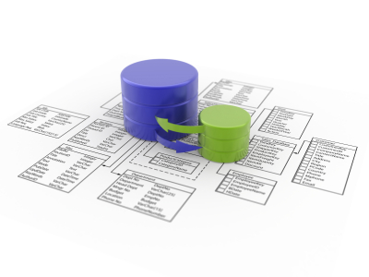

VAMDC is in the cloud
Query
Extract
Notes:
It’s a collection of DBs and the DBs stay in the cloud. Used always by querying to extract extracts of the DBs - no option to download “VAMDC” or “one of the VAMDC databases”.

Slide 5

A flock of databases
Science application
VAMDC
data
nodes
Notes:
VAMDC is divided into data nodes, each containing a database attached to a web site. Applications talk to these nodes separately and can either hide or expose the separation in the UI. Most current applications expose the separation - e.g. they show the user separate results from each node.
Results from nodes are in a common format and can be compared or combined - this is the point of VAMDC. Where results overlap (e.g. two nodes give different energies for the same level of an atom), then either the user or the application has to decide which data are best. Currently, nothing in VAMDC selects between equivalent data.

Slide 6
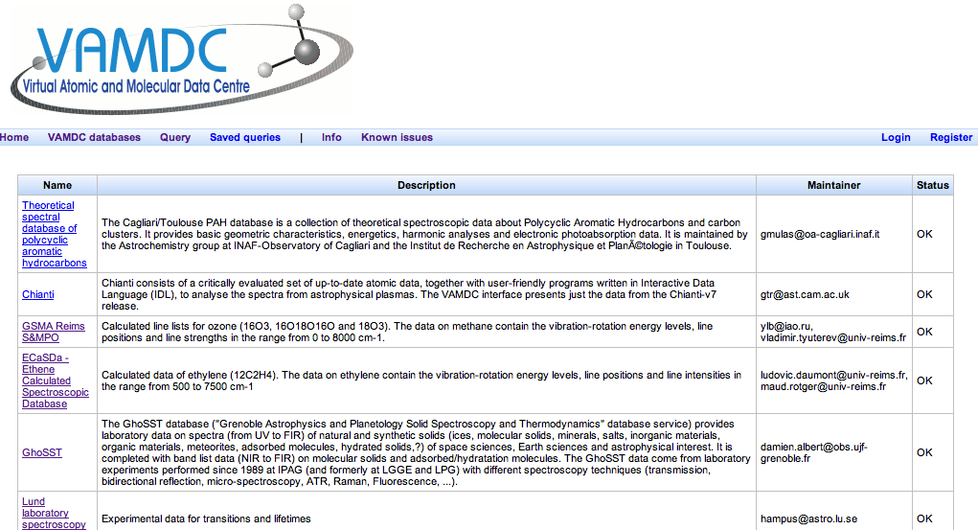
For list of databases see:
http://portal.vamdc.eu/vamdc_portal/nodes.seam

Slide 7
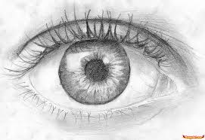


Two-stage selection
Select
Filter and extract
OR
XSAMS
Science code
Notes:
Almost every use of VAMDC involves selecting some data from the nodes in the XSAMS interchange format, then extracting part of the information from XSAMS and using that second extract. This happens whether you are just looking at the results on a display or passing them to a science code. You may not see the two stages (the UI may hide them) but they are always there.
XSAMS is a rich format with a lot of metadata to explain what has been returned. The ideas is that you easily get enough data+metadata for whatever need to do, but you don’t always need all the information.

Slide 8
XSAMS
XML Schema for Atoms, Molecules and Solids
IAEA originally; developed by VAMDC
Rich ⇒ good for transforming to other formats
See http://www.vamdc.eu/documents/standards/dataModel/vamdcxsams/index.html
Notes:
XSAMS defines the envelope of what data can be got out of VAMDC. Only programmers need to learn the details of XSAMS, but other users might care to look at the genera structure.

Slide 9
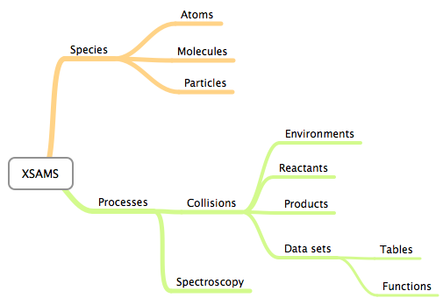
E.g. XSAMS for phys. chem.

Slide 10
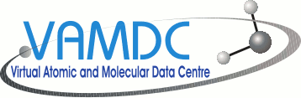

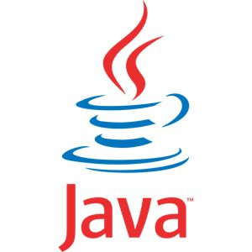
Many UIs
web sites
VAMDC web-portal
Your software here
scripts
applications
Notes:
The cloudy part of VAMDC can be accessed through many UIs. We provide a general portal on the web, but other web sites can connect too (e.g. CDMS have links from their site). Applications can connect directly; we have written some and adapted others. We encourage users and communities to connect their own software.

Slide 11
Some UIs and applications
VAMDC web portal - the starting point
SpectCol - combine spectroscopy and collisions
Specview - STScI’s spectrum viewer with VAMDC support
Query Builder - app to generate queries for scripting
VAMDC as IVOA PDL service - astronomy integration
Taverna - workflow engine with VAMDC plug-in
Selection of Python scripts from VAMDC
Various XSAMS-processing web-services

Slide 12
Finding things: registry
Application
2: Discover
3: Query
Registry web-service
Data node
1: Register
Avoids hard-coding addresses: data nodes may move

Slide 13
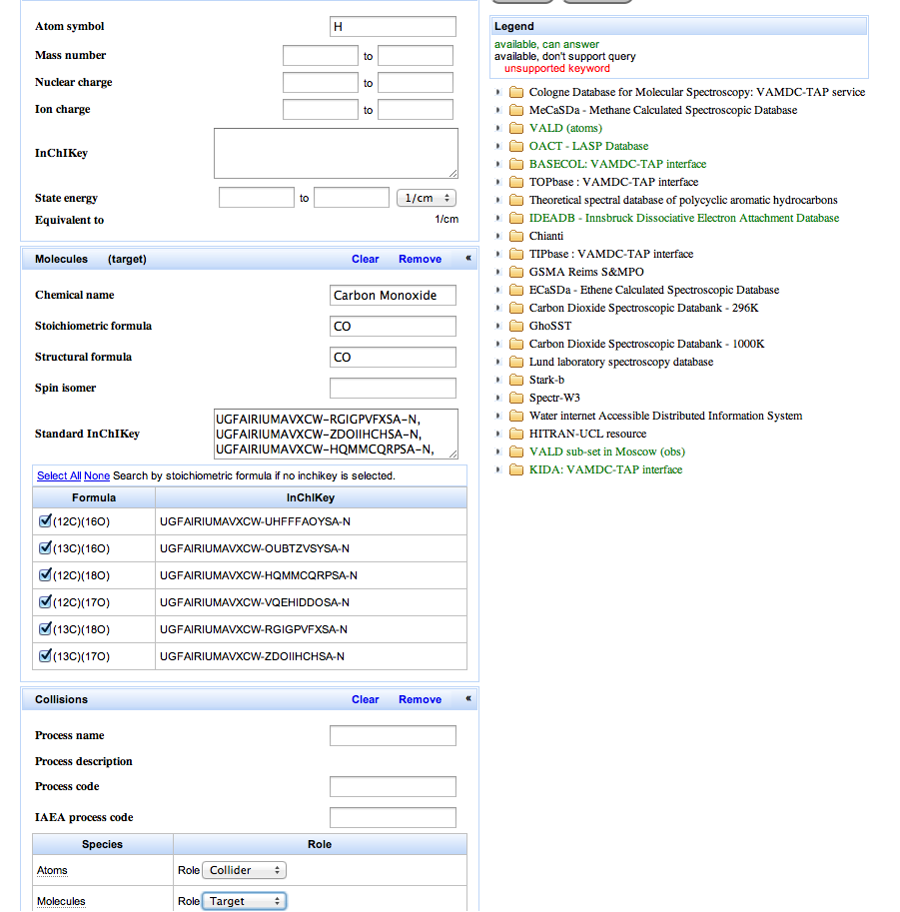
VAMDC web portal: query

Slide 14
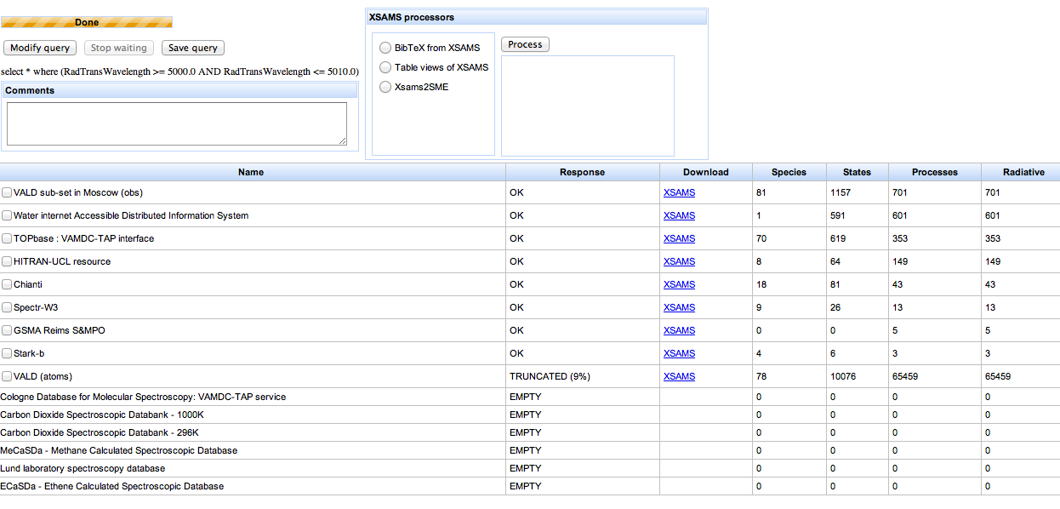
VAMDC web-portal: results

Slide 15
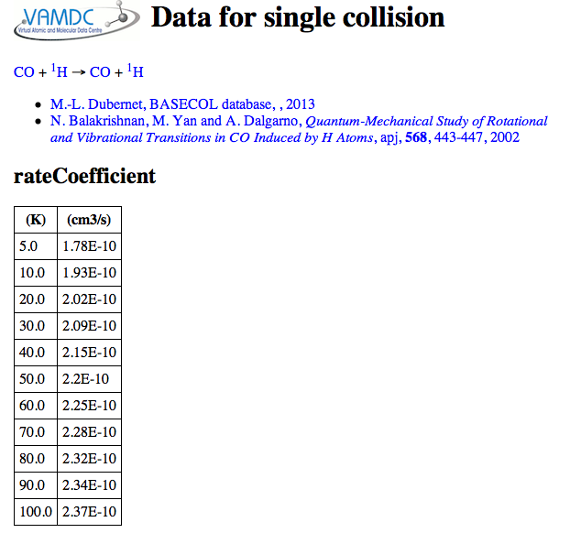
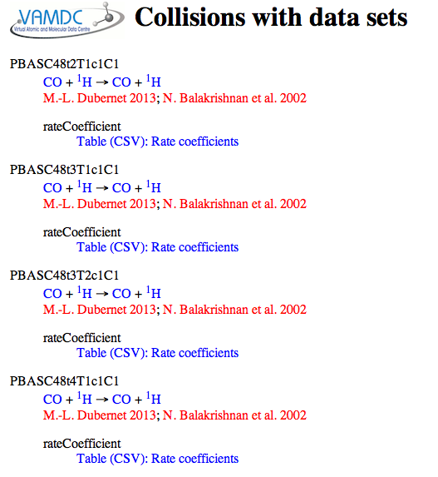
VAMDC web-portal: display

Slide 16

Portal, nodes & processors
http://portal.vamdc.eu/
Portal
Registry
XSAMS
Data node
Processor
Data node
Data node
Data node
Data node
Independent services,
can be used with any UI
http://registry.vamdc.eu/
Notes:
VAMDC provides a web portal as a proxy for a connected application. The user drives the portal with a web browser and forms the queries interactively, typically routing the results to a processor for transformation into a desired format. The results are saved on disc and then offered to a local application.
In a system, there is one portal, many data nodes and many processors, all on different sites.

Slide 17
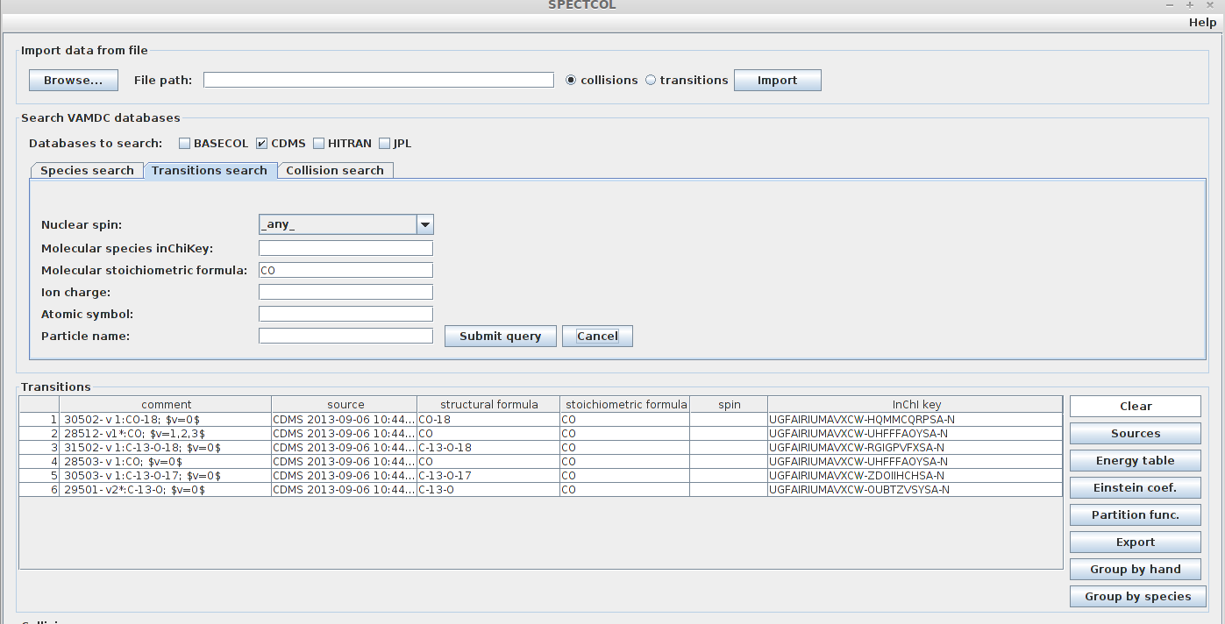
SpectCol application
Implements the original use case for matching spectroscopic and collisional data
See http://www.vamdc.eu/software

Slide 18
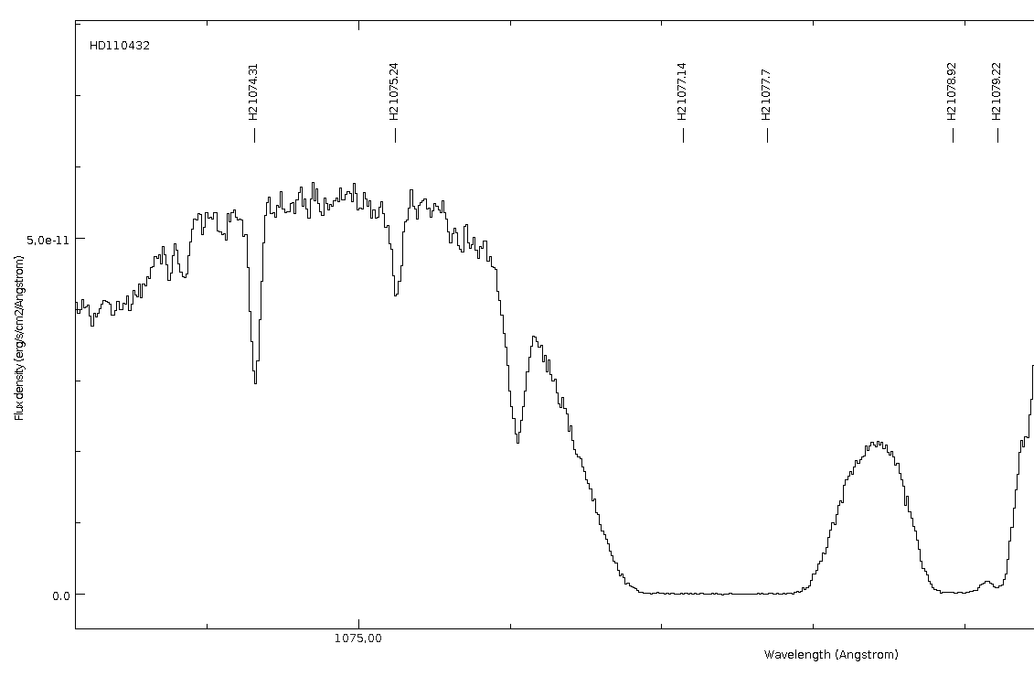
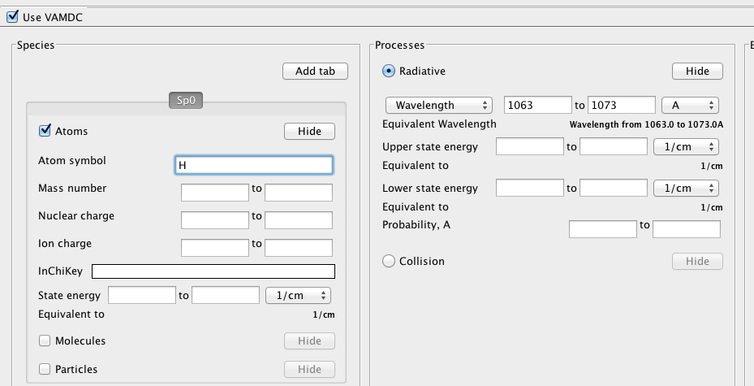
Specview application
Line IDs for
astronomy:
VAMDC data
added to existing
application
This query UI available as a Java library
See http://www.vamdc.eu/software

Slide 19
Introduction to node building

Slide 20
Options for data providers
Publish your data into VAMDC by:
  adding your data to an existing node, or
  build a new node around your data and run it, and
    host the node at your site or
    have the node hosted at another VAMDC site

Slide 21

Database → data node
Science application (e.g. portal)
VAMDC
data
nodes
Notes:
VAMDC is divided into data nodes, each containing a database attached to a web site. Applications talk to these nodes separately and can either hide or expose the separation in the UI. Most current applications expose the separation - e.g. they show the user separate results from each node.
Results from nodes are in a common format and can be compared or combined - this is the point of VAMDC. Where results overlap (e.g. two nodes give different energies for the same level of an atom), then either the user or the application has to decide which data are best. Currently, nothing in VAMDC selects between equivalent data.

Slide 22
Parts of a data node
Web server
VAMDC
standard
Node software
=
Database
Database
specific
Web service,
runs in web server

Slide 23
Qualifying as a data node
A web service is a VAMDC node if it:
  implements the VAMDC-TAP protocol
  is publicly visible on port 80
  is registered in the VAMDC registry
  actually emits data
(No constraint on how you achieve that)

Slide 24
VAMDC-TAP
VAMDC Table Access Protocol
Based on IVOA Table Access Protocol
Specifies a facade for queries to DB via web service
Also ancillary interfaces for registration, availability checks
Synchronous query
Science application (e.g. portal)
Availability
Capabilities

Slide 25
VAMDC-TAP: query
http://some.server/tap/sync?
LANG=VSS2&FORMAT=XSAMS&QUERY=SELECT+*+...
Synchronous-query URL within TAP service
HTTP HEAD → statistics, no data raised
HTTP GET, POST → data raised, returned in HTTP response
Query language, result format variable
  VAMDC requires VSS2 and XSAMS
  could add others

Slide 26
VSS2 query-language
VAMDC SQL Sub-set #2
ANSI SQL with much of the detail excluded
E.g. SELECT * WHERE collider.AtomSymbol=’He’ AND target.MoleculeInchiKey=...
Operates on a virtual, single table with columns defined by VAMDC dictionary
See http://www.vamdc.eu/documents/standards/queryLanguage/index.html

Slide 27
VAMDC dictionary
Lists, defines:
  RESTRICTABLES: columns to constraints in query
  RETURNABLES: columns that can be in the results
  REQUESTABLES: columns/structures desired in results
See http://dictionary.vamdc.eu/

Slide 28
VAMDC-TAP: capabilities
http://some.server/tap/capabilities
Describes service interfaces in a form that the registry understands
Responds to HTTP GET
XML document
Capability for VAMDC-TAP lists:
  version of standards
  version of software
  search terms supported in query
  sample queries
E.g. http://ag02.ast.cam.ac.uk/chianti/tap/capabilities

Slide 29
VAMDC-TAP: availability
http://some.server/tap/availability
Check that web-service is up
XML document (XSL for browser display)
E.g. http://ag02.ast.cam.ac.uk/chianti/tap/availability

Slide 30
VAMDC standard “stack” for node
Custom
code
for DB
Common
node
software
From VAMDC;
code in GitHub;
docs on vamdc.eu site
You write this bit
Django
MySQL
Python
httpd/
WSGI
Readily available;
usually as optional
package in Linux
distro
See http://www.vamdc.eu/software

Slide 31
What does Django do?
Represents DB tables as “Model” objects
  Handles joins
  E.g. http://ag02.ast.cam.ac.uk/tutorials/_downloads/models.py
Represents queries as “Q” objects
  E.g. http://ag02.ast.cam.ac.uk/tutorials/_downloads/queryfunc.py
Represents query results as “query-set objects”
  Cursors on DB query
  ⇒ lazy evaluation
  E.g. http://ag02.ast.cam.ac.uk/tutorials/_downloads/queryfunc.py

Slide 32
Processing a query
Extract VSS2
from URL
Nest
result-sets
Common part
Custom part
VSS2 →
Django Q
Common part
using dictionary
from custom part
Extract stats
Custom part
Apply Q →
main result set
Set HTTP
status & headers
Custom part
Common part
Common part,
using dictionary
from custom part
Truncate main
result-set
Generate and stream XML
Custom part
Derive subsidiary
result-sets
Custom part

Slide 33
Therefore, you write:
models.py: define table structure to Django
dictionaries.py: define mappings to VAMDC
  RESTRICTABLES: VSS2 → Django Q
  RETURNABLES: Django query-set → XSAMS
queryfunc.py: implement query flow as per previous slide

Slide 34
Pause to digest that information...
...possibly reviewing examples:
  http://ag02.ast.cam.ac.uk/tutorials/_downloads/queryfunc.py
  http://ag02.ast.cam.ac.uk/tutorials/_downloads/models.py
  http://ag02.ast.cam.ac.uk/tutorials/_downloads/dictionaries.py

Slide 35
Design sequence
Choose DB tables; define as Django models
Design query strategy (queryfunc.py) for models
Choose search terms (RESTRICTABLES dictionary)
“Wire up” models to XSAMS (RETURNABLES dictionary)
Test; iterate, refine

Slide 36
Database ingestion
Node software doesn’t care how you load data
MySQL can read either SQL scripts or ASCII files
ASCII inputs have to match chosen DB-schema
Node software includes code to re-arrange ASCII files:
  see imptools package: https://github.com/VAMDC/NodeSoftware/tree/master/imptools
  docs at http://www.vamdc.eu/documents/nodesoftware/importing.html

Slide 37
Testing sequence
Define DB
Y
Working?
N
Done
Code Python modules
Test with portal
Test with internal server + TAP validator
Register
Working?
Deploy on server
Y
N
Tweakable?
Y
Re-evaluation
N

Slide 38
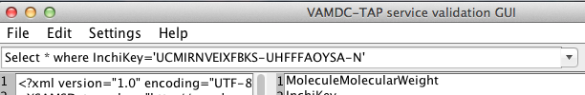
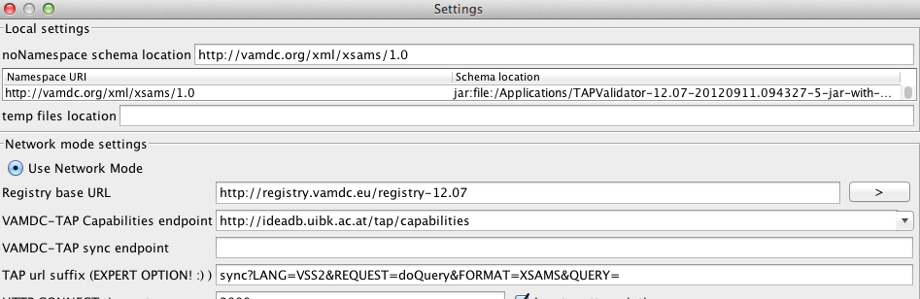
TAP validator
See http://www.vamdc.eu/software
Download and run locally
Enter Capabilities URL for your node in settings page...

Slide 39
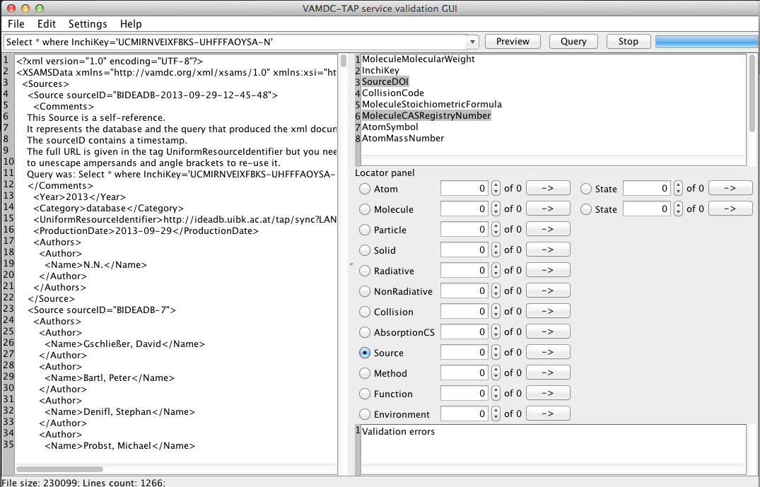
TAP validator (2)
Query
XSAMS
results
Validity report here

Slide 40
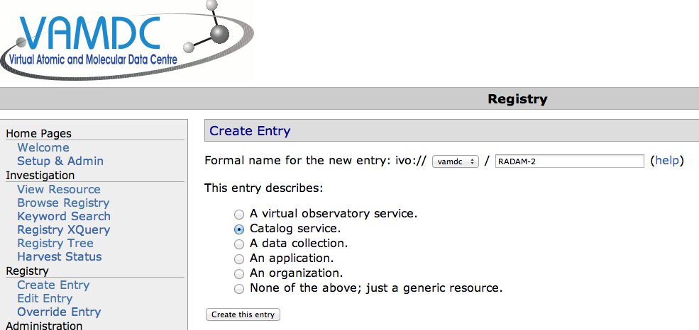
Registration, step 1
Go to http://registry.vamdc.eu/ and select production* registry
Select “create entry” from side-bar
Fill out name of service; select “catalog service” type
*or use dev registry for practice: http://casx019-zone1.ast.cam.ac.uk/registry/

Slide 41
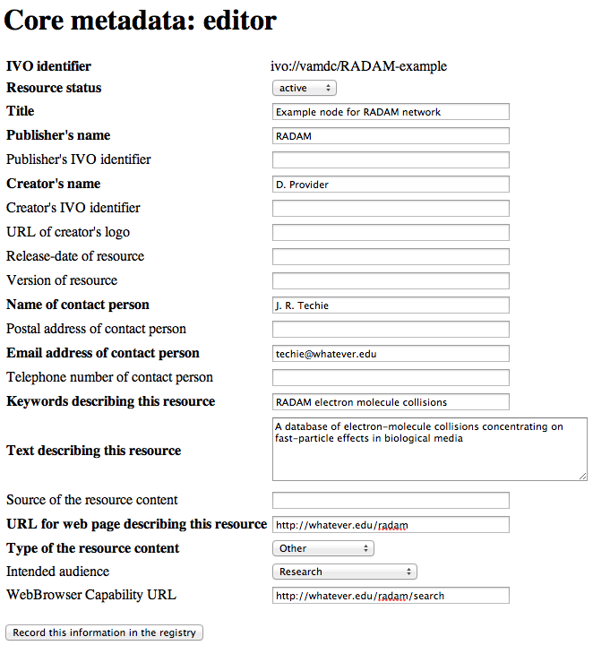
Registration, step 2
Fill out “core information” on next form

Slide 42
Registration, step 3
Select “edit” for this registry entry (use “browse registry” to search for entry if necessary)
Select “Edit metadata ... by VOSI”
Paste in the capabilities URL for your node and submit

Slide 43
More information
Node-software manual: http://www.vamdc.eu/documents/nodesoftware/
VAMDC standards: http://www.vamdc.eu/standards
Node-software video tutorials: http://ag02.ast.cam.ac.uk/tutorials/self-study/data-provider-self-study/index.html

Slide 44
Self paced tutorials using VAMDC’s on-line material

Slide 45
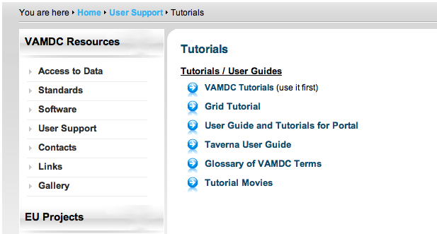
On-line tutorial suite
http://www.vamdc.eu/usersupport/tutorials

Slide 46
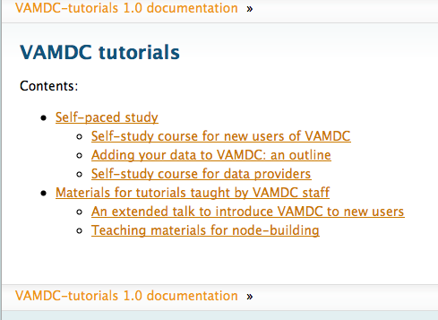
Self-paced tutorials

Slide 47
Examples of node building

