Slide 1
MCQify: Universal Multiple Choice Question Generator
Krishna Vamsi Nadh Arikatla Manik Malhotra

Slide 2
Introduction
MCQify revolutionizes the way multiple-choice questions are created. It's an innovative tool designed to automate and streamline the generation of MCQs from various inputs like text, audio, images, and URLs, catering to diverse educational needs.

Slide 3
The Problem
Creating MCQs manually is time-consuming and challenging. Educators often struggle with maintaining question quality and diversity, which is crucial for effective learning assessments.

Slide 4
The Solution
MCQify offers an automated solution to these challenges. By leveraging advanced AI and machine learning algorithms, it simplifies the MCQ generation process, making it more efficient and less prone to errors.

Slide 5
Model
We have used pretrained large language model gpt-4 for this task. After testing the multiple models we found GPT-4 is very efficient in MCQ Generation.
We are using API to infer GPT4 model.

Slide 6
GPT-4
GPT-4 exhibits a deep understanding of context, nuances, and complexities in language, enabling it to generate more accurate and coherent responses.
GPT-4 offers improved conversational abilities, making interactions more natural and engaging, and it can perform a variety of tasks, including text generation, summarization, and question answering.

Slide 7
How It Works (Part 1)
For text-based inputs, MCQify uses Natural Language Processing (NLP) to analyze and extract key concepts, formulating them into well-structured MCQs.
Text is passed to gpt4 model as context to generate MCQS.

Slide 8
How It Works (Part 2)
For audio and image inputs, MCQify employs speech-to-text conversion and Optical Character Recognition (OCR) technologies, respectively, to convert these inputs into text before generating MCQs.
We have used gpt-4 vision model to extract key features from images, and for speec-to -text we have used openai whisper.

Slide 9
Features
Key features include multiple input type handling, AI-driven question generation, customizable difficulty levels, and support for various languages.

Slide 10
Benefits
MCQify benefits educators and students by saving time, providing high-quality and diverse questions, and offering adaptability to different learning materials and styles.

Slide 11
Technology Used
MCQify integrates AI, NLP, OCR, and speech recognition technologies, ensuring a versatile and robust platform for MCQ generation.

Slide 12
User Interface
The user interface of MCQify is designed for ease of use and accessibility, ensuring a seamless experience for users of all technical backgrounds.

Slide 13
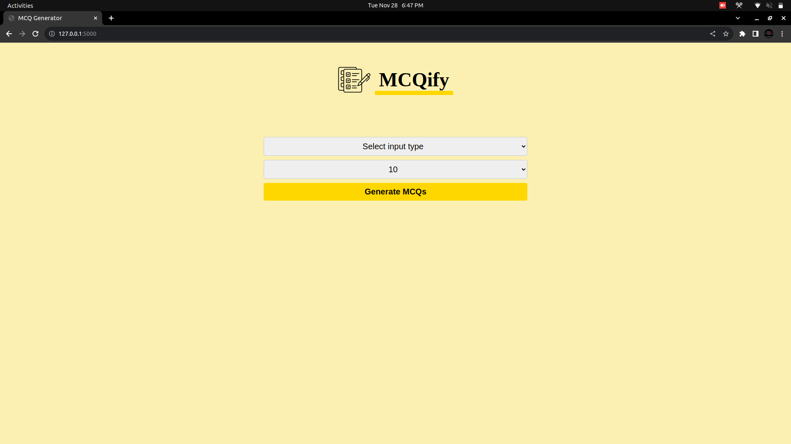

Slide 14
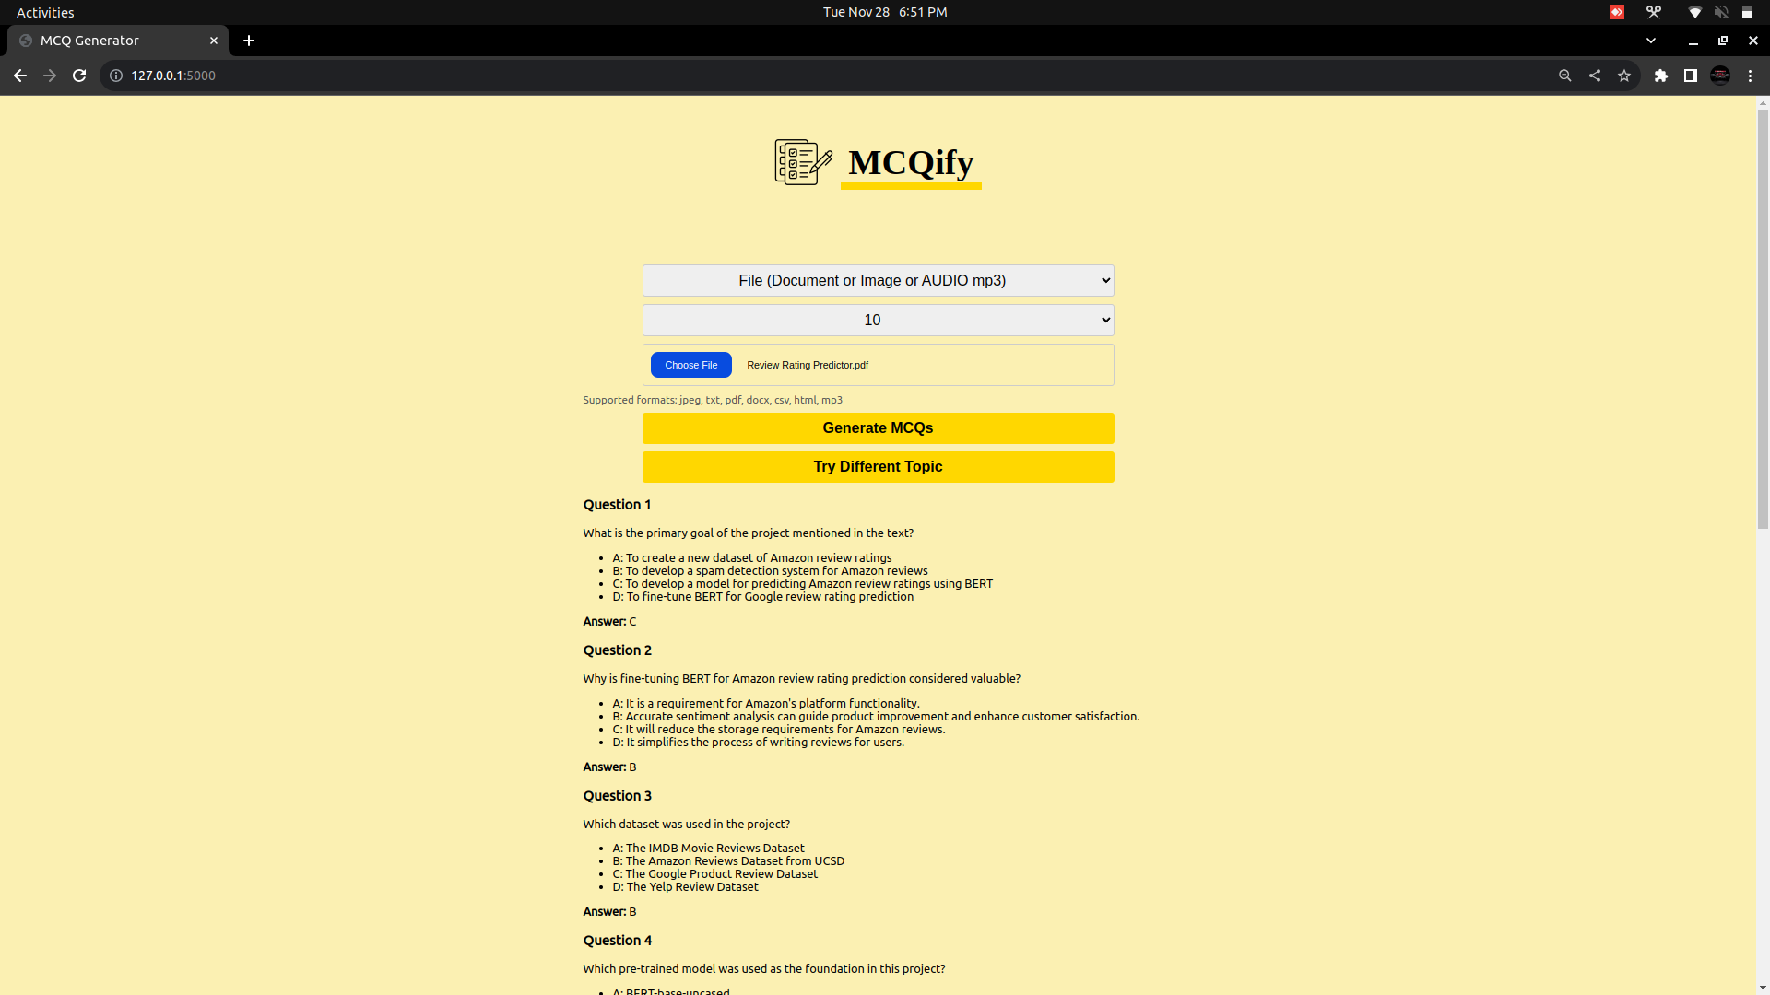

Slide 15
Conclusion & Call to Action
In Conclusion, MCQify is a web application designed to simplify the process of creating and managing multiple-choice questions (MCQs) for educators, students, and professionals. It provides an intuitive interface for generating, organizing, and storing MCQs, making it easier to create quizzes, exams, and practice tests.

