Slide 1
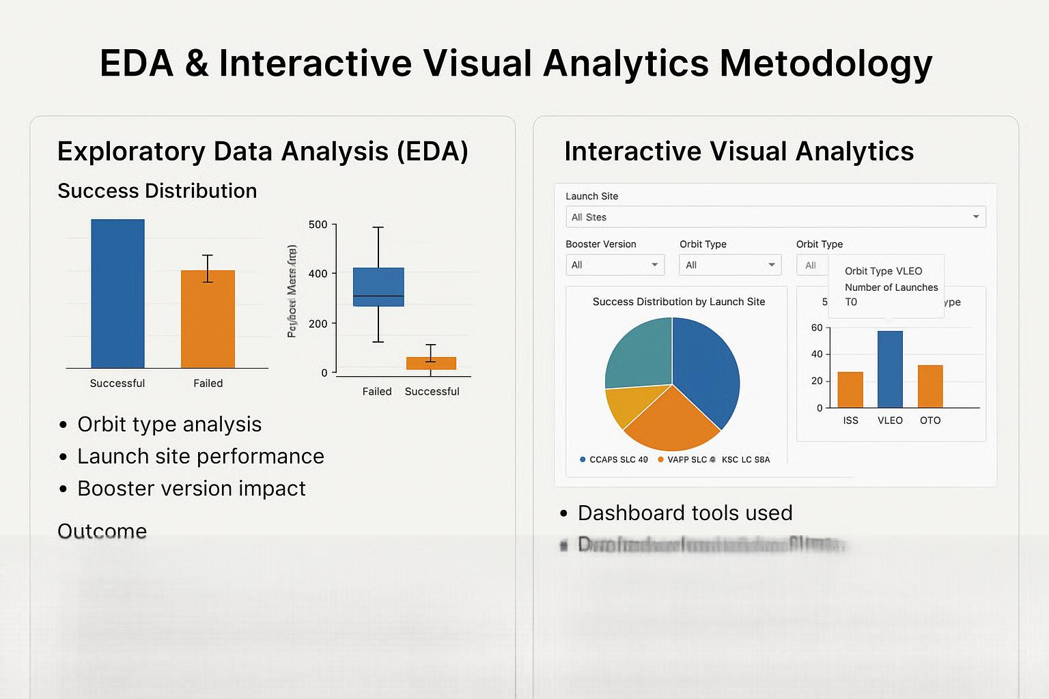

Slide 2

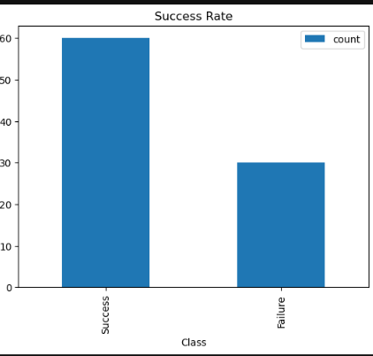
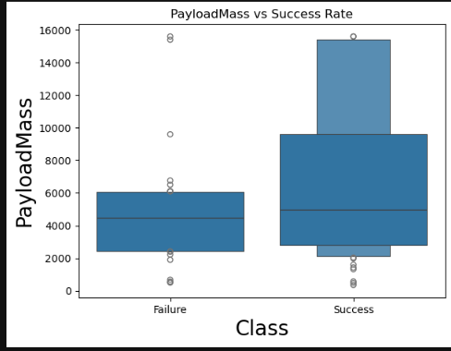
Exploratory Data Analysis (EDA)
Success Distribution: Bar chart showing number of successful vs. failed landings.
Payload Mass vs. Success: Box plot or scatter plot
showing how payload mass affects landing outcome
Orbit Type Analysis: Success rates across different
orbit types (e.g., ISS, VLEO, GTO)
Launch Site Performance: Bar chart comparing
success rates by site (e.g., CCAFS SLC 40, KSC LC 39A)
Booster Version Impact: Success rates by booster
version (e.g., Block 5 vs. earlier versions)

Slide 3
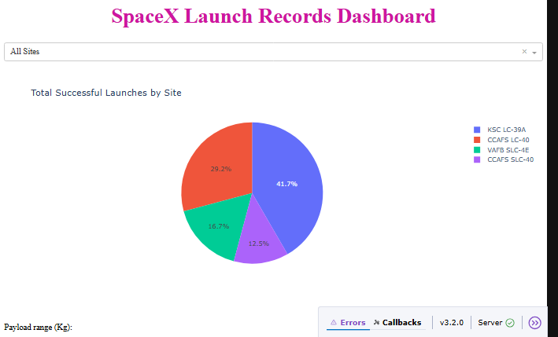
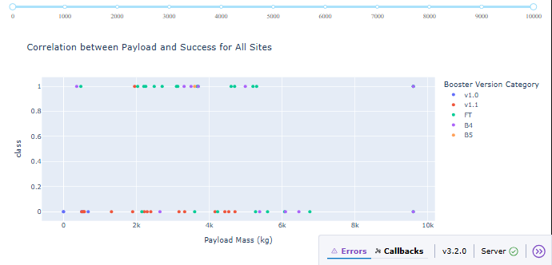
Interactive Visual Analytics
Dashboard Tools Used: Dash, Plotly.
Features:
Dropdown filters for launch site, booster version, orbit type
Hover tooltips showing detailed launch info
Dynamic charts updating based on user selection
Purpose:
Allow users to explore patterns and trends
Enable decision-makers to simulate launch scenarios

