Slide 1
Exact Set Matching
Charles Yan
2008

Slide 2
Exact Set Matching
Goal: To find all occurrences in text T of any pattern in a set of patterns P={p₁,p₂,…,p_{z}}.
n: the total length of all the patterns in P.
m: the length of T
O(n+zm) vs. O(n+m+k)
k: the number of occurrences in T the patterns from P.

Slide 3
Keyword Tree
Keyword tree for a set P is a rooted directed tree k satisfying three conditions: (1) each edge is labeled with one character; (2) any two edges out of the same node have distinct labels; and (3) every pattern P_{i} in P maps to some node v of K such that the characters on the path from the root of K to v exactly spell out P_{i} and every leaf of K is mapped to by some pattern in P.

Slide 4
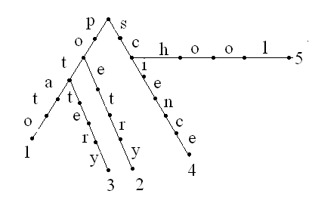
Keyword Tree
P={potato, poetry, pottery, science, school}

Slide 5
Keyword Tree
Construction of keyword tree
K₁: the tree that includes only pattern 1
K_{i}: the tree that includes patterns p₁ …p_{i}
Assuming a fixed-size alphabet
Construction of K_{i} by adding P_{i} to K_{i-1} costs O(|P_{i}|)
Thus total time is O(n)

Slide 6
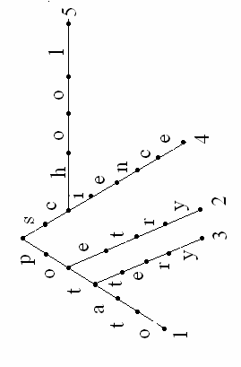
Keyword Tree
Naive use of keyword tree for exact set matching: Start from each position l in T and follow the unique path from r in K that matches a substring of T starting at l . O(mn)
p o t a t t o o
p o t a t t o o

Slide 7
Keyword Tree
The dictionary problem: To find if a input word is contained in the dictionary.
The words in a dictionary (P) are encoded in a keyword tree.
The problem is reduced to whether the input word (T) completely matches some pattern in P.
Require that the set of patterns are initially known.

Slide 8
Keyword Tree
Speedup the exact set matching problem
(1) shift the tree by more than one positions
(2) skip comparisons that have been made in previous steps.

Slide 9
Failure Link
v: a node in keyword tree K
L(v): the label on v, that is, the concatenation of characters on the path from the root to v.
lp(v): the length of the longest proper suffix of string L(v) that is a prefix of some pattern in P. Let this substring be α.
Lemma. There is a unique node in the keyword tree that is labeled by string α. Let this node be n_{v}. Note that n_{v} can be the root.
The ordered pair (v, n_{v}) is called a failure link.

Slide 10
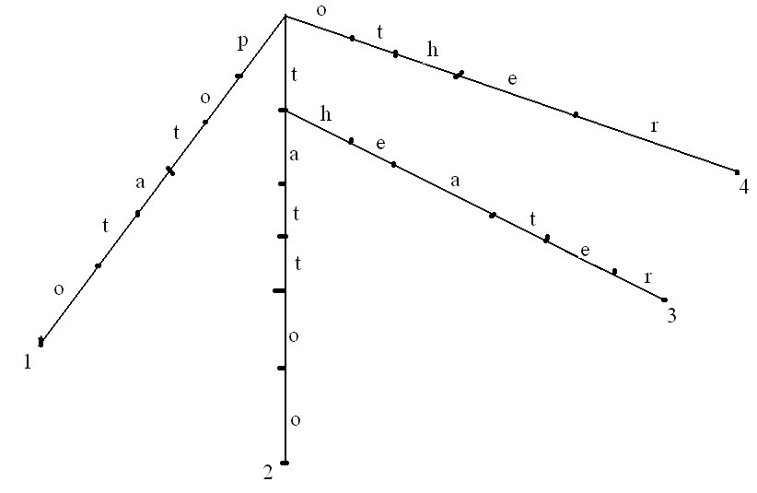
Failure Link
P={potato, tattoo, theater, other}
α
n_{v}
v

Slide 11
Failure Link

Slide 12
Failure Link
A failure link (v, n_{v}) indicates the position to which we should shift the keyword three if a mismatch occurs at v.
l: the starting position in T
c: the current character of T to be compared with a character on K
w: the current node on K
If a mismatch occurs at w, then shift the keyword tree to the right so that n_{w} is in the place of w.

Slide 13
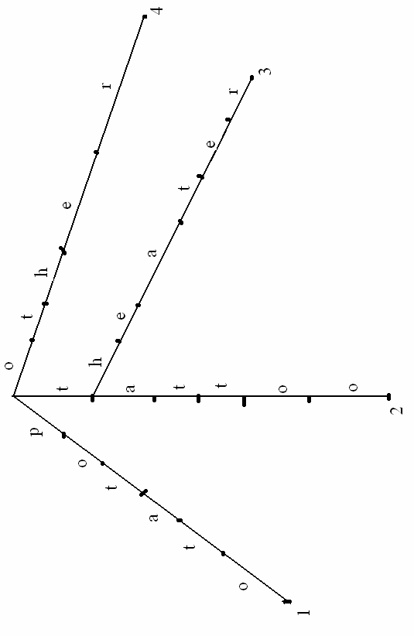
Failure Link
l=3
c=8
x x p o t a t t o o x x
n_{w}
w

Slide 14
Failure Link
l=c-lp(w)=8-3=5
c=8
x x p o t a t t o o x x
n_{w}
w

Slide 15
Boyer-Moore
The strong good suffix rule: When a mismatch occurs at position i-1 of P
(1) If L’(i)>0 (i.e. t’ exists), then using the strong good suffix rule we can shift P by n-L’(i) positions to the right.
(2) Else if L’(i)=0 (i.e. t’ does not exists)? We can shift P past the left end of t by the least amount such a prefix of the shifted pattern matches t, that is by n-l’(i) positions to the right.
T
x
t
P
z
t’
y
t
L’(i)
i
n
z
t’
y
t
L’(i)
i
n
T
x
t
P
β’
y
t
β
l’(i)
i
n
P
y
t
i
n

Slide 16
Aho-Corasick Algorithm
Input: Pattern set P and text T
Output: all occurrences in T any patter from P
Algorithm AC
l=1;
c=1;
w=root of K
Repeat
while there is an edge (w, w’) labeled with T(c)
if w` is numbered by pattern i then
report that p_{i} occurs in T starting at l;
w=w’; c++;
w=n_{w} and l=c-lp(w);
Until c>m

Slide 17
Failure Link
How to construct failure links for a keyword tree in a linear time?
Let d be the distance of a node (v) from the root r.
When d≤1, i.e., v is the root or v is one character away from r, then n_{v}=r.
Suppose n_{v} has been computed for every node (v) with d ≤ k, we are going to compute n_{v} for every node with d=k+1.
v`: parent of v, then v` is k characters from r, that is d=k
thus the failure link for v` has been computed. n_{v`}
x: the character on edge (v`, v)

Slide 18
Failure Link
(1) If there is an edge (n_{v`}, w) out of n_{v`} labeled with x, then n_{v}=w.
α’
α
α’
n_{v’}
α
n_{v’}
x
v’
x
n_{v}=w
v’
x
x
w
v
v

Slide 19
Failure Link
α’
α
α’
β-x
n_{v’}
α
n_{v’}
x
v’
x
v’
β
x
x
v
x
v
x

Slide 20
Failure Link
v’
n_{v’}
n_{v}
v

Slide 21
Failure Link
(2) If such an edge does not exist, exam n_{nv`} to see if there an edge out of it labeled with x. Continue until the root.
β’
β’
n_{nv’}
x
w
α’
n_{nv’}
x
w
α’
β’
β’
α’
β’
n_{v’}
β’
α’
n_{v’}
y
v’
y
v’
z
z
x
x
v
v

Slide 22
Failure Link
(2) If such an edge does not exist, exam n_{nv`} to see if there is an edge out of it labeled with x. Continue until the root.
β’
β’
n_{nv’}
x
w
α’
n_{nv’}
x
α’
n_{v’}
n_{v}=w
β’
β’
α’
β’
β’
α’
n_{v’}
y
v’
y
v’
z
z
x
x
v
v

Slide 23
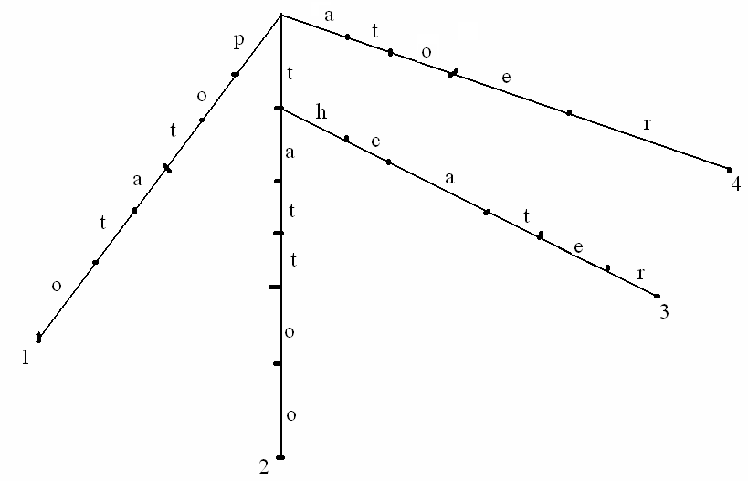
Failure Link
n_{nv’}
n_{v}
v’
n_{v’}
v

Slide 24

Failure Link
n_{v}
n_{nv’}
n_{v’}
v’
v

Slide 25
Failure Link
Output: calculate n_{v} for v
Algorithm n_{v}
v` is the parent of v in K
x is the character on edge (v`, v)
w=n_{v`}
while there is no edge out of w labeled with x and w≠r
w=n_{w}
If there is an edge (w, w`) out of w labeled x then
n_{v}=w`
else n_{v}=r

Slide 26
Failure Link
Algorithm n_{v} is O(n). Where n is the total length of pattern.
Consider a patter p_{i} with length t. Let’s analyze the time for calculating failure links for every node on the this path.
The statements in blue cost O(1) for each node v.
How many times the while loop is executed?

Slide 27
Failure Link
lp(v): the length of the longest proper suffix of string L(v) that is a prefix of some pattern in P.
v
n_{v}
α

Slide 28
Failure Link
lp() may increase from v` to v
lp(v)≤ lp(v`)+1
Then lp() can increase by at most t in total.
v`
n_{v}
v
α

Slide 29
Failure Link
lp() may increase from v` to v
lp(v)≤ lp(v`)+1
Then lp() can increase by at most t in total.
lp() will decrease each time we follow a failure link in the computation of n_{v}, i.e., each time we assign w=n_{w}
lp() ≥0 for all the time.
Thus, the number of decrease ≤ t. i.e., w=n_{w} is executed by at most t times in the computation of failure links for every node on the this path.

Slide 30
Aho-Corasick Algorithm
Input: Pattern set P and text T
Output: all occurrences in T any patter from P
Algorithm AC
l=1;
c=1;
w=root of K
Repeat
while there is an edge (w, w’) labeled with T(c)
if w` is numbered by pattern i then
report that p_{i} occurs in T starting at l;
w=w’; c++;
w=n_{w} and l=c-lp(w);
Until c>m

Slide 31
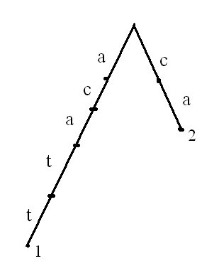
Aho-Corasick Algorithm
What if pattern p_{i} is a a substring of p_{j} ?
P={acaat, ca}
T=acatg

Slide 32
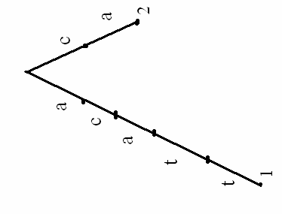
Aho-Corasick Algorithm
l=1
c=5
l=c-lp(w)=5
c=5
a c a t g
a c a t g
n_{w}
w
2
w

Slide 33
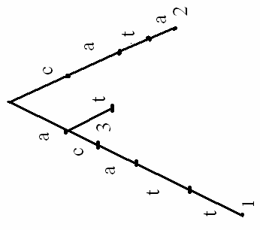
Aho-Corasick Algorithm
l=1
c=5
l=c-lp(w)=5
c=5
a c a t g
a c a t g
3
w
w
3

Slide 34
Aho-Corasick Algorithm
Solution: when v is reached, report the occurrence of pattern i if v is labeled with i or there is a directed path of failure links from v to a node labeled with i.
Input: Pattern set P and text T
Output: all occurrences in T any patter from P
Algorithm AC
l=1;
c=1;
w=root of K
Repeat
while there is an edge (w, w’) labeled with T(c)
if w` is numbered by pattern i or there is a directed path of failure links from v to a node labeled with i then
report that p_{i} occurs in T starting at l;
w=w’; c++;
w=n_{w} and l=c-lp(w);
Until c>m

Slide 35
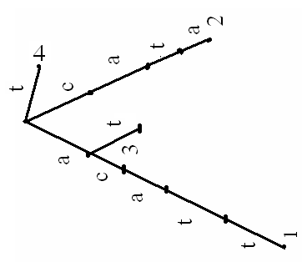
Aho-Corasick Algorithm
Implementation 1: Labels.
Worst case: non-linear time and space
l=1
c=5
a c a t g
3,4
4
w
3,4

Slide 36
Aho-Corasick Algorithm
Implementation 2:
Output link: The output link (if exists) at a node v points to the numbered node (other than v) that is reachable from v by the fewest failure links.
Whenever a node v is encountered that has an output link, the algorithm traverse the path of output links from v, and report an occurrence for each output link.
Total number of output link traversals is k, the total times of occurrences.
l=1
c=5
a c a t g
w

Slide 37
Aho-Corasick Algorithm
Construction of output links:
Output link for node v is determined when n_{v} is determined:
if n_{v} is a labeled node, then the output link from v points to n_{v}.
else if n_{v} is not a labeled node, but has a output link to node w, then the output link from v points to w.
else v has no output link.
O(n) time.

Slide 38
Aho-Corasick Algorithm
The running time of Aho-Corasick Algorithm:
Construction of keyword tree, failure links and output links
O(n)
Comparisons, shifting keyword tree O(m)
Traverse output links O(k)
O(n+m+k)

Slide 39
Application 1: Sequence-Tagged-Sites
A sequence-tagged-site (STS) is a DNA string of length 200-300 that occurs once in the entire genome.
The STS map shows the locations of thousands of STSs in a genome.
Given a anonymous DNA sequence, to locate it on the STS map.
STSs: the set of patterns P
Anonymous DNA sequence: text T.

Slide 40
Application 2: Exact matching with wild cards
φ: a wild card that matches any single character.
P: abφφcφ
Τ: xabvccbababcax
Real-world problem:
Zinc finger: CφφCφφφφφφφφφφφφφΗφφΗ
Given a protein sequence, to determine whether it has Zinc fingers.

Slide 41
Application 2: Exact matching with wild cards
1. Let C be a vector of length n initialized with 0s.
2. Divide P into a set of maximal patterns that do not contain φ. Let k be the number of patterns. Remember their starting locations in T
P=abφφcφabφφ
➔{p₁=ab, p₂=c, p₃=ab}
{l₁=1, l₂=5, l₃=7}
3. Use Aho-Corasick algorithm to find the occurrence of p_{i} in T.
if p_{i} occurs in T starting at position j, then C[j-l_{i}+1] ++.
4. For j=1,…,n, if C[j]=k, then P occurs in T starting at position j.

Slide 42
Application 2: Exact matching with wild cards
P=abφφcφabφφ
➔{p₁=ab, p₂=c, p₃=ab}
{l₁=1, l₂=5, l₃=7}
1 2 3 4 5 6 7 8 9 0 1 2 3 4
T=x a b v c c b a b a b c a x
C[i]: the number of supports that P occurs in T starting at position i
We need k supports in C[i] for P to occurs at position i
1 | 3 | 0 | 0 | 0 | 0 | 0 | 2 | 0 | 1 | 0 | 0 | 0 | 0

Slide 43
Application 3: Two-dimensional exact matching
A rectangular digitalized picture is a two-dimensional array where each point is given a number indicating its color and brightness.
To find the occurrences of a smaller picture P in a larger picture T.
Assumption: the bottom edges of P and T are parallel to each other. (Don not consider rotations).
n`: the number of rows in P
n: the number of points in P
m: the number of points in T
O (m+n)

Slide 44
Application 3: Two-dimensional exact matching
Phase 1: Treat each row in P as a pattern, n` patterns.
Find all occurrences of these patterns in the rows of T.
If p_{i} is found at position (a,b) in T, write number i in position (a,b) of a matrix M with the same dimension as T
r₁
r₂
r_{k}
P₁
P₂
P_{n`}
{p1, p2,…,p_{n`}}
S=r₁$r₂$r₃$...r_{k}

Slide 45
Application 3: Two-dimensional exact matching
Phase 2: Search the columns of M to search for the occurrence of the string 1,2,…,n`.
If this pattern in found that at j column starting at i position, then P occurs in T with upper left corner at position (i,j)
r₁
r₂
r_{k}
 |  |  |  | 1
 |  |  |  | 2
 |  |  |  | …
 |  |  |  | n`
P₁
P₂
P_{n`}

