Slide 1
SIL765: Network & System Security
ADVANCED ENCRYPTION STANDARD (AES)
Sybmitted By:
Vamsi Yalavarthi(2015MCS2358)
Avantika Chhabra(2015MCS2334)

Slide 2
Index
Encryption Algorithm
Decryption Algorithm
Stages
Key Expansion
Verification

Slide 3
Encryption Algorithm
Encrypt( state, sub-key)
1. AddRoundKey(state, expanded key for round).
2. For round 1 to n-1:
SubBytes(state)
ShiftRows(state)
MixColumns(state)
AddRoundKey
For last round
SubBytes(state)
ShiftRows(state)
AddRoundKey

Slide 4
Decryption Algorithm
Decrypt(ciphertext, subkey)
1. AddRoundKey
2. For round 1 to n-1:
InverseShiftRows(state)
InverseSubBytes(state)
AddRoundKey
InverseMixColumns(state)
For last round:
InverseShiftRows(state)
InverseSubBytes(state)
AddRoundKey

Slide 5
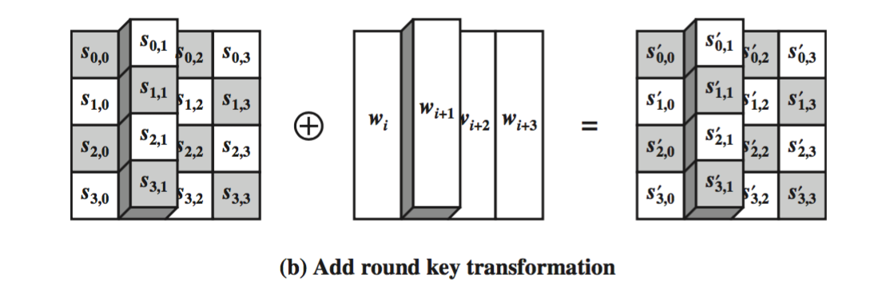
Add Round Key
The Add Round Key operation is simple XOR of input state with the corresponding 32-bit word of key.

Slide 6
Substitute Bytes
The forward substitute byte transformation, called SubBytes, is a simple table lookup.
AES defines a 16 * 16 matrix of byte values, called an S-box, that contains a permutation of all possible 256 8-bit values.
Each byte of input matrix performs its corresponding lookup in SBox.
The backward substitute byte transformation is InvSubBytes and lookup is done in InvSBox.

Slide 7
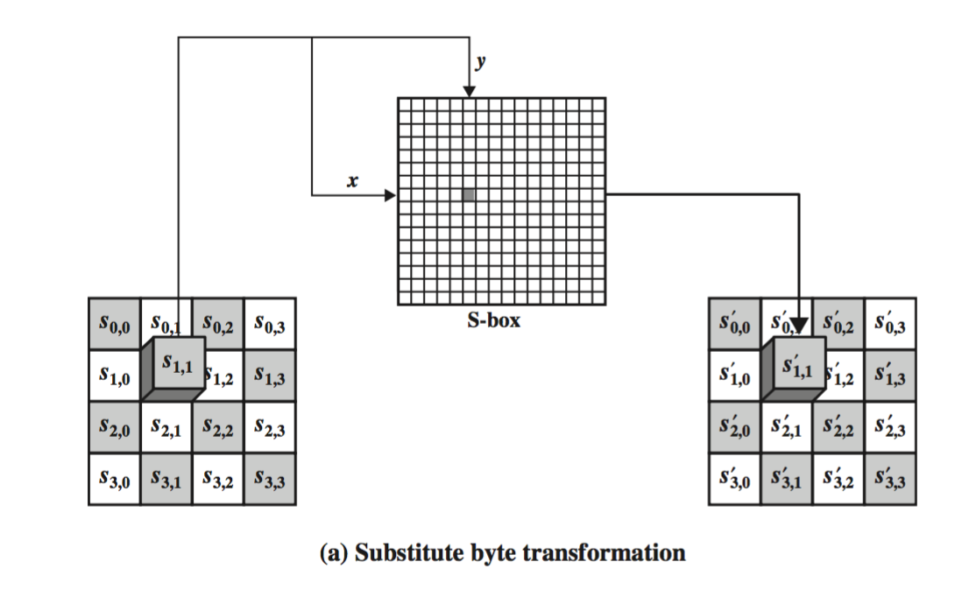
Substitute Bytes

Slide 8
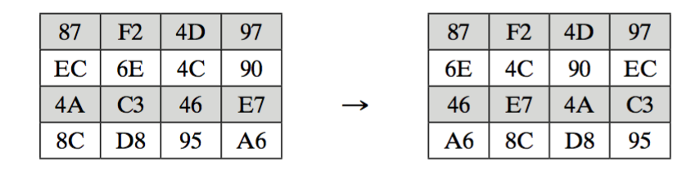
Shift Rows
The forward shift row transformation, called ShiftRows, is circular left shift of each row by 0, 1, 2, 3 respectively.
The inverse shift row is InvShiftRows, is circular right shift of the rows.
Example :

Slide 9
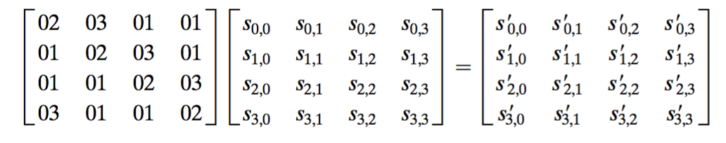
Mix Columns
The forward mix column transformation, called MixColumns, operates on each column individually.
Each byte of a column is mapped into a new value that is a function of all four bytes in that column.
The transformation can be defined by the following matrix multiplication on State.

Slide 10
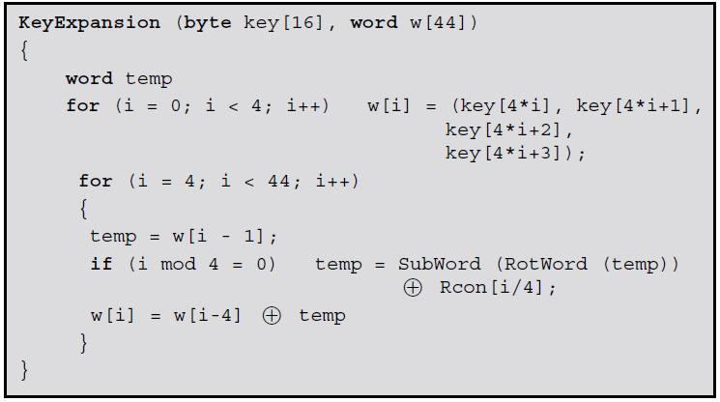
Key Expansion
The AES key expansion algorithm takes as input a four-word (16-byte) key and produces a linear array of 44 words.
This is sufficient to provide a four word round key for the initial AddRoundKey stage and each of the 10 rounds of the cipher.

Slide 11
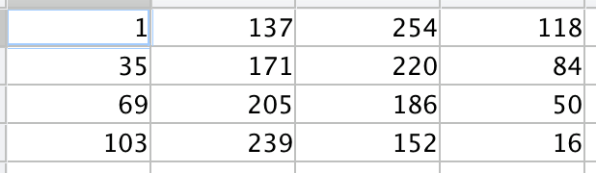
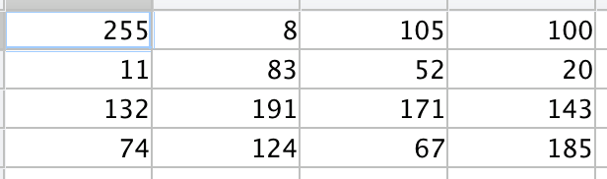
Example: A plaintext to cipher text example is shown below:
Input state matrix
Output state matrix

Slide 12
Verification
The verification as asked in the question has been performed and the results are collected in a file.
It shows the value of state matrix after each iteration of the algorithm for both the encryption as well as the decryption.
Results are verified and the corresponding state matrices are same as expected.

Slide 13
THANK YOU

