Slide 1
SECURED GMT PROVIDER
NETWORK SECURITY (SIL765)
ASSIGNMENT - 2
BY
Avantika Chhabra(2015MCS2334)
Vamsi Yalavarthi(2015MCS2358)

Slide 2
INDEX
PROBLEM STATEMENT
INTRODUCTION
SOFTWARE MODULES
DIGITAL SIGNATURE
PROPERTIES OF SYSTEM

Slide 3
PROBLEM STATEMENT
This application relates to providing a certified copy of the current GMT time.
The client requests and obtain a digitally signed copy of the current GMT data and time.
It is implemented using the access to a web based “GMT date and time server”.
Server returns a file which contains the current GMT date and time with digital signature.
Signature can be used to verify the authentication of the server.
Signed digitally with the server’s RSA-based private key and is verified by the client using public key.

Slide 4
introduction
The system is named as “Secured GMT Provider” is developed to fulfil the requirements of Assignment 2 of Network Security(SIL765).
The system is developed to fetch secured GMT date and time from the GMT server.
This system offers the users a way to secure their information and provide authenticity and integration to the clients.

Slide 5
software modules
There are basically two different modules. a)Server Module. b)Client Module.
SERVER MODULE:
Fetch GMT time and date from the GMT server .
Digitally sign the GMT information using RSA algorithm.
Transfer the message as well as the signature using a file to the requested client.
CLIENT MODULE:
Client requests for the current GMT date and time by clicking the link on client site.
Server responds with a text file containing the message and its digital signature to verify authenticity of the received message.

Slide 6
DIGITAL SIGNATURE
Digital signatures provide the ability to:
Verify author, date and time of signature.
Authenticate message contents
Verified by the third parties to resolve disputes.
Hence the digital signature provides authentication in addition to confidentiality and non-repudiation provided by asymmetric key cryptography of RSA.
The digital signature is generated by encryption of hash of the message using the private key of the server using RSA algorithm.

Slide 7
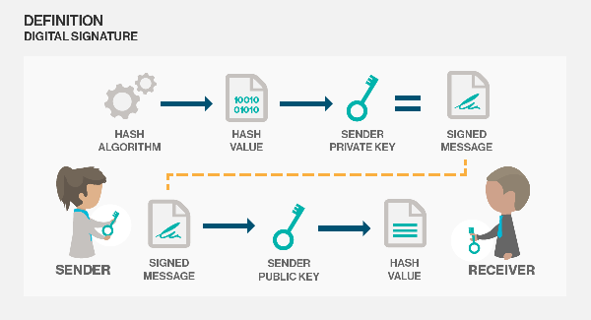
DIGITAL SIGNATURE

Slide 8
PROPERTIES OF THE SYSTEM
AUTHENTICATION
The system permits only authenticated server to send GMT date and time by signing with it’s private key.
The verification is done by decryption of message digest at the client with the public key that is in pair with the private key of the server.
If the decryption fails it indicates the data is not from a valid server.
This mechanism ensures authentication of the server.

Slide 9
PROPERTIES OF THE SYSTEM
NON - REPUDIATION
The user at the client end want to ensure that these details are from a genuine server and later server cannot deny about these details.
Non repudiation is achieved by using RSA algorithm encryption and decryption.
Server signs the message containing details of data and signature and sends to client.
At the client side, this signature is verified using server’s RSA public key.
If the date and time successfully decrypted the server cannot deny that it sent the data as it is decrypted by server’s public key successfully.

Slide 10
PROPERTIES OF THE SYSTEM
INTEGRITY
All the communication in the system is having integrity code in each message.
This integrity code is generated involving hash of shared secret of the user.
Therefore any tampering of data can be detected at both the ends.

Slide 11
THANK YOU

