Slide 1

1.
LIFE EXPECTANCY
ANALYSIS
BABARIA INSTITUTE OF TECHNOLOGY
SUBMITTED TO:
DARSHAN PARMAR
ASSISTANT PROFESSOR
BABARIA INSTITUTE OF TECHNOLOGY
SUBMITTED BY:
VANDAN PATEL-200050131051
VISHESH PATEL-200050131052
COMPUTER SCIENCE & ENGINEERING
BATCH-B
DIV-2

Slide 2
2.
TABLE OF CONTENT
Project Description
Dataset
Describing the Dataset
Observation
Results
Conclusion

Slide 3
3.
PROJEC T DESCRIPTION
Life expectancy refers to the number of years a person is expected to live based on the statistical average. It depends on the geographical context of the area.
Before the modernization of the world, life expectancy was around 30 years in all parts of the world.
Life expectancy increased at the beginning of the 19th century but until there are the same countries while it remains low in the rest of the world.
This shows that health standards are not the same all over the world. In the 20th century, this global inequality is reduced and similarly, life expectancy is approaching 70 to 75 years and similarly no country in the world today has a low life expectancy than countries with high life expectancy in 1800.

Slide 4
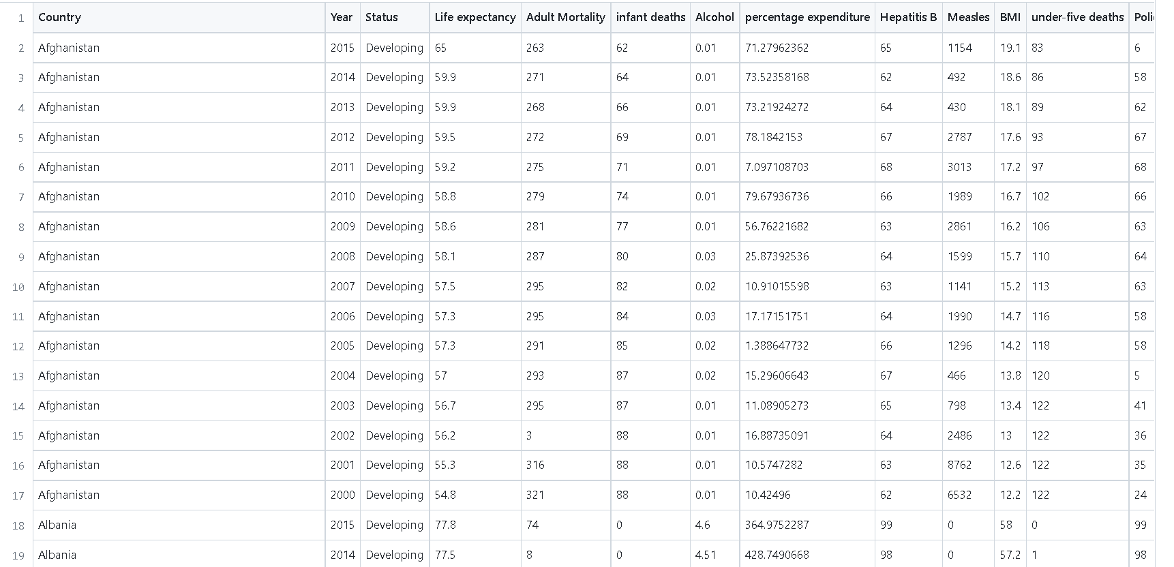
4.
DATASET

Slide 5
5.
DESCRIBING THE DATASET
country (Nominal) - the country in which the indicators are from (i.e. United States of America or Congo)
year (Ordinal) - the calendar year the indicators are from (ranging from 2000 to 2015)
status (Nominal) - whether a country is considered to be 'Developing' or 'Developed' by WHO standards
life_expectancy (Ratio) - the life expectancy of people in years for a particular country and year
adult_mortality (Ratio) - the adult mortality rate per 1000 population (i.e. number of people dying between
15 and 60 years per 1000 population); if the rate is 263 then that means 263 people will die out of 1000 between
the ages of 15 and 60; another way to think of this is that the chance an individual will die between 15 and 60 is 26.3%
infant_deaths (Ratio) - number of infant deaths per 1000 population; similar to above, but for infants

Slide 6
6.
DESCRIBING THE DATASET
alcohol (Ratio) - a country's alcohol consumption rate measured as liters of pure alcohol consumption per capita
percentage_expenditure (Ratio) - expenditure on health as a percentage of Gross Domestic Product (gdp)
hepatitis_b (Ratio) - number of 1 year olds with Hepatitis B immunization over all 1 year olds in population
measles (Ratio) - number of reported Measles cases per 1000 population
bmi (Interval/Ordinal) - average Body Mass Index (BMI) of a country's total population
under-five_deaths (Ratio) - number of people under the age of five deaths per 1000 population
polio (Ratio) - number of 1 year olds with Polio immunization over the number of all 1 year olds in population
total_expenditure (Ratio) - government expenditure on health as a percentage of total government expenditure

Slide 7
7.
DESCRIBING THE DATASET
diphtheria (Ratio) - Diphtheria tetanus toxoid and pertussis (DTP3) immunization rate of 1 year olds
hiv/aids (Ratio) - deaths per 1000 live births caused by HIV/AIDS for people under 5; number of people under 5 who die due to HIV/AIDS per 1000 births
gdp (Ratio) - Gross Domestic Product per capita
population (Ratio) - population of a country
thinness_1-19_years (Ratio) - rate of thinness among people aged 10-19 (Note: variable should be renamed to thinness_10-19_years to more accurately represent the variable)
thinness_5-9_years (Ratio) - rate of thinness among people aged 5-9
schooling (Ratio) - average number of years of schooling of a population

Slide 8
8.
OBSERVATIONS
Adult_mortality has a negative relationship with education, the composition of resource income, and a positive relationship with HIV / AIDS.
Infant_deaths and Under_five_deaths have a strong positive relationship.
Schooling and alcohol have a positive relationship.
Percentage expenditure has a positive relationship with education, the composition of resource income, GDP and life expectancy.
hepatitis B has a strong positive relationship with polio and diphtheria.
Polio also has a strong positive relationship with diphtheria, hepatitis B, and life expectancy.
Diphtheria has a strong positive relationship with polio and life expectancy.

Slide 9
9.
OBSERVATIONS
The following data points have a very high correlation:
Under five deaths & Infant deaths (0.99)
GDP & percentage expenditure (0.7)
Dipteria & Polio (0.67)
Thinness 5-9 years & Thinness 1-19 years (0.94)
Income compostion of resources & Schooling (0.8)

Slide 10
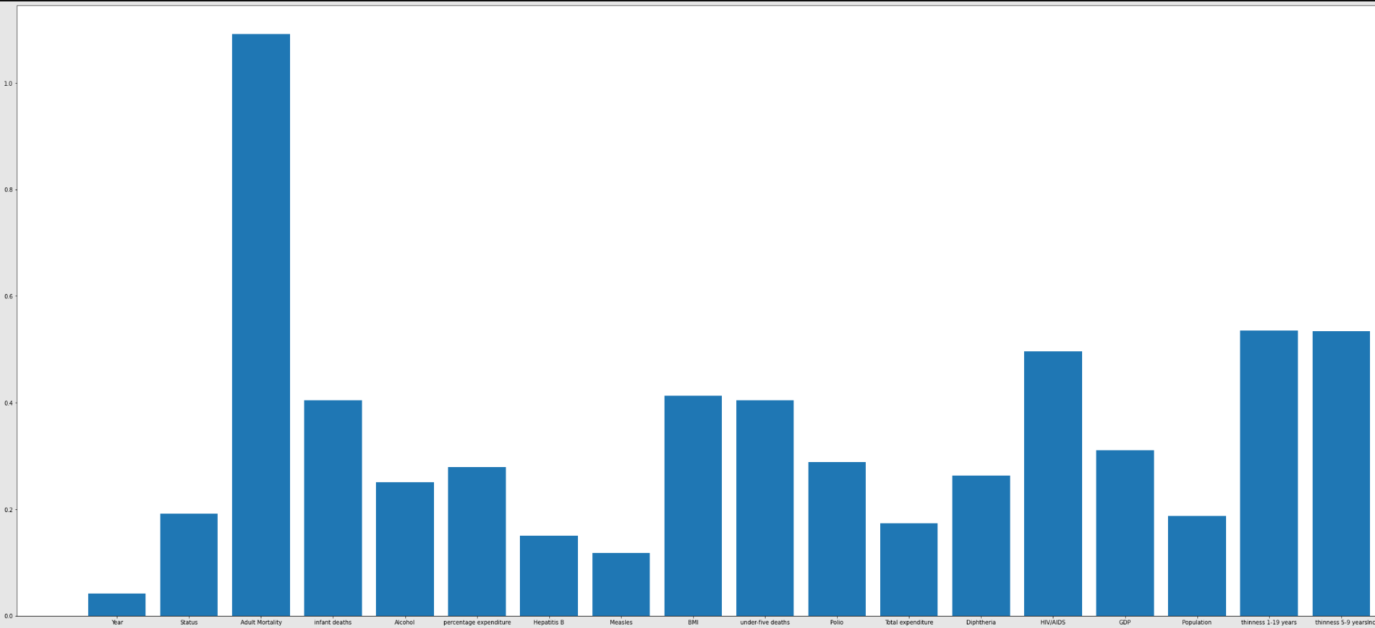
10.
RESULTS

Slide 11
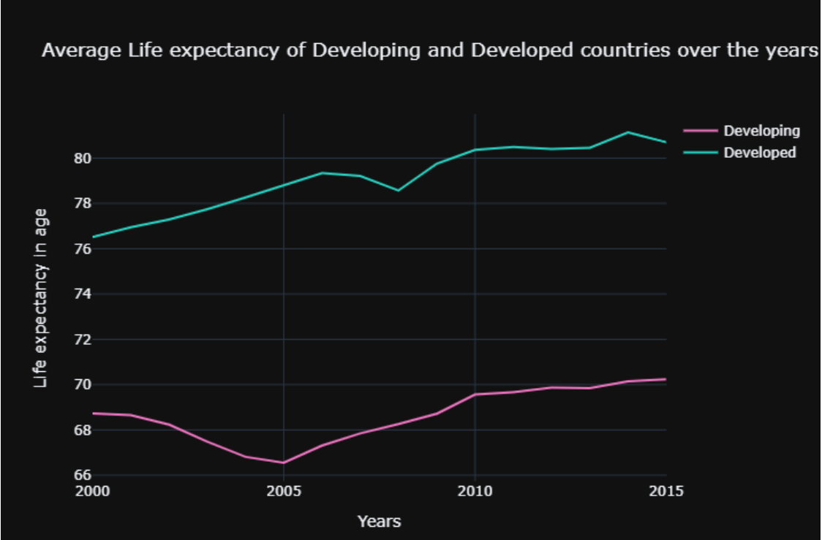
11.
RESULTS

Slide 12
12.
CONCLUSION
We can see from the above graph that developed
countries have more life expectancy than in developing countries.
Life_expectancy has a positive relationship with education, resource income composition, GDP, diphtheria, polio, and percentage spending. Life_expectancy has a negative relationship with Adult_mortality, Thinness_1-19_years, Thinness_5-9_years, HIV / AIDS, Under_five_deaths, and Infant_deaths.

Slide 13
THANK YOU

