Slide 1

Dodge the Blocks: A Simple Pygame Project
A fun and engaging game built with Python and Pygame.

Slide 2

Team Members
Muskan Chauhan [24071 ]
Ayush Aggarwal [24089 ]
Vansh Gupta [ 24092 ]
Lakshay Yadav [ 24093 ]
Raish Kausar [ 24101 ]

Slide 3
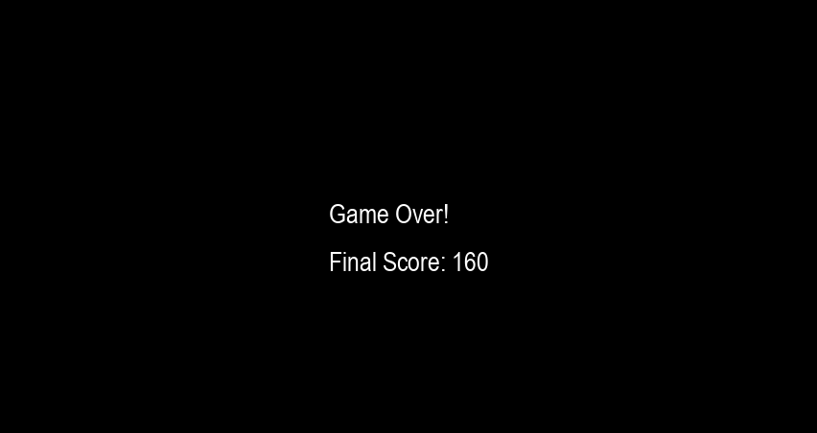
Game Objective
Main Objective
Avoid falling blocks
Secondary Objective
Achieve the highest score

Slide 4

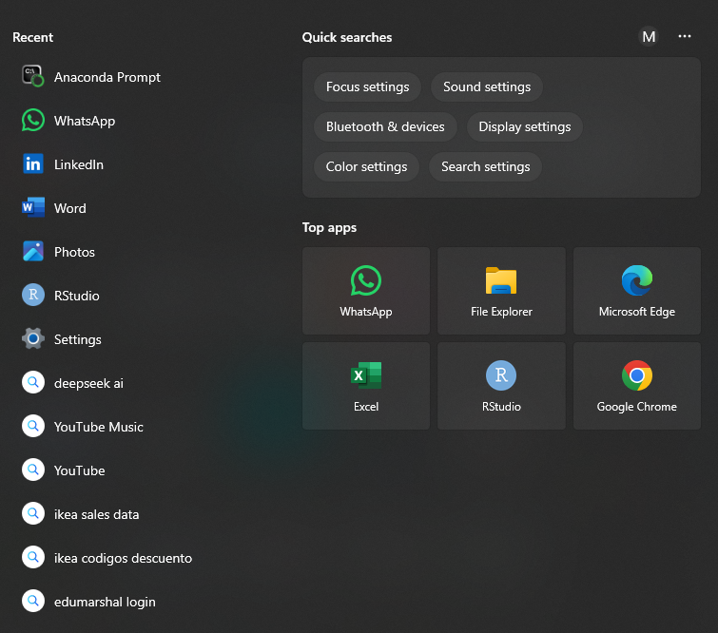
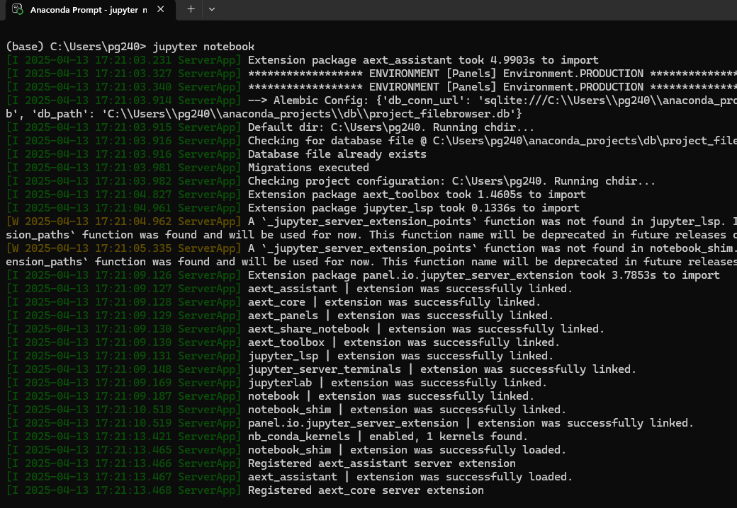
Setting Up the Game
1
Development Environment
Download anaconda, Python 3.x, Pygame library
2
Installation Steps
Install Python and Pygame using pip
3
Game Dimensions
1200 pixels wide, 600 pixels high

Slide 5
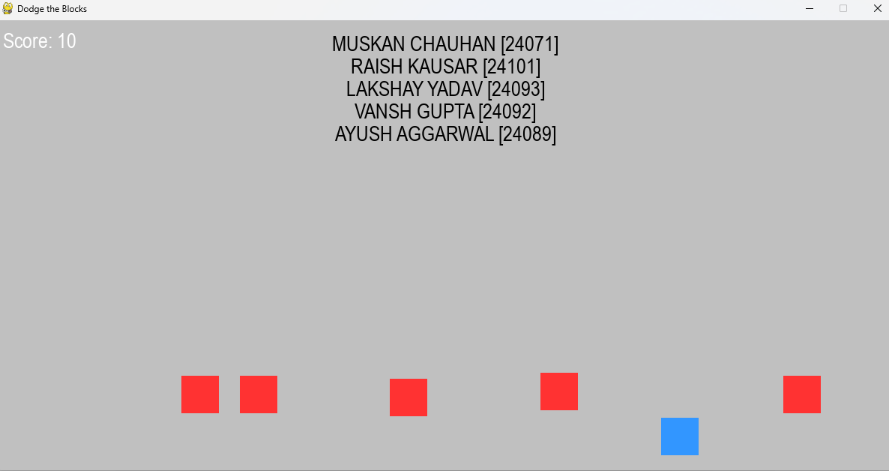

Key Features
Player Control
Move left and right with arrow keys
Dynamic Gameplay
Blocks fall at increasing speeds
Scoring System
Score increases with successful dodges
Game Over
Collision with a block ends the game

Slide 6
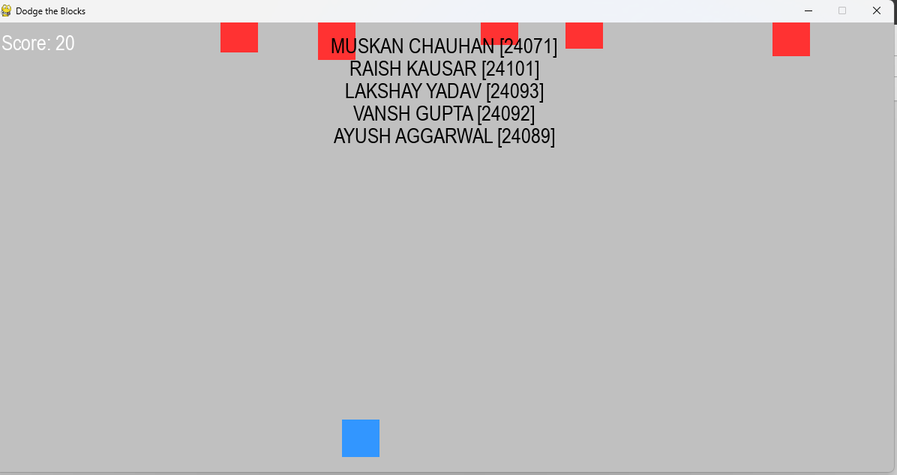



Dependencies
Required Libraries
Pygame for game development
System Requirements
Any system supporting Python and Pygame
Additional Resources
Pygame documentation for customization

Slide 7
Game Description
1
Game Overview
Dodge falling blocks with a player character
2
Gameplay Mechanics
Move horizontally to avoid blocks
3
Visuals and Theme
Bright colors, simple yet engaging interface

Slide 8
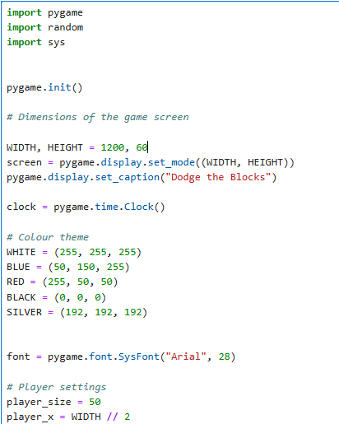




Code Structure
Game Initialization
Set up the game window and objects
Game Loop
Handle events, update game state, and draw graphics
Collision Detection
Check for collisions between player and blocks
Scoring and Game Over
Track player score and handle game over conditions

Slide 9


