Slide 1
Bluestock Mutual Fund Analytics
Final Capstone Presentation
ETL • SQL • EDA • Performance • Advanced Analytics • Power BI
34 NAV-active schemes | 32,778 investor transactions | 322 holdings

Slide 2
Problem & Objectives
Build an end-to-end mutual-fund analytics product.
Measure returns, risk-adjusted performance and downside risk.
Understand investor cohorts and SIP continuity.
Measure portfolio concentration and provide risk-based recommendations.

Slide 3
Data Sources & Scale
10 canonical CSV datasets plus live NAV API integration.
35 metadata records; 34 schemes with usable NAV.
40 scheme-performance reference rows.
32,778 investor transactions.
322 portfolio holding records.

Slide 4
ETL Architecture
Historical CSVs → ingestion → cleaning/validation → live NAV → processed data → SQLite → analytics → Power BI.
Master pipeline stages: Data Ingestion, Live NAV Fetch, Preprocessing, Validation, SQLite Loading.
Final run completed all stages successfully.

Slide 5
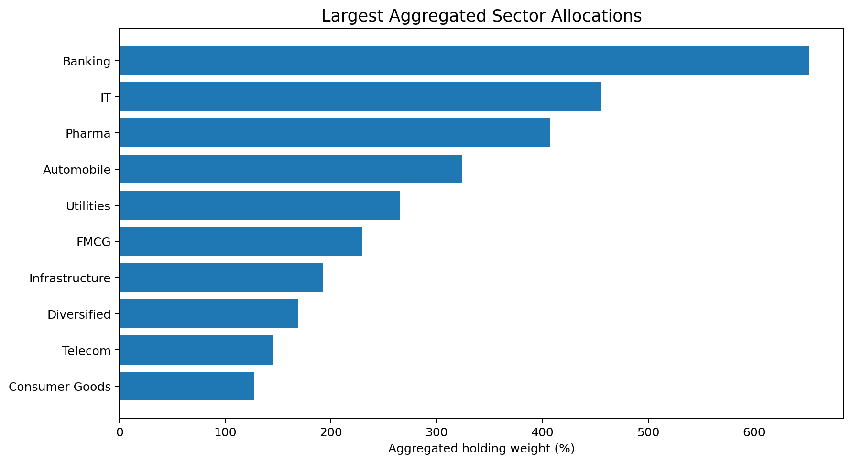
EDA Highlights I
SBI Mutual Fund shows strong AUM scale in the supplied industry series.
Banking, IT and Pharma are the largest aggregated portfolio sectors.
Investor activity spans multiple age, gender and geographic segments.

Slide 6
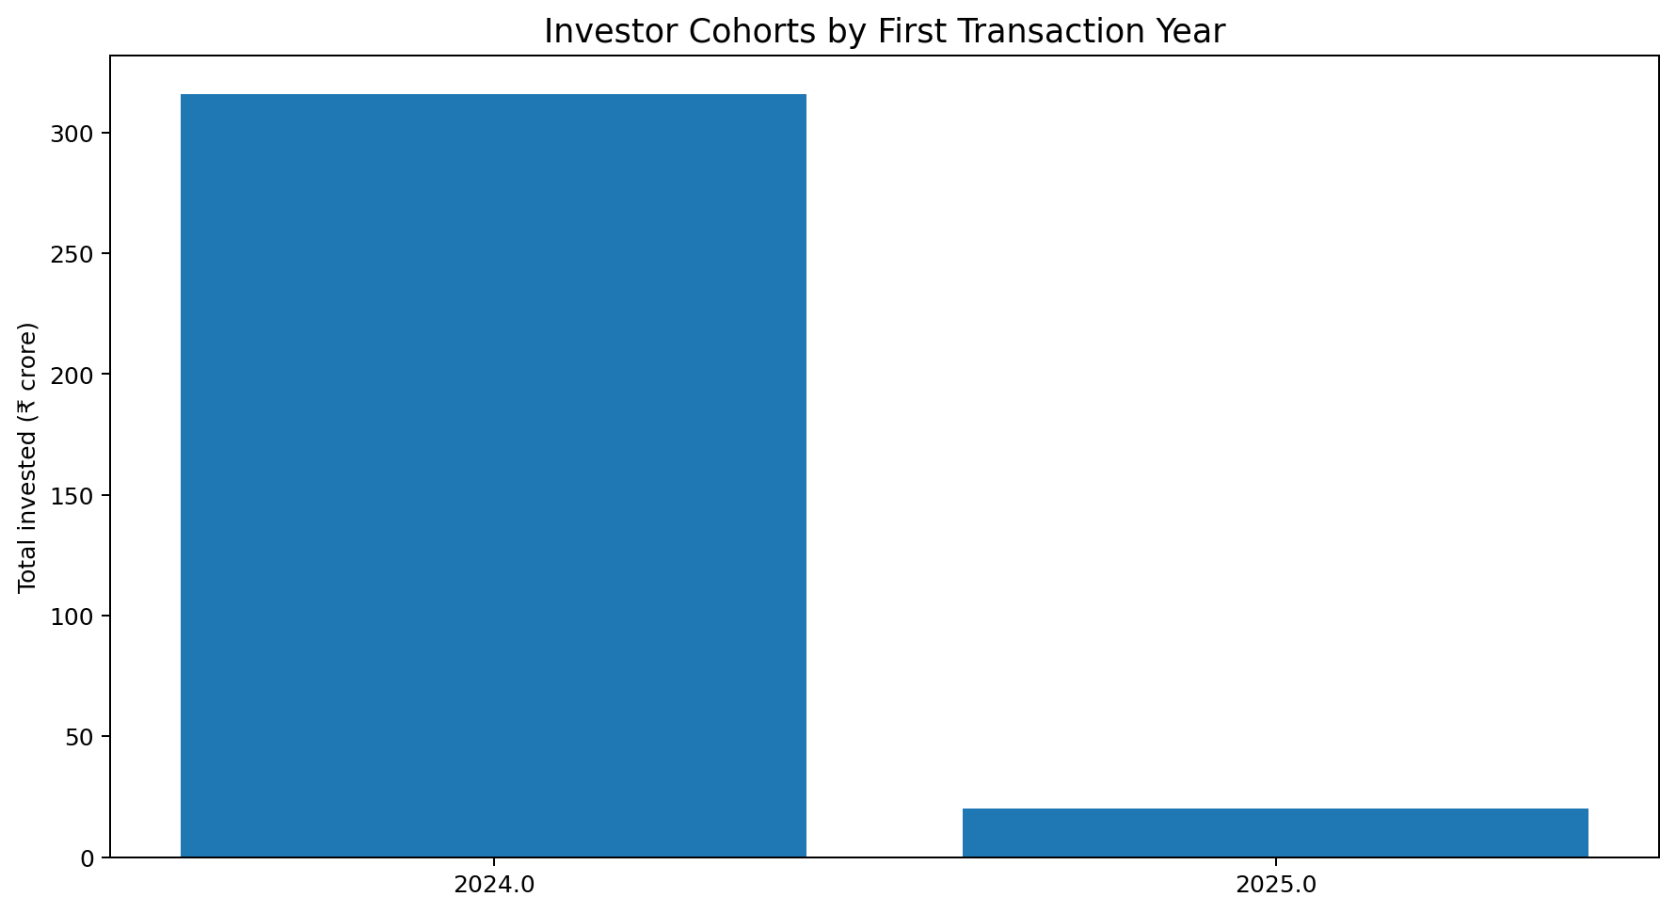
EDA Highlights II
2024 is the dominant investor cohort in the supplied cohort analysis.
SIP activity forms a major part of transaction behaviour.
The project uses cohort and continuity analysis to move beyond simple fund rankings.

Slide 7
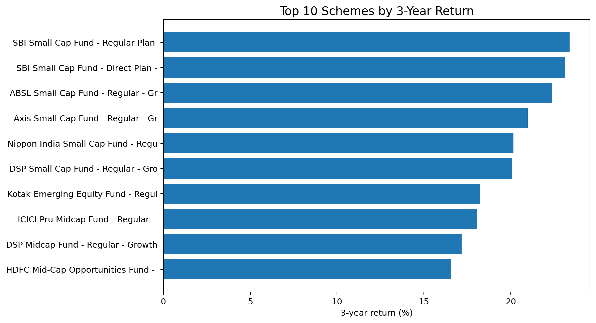
Performance Metrics I
Top 3-year return schemes are led by SBI Small Cap and ABSL Small Cap.
Absolute return leadership is not equivalent to risk-adjusted leadership.
CAGR is calculated over 1-, 3- and 5-year horizons.

Slide 8
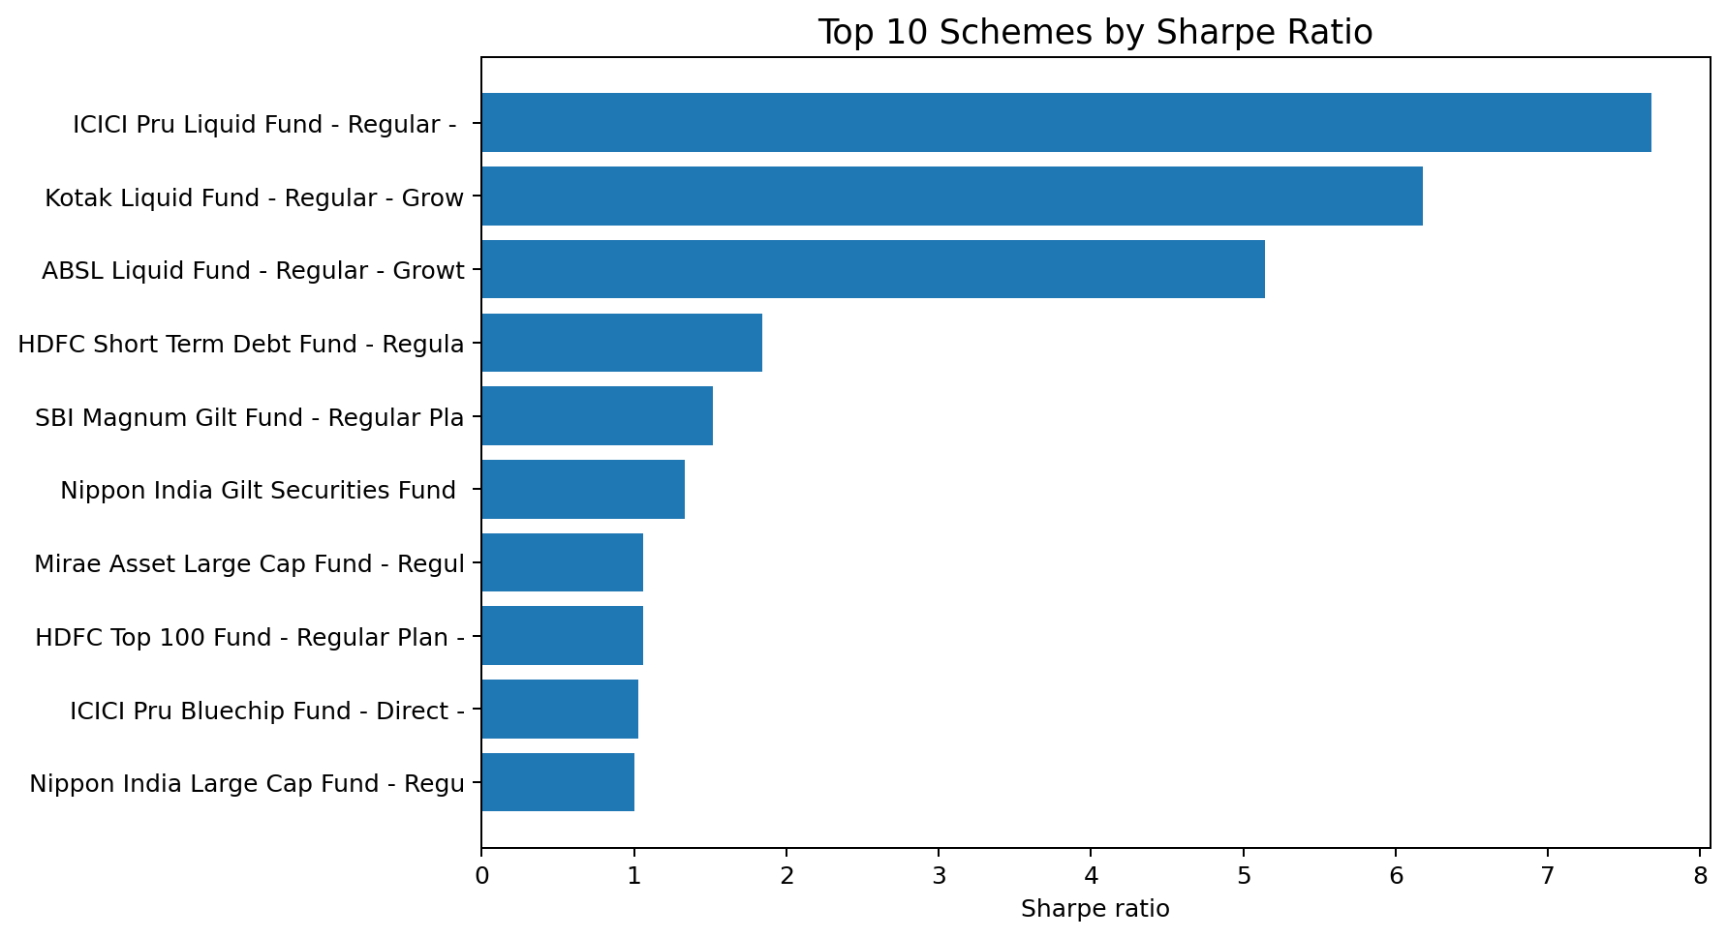
Performance Metrics II
Sharpe and Sortino capture risk-adjusted performance.
VaR/CVaR quantify downside-tail behaviour.
Alpha/Beta regression uses NIFTY100 overlap; 29 schemes have sufficient observations.

Slide 9
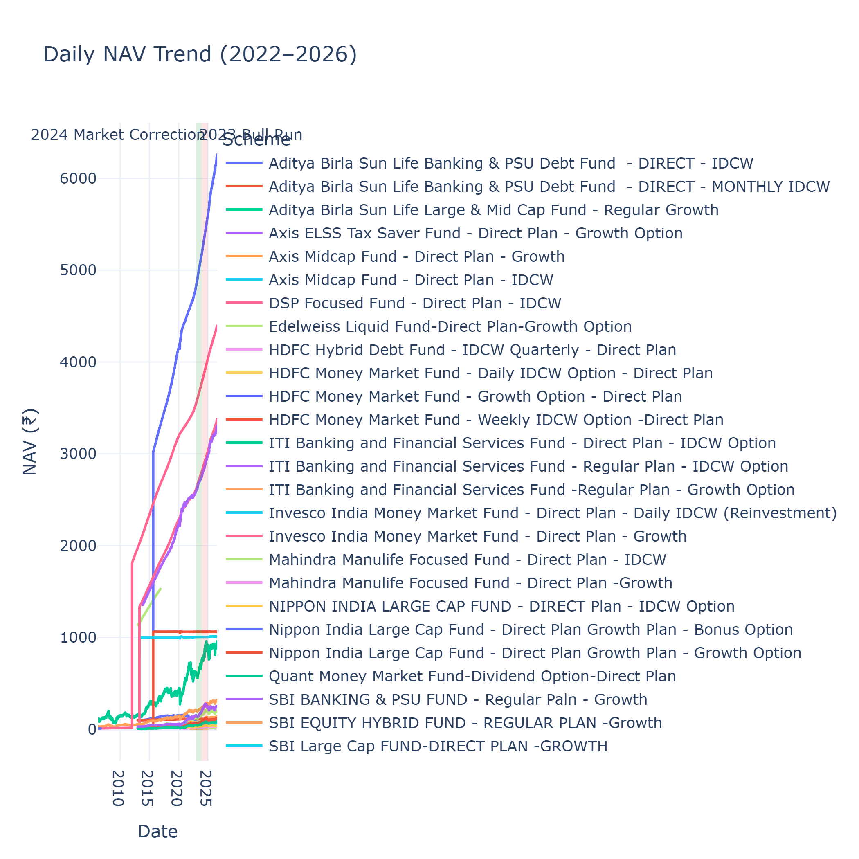
Power BI Dashboard — Executive & Fund Performance
PBIX contains four pages.
Executive Overview: 11 visuals.
Fund Performance: 6 visuals.
Interactive slicers are present in the dashboard layout.

Slide 10
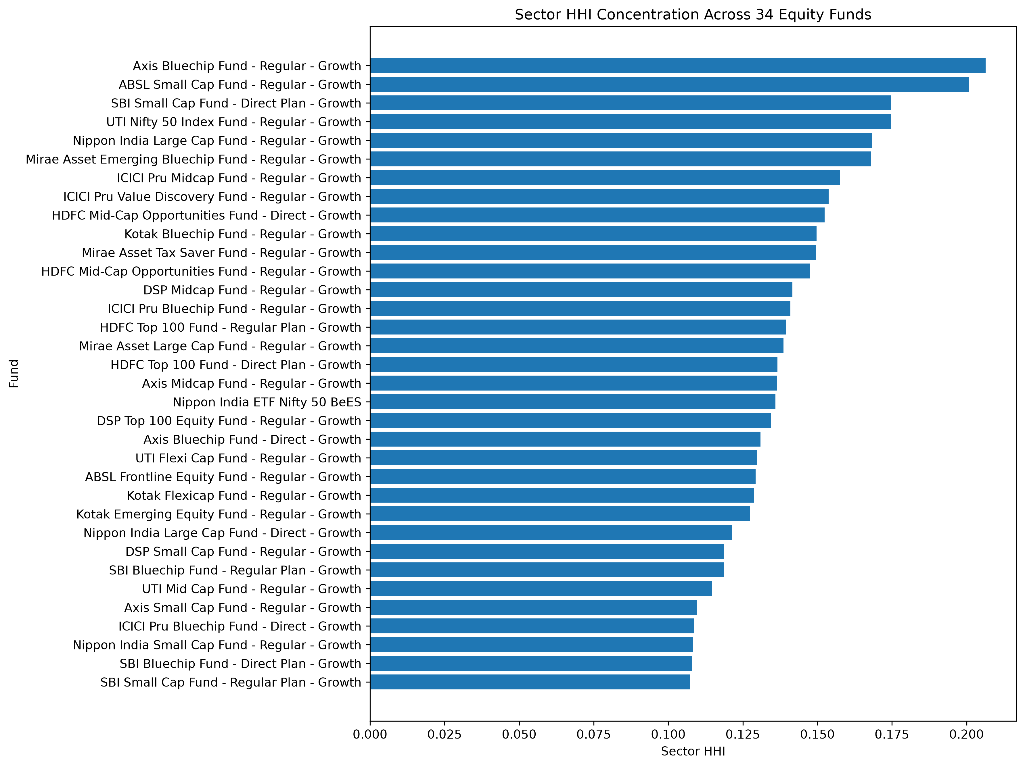
Power BI Dashboard — Investor & Portfolio
Investor Analysis: 7 visuals.
Portfolio & Market: 5 visuals.
Portfolio page includes holdings, sector concentration and market context.
The supplied PBIX is the interactive dashboard source.

Slide 11
Key Findings
1. Small-cap funds lead absolute 3-year returns but carry higher risk grades.
2. Liquid/debt schemes dominate risk-adjusted Sharpe rankings.
3. Highest historical VaR is about -2.01%, with CVaR about -3.21%.
4. All 38 eligible 6+ SIP investors are flagged At-Risk under the 35-day rule.
5. Sector HHI highlights meaningful concentration differences.

Slide 12
Thank You
Final deliverables: Final_Report.pdf, Bluestock_MF_Presentation.pptx and cleaned GitHub repository.
Release target: v1.0
Questions?

