Slide 1
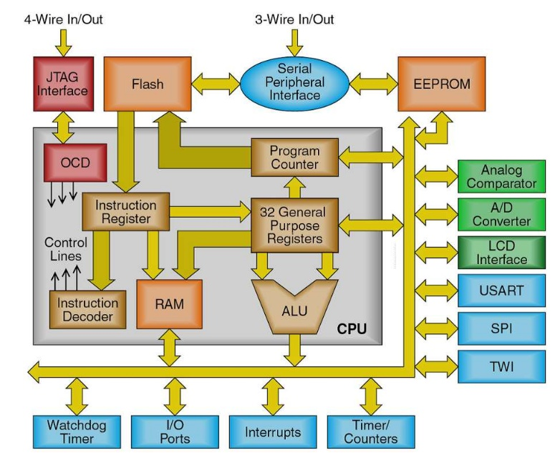
AVR Architecture

Slide 2
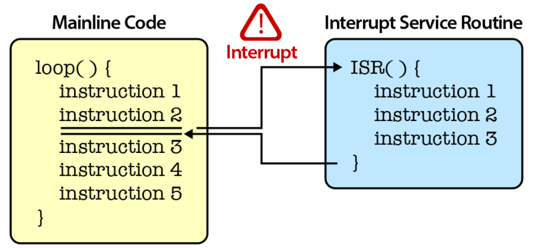
Interrupt

Slide 3
Syntax
attachInterrupt(digitalPinToInterrupt(pin), ISR, mode);
pin: the pin number
ISR: the ISR to call when the interrupt occurs; this function must take no parameters and return nothing.
mode: defines when the interrupt should be triggered. Four constants are predefined as valid values:
RISING to trigger when the pin goes from low to high,
FALLING for when the pin goes from high to low.
LOW to trigger the interrupt whenever the pin is low,
CHANGE to trigger the interrupt whenever the pin changes value

Slide 4
Digital Pins With Interrupts
BOARD | DIGITAL PINS USABLE FOR INTERRUPTS
Uno, Nano, Mini, other 328-based | 2, 3
Uno WiFi Rev.2 | all digital pins
Mega, Mega2560, MegaADK | 2, 3, 18, 19, 20, 21
Micro, Leonardo, other 32u4-based | 0, 1, 2, 3, 7
Zero | all digital pins, except 4
MKR Family boards | 0, 1, 4, 5, 6, 7, 8, 9, A1, A2
Due | all digital pins
101 | all digital pins (Only pins 2, 5, 7, 8, 10, 11, 12, 13 work with CHANGE)

Slide 5
Notes and Warnings
Inside the attached function
delay() won’t work.
The value returned by millis() will not increment.
Serial data received while in the function may be lost.
You should declare as volatile any variables that you modify within the attached function.

