Slide 1
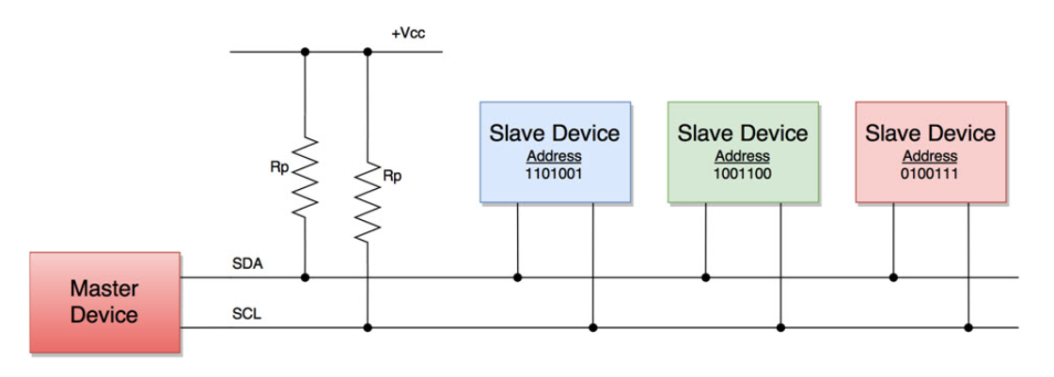
I2C communication
Bus type communication (one transmits, multiple receives)
All the devices in the bus have a specific 7-bit address
Requires 2 wires (SDA & SCL) – A4: SDA – A5: SCL
SDA = Serial Data Line
SCL = Serial Clock Line

Slide 2
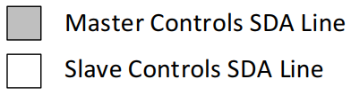
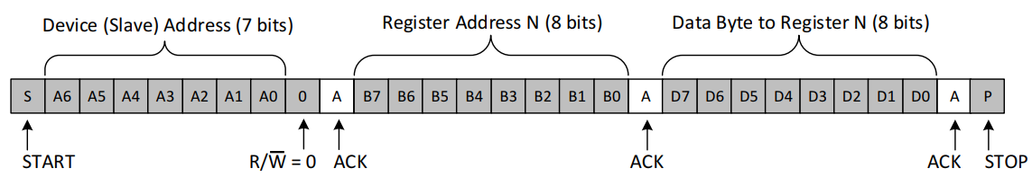
Writing to a Slave On The I²C Bus

Slide 3
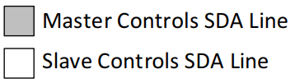
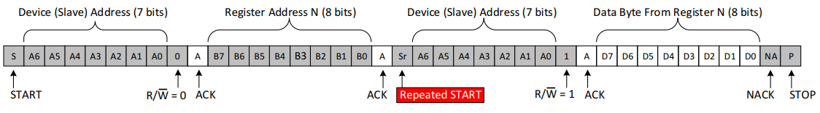
Reading From a Slave On The I²C Bus

Slide 4
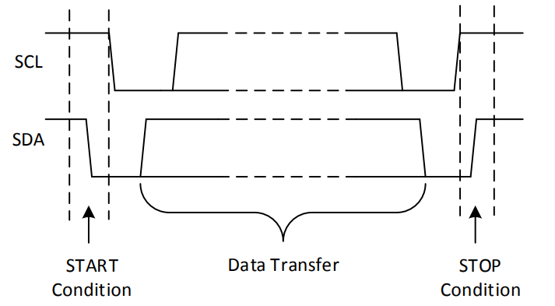
START and STOP Condition

Slide 5
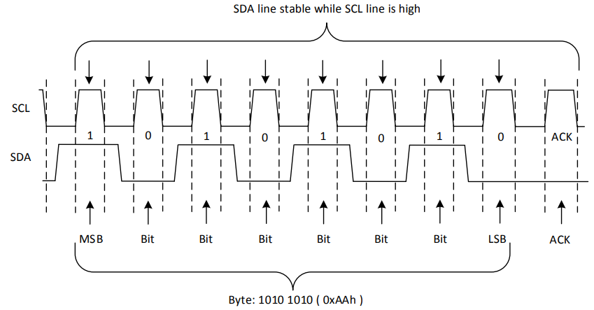
Example of Single Byte Data Transfer

Slide 6
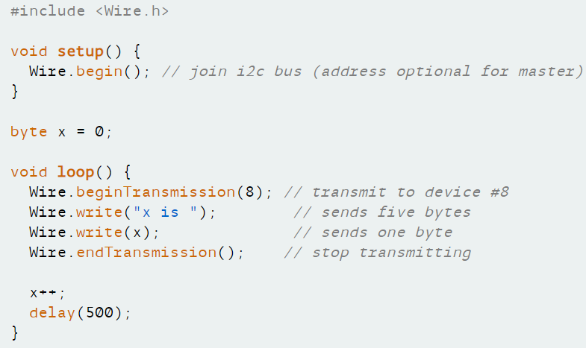
Write Example

Slide 7
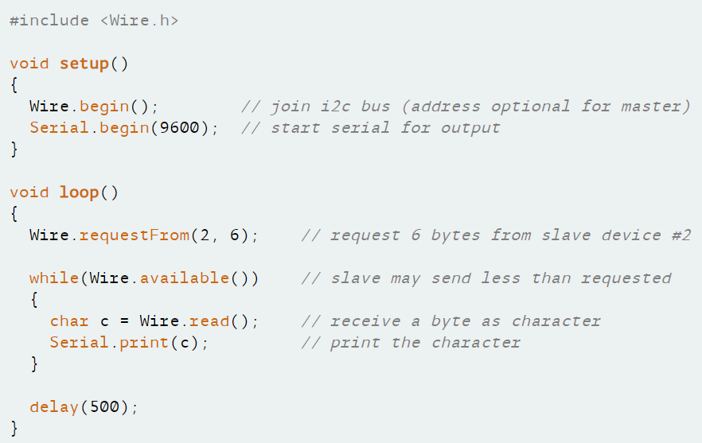
Read Example

Slide 8
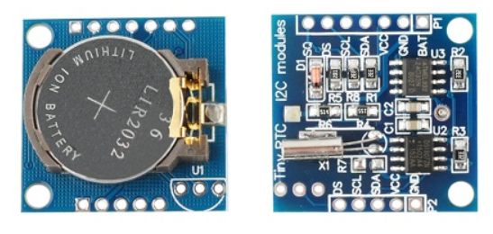
DS1307
Real-Time Clock

Slide 9
Real-Time Clock: Seconds, Minutes, Hours, Date of the Month, Month, Day of the Week, and Year with Leap-Year (up to 2100)
I2C Serial Interface
The end of the month days: 28, 29, 31
24-hour or 12- hour format with AM/PM indicator.
Programmable Square-Wave Output Signal
Consumes Less than 500nA in BatteryBackup Mode with
Oscillator Running o Automatic Power-Fail Detect and Switch Circuitry
Optional Industrial Temperature Range: -40°C to +85°C

Slide 10
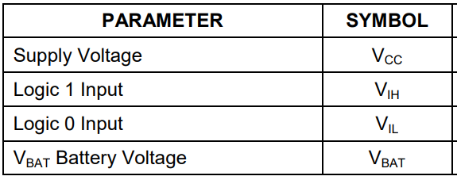
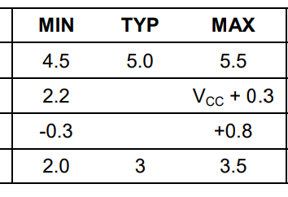
ABSOLUTE MAXIMUM RATINGS
Voltage Range on Any Pin Relative to Ground .....-0.5V to +7.0V Operating Temperature Range (Noncondensing) Commercial............................................................0°C to +70°C Industrial .................................................................-40°C to +85°C Storage Temperature Range....................................................................................................... -55°C to +125°C Soldering Temperature (DIP, leads)................................................+260°C for 10 seconds Soldering Temperature (surface mount)…..……………….Refer to the JPC/JEDEC J-STD-020
Specification
RECOMMENDED DC OPERATING CONDITIONS

Slide 11
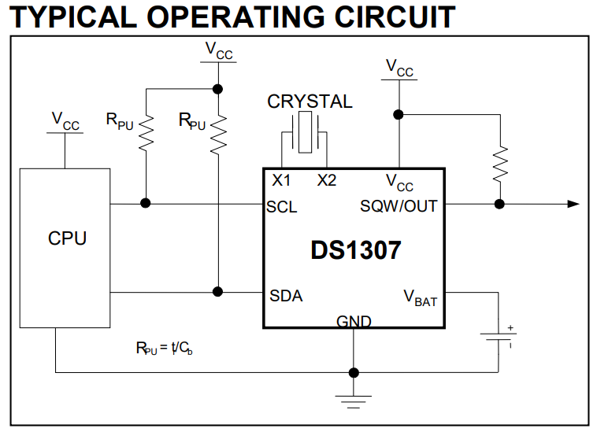

Slide 12
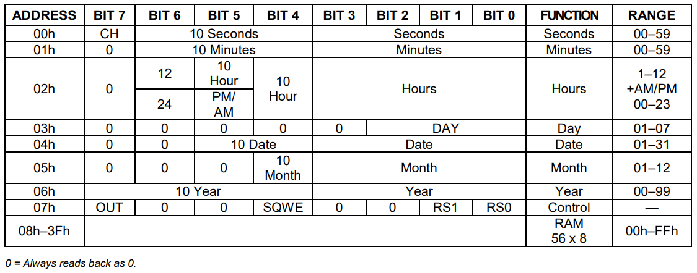
Timekeeper Registers

Slide 13
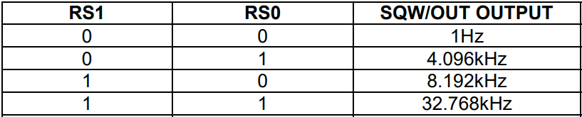
CONTROL REGISTER
The DS1307 control register is used to control the operation of the SQW/OUT pin
Bit 7: Output Control (OUT):
- typically set to a 0
- the logic level on the SQW/OUT pin is 1 if OUT = 1 and is 0 if OUT = 0
Bit 4: Square-Wave Enable (SQWE):
- enables the oscillator output
- typically set to a 0
Bits 1 and 0: Rate Select (RS[1:0]):
- typically set to a 1

Slide 14
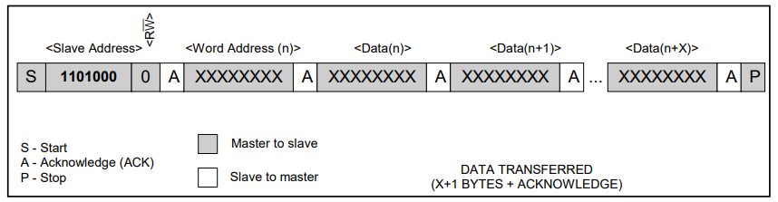
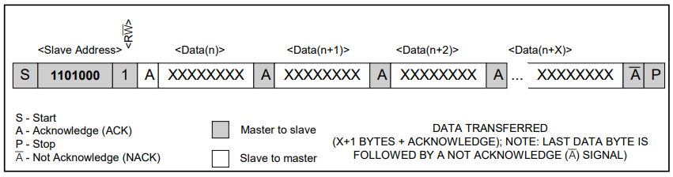
Data Write—Slave Receiver Mode
Data Read—Slave Transmitter Mode

Slide 15
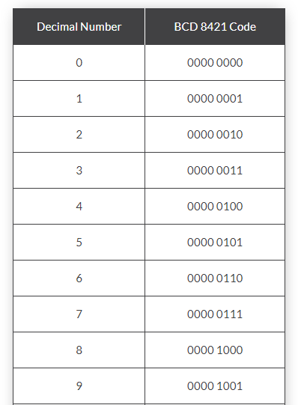
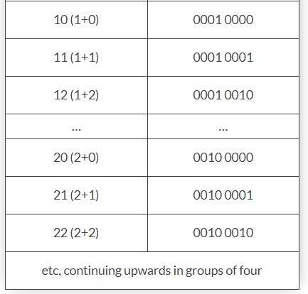
Binary-Coded Decimal

Slide 16
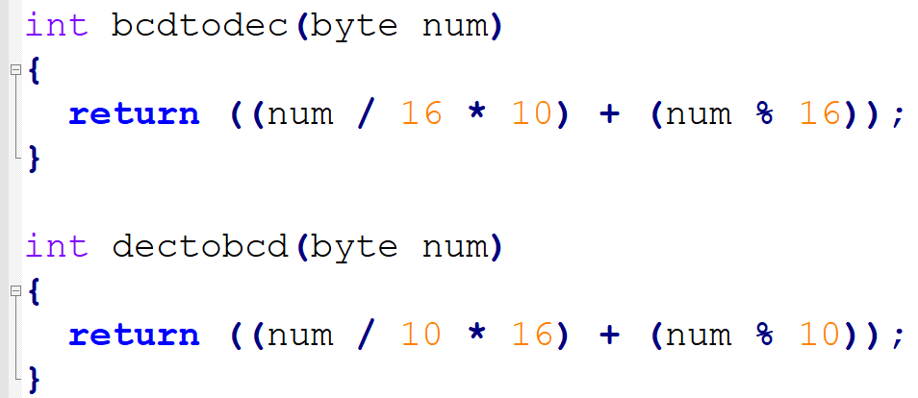

Slide 17
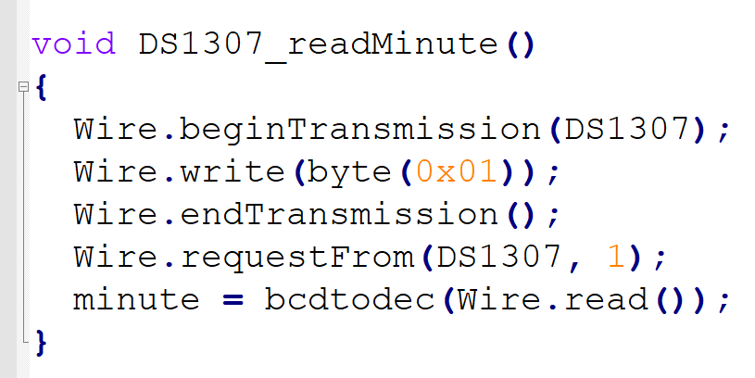

Slide 18
