Slide 1

ChuMuc
0338686180 – nguyenvanthochutsinivesoss15@gmail.com
Nguyễn Văn Thọ - BKDN
Link
Link : https://ngoinhaiot.com/
https://console.hivemq.cloud/?utm_source=hivemq-com&utm_medium=download-page&utm_campaign=cloud
http://www.hivemq.com/demos/websocket-client/

Slide 2
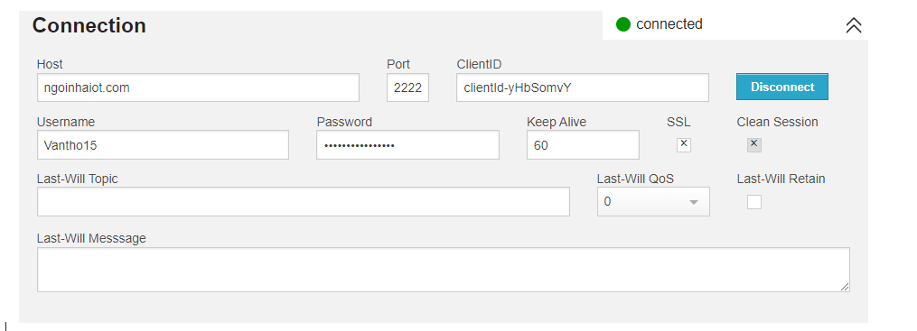
ChuMuc
0338686180 – nguyenvanthochutsinivesoss15@gmail.com
Nguyễn Văn Thọ - BKDN
Kết Nối nhà IOT

Slide 3
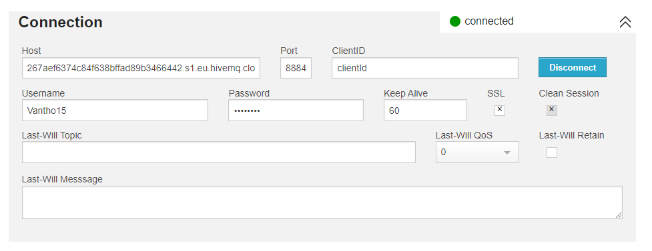
ChuMuc
0338686180 – nguyenvanthochutsinivesoss15@gmail.com
Nguyễn Văn Thọ - BKDN
Kết nối HiveMQ

Slide 4
ChuMuc
0338686180 – nguyenvanthochutsinivesoss15@gmail.com
Nguyễn Văn Thọ - BKDN
Cài Đặt
Sử dụng SSL thì port là 3333 khi đó là wss
Không sử dụng SSL thì port là 2222 khi đó là ws

Slide 5
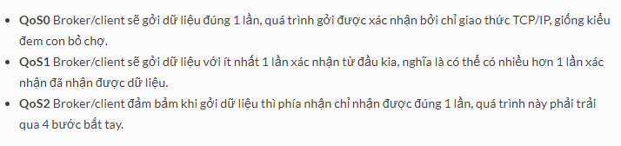
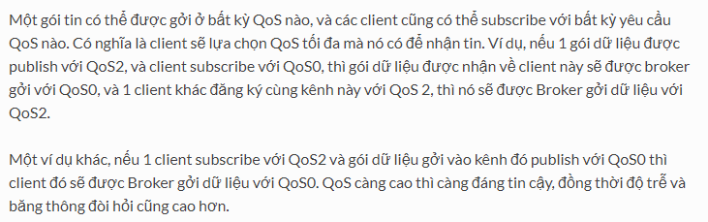
ChuMuc
0338686180 – nguyenvanthochutsinivesoss15@gmail.com
Nguyễn Văn Thọ - BKDN
QOS

Slide 6
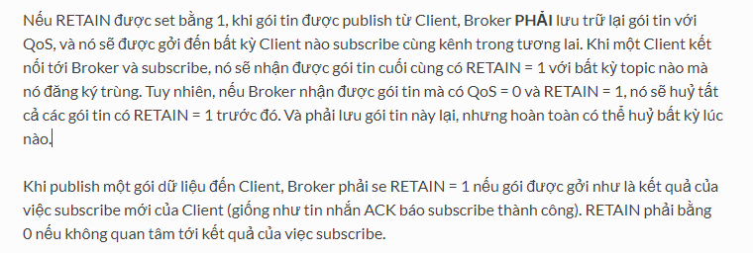
ChuMuc
0338686180 – nguyenvanthochutsinivesoss15@gmail.com
Nguyễn Văn Thọ - BKDN
Retain

Slide 7
ChuMuc
0338686180 – nguyenvanthochutsinivesoss15@gmail.com
Nguyễn Văn Thọ - BKDN
NodeJS
Chạy Code ngon lành

Slide 8
ChuMuc
0338686180 – nguyenvanthochutsinivesoss15@gmail.com
Nguyễn Văn Thọ - BKDN
React_native
+ link : https://www.npmjs.com/package/sp-react-native-mqtt
+ npm install sp-react-native-mqtt --save

Slide 9
ChuMuc
0338686180 – nguyenvanthochutsinivesoss15@gmail.com
Nguyễn Văn Thọ - BKDN
Link
A

Slide 10
ChuMuc
0338686180 – nguyenvanthochutsinivesoss15@gmail.com
Nguyễn Văn Thọ - BKDN
Link
A

