Slide 1

GIT & GITHUB
Trainer Nguyễn Văn Thọ
18CDT1 Khoa Cơ Khí - BKDN

Slide 2
Introduce about Version Control System (VCS)
Version control is a system that records changes to a file or set of files over time so that you can recall specific versions later.
It allows you to revert files back to a previous state, revert the entire project back to a previous state, compare changes over time, see who last modified something that might be causing a problem, who introduced an issue and when , and more ☺)))
Using a VCS also generally means that if you screw things up or lose files, you can easily recover. In addition, you get all this for very little overhead.

Slide 3
Local Version Control Systems
VCS that had a simple database that kept all the changes to files under reversion control
Local Computer
Checkout
Version 3
File
Version 2
Version 1

Slide 4
Centralized Version Control Systems
If(Server==Error) ?
Central VCS Server
Computer A
Version Database
File
Version 1
Computer B
Version 2
File
Version 3

Slide 5
Distributed Version Control Systems
Such Git
Clients don’t just check out the latest snapshot of the files: they fully mirror the repository
Thus if any server dies, and these systems were collaborating via it, any of the client repositories can be copied back up to the server to restore it
Computer A
Server Computer
File
Version Database
Version 1
Version 2
Computer B
Version 3
File

Slide 6
Introduce about GIT
In 2002, Linux project began using a proprietary called BitKeeper.
In 2005, the relationship go down.
=> Git
Snapshots
Nearly Every Operation Is Local
Git Has Integrity
Git Generally Only Adds Data
The Three States

Slide 7
Snapshots
+ The major difference between Git and any VCS
Checking Over Time
VCS
Version 1
Version 2
Version 3
Version 4
Version 5
File A
A1
A2
File B
B1
B2
File C
C1
C2
C3

Slide 8
Snapshots
+ Git think of its data like a set of snapshots of a miniature filesystem
Checking Over Time
Version 1
Version 2
Version 3
Version 4
Version 5
File A
A1
A1
A2
A2
File B
B
B
B1
B2
File C
C1
C2
C2
C3

Slide 9
Nearly Every Operation Is Local
Most operations on Git only need local files and resources to operate – generally no information is needed from another computer on your network.
Git Has Integrity
Everything in Git is check-summed before it is stored and is then referred to by that check-sum
You can’t lose information in transit or get file corruption without Git being able to detect it.
The mechanism that Git uses for this check-summing is called a SHA-1 hash. This is a 40-character string composted of hexadecimal characters (0-9 and a-f) and calculated based on the contents of a file or directory structure in Git
Git Generally Only Adds Data
When you do actions in Git, nearly all of them only add data to the Git database
After you commit a snapshot into Git, it is very different to lost , especially if you regularly push your database to another repository

Slide 10
The Three States
Git has three main states that your files can reside in : committed, modified, staged.
Working
Directory
Staging
Area
.git directory
(Repository)
Checkout The Project
Stage Fixes
Commit

Slide 11
1: + git add nameFile
2: + git commit –m “ahihi”
3: + git restore –staged nameFile
Working
Directory
Staging
Area
.git directory
(Repository)
1
2
Git checkout hfsgfgjhsdhjgd : đưa về trạng thái khi ở commit đó
Checkout The Project
3
Stage Fixes
Git status , Git log, thoát log bấm q

Slide 12
Git Setting
Your Identity
Git config –global user.name “VanTho15”
Git config –global user.email nguyenvanthochutsinivesoss15@gmail.com
git config --list
2. Help
1. Git “Lenh” help

Slide 13
GITHUB
Là 1 website cho ta đăng kí Free
Mỗi tài khoản đăng kí có thể lưu rất nhiều các file
Cho phép hosting website
Dùng GIT&GITHUB để lưu trữ file làm việc
GIT&GITHUB hoàn toàn miễn phí
Không giới hạn dung lượng lưu trữ
Có khả năng lấy lại file mà ta lỡ xóa, quay lại bước trước đó mà ta mới làm
Chúng ta làm việc thì trên local
Git quản lý toàn bộ nội dung của file, đảm bảo cho file nguyên vẹn thông qua checksum 40 kí tự mã 16

Slide 14
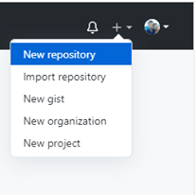
Used
B1. Create New Repository

Slide 15
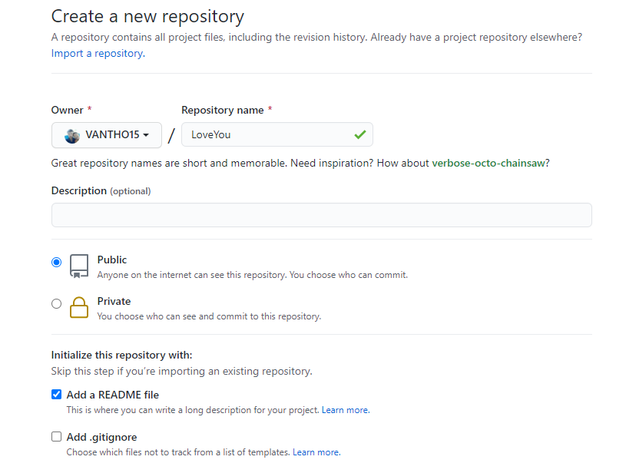

Slide 16
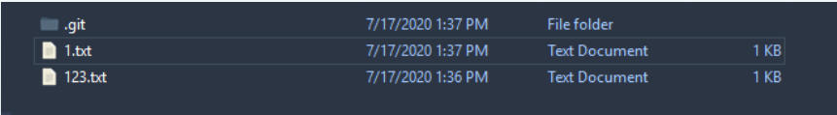
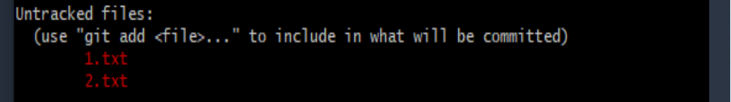
B2. Create 1 forder
B3. Choose “Git Bash Here”
B4. “Git init” : Create 1 Store
Create some files
B5. Click “git status”

Slide 17
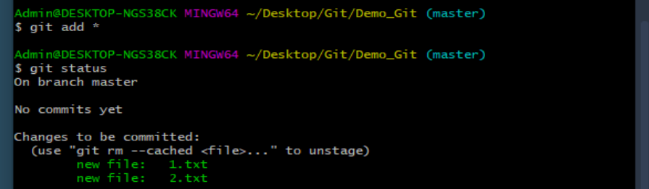
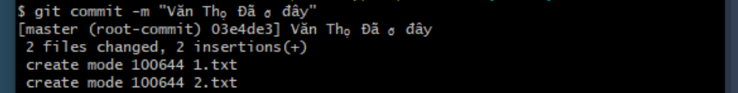
B6: - Click “ git add .” or “ git add *” : Add all file
- Cick “ git add file_name” : Add one file
B7: Click “ git commit –m “note”” : commit up, “m” is message

Slide 18

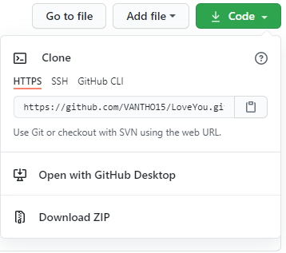
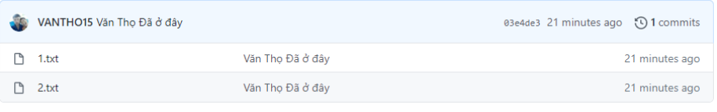
B8: Click “ git remove add origin http://.....”
B2. Click “ git push origin master ”
OK

Slide 19
Pull Data
Create foder
Click “Git bash here”
Git init
Git remote add origin http://......
Git pull origin master

Slide 20
Clone Data
Git clone link

Slide 21
Recoding changes to the Repository
Content
Checking the status of the file
Tracking new file
Ignoring files
Viewing your stager and unstaged changes
Committing your change
Skipping the Staging aria
Remove files
Moving files

Slide 22
The lifecycle of the status of your files
Untracked
Unmodified
Modified
Staged
Add the file
Edit the file
Stage the file
Remove the file
Commit

Slide 23
Git status :Checking the status of the file
Git add “Tenfile”: Tracking new file
Ignoring files
Viewing your stager and unstaged changes
Git commit -a –m “ahihi” :Committing your change
Git add * :Skipping the Staging aria
Git rm –cached 12.txt: Remove files
Moving files

Slide 24
Viewing The Commit History
You can also use -2, which limits the output to only the last two entries
Git log –p -2
Git log
If you want to see some abbreviated start for each commit you can use the –start option
The –start option prints below each commit entry a list of modified files, how many files were changed, and how many lines in those files added and removed
Git log --start

Slide 25
TAG
Tagging
Listing your Tag
Creating tags
Lightweight Tags
Tagging Later
Sharing Tag
Checking Out Tags
Dalete Tag

Slide 26
TAGGING
Git has the ability to tag specific points in history as being important
Ex V1.0, V1.1 …
“git tag” :Listing the available tags in Git

Slide 27
Create Tag
+ Create tag for commit if we just commit
- Git tag –a V1.0 –m “Version 1”
- Git show V1.0 : show info Tag
+ Create for commit random
- Git tag –a V1.1 key ( key is commit random )

Slide 28
Used Tag
Git push origin V1.0 : Push Tag
Git push origin --tags : Push all Tag
Git checkout -b nhanh2 v1.0 : Detach 1 tag to 1 branch
Git tag -d v1.1 : delete tag
Git push origin –delete v1.0 : delete Tag on Server

Slide 29
Git Branching
HEAD
V1.0
Master
15cx2
06bca
09tho
Snapshot A
Snapshot B
Snapshot C

Slide 30
Creating a New Branch
+ Git branch Name_branch.
+ This creates a new pointer to the same commit you’re currently on.
Master
HEAD
tho15
hoho
ahihi
Git checkout New_branch
New_branch

Slide 31
Branch Management
We will create, merged, delete some branches
Git branch : view list branch
Git branch –v : view commit finish of branch
Git branch –merged : what is branch was merged to current branch
Git branch –no-merged : what is branch was not merger to current branch
Git branch –d name_branch : delete branch
Git push origin –delete name_branch
Note :
+ the * character => the branch that HEAD points to
+ “-d” delete branch merged
+ “-D” delete branch merge

Slide 32
Branching workflows
(Luồng làm việc của nhánh)
Long Running Branches
Master
Develop
Topic
C1
C2
C3
C4
C5
C6

Slide 33
Topic Branches
Iss2
Iss3
Master
Com
Com
Com
Iss1
Com
Com
Com
Com
Com
Com
Com
Com
Com

Slide 34
Branches far
Remove references are references (pointers) in your Repo
You can get a full list of remote reference with
Git ls-remote “origin” or git remote show “origin”

Slide 35
Server and Local Repo After Cloning
Git.vantho.com
Master
Commit
Commit
Commit
Commit
My computer
Origin/Master
Commit
Commit
Commit
Commit
Master

Slide 36
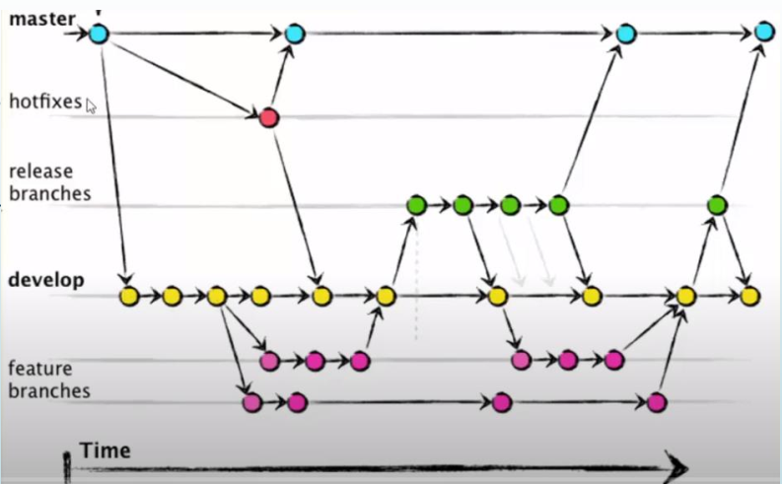

Slide 37
Command
Git branch : view list branch
Git checkout name_branch : return branch name_branch
Git log –online –decore: view HEAD
Create Branch and Merge
Git branch name_branch : Create branch
Khi này nhánh name_branch đang trỏ tới commit mà nhánh trước đó ta đang trỏ tới
Vd ta đang ở nhánh master mà trỏ tới commit A thì nhánh mới cũng trỏ tới commit A
Merge thì đưa HEAD về master
Khi marge thì sẽ tạo ra 1 commit mới

Slide 38
Example
Ví dụ ra đang ở nhánh master muốn marge nhánh nhanh1
Git marge nhanh1
Git push –set-upstream origin master : kết nối master local với master server
Git checkout nhanh1
Git push –set-upstream origin nhanh1

Slide 39
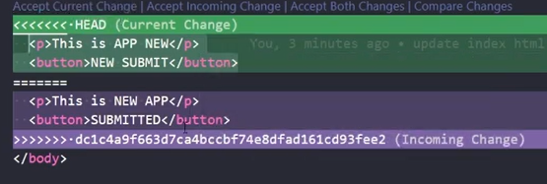
ERROR
Vấn đề : 1 người sửa 1 file trên master ,1 người sửa trên nhanh1 có tên file trùng nhau, khi merge thì nó không biết nên lấy cái nào.
Sửa:
+ Tải diffmerge về : https://sourcegear.com/diffmerge/downloads.php + git config --global merge.tool : xem tool + git config --global merge.tool diffmerege + git merge nhanh1 + git mergetool + diffmerge
Sửa :
+ git pull
+ chọn xem muốn lấy sự thay đổi nào
+ rồi add, commit, push lên

Slide 40

Không Muốn đưa file, hoặc folder lên
+ Tạo file .gitignore
+ đưa tên file, folder vào đó thì nó sẽ không đưa lên

Slide 41
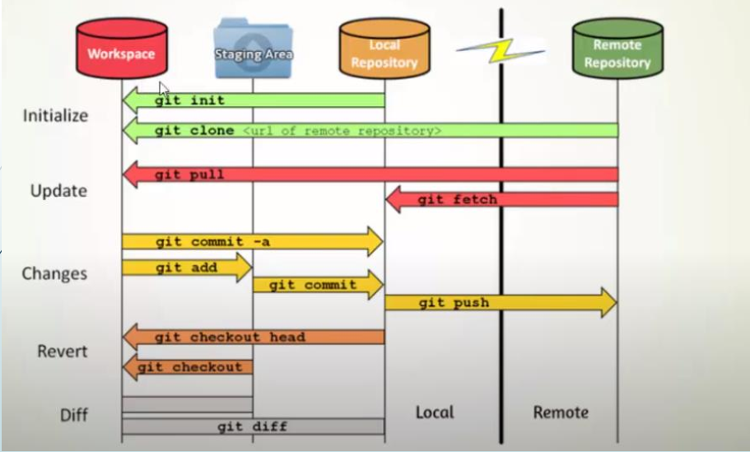

Slide 42
Làm việc nhóm
+ B1: Thọ tạo branch master
+ B2: Push branch master lên
+ B3: Bình, Đức pull master về và push nhánh lên
+ B4: Thọ “git pull” và merge bình thường

Slide 43
Thank you

