Slide 1

GIT TRAINING
Create by ThoNV12
Spi mãi đĩnh

Slide 2
Introduce about Version Control System (VCS)

Slide 3
VCS
Version control is a system that records changes to a file or set of files over time so that you can recall specific versions later
It allows you to revert files back to a previous state, revert the entire project back to a previous state, compare changes over time, see who last modified something that might be causing a problem, who introduced an issue and when , and more ☺)))
Using a VCS also generally means that if you screw things up or lose files, you can easily recover. In addition, you get all this for very little overhead.
Spi mãi đĩnh

Slide 4
Local Version Control Systems
VCS that had a simple database that kept all the changes to files under reversion control
Local Computer
Checkout
Version 3
File
Version 2
Version 1
Spi mãi đĩnh

Slide 5
Centralized Version Control Systems
If(Server==Error) ?
Computer A
Central VCS Server
File
Version Database
Version 1
Computer B
Version 2
File
Version 3
Spi mãi đĩnh

Slide 6
Distributed Version Control Systems
Such Git
Clients don’t just check out the latest snapshot of the files: they fully mirror the repository
Thus if any server dies, and these systems were collaborating via it, any of the client repositories can be copied back up to the server to restore it
Computer A
Server Computer
File
Version Database
Version 1
Version 2
Computer B
Version 3
File
Spi mãi đĩnh

Slide 7
Introduce about GIT
Spi mãi đĩnh

Slide 8
Introduce about GIT
In 2002, Linux project began using a proprietary called BitKeeper.
In 2005, the relationship go down
=> Git
Spi mãi đĩnh

Slide 9
Introduce about GIT
Snapshots
Nearly Every Operation Is Local
Git Has Integrity
Git Generally Only Adds Data
The Three States
Spi mãi đĩnh

Slide 10
1. Snapshots
+ The major difference between Git and any VCS
Checking Over Time
VCS
Version 1
Version 2
Version 3
Version 4
Version 5
File A
A1
A2
File B
B1
B2
File C
C1
C2
C3
Spi mãi đĩnh

Slide 11
1. Snapshots
+ Git think of its data like a set of snapshots of a miniature filesystem
Checking Over Time
Version 1
Version 2
Version 3
Version 4
Version 5
File A
A1
A1
A2
A2
File B
B
B
B1
B2
File C
C1
C2
C2
C3
Spi mãi đĩnh

Slide 12
2. Nearly Every Operation Is Local
Most operations on Git only need local files and resources to operate – generally no information is needed from another computer on your network.
3. Git Has Integrity
Everything in Git is check-summed before it is stored and is then referred to by that check-sum
You can’t lose information in transit or get file corruption without Git being able to detect it.
The mechanism that Git uses for this check-summing is called a SHA-1 hash. This is a 40-character string composted of hexadecimal characters (0-9 and a-f) and calculated based on the contents of a file or directory structure in Git
4. Git Generally Only Adds Data
When you do actions in Git, nearly all of them only add data to the Git database
After you commit a snapshot into Git, it is very different to lost , especially if you regularly push your database to another repository
Spi mãi đĩnh

Slide 13
5. The Three States
Git has three main states that your files can reside in : committed, modified, staged.
Working
Directory
Staging
Area
.git directory
(Repository)
Checkout The Project
Stage Fixes
Commit
Spi mãi đĩnh

Slide 14
5. The Three States
1: + git add nameFile
2: + git commit –m “ahihi”
3: + git restore –staged nameFile
+ Git checkout Key_Number: đưa về trạng thái khi ở commit đó
+ Thoát log bấm q
Working
Directory
Staging
Area
.git directory
(Repository)
1
2
Checkout The Project
3
Stage Fixes
Spi mãi đĩnh

Slide 15
The lifecycle of the status of your files
Untracked
Unmodified
Modified
Staged
Add the file
Edit the file
Stage the file
Remove the file
Commit
Spi mãi đĩnh

Slide 16
Recoding changes to the Repository
Git status :Checking the status of the file
Git add “Tenfile”: Tracking new file
Ignoring files
Viewing your stager and unstaged changes
Git commit -a –m “ahihi” :Committing your change
Git add *
Git rm –cached 12.txt: Remove files
Moving files: git mv file_from file_to
Spi mãi đĩnh

Slide 17
Unmodifying a modifiled file
Git checkout -- namefile
Untracked a Staged file
1. Git reset HEAD namefile
Spi mãi đĩnh

Slide 18
Viewing The Commit History
You can also use -2, which limits the output to only the last two entries
Git log –p -2
Git log
If you want to see some abbreviated start for each commit you can use the –start option
The –start option prints below each commit entry a list of modified files, how many files were changed, and how many lines in those files added and removed
Git log –start
Spi mãi đĩnh

Slide 19
Git Pull Data
Create foder
Click “Git bash here”
Git init
Git remote add origin http://......
Git pull origin master
Spi mãi đĩnh

Slide 20
Git Clone Data
Create foder
Click “Git bash here”
Git clone http://......
Git CD Name_Repo
Spi mãi đĩnh

Slide 21
Origin
Là 1 short name đại diện cho cái remote https:…
mình có 1 git ở local mà muốn liên kết với 1 github
Git remote add <short name> <link>
Ta fetch repo về tuy nhiên thì nó để xem code có gì mới không thôi chứ không phải hành động download code về
git fetch [remote name] (git fetch origin)
git remote -v: show ra origin
git remote rename origin vantho : rename origin
git remote rm vantho
Spi mãi đĩnh

Slide 22
Git commit --amend
Ta mới commit
Ta add thêm 1 file và tạo commit nữa thì thành 2 commit
Git commit –amend
Commit sau ghi đè commit trước và them file
Tránh tạo nhiều commit không cần thiết
Spi mãi đĩnh

Slide 23
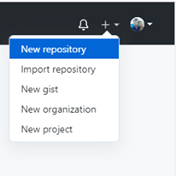
Used
B1. Create New Repository
Spi mãi đĩnh

Slide 24
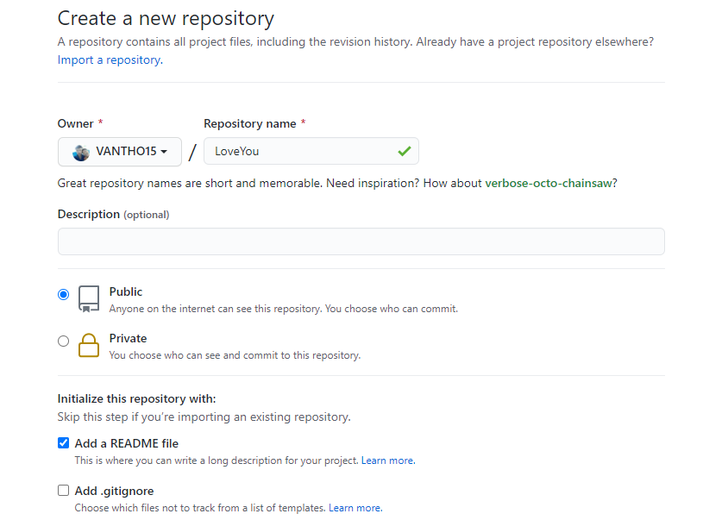
Used
Spi mãi đĩnh

Slide 25
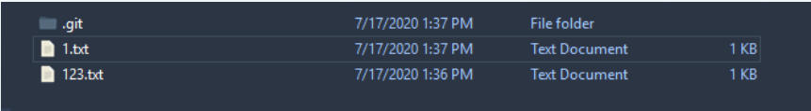
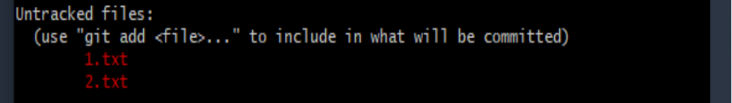
Used
B2. Create 1 forder
B3. Choose “Git Bash Here”
B4. “Git init” : Create 1 Store
Create some files
B5. Click “git status”
Spi mãi đĩnh

Slide 26
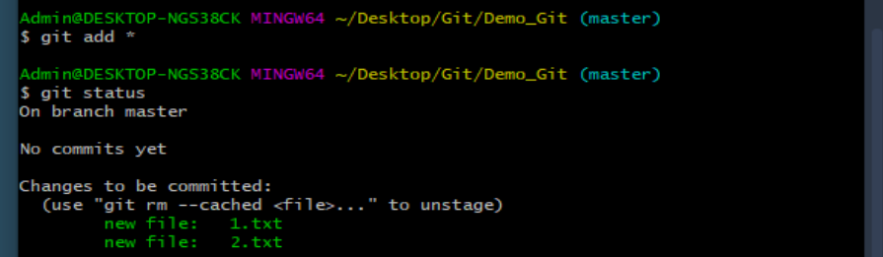
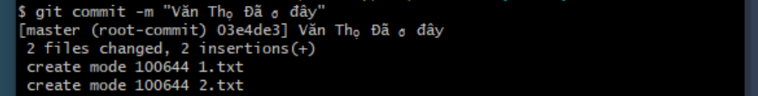
Used
B6: - Click “ git add .” or “ git add *” : Add all file
- Cick “ git add file_name” : Add one file
B7: Click “ git commit –m “note”” : commit up, “m” is message
Spi mãi đĩnh

Slide 27

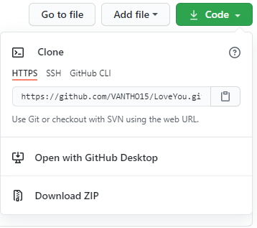
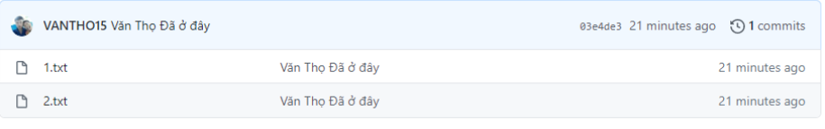
Used
B8: Click “ git remove add origin http://.....”
B2. Click “ git push origin master ”
OK
Spi mãi đĩnh

Slide 28
GIT TAG
Git has the ability to tag specific points in history as being important
Ex V1.0, V1.1 …
“git tag” :Listing the available tags in Git
Git log –pretty=oneline: Show commit
Spi mãi đĩnh

Slide 29
Create Tag
+ Create tag for commit if we just commit
- Git tag –a V1.0 –m “Version 1”
- Git show V1.0 : show info Tag
+ Create for commit random
- Git tag –a V1.1 key ( key is commit random mã commit )
Spi mãi đĩnh

Slide 30
Used Tag
Git push origin V1.0 : Push Tag
Git push origin --tags : Push all Tag
Git checkout -b nhanh2 v1.0 : Detach 1 tag to 1 branch
Git tag -d v1.1 : delete tag
Git push origin –delete v1.0 : delete Tag on Server
Spi mãi đĩnh

Slide 31
Alias
Git config –global alias.co checkout
Git config –global alias.ci commit
…
Spi mãi đĩnh

Slide 32
Git Branching
HEAD
V1.0
Master
15cx2
06bca
09tho
Snapshot A
Snapshot B
Snapshot C
Spi mãi đĩnh

Slide 33
Creating a New Branch
+ Git branch Name_branch.
+ This creates a new pointer to the same commit you’re currently on.
Master
HEAD
tho15
hoho
ahihi
Git checkout New_branch
New_branch
Spi mãi đĩnh

Slide 34
Branching workflows
Long Running Branches
Master
Develop
Topic
C1
C2
C3
C4
C5
C6
Spi mãi đĩnh

Slide 35
Topic Branches
Iss2
Iss3
Master
Com
Com
Com
Iss1
Com
Com
Com
Com
Com
Com
Com
Com
Com
Spi mãi đĩnh

Slide 36
Branch Management
We will create, merged, delete some branches
Git branch : view list branch
Git branch –v : view commit finish of branch
Git branch –merged : what is branch was merged to current branch
Git branch –no-merged : what is branch was not merger to current branch
Git branch –d name_branch : delete branch
Git push origin –delete name_branch
Note :
+ “-d” delete branch merged
+ “-D” delete branch merge
Spi mãi đĩnh
Spi mãi đĩnh

Slide 37
Command
Git branch : view list branch
Git checkout name_branch : return branch name_branch
Git log –online –decore: view HEAD
Create Branch and Merge
Git branch name_branch : Create branch
Khi này nhánh name_branch đang trỏ tới commit mà nhánh trước đó ta đang trỏ tới
Vd ta đang ở nhánh master mà trỏ tới commit A thì nhánh mới cũng trỏ tới commit A
Khi marge thì sẽ tạo ra 1 commit mới
--set-upstream : nhánh ở local chưa kết nối với nahnhs ở web, nên tạo 1 nhánh ở web và kết nối 2 cái với nhau

Slide 38
Example
Ví dụ ra đang ở nhánh master muốn marge nhánh nhanh1
Git marge nhanh1
Git push –set-upstream origin master : kết nối master local với master server
Git checkout nhanh1
Git push –set-upstream origin nhanh1
Spi mãi đĩnh

Slide 39
Branches far
Remove references are references (pointers) in your Repo
You can get a full list of remote reference with
Git ls-remote origin or git remote show origin
Git log –oneline –decorate: Show branchs and tags
Spi mãi đĩnh

Slide 40
Server and Local Repo After Cloning
Git.vantho.com
Master
Commit
Commit
Commit
Commit
My computer
Origin/Master
Commit
Commit
Commit
Commit
Master
Spi mãi đĩnh

Slide 41
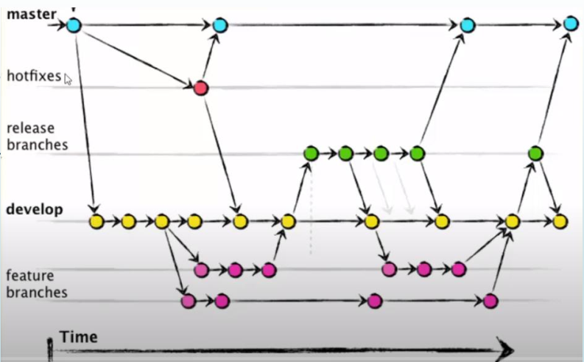
Spi mãi đĩnh

Slide 42
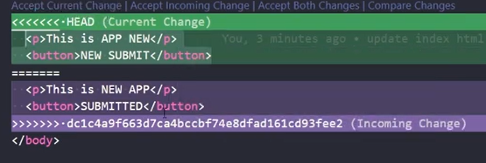
ERROR conlicts
Vấn đề : 1 người sửa 1 file trên master ,1 người sửa trên nhanh1 có tên file trùng nhau, khi merge thì nó không biết nên lấy cái nào.
Sửa:
Sửa :
+ git push
+ chọn xem muốn lấy sự thay đổi nào
+ rồi add, commit, push lên
+ Tải diffmerge về : https://sourcegear.com/diffmerge/downloads.php + git config --global merge.tool : xem tool + git config --global merge.tool diffmerege cấu hình khi bị xung đột thì sử dụng nó + git merge nhanh1 + git mergetool + diffmerge
Spi mãi đĩnh

Slide 43

Không Muốn đưa file, hoặc folder lên
+ Tạo file .gitignore
+ đưa tên file, folder vào đó thì nó sẽ không đưa lên
Spi mãi đĩnh

Slide 44
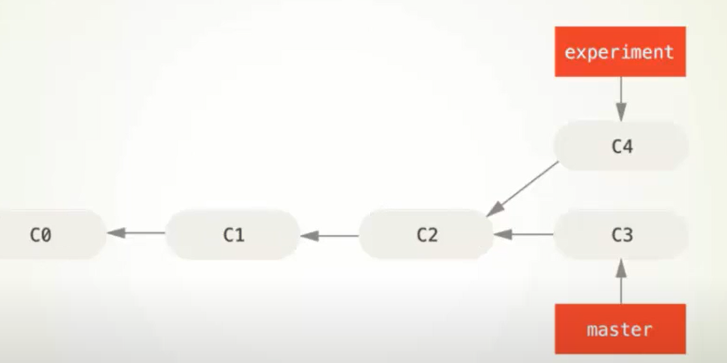
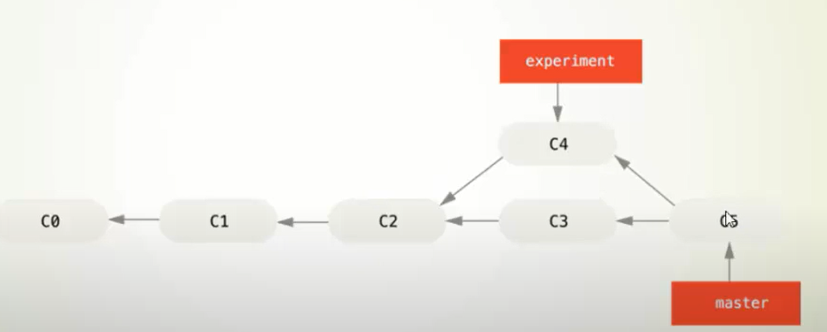
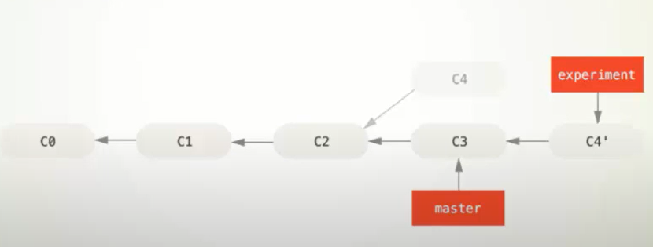
Rebase
MERGE
REBASE
Spi mãi đĩnh

Slide 45
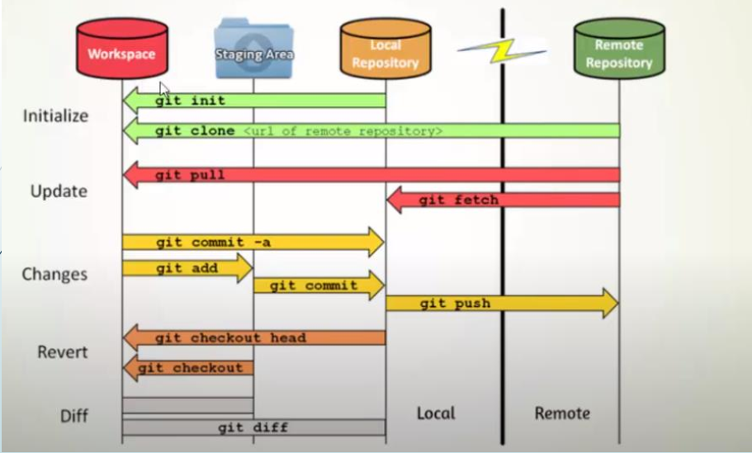
Spi mãi đĩnh

Slide 46
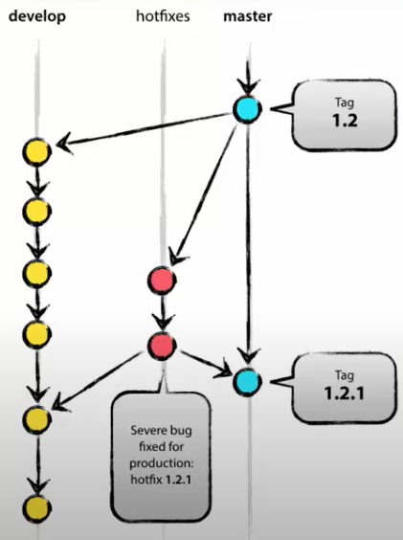
Spi mãi đĩnh

Slide 47
Thank You !
Spi mãi đĩnh

