Slide 1
REAL-TIME PARALLEL SHOPLIFTING DETECTION USING MULTIMODAL AI
Under guidance of
Prof. Dr Handan Liu
Team 20: Vanshi Patel, Malav Gajera

Slide 2
OVERVIEW
Process of training models on multiple GPUs
Parallelization strategies for data loading and preprocessing
Data Parallelism (DP) for model training
Distributed Data Parallel (DDP) implementation
Fully Sharded Data Parallel (FSDP) for maximum memory efficiency
Performance analysis across parallelization techniques
Resource utilization visualization and optimization

Slide 3
INTRODUCTION
Economic Impact and Technical Challenge
Project Goal
Retail shrinkage: $94.5 billion annual losses
Computationally intensive real-time video processing
Multiple camera streams require sophisticated parallelization
Multimodal integration increases computational demands
Develop an efficient, real-time shoplifting detection system using advanced parallel computing techniques and multimodal AI

Slide 4
PARALLELIZATION STRATEGIES
Joblib Parallelization: Simple but effective CPU parallelism
Dask Distributed Computing: Scalable cluster computing
Data Parallel (DP): Basic multi-GPU training
Distributed Data Parallel (DDP): Process-based efficient parallelism
Fully Sharded Data Parallel (FSDP): Memory-optimized parameter sharding

Slide 5
PARALLEL DATA LOADING & PREPROCESSING
Joblib: Parallel video file processing with configurable worker counts
Dask: LocalCluster configuration with customizable workers per CPU
Multi-threaded Frame Extraction: Efficient temporal sampling
Batched processing: Optimized disk I/O operations

Slide 6
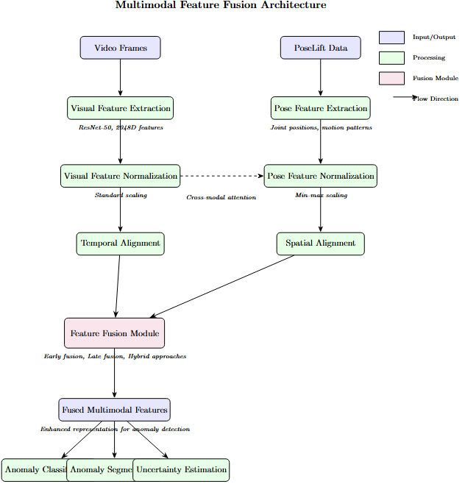
MULTIMODAL FEATURE EXTRACTION
Parallel Feature Extraction:
Distributes tasks across available GPUs
Processes videos in batches to optimize memory
Implements dynamic load balancing
Multimodal Feature Fusion:
Integration of visual features with pose estimation data
Feature normalization and alignment across modalities

Slide 7
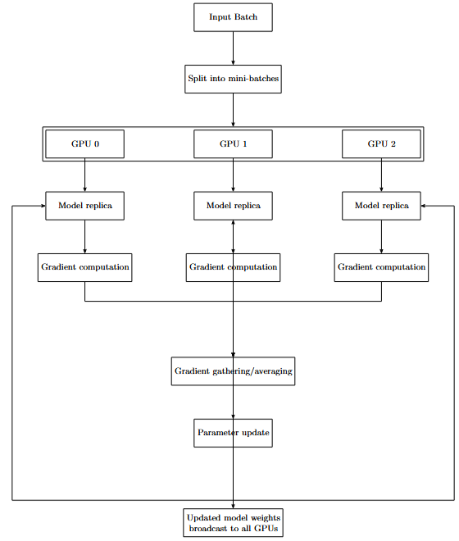
DATA PARALLEL (DP)
Creates multiple replicas of model on different GPUs
Distributes batches of data across available GPUs
Synchronizes gradients across all model replicas
Simple to implement but limited scaling efficiency
Computational Model: Time per batch = Tcomp + Tcomm
Tcomp = Forward and backward pass computation
Tcomm = Gradient synchronization across devices

Slide 8
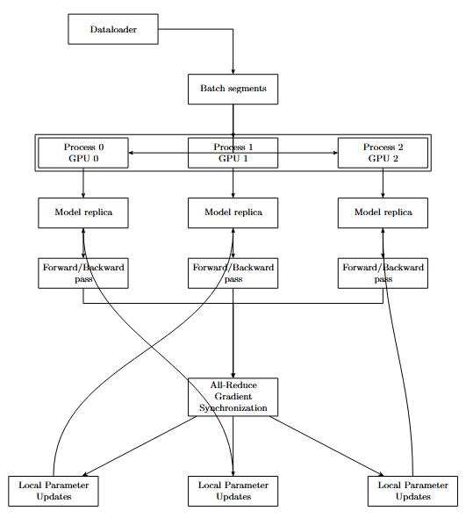
DISTRIBUTED DATA PARALLEL (DDP)
Architecture & Optimization:
Process-based parallelism (one GPU per process)
Bucket-based gradient synchronization for improved communication
Overlap of computation and communication
NCCL backend for GPU-to-GPU communication
Performance Enhancements
Mixed-precision training using Automatic Mixed Precision (AMP)
Learning rate scaling based on number of GPUs
Warm-up learning rate scheduling

Slide 9
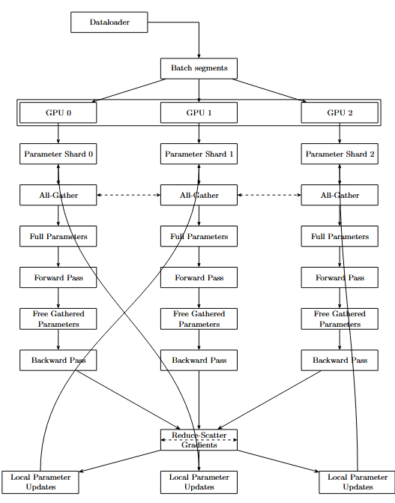
FULLY SHARDED DATA PARALLEL (FSDP)
Memory Optimization Through Sharding:
Model parameters sharded across GPUs to reduce memory requirements
On-demand gathering of parameters for forward and backward passes
Mixed-precision support for improved performance
Sharding Strategies Compared
FULL_SHARD: All parameters, gradients, and optimizer states sharded
SHARD_GRAD_OP: Only gradients and optimizer states sharded
NO_SHARD: No sharding (equivalent to standard DDP)

Slide 10
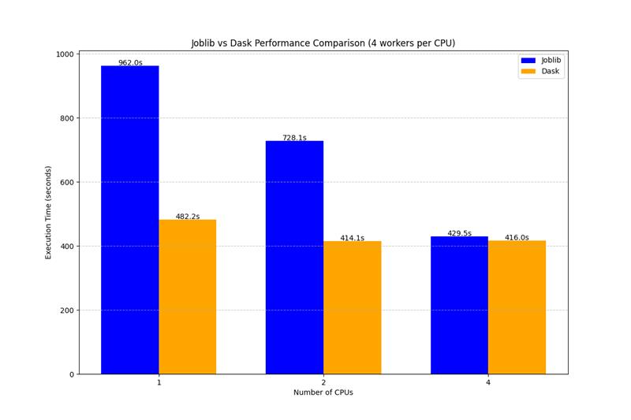
PARALLEL DATA LOADING PERFORMANCE
Comparative Analysis
Both Joblib and Dask showed improved performance with increasing CPU counts
Joblib outperformed Dask for smaller CPU counts (1-4)
Dask showed better scalability for larger clusters (8-16)
Sublinear speedup (8x with 16 CPUs) suggests I/O bottlenecks

Slide 11
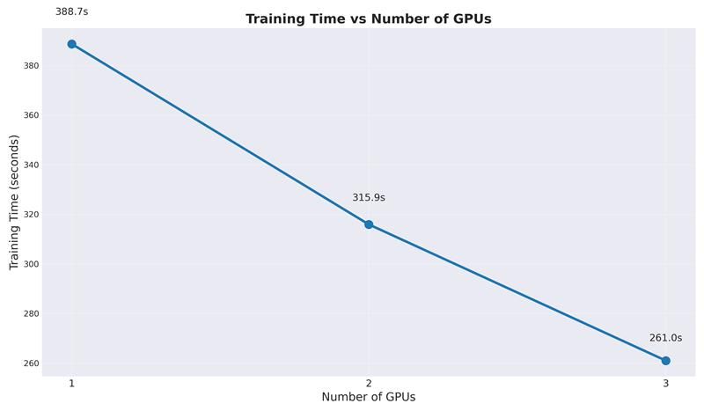
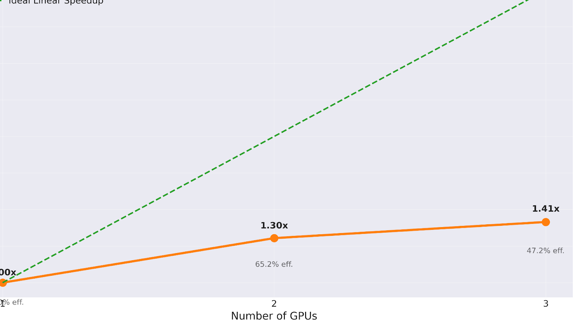
GPU DATA PARALLELISM PERFORMANCE
DP Analysis
Maximum speedup of 1.19x with 4 GPUs
Efficiency drops significantly from 100% to 30% with 4 GPUs
All-to-one gradient synchronization becomes bottleneck
Memory replication constrains batch size scaling

Slide 12
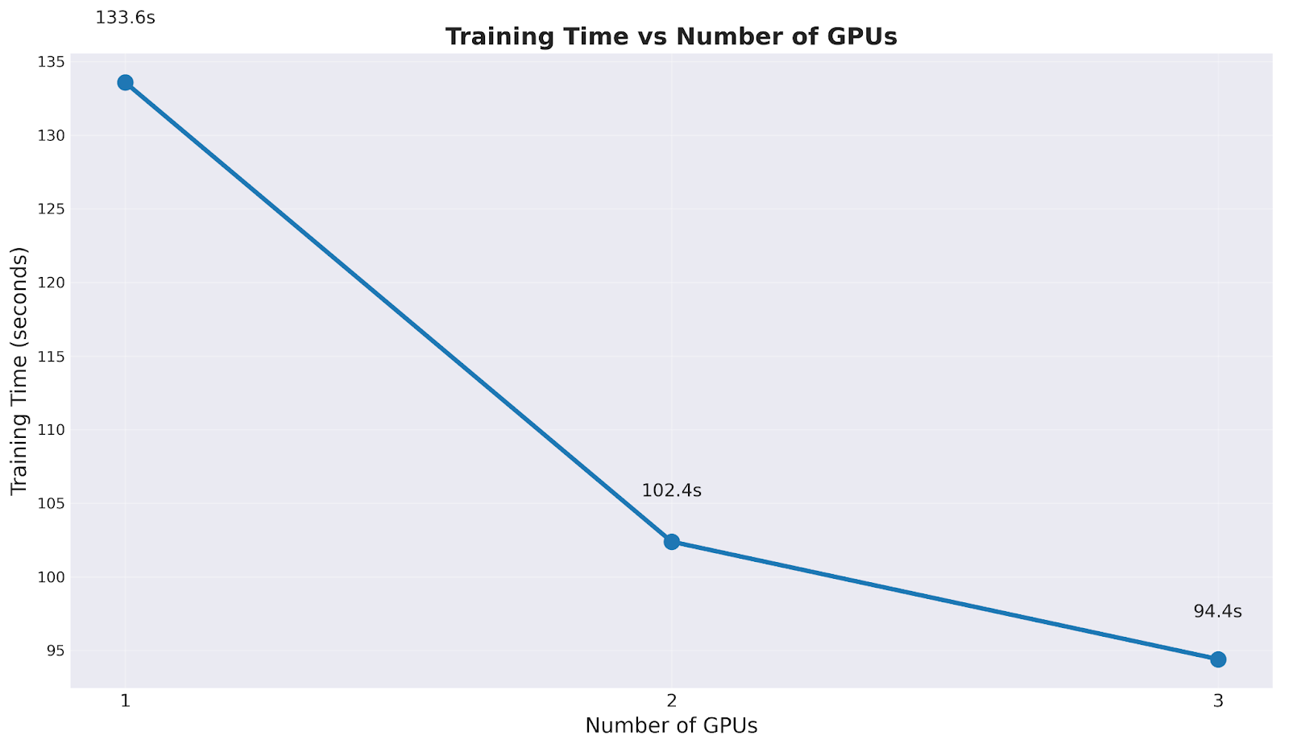
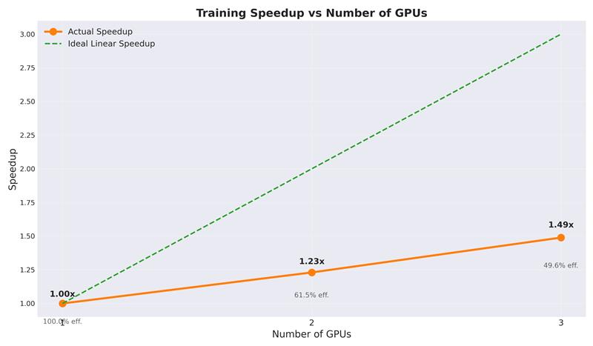
DDP PERFORMANCE
DDP Analysis
Better scaling than standard DP (1.98x speedup with 4 GPUs)
Efficiency remains above 60% with 2 GPUs
DDP with AMP provides additional speedup
Ring-based all-reduce pattern scales better with more GPUs
Process-based parallelism allows better computation-communication overlap

Slide 13
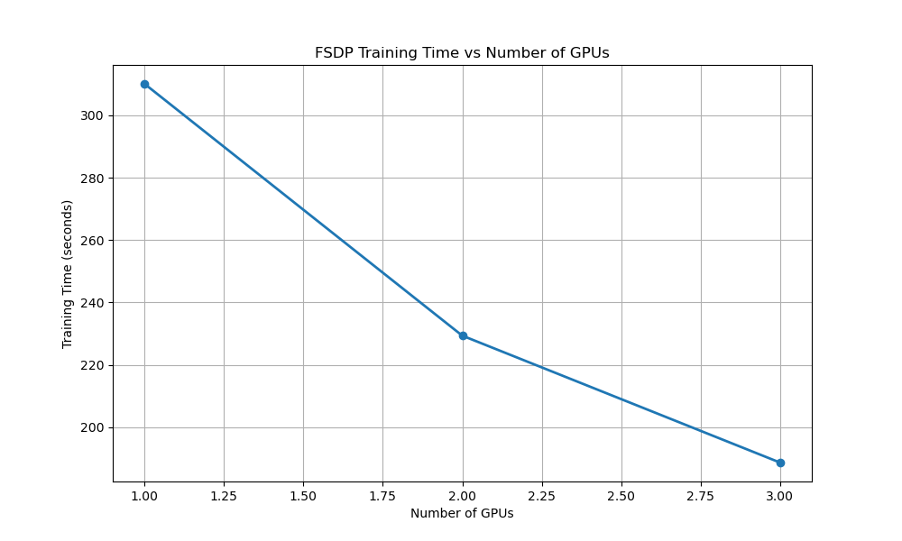
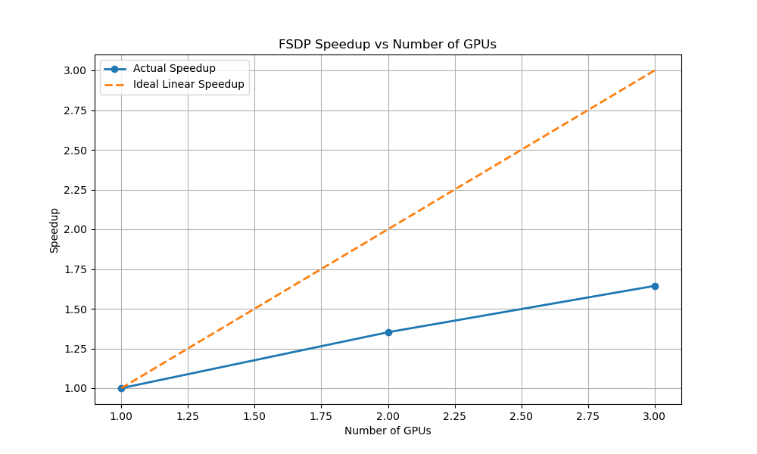
FSDP PERFORMANCE
FSDP Analysis
SHARD_GRAD_OP strategy: best balance of speedup and memory efficiency
Training time reduced by 39% when scaling from 1 to 3 GPUs
Significantly reduced memory usage per GPU
Mixed precision training provided additional 1.5x speedup

Slide 14
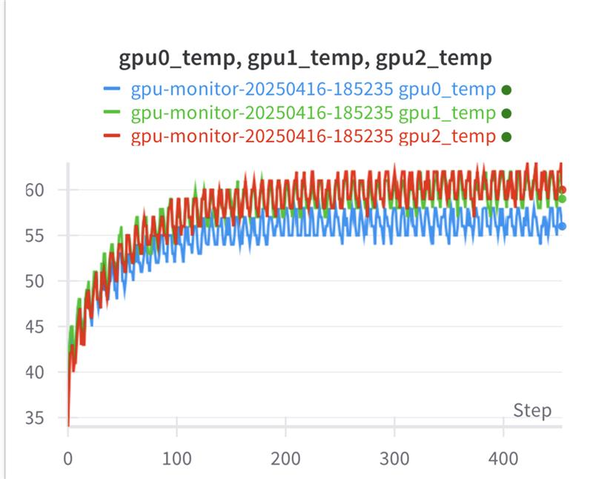
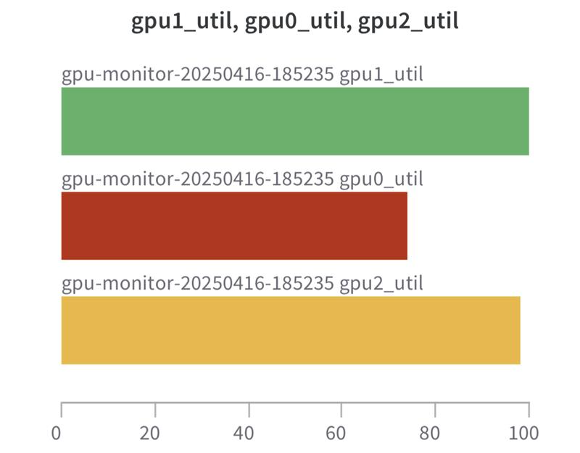
PERFORMANCE MONITORING WITH WEIGHT AND BIASES
Real-time Resource Analysis
GPU utilization patterns reveal computation and synchronization phases
DDP and FSDP achieved more consistent GPU utilization compared to DP
Memory utilization 40% more efficient with FSDP
Overlapping computation and communication more effective in DDP than DP

Slide 15
COMPARATIVE SCALING ANALYSIS
DDP and FSDP consistently outperform DP across all configurations
2-GPU configurations show highest efficiency (≈62%)
4-GPU setups provide fastest absolute training times but reduced efficiency (≈49%)
FSDP with SHARD_GRAD_OP: optimal balance of memory and performance

Slide 16
ENVIRONMENT & HARDWARE
- 4x V100s, RTX A5000
- Intel Xeon 6248 (20c/40t)
- 256GB RAM, CUDA 11.6, PyTorch 1.13.1
-Software Stack
  CUDA: 11.6
  PyTorch: 1.13.1
  Python: 3.8.10
  Libraries: Joblib, Dask, NumPy, OpenCV, H5py

Slide 17
CONCLUSIONS
Key Findings on Parallelization Strategies
Joblib: Best for small-to-medium workloads on a single machine
Dask: Better scalability for larger clusters
DDP: Nearly 2x speedup with 4 GPUs compared to single GPU
FSDP: Optimal balance of memory efficiency and computational performance
Mixed precision with AMP: Up to 1.5x speedup with minimal accuracy impact
Future Directions
Testing on larger clusters (8+ GPUs)
Exploring Zero Redundancy Optimizer (ZeRO-3) for more efficient distributed training
Edge deployment optimizations with model compression

Slide 18
REFERENCES
National Retail Federation, "2023 National Retail Security Survey," NRF, 2023.
Sultani, W., Chen, C., & Shah, M. (2018). Real-world Anomaly Detection in Surveillance Videos. Proceedings of the IEEE Conference on Computer Vision and Pattern Recognition (CVPR), 6479-6488.
Dask Development Team, "Dask: Library for dynamic task scheduling," 2016. [Online]. Available: https://dask.org
Joblib Development Team, "Joblib: running Python functions as pipeline jobs," 2020. [Online]. Available: https://joblib.readthedocs.io
Li, S., et al. (2023). "PyTorch FSDP: Experiences on Scaling Fully Sharded Data Parallel," arXiv preprint arXiv:2304.11277.
PyTorch Team, "PyTorch Distributed: Experiences on Accelerating Data Parallel Training," 2020.
Cao, Z., Hidalgo, G., Simon, T., Wei, S. E., & Sheikh, Y. (2021). OpenPose: Realtime multi-person 2D pose estimation using Part Affinity Fields. IEEE Transactions on Pattern Analysis and Machine Intelligence, 43(1), 172-186.

