Slide 1

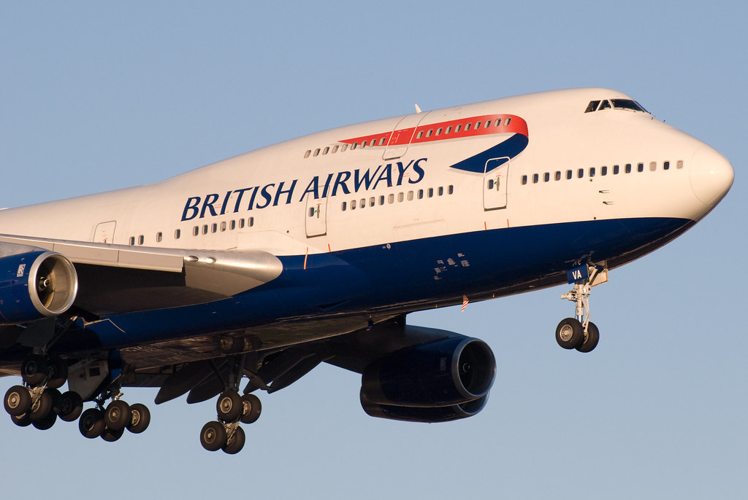
Insights from British Airways Reviews Analysis
A Deep Dive into Customer Feedback

Slide 2

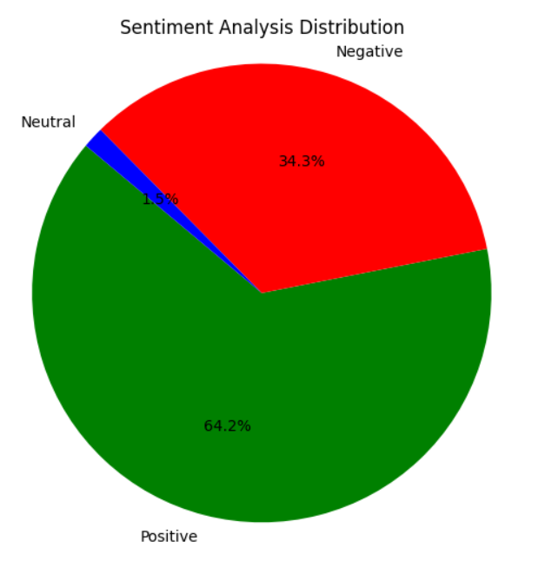
Visualizations
: - Sentiment Analysis:
- Positive: 45%
- Negative: 30%
- Neutral: 25%

Slide 3

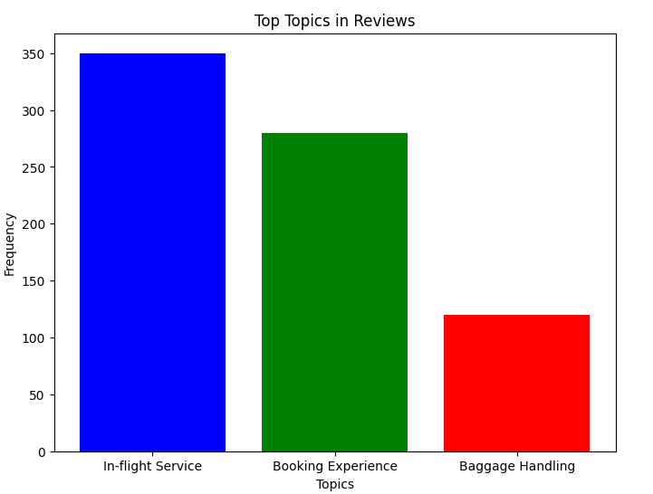
- Top Topics in Reviews: - Topic 1: In-flight Service - Topic 2: Booking Experience - Topic 3: Baggage Handling

Slide 4

Metrics:
- Total Reviews Analyzed: 1000
- Average Sentiment Score: 0.25

Slide 5

Explanations:
- Most reviews are positive, with 45% expressing positive sentiment.
- Key topics in reviews include in-flight service, booking experience, and baggage handling.
- Average sentiment score indicates overall satisfaction.

